Slide 1

Brute Force
Presents

Slide 2
BAYMAX
- Refined, accurate & quick search
Team Members
Dikshant [1535]
Rakshit [1063]
Samarth [1174]
Anand [1816]
Brute Force
presents :

Slide 3
Problem Statement :
A person has X symptoms and he is unable to access medical facilities or consult to a doctor at the that time & he wants to know about his current situation (whether he has a disease or not) by giving symptoms only…
Solution : BayMAx

Slide 4
Solution :
BayMAx

Slide 5
What is Baymax?
Baymax is a web application or a platform where it predicts the disease according to the symptoms entered by the user.
The Machine learning behind the application goes through the symptoms entered by the user and compares the input data with the dataset which is created by the data scientist and gives the name of disease he/she might be having.

Slide 6
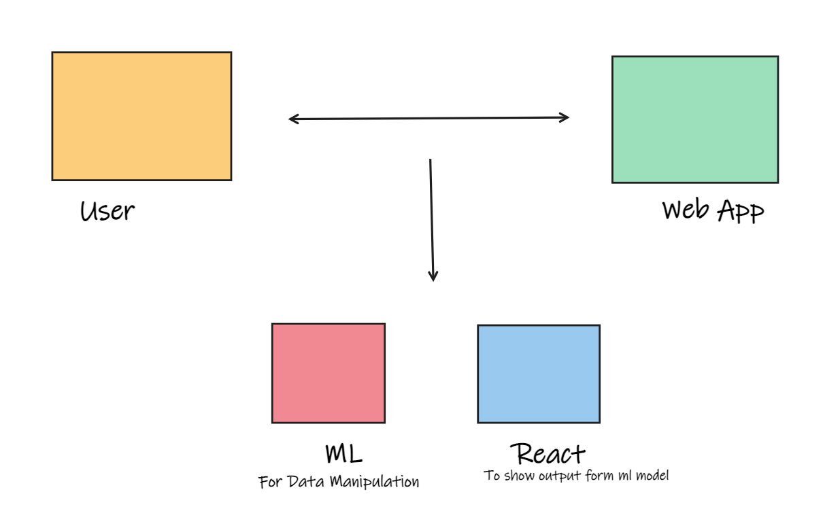

Slide 7
Things to do when you visit us :)
Create an account.
After creating an account, sign in using email or you can login through google.
Go to profile section enter your personal information.
To check the disease, go to check up section and answer the questions asked.
After submitting the check-up form, backend will generate Report.
Report will be shown in result section.
Now you can consult the doctor according to the predicted disease.

Slide 8













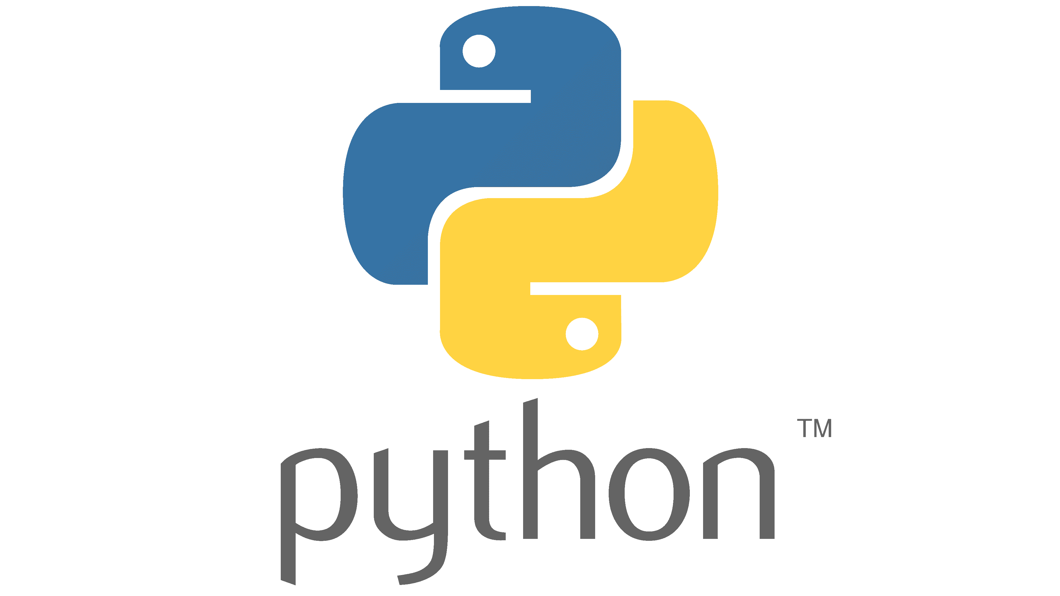


Tech Stack

Slide 9
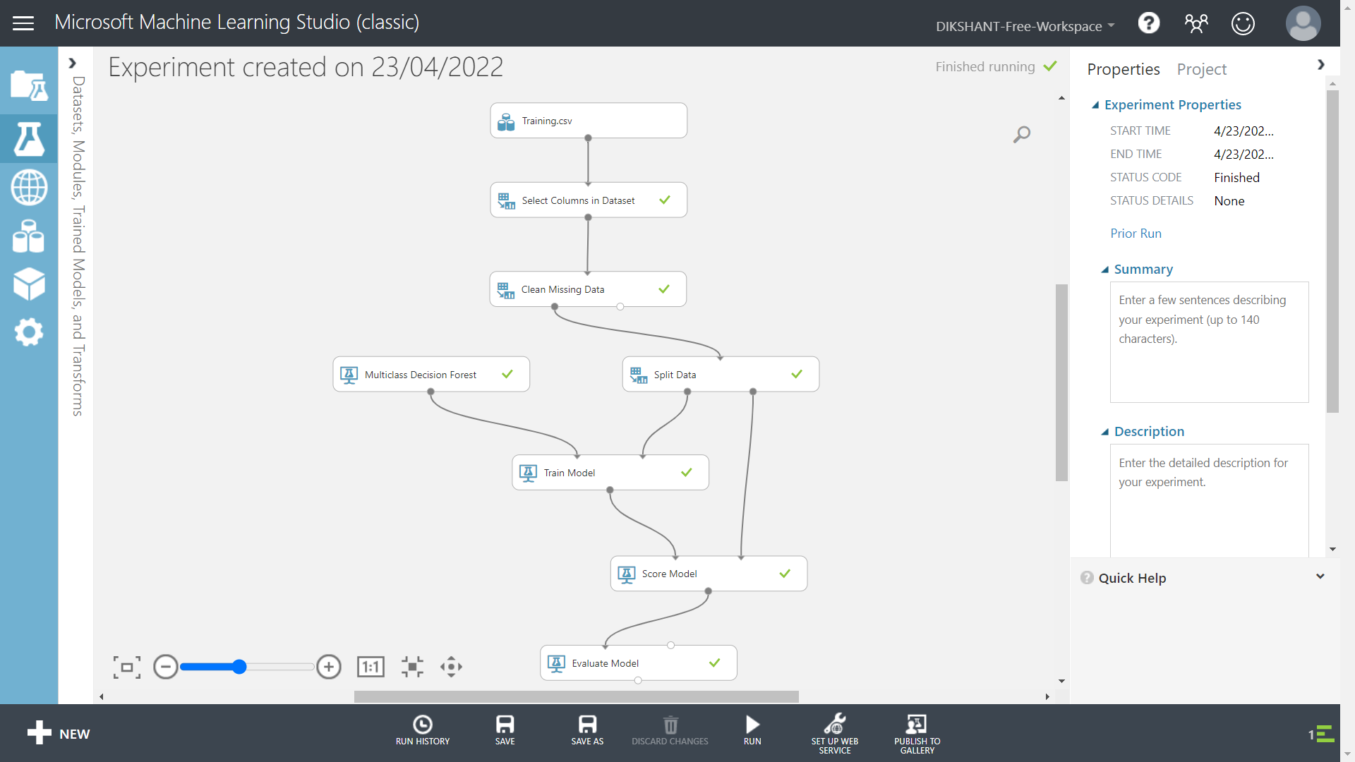

Slide 10
Uniqueness of Baymax
Preliminary analysis of a disease thus, we alert the patient about the criticality about the disease he/she is suffering from.
Get to know about the disease before hand consulting a doctor.
No need to waste time on searching google, it always shows cancer.
Machine learning system will provide user information of specialized hospital

Slide 11
Future Possibilities and scope
Providing information of nearest hospital and making a reservation.
Providing specialized doctors in that category of disease.
Virtual support of doctors 24/7.
We can improve our models by increasing the training dataset.
We can expand our web app to Android.

Slide 12
Members of Brute Force
Dikshant
Rakshit Sharma
Samarth Sharma
Anand Sahni

