Slide 1

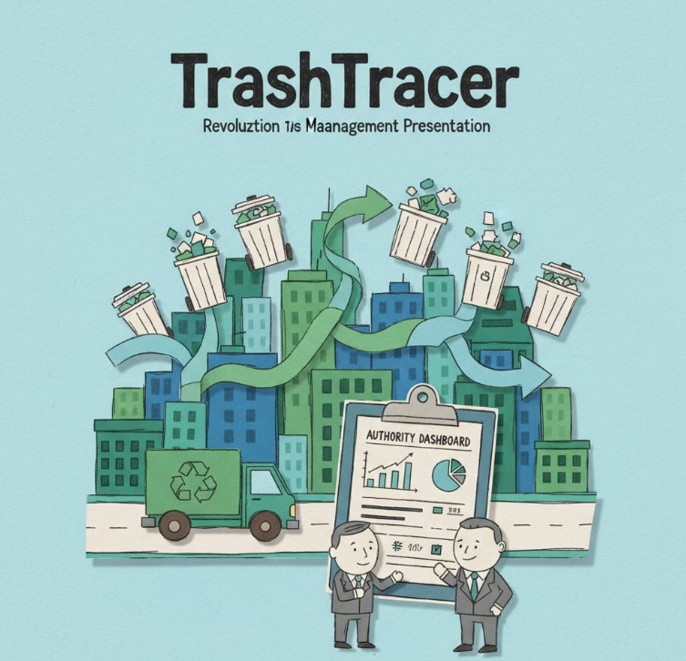
TrashTracer AI: Revolutionising Urban Waste Management
Improving urban sanitation through smart, AI-driven solutions for municipal authorities.

Slide 2
Introduction & Problem Statement
Introduction: As urban populations grow, municipal authorities face escalating challenges in effective waste management. The lack of real-time, verifiable data creates a significant gap between planned operations and on-the-ground reality.
Problem Statement: Urban authorities grapple with critical inefficiencies in waste management. From missed collections to fraudulent reporting, these issues culminate in unhygienic conditions, public dissatisfaction, and escalating municipal expenditure. The core problems are:
Skipped Bins & Fake Entries: Lack of real-time verification leads to uncollected waste and false reports of completion by sanitation workers.
Delayed Complaint Resolution: Manual complaint systems are slow and disconnected from operational teams, causing citizen frustration and prolonged sanitation issues.
Unforeseen Costs: Inefficient routes, fuel wastage, and the need for manual supervision result in higher operational costs for municipalities.
Proposed Solution (Brief): To address these critical gaps, we propose TrashTracer AI, an authority-centric command and control system designed to provide real-time oversight and data-driven insights.
.

Slide 3
Literature Review & Existing Work
Introduction: A review of current waste management systems reveals significant limitations in accountability, efficiency, and data integration. Existing methods fall into four main categories, each with critical flaws.
. Manual Supervision & Paper-Based Reporting
Description: This is the traditional method, relying on supervisors to physically monitor routes and workers to maintain manual logbooks of their activity.
Limitations:
  No Verifiable Data: It operates on trust and is extremely vulnerable to fraudulent entries and "ghost" reporting. Authorities have no way to digitally verify if a location was actually serviced.
  High Operational Overhead: Requires a large supervisory staff, making it expensive and impossible to scale effectively across a large urban area.
  Completely Reactive: Issues are only discovered hours or days later, after citizens have already been inconvenienced.
Collector-Side Smartphone GPS Tracking
Description: A common upgrade where sanitation workers use a GPS-enabled app on their personal or work-provided smartphones to track their routes.
Limitations:
  Weak Accountability Loop: This method tracks the device, not the person. A worker can simply leave the phone in the vehicle while skipping a street, completely defeating the purpose of the tracking.
  High Potential for Manipulation: Workers can easily turn off GPS, use "mock location" apps, or claim the phone's battery has died. This puts the control in the hands of the worker, not the authority.
  Dependency on Worker's Device: Relies on the worker having a compatible, charged, and functioning smartphone.
Disconnected Citizen Complaint Portals
Description: Municipalities often have a separate website or a generic city app where citizens can log complaints about uncollected waste.
Limitations :
Lack of Real-Time Integration: These portals are typically just digital suggestion boxes. The complaint is logged in one system and has to be manually viewed and forwarded to the sanitation department, causing significant delays.
No Automated Verification: There is no system to automatically cross-reference a citizen's complaint with the assigned worker's real-time location data to instantly verify the issue.

Slide 4
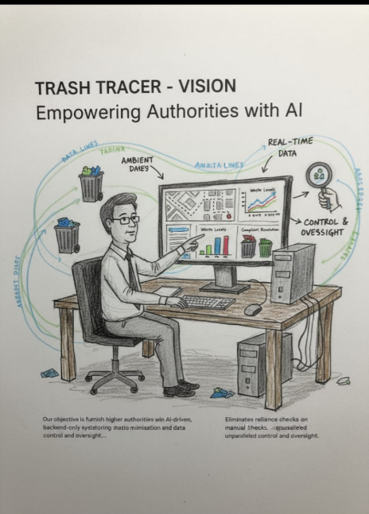
Our Vision: Empowering Authorities with AI
Our objective is to furnish higher authorities with an AI-driven, backend-only system for real-time monitoring, automated complaint handling, and data-informed waste minimisation strategies. This eliminates reliance on manual checks or collector-side applications, offering unparalleled control and oversight.

Slide 5
Novelty of the Project (Core Innovations).
1
2
3
GPS-Enabled Smart ID Cards
AI Bin Monitoring
Centralised Authority Dashboard
QR codes combined with optional AI cameras instantly detect uncleaned bins, providing immediate alerts.
Track collectors in real-time, eliminating the need for separate mobile applications and ensuring accountability.
A comprehensive view of ward status, skipped bins, and granular collector performance data at a glance.

Slide 6
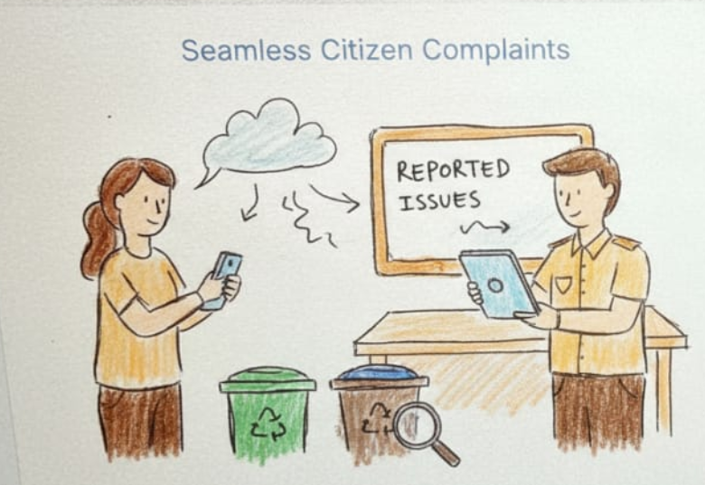
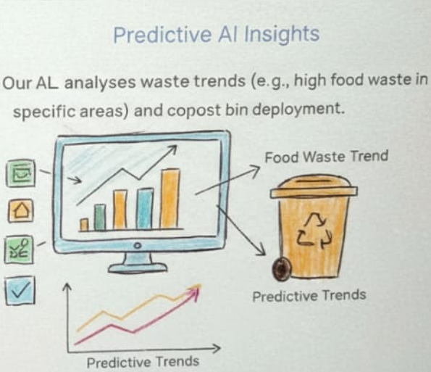
Authority-Driven Citizen Response
TrashTracer AI bridges the gap between citizens and authorities, fostering a proactive approach to waste management.
Seamless Citizen Complaints
Predictive AI Insights
WhatsApp integration allows citizens to report issues effortlessly, instantly flagging them on the dashboard for rapid response.
Our AI analyses waste trends (e.g., high food waste in specific areas) and suggests tailored solutions like compost bin deployment.

Slide 7




Enhanced Capabilities: Advanced Add-ons
Beyond its core features, TrashTracer AI offers advanced modules to further refine and optimise urban waste management.
Dynamic Route Optimisation
Missed-Bin Prediction
Real-time adjustment of collection routes for maximum efficiency and reduced fuel consumption.
Algorithms predict potential missed collections based on historical data and current conditions, enabling pre-emptive action.
Officer Chatbot Support
Automated Reporting
AI-powered chatbot provides immediate assistance and information to on-duty sanitation officers.
Generate comprehensive, customisable reports on performance, compliance, and waste metrics effortlessly.

Slide 8
A Command & Control Centre for Sanitation
TrashTracer AI provides a single, powerful interface for complete operational oversight.
Key Point 1: Total Visibility
Monitor your entire sanitation workforce on a single map. Track routes, work hours, and completion status in real-time without relying on self-reporting.
Key Point 2: Data-Driven Decision Making
Move from reactive complaint handling to proactive management. Use AI-generated insights to identify problem areas, allocate resources effectively, and prevent issues before they escalate.
Key Point 3: Streamlined Management
Eliminate the need for multiple apps and manual verification processes. Manage everything from alerts to performance reports from one centralized, secure dashboard.

Slide 9
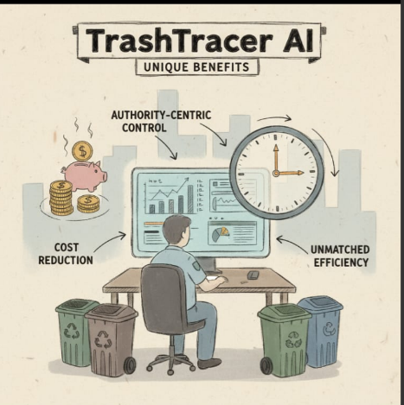
Why TrashTracer AI Stands Apart
TrashTracer AI revolutionises waste management by providing higher authorities with unparalleled control and insights. Our unique backend-only approach eliminates the complexities of public-facing applications, ensuring a streamlined, authority-centric solution.
Authority-Centric Control: Full oversight and management directly by municipal bodies.
Enhanced Accountability: Transparent tracking of collectors and waste status ensures responsibility.
Unmatched Efficiency: Automated processes and data-driven insights optimise operations and resource allocation.
Cost Reduction: Streamlined operations and reduced inefficiencies lead to significant savings.

Slide 10




Transforming Urban Landscapes
By adopting TrashTracer AI, cities can anticipate a visible transformation in their sanitation landscape, leading to healthier, more sustainable urban environments.
Increased Citizen Satisfaction
Cleaner, Healthier Cities
Prompt resolution of complaints and consistently clean environments enhance quality of life.
Proactive management of waste reduces disease vectors and improves public health.
Smarter Urban Governance
Optimised Resource Utilisation
Leveraging AI for urban services positions cities at the forefront of modern governance.
Efficient routing and data-driven decisions ensure taxpayer money is spent wisely.

Slide 11




Key Benefits at a Glance
TrashTracer AI offers a comprehensive solution that delivers tangible benefits across all facets of urban waste management.
30%
50%
Reduction in Missed Collections
Faster Complaint Resolution
Through real-time tracking and automated alerts.
Enabled by instant WhatsApp integration.
20%
15%
Decrease in Operational Costs
Improved Public Trust & Accountability
Due to optimised routes and improved efficiency.
From a cleaner environment and responsive services.

Slide 12
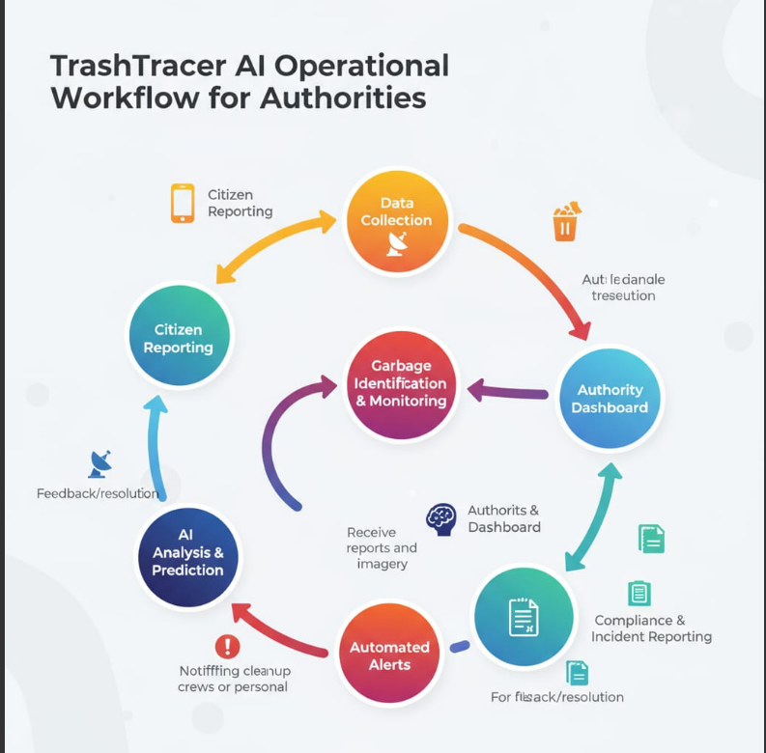

Slide 13
Real-Life Usage Scenario: From Complaint to Resolution
1. A Worker Finishes Their Route (11:00 AM)
A sanitation worker completes their assigned area and reports their route as "Finished" for the day.
In a normal system, the supervisor would have to take this report at face value.
2. The System Flags a Problem (11:01 AM)
The supervisor looks at the TrashTracer AI dashboard.
The AI engine has already cross-referenced the worker's "Finished" report with the actual GPS track from their Smart ID Card.
The system automatically flags a discrepancy: The GPS data shows the worker completely skipped two high-density streets on their assigned route. A red alert icon appears next to that worker's status.
3. The Authority Takes Control (11:02 AM)
The supervisor clicks the alert. The dashboard instantly displays a map showing the worker's actual path next to the officially assigned route, clearly highlighting the two missed streets.
There is no argument or guesswork. The supervisor has irrefutable, data-driven proof of the incomplete work.
4. The Outcome: True Accountability (11:15 AM)
The supervisor dispatches a different worker to cover the missed streets, preventing citizen complaints before they even happen.
Most importantly, the incident is automatically logged in the system as a "Service Deviation." This data is used for the worker's performance review and helps identify patterns of poor service, ensuring long-term accountability.

Slide 14
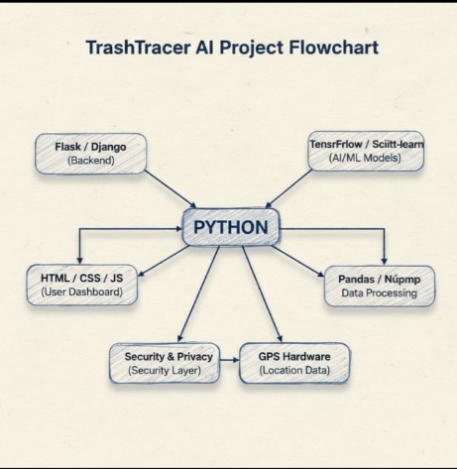

Slide 15


Next Steps: Partnering for a Cleaner Future
We invite city and municipal authorities to explore how TrashTracer AI can revolutionise your waste management systems.
Schedule a Comprehensive Demo
Consultation & Implementation Plan
Experience TrashTracer AI first-hand with a tailored demonstration focusing on your specific needs and challenges.
Our experts will work with you to develop a bespoke implementation strategy, ensuring seamless integration and maximum impact.
Thank you.
TrashTracer AI

