Slide 1

Advanced Foundations
for
Machine Learning Course Project
Physics-Informed Foley: Real-Time Intensity Control Using Hand Kinematics
Samarth M Bharadwaj, PES1UG23AM260
Sachith Kanwa, PES1UG23AM253
Sanchith Etagi, PES1UG23AM268
Shashank Prashant Karajagi, PES1UG23AM283

Slide 2

Submission Checklist
Advanced Foundations for Machine Learning
No | Feature Description | Drive Shared ( Y/N)
1 | Code notebook | YES
2 | Dataset or dataset source | YES
3 | This PPT | YES
4 | The 5 mins Video presenting your paper | YES
5 | Brief Project Report in IEEE Format | YES
Note: The drive was shared with the following email-ids: adyabhat0201@gmail.com ; bhaskarjyoti01@gmail.com ; tenacioustejas@gmail.com ;
anagha.7.k@gmail.com ; shusrith03@gmail.com ; siddhizanwar03@gmail.com

Slide 3
Problem Statement
Advanced Foundations for Machine Learning
Manual Foley (sound effects) is slow and expensive. Current "black-box" AI models are too complex and lack control.
Goal: To build an "AI-Powered Foley Artist" that automatically generates controllable sound for video impacts.
Core Focus:
  Temporal Synchronization: Sound must align perfectly with the visual impact.
  Physical Intensity: Sound loudness must match the visual force of the hit.

Slide 4
Uniqueness
Advanced Foundations for Machine Learning
Physics-Informed, Not "Black-Box": Instead of a complex model mapping pixels to sound, we use a simple, interpretable pipeline. We map Pixels - Physics - Sound.
Kinematic Feature Engineering: We prove that a single physical feature, Maximum Deceleration can be used to predict the sound's intensity.
Data-Efficient: Our "physics-informed" approach (a simple Linear Regression) works with a tiny, curated dataset of just 14 clips, unlike deep learning models that need thousands.
Focus on Control: We don't just generate a sound; we control a specific parameter (loudness) of the sound, which is more practical and controllable for real-world media production.

Slide 5
Dataset
Advanced Foundations for Machine Learning
Source: We used the "Greatest Hits" dataset by Owens [4], which contains 977 videos (20GB) of objects being struck.
Curation Strategy: Instead of using the full dataset, we curated a small subset of short video clips to isolate variables and prove our physics hypothesis.
Key Attributes:
Single Material: All clips are of "wood" being struck. This was a deliberate choice to isolate the variable of impact force.
Labeled Intensity: We manually selected and named clips as "hard" or "soft" based on the visual speed of the impact.

Slide 6
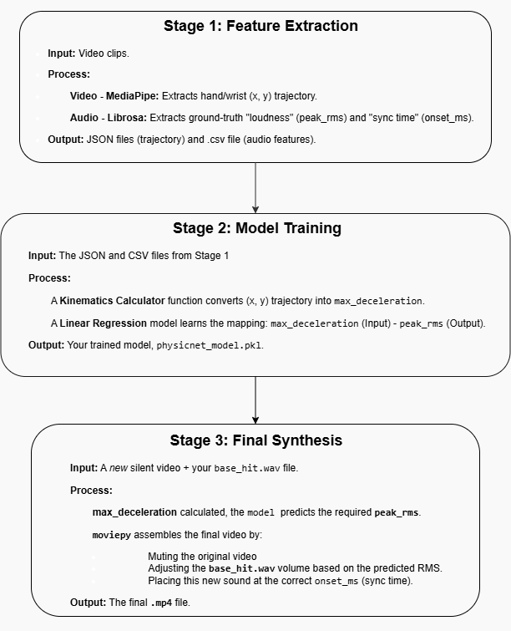
Overall Design or Approach
Advanced Foundations for Machine Learning
Stage 1: Feature Extraction
MediaPipe to track the hand's (x, y) trajectory from the video.
Librosa to analyze the original audio and get the ground-truth “loudness”(peak_rms) and “sync time” (onset_ms)
Stage 2: Model Training
A "Kinematics Calculator" function converts the (x, y) trajectory into our single physics feature: Maximum Deceleration.
A simple Linear Regression model is trained to learn the mapping: max_deceleration – peak_rms
Stage 3: Final Synthesis
For a new silent video, we calculate its max_deceleration
Our trained model predicts the required peak_rms
MoviePy assembles the final video by placing a base sound file (base_hit.wav) at the correct onset_ms and adjusting its volume to the predicted level.

Slide 7
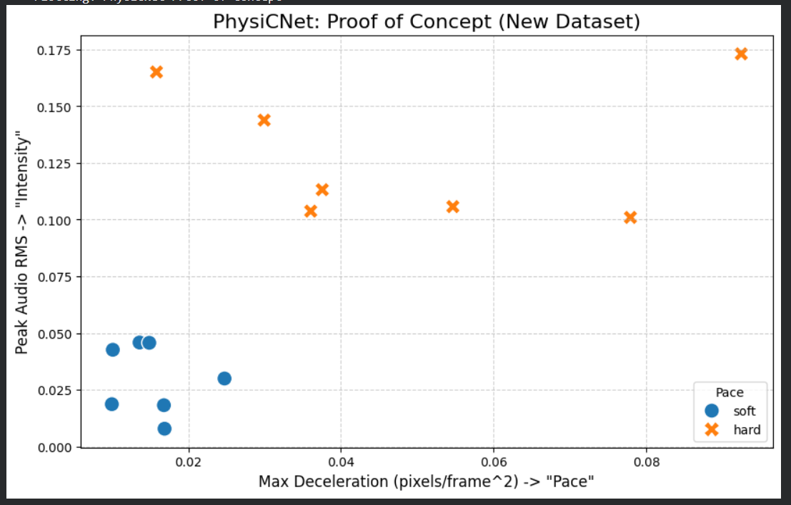
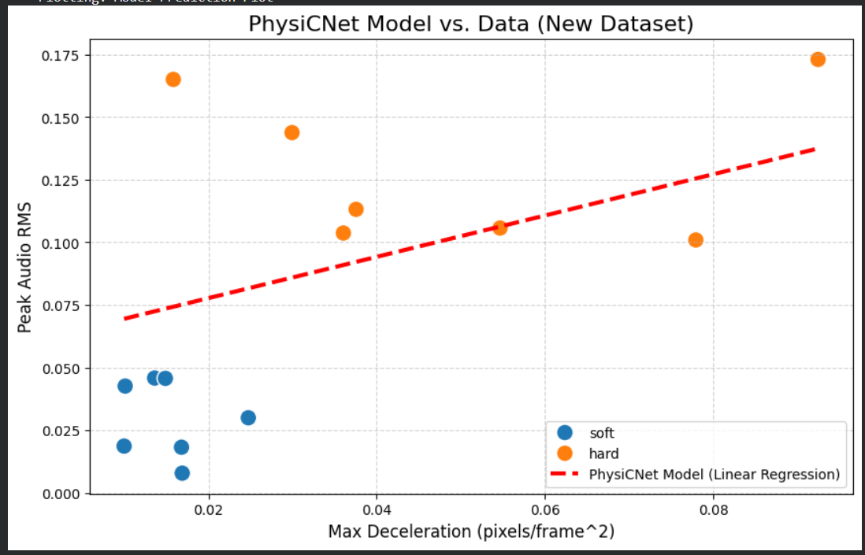
Final Results
Advanced Foundations for Machine Learning

Slide 8
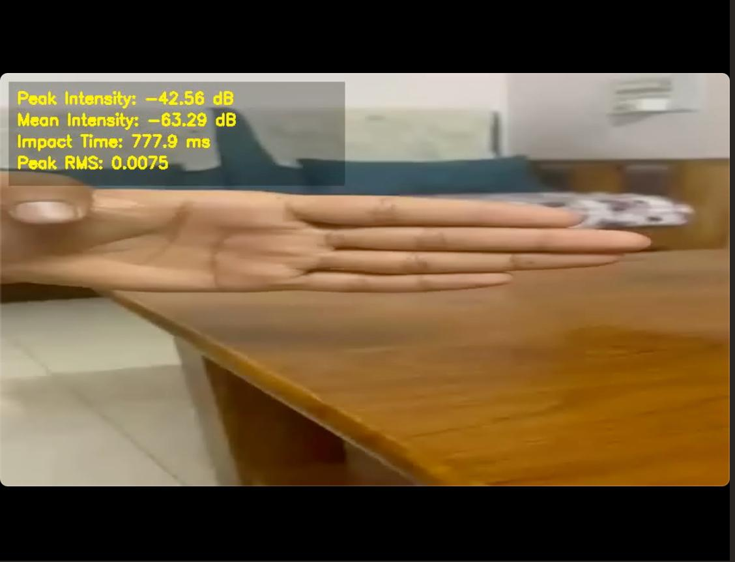
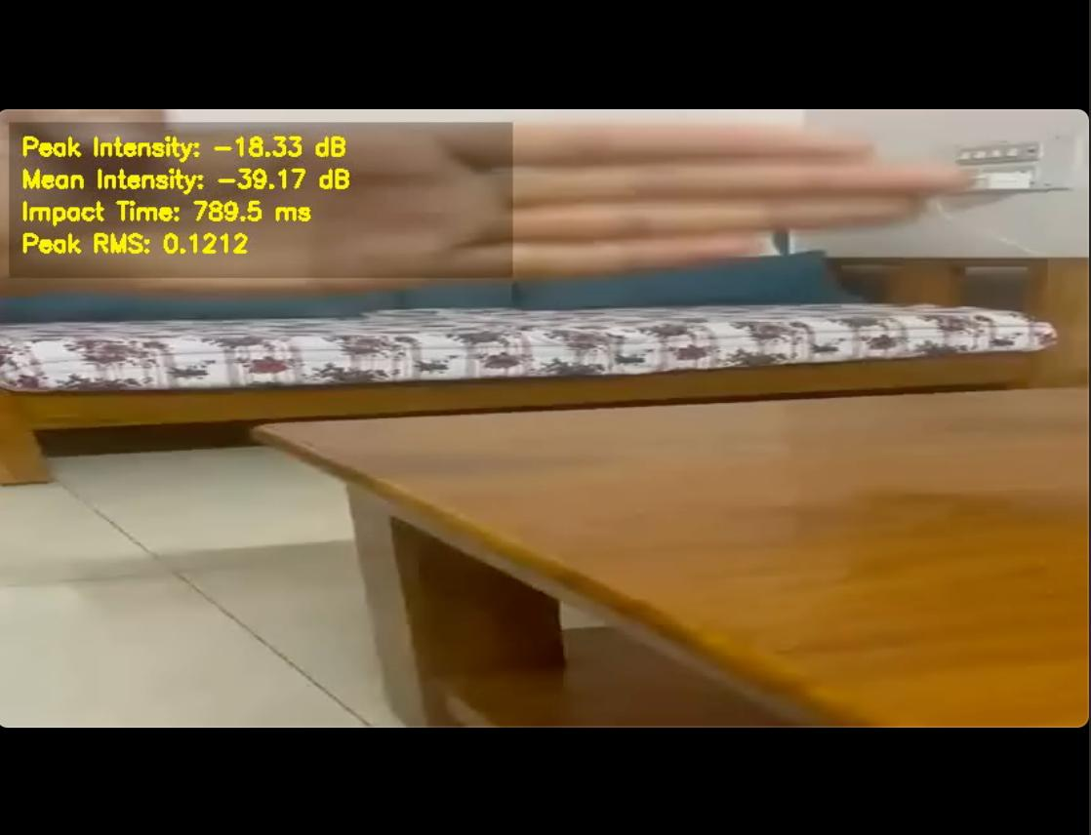
Final Results
Advanced Foundations for Machine Learning
Soft Tap
Hard Tap
Max Deceleration: 0.0159
Max Deceleration: 0.0481

Slide 9
Features : Done vs. Remaining to be done
Advanced Foundations for Machine Learning
No | Description | Done or To be Done ?
1 | Hand tracking and trajectory extraction using MediaPipe The system uses MediaPipe to lock onto the user's hand in a video and extract a frame-by-frame (x, y) trajectory of the wrist. | DONE
2 | Kinematic Feature Engineering: It converts the raw (x, y) motion path into a physics-based signal, calculating the hand's velocity and deceleration for the entire clip. | DONE
3 | Multi tap detection and intensity based audio synthesis Identifies multiple tap events and generates volume adjusted sounds for each. | PARTIALLY DONE
4 | Real time processing and occlusion handling Processes live video feed and manages scenarios where hands are temporarily hidden | TO BE DONE

Slide 10
Features : Who did what
Advanced Foundations for Machine Learning
No | Feature Description | Contributed By
1 | Hand tracking and trajectory extraction using MediaPipe | Sachith and Sanchit
2 | Physics based feature engineering and intensity | Shashank and Samarth
3 | Multi tap detection and dynamic audio synthesis | Collaborative - All teammates
4 | System Integration, testing and documentation | Collaborative - All teammates
5 | Dataset procurement and selection | Sachith and Samarth

Slide 11
Quantity and Quality of Work
Advanced Foundations for Machine Learning
No | Feature | % Complete | Runs w/o Issues (Y/N) | Minor Issues
1 | Hand Tracking & Trajectory Extraction (MediaPipe) | 100% | Y | Occasional dropped frames in fast motion
2 | Physics-based Feature Engineering (Velocity & Decel) | 100% | Y | Pandas interpolation warning (non-blocking)
3 | Audio Feature Extraction (RMS, Onset, Base Sound) | 100% | Y | Librosa fallback to audioread warning
4 | Model Training (Decel → RMS Linear Regression) | 100% | Y | Small dataset causes slight variance
5 | Final Synthesis (Single & Multi-Tap Demos) | 100% | Y | Minor MoviePy last-frame warnings

Slide 12
Top Few Learnings from this Project
Advanced Foundations for Machine Learning
No | Description
1 | We’ve come to realise that data quality is way more important than model complexity. Initially our project was completely stuck with the original dataset. Only after we cleaned and tuned specific data, the exact same model worked perfectly. We went through multiple samples of the dataset and decides to set up the environment and make a set of 15-20 datasets that act as the core foundation.
2 | We thought our model was failing, but the debug videos showed our tracker was the problem. We were trying to fix the wrong thing. Initially we thought that the model was failing but after further checks the debug videos showed our tracker was the problem. We came to the conclusion that just by looking at the final system accuracy we can’t tell where the problem is. It may lay in any of the intermediate processes.
3 | Initially we considered building an end-to-end deep learning model that would take raw video frames as input and directly predict sound parameters. End-to-end models need enormous amounts of labeled training data, which doesn’t feel very feasible at the point. For hand impacts, mass is roughly constant (a person's hand doesn't change weight), so loudness is primarily a function of impact velocity - specifically, the speed at which the hand is moving when it makes contact with the surface.

Slide 13
Top Unresolved Challenges
Advanced Foundations for Machine Learning
No | Description
1 | Our model only controls loudness (intensity), not the quality (timbre) of the sound. A hard hit and a soft tap use the same base audio file, just at different volumes. When the model detects a strong impact, it plays the sound louder. When it detects a gentle touch, it plays the same sound quieter. This basically means that the actual character and texture of sound in the audio waveform remains identical irrespective of the impact force.
2 | The visual tracker can fail if the hand is covered or moved too fast. Our tracking system relies on continuously detecting and following the hand in each video frame. If the hand moves away from the view, even partially, then the tracker loses its ability to accurately pin point the hand’s location. The same issue is faced when the hand blends with something from the background, making it hard for detection.

Slide 14
References, if any
Advanced Foundations for Machine Learning
No | Paper title | Year of publication
1 | Diff-Foley: Synchronized Video-to-Audio Synthesis with Latent Diffusion Models,(Various) | 2023
2 | SyncFusion: Multimodal Onset-synchronized Video-to-Audio Foley Synthesis,(Various) | 2024
3 | AlignNet: A Unifying Approach to Audio-Visual Alignment,(Various), | 2020
4 | The ""Greatest Hits"" (Visually Indicated Sounds)",Andrew Owens (UC Berkeley), Dataset reference Initial Dataset. This was our first choice, but we found it unworkable. The motion blur, low resolution, and similar colors of the stick and wood made reliable visual tracking impossible.

Slide 15

THANK YOU
November 2025
Department of Computer Science and Engineering in AI &ML

