Slide 1
LOGIC OF INFERENCE
Maze-Problem
Samarth Nasit - 201501082
Meet Goti - 201501093
Jay Patel - 201501186

Slide 2
Introduction
Maze is a puzzle with one starting-point , many dead-ends and one (more than one possible) ending point or destination.
More than one path from Source to Destination is possible and all are valid path as Solution as maze.

Slide 3
Types of Maze/Maze-solving Algorithm
Types of Maze:
1.Fixed wall maze
2.Moving wall maze
Types of Solving Algorithms:
1.Known Maze Solving Algorithms
2.Unknown Maze Solving Algorithm

Slide 4
Algorithms
DFS (Implemented)
Wall-Follower Algorithm
Dead-End Filling Algorithm
BFS
A* Algorithm (Implemented)

Slide 5
Implementation
DFS Algorithm:
Stack-based implementation
Go through every paths in the maze.
Returns the first path that acquires destination.
Not used basic DFS (random path choice) But used path preference Up > Left > Right > Down

Slide 6
Implementation:
A* Algorithm:
Tries to find the shortest path with minimum steps possible (Doesn’t always get shortest path though).
Efficiency depends on Heuristic-Function chosen
It chooses to explore the path that will give better state to reach the final state and betterness of the heuristic-function.

Slide 7
Implementation
A* Algorithm (Contd.):
Used Manhattan-Distance and Euclidean-Distance to destination as heuristic-functions
Manhattan-Distance : |x₁ - x₂| + |y₁ - y₂|
Euclidean-Distance : sqrt((x₁ - x₂)² + (y₁ - y₂)²)
Destination node should be given prior in this implementation because of heuristic function prediction uses the destination coordinates

Slide 8
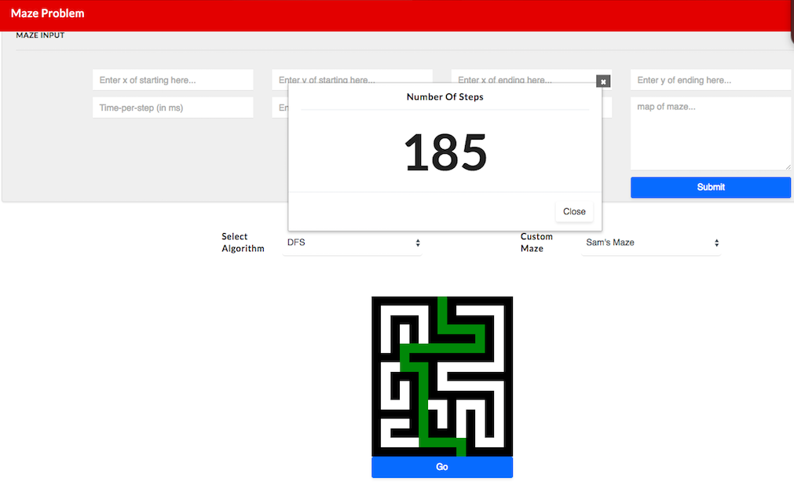
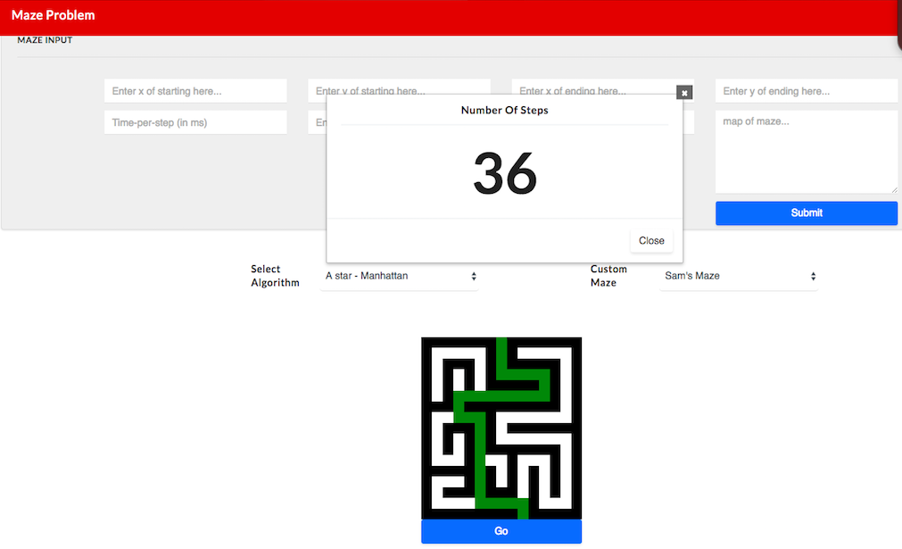
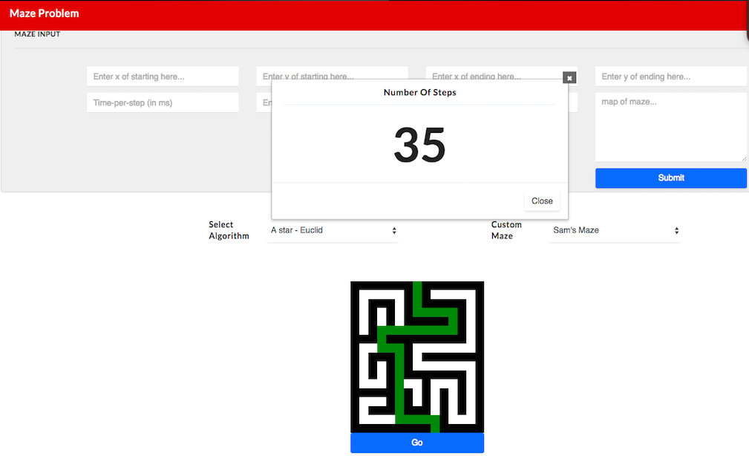
Time Complexity in terms of Steps
Using different algorithms like DFS , A* -Manhattan & A* -Euclid
Time Complexity of different algorithms are same and efficiency of algorithm will depends on Maze

Slide 9
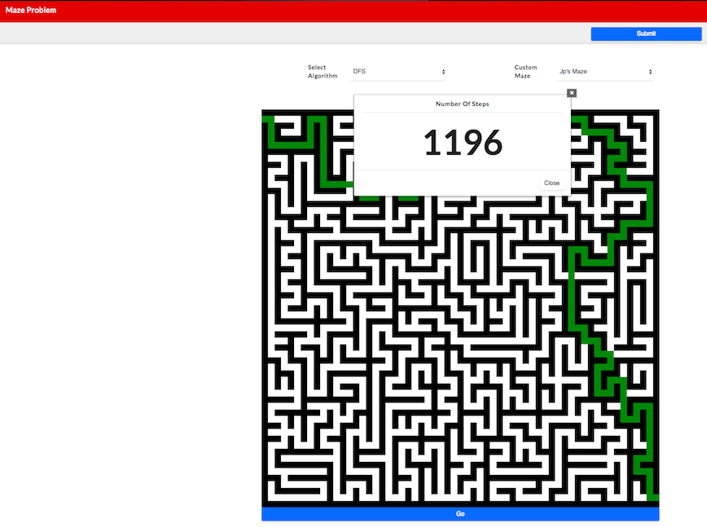
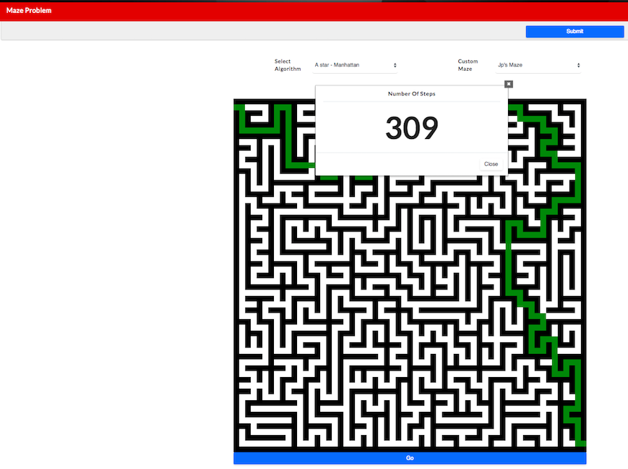


Slide 10
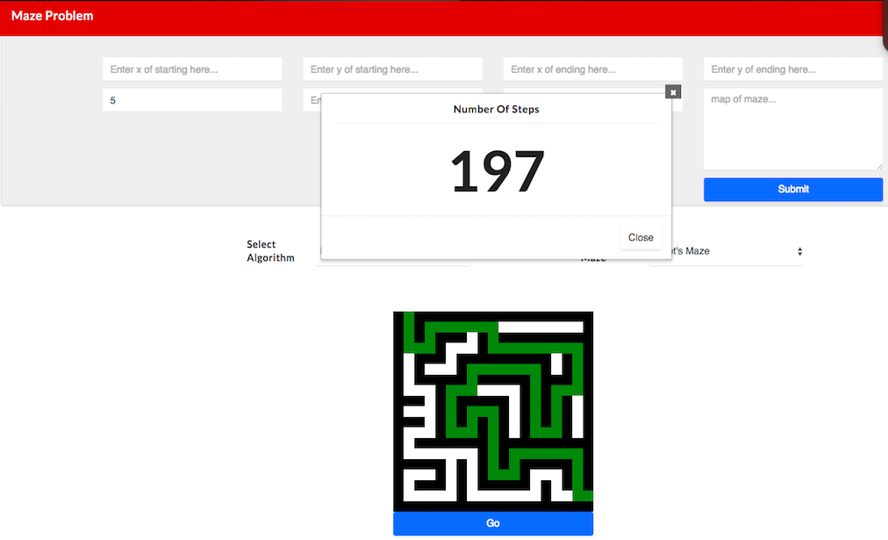
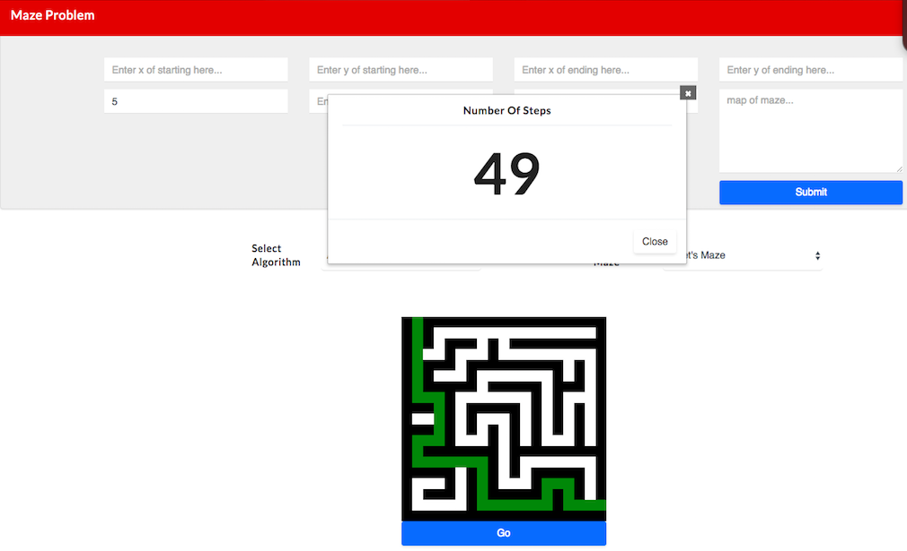
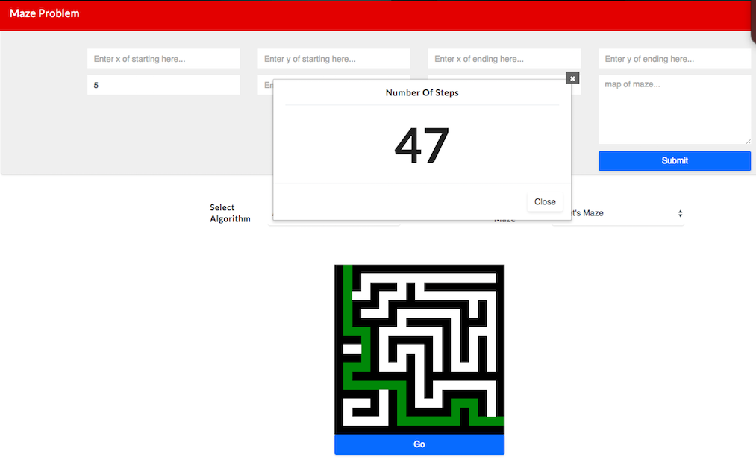

Slide 11
Thank You

