Slide 1
FIT N FINE
FITNESS CLUB
SILVER OAK COLLAGE OF COMPUTER APPLICATION
PROJECT NAME : GYM WEBSITE
DIV :M1A4
SUBJECT : Internship( html/css )

Slide 2

HOME
HOME

Slide 3
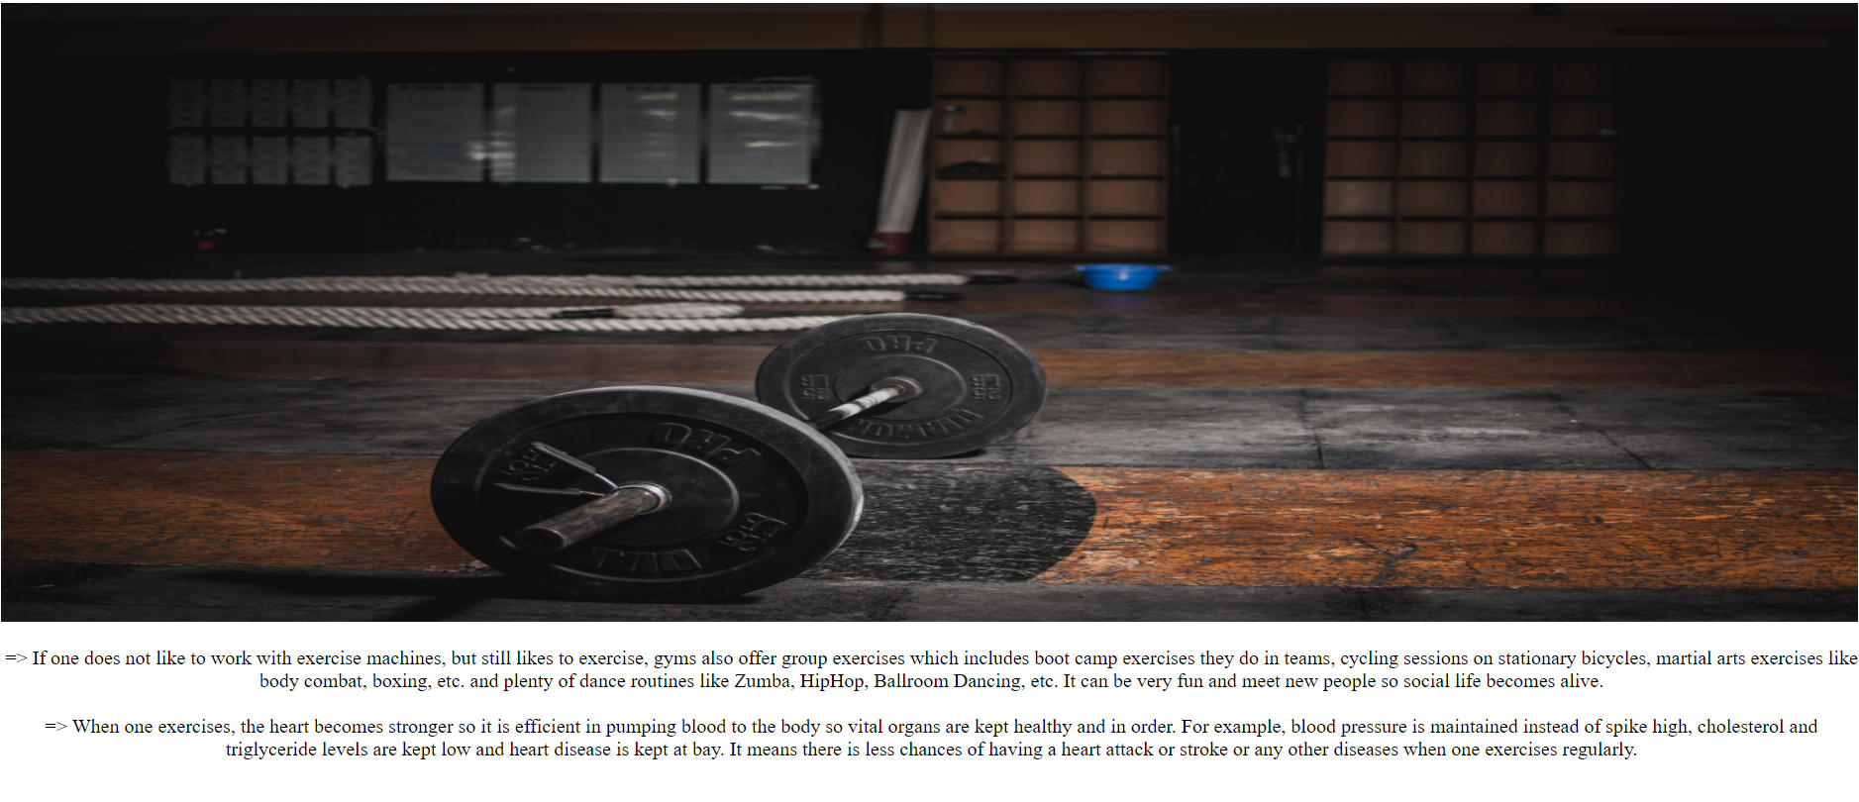
About us
ABOUT US

Slide 4
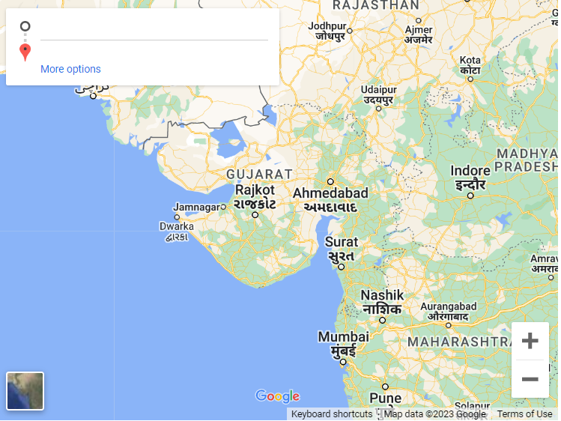
LOCATION

Slide 5
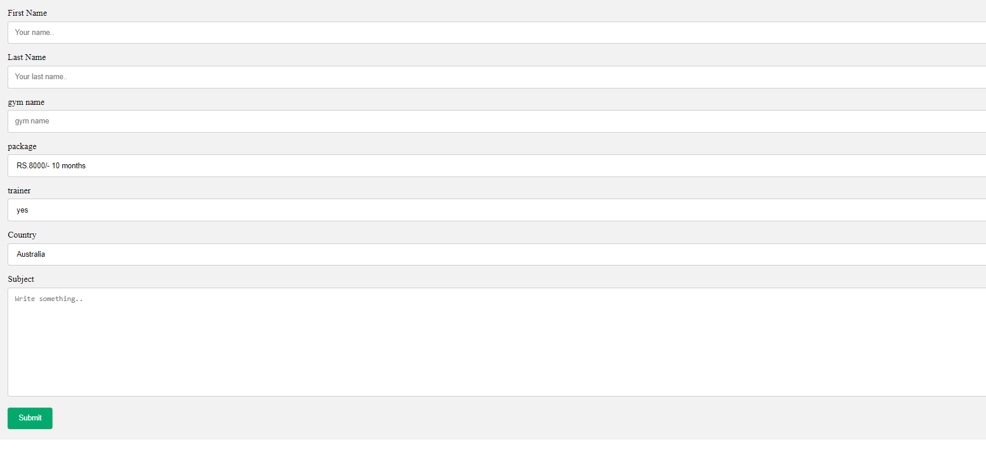
CONTECT US

Slide 6
THANK YOU
NAME : PARMAR SAMARTHKUMAR A.
EMAIL : Samarthparmar5993@gmail.com
GITHUB ID : Samarth5993

