Slide 1
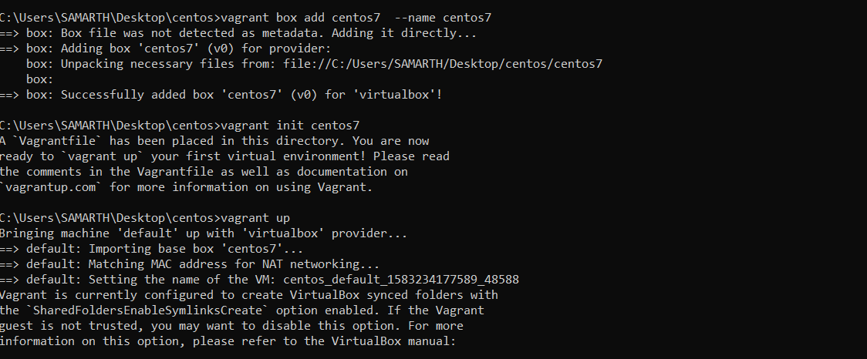
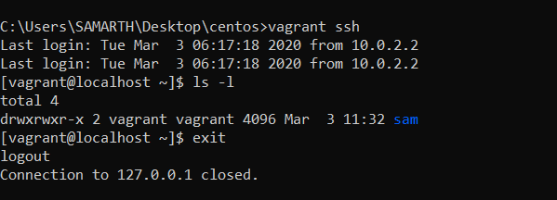

Set up vagrant file

Slide 2
Open vagrant, check number of file and close vagrant

Slide 3
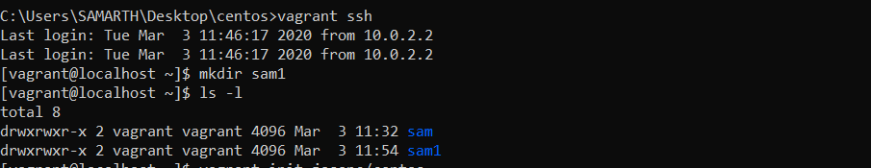
Make file at vagrant

