Slide 1
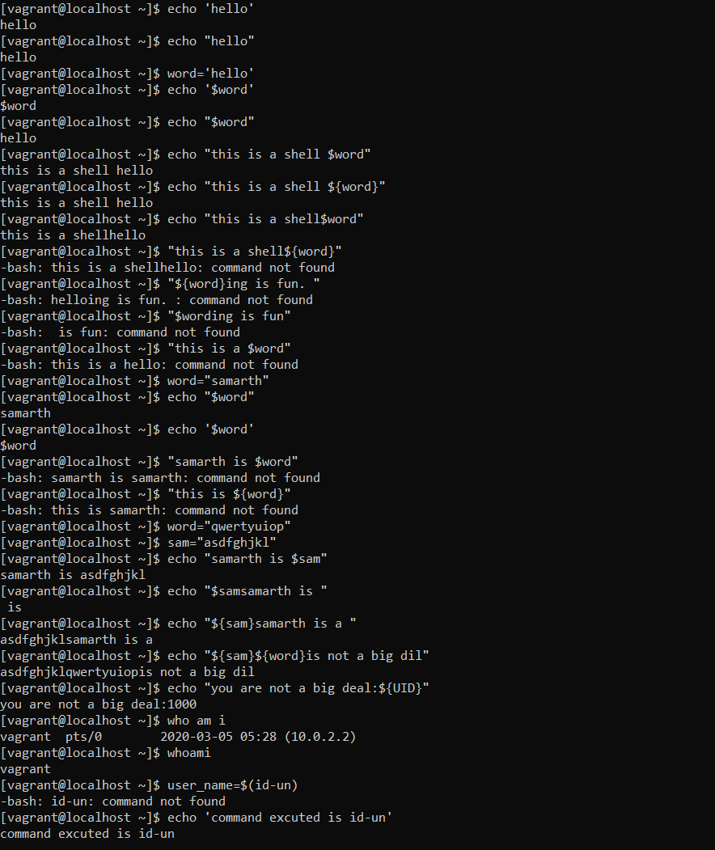
Use of echo to print any string, number and so on.
Use any as a variable.
Format echo “sentence”
If there is a variable echo “${variable}”

Slide 2
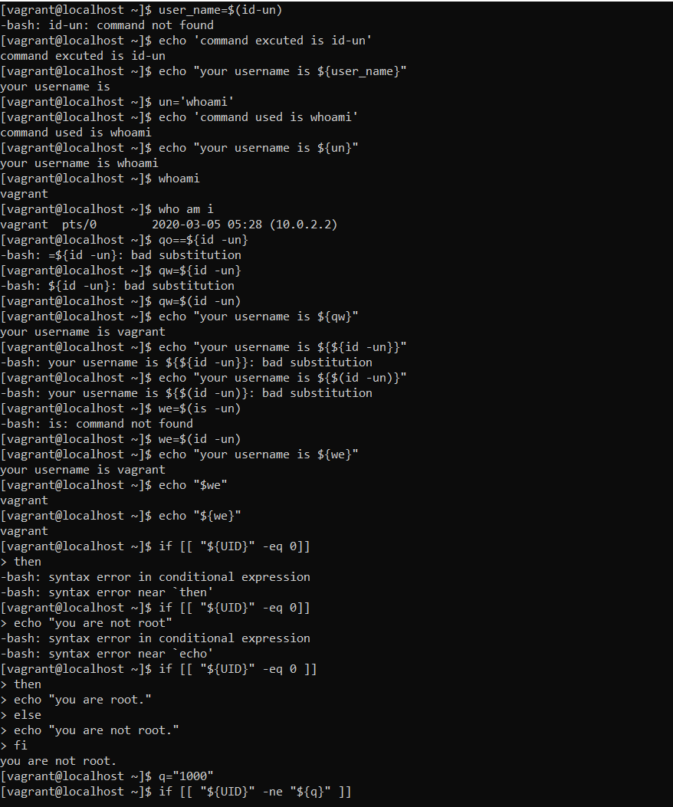
Use of if-else condition
Format -> if [[ condition ]]
then
echo “statement”
else
echo “statement”
fi
-ne -> not equal to
-eq -> equal to

Slide 3
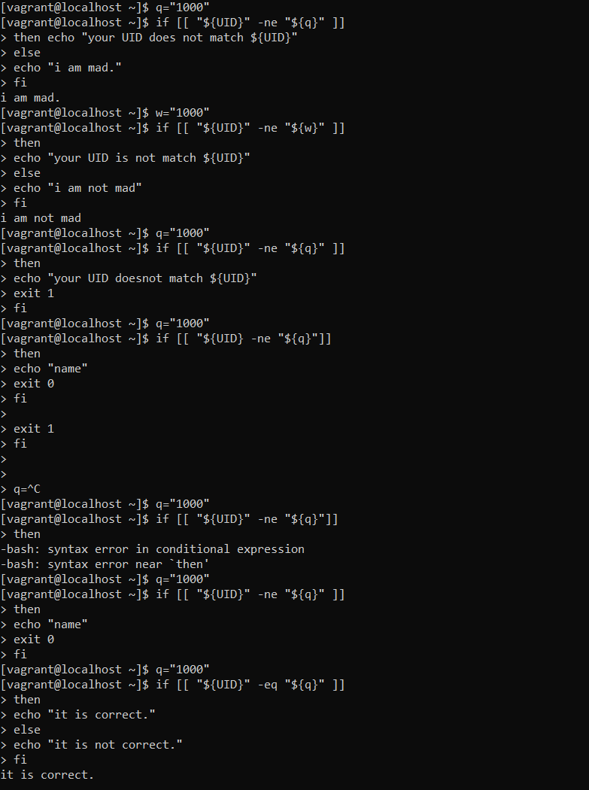

Slide 4
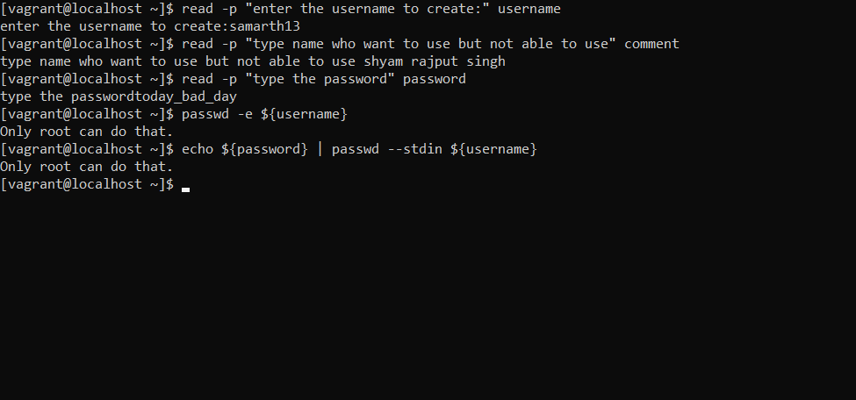
read –p -> is read the statement
Format ->
read –p “statement” variable_name
To change the password
passwd –e ${username}
(2) echo ${password} | passwd –stdin ${username}

