Slide 1
Customer Churn Prediction Using Machine Learning
By SAMARTHA GAIKWAD

Slide 2
Problem Statement
Customer churn is a major challenge for subscription-based businesses.
When customers discontinue services:
Companies lose recurring revenue
Customer acquisition costs increase
Long-term profitability decreases
Objective: Build a machine learning model to predict customers likely to churn.

Slide 3
Business Impact
Why churn prediction is important:
Retaining customers is cheaper than acquiring new ones
Early identification enables targeted retention strategies
Helps reduce revenue loss
Business Goal: Reduce churn rate using predictive analytics.

Slide 4
Project Objectives
Analyze customer behavior patterns
Identify key factors influencing churn
Build and evaluate ML classification model
Deploy prediction system as web application
Provide business recommendations

Slide 5
Dataset Overview
Dataset: Customer Churn Dataset
Includes: Demographic information
Contract details:
Billing data
Tenure
Service-related features
Target Variable: Churn (Yes/No)

Slide 6
Data Preprocessing
Steps performed:
Removed duplicate records
Converted TotalCharges to numeric format
Handled missing values
One-Hot Encoding for categorical variables
Train-Test Split (80:20)

Slide 7
Exploratory Data Analysis (EDA)
Key Insights:
Customers with shorter tenure churn more
Higher monthly charges increase churn probability
Certain contract types show higher churn rate
Visualizations Used:
Churn distribution
Contract vs Churn
Monthly Charges vs Churn

Slide 8
Feature Engineering
Applied One-Hot Encoding
Feature alignment for deployment consistency
Saved feature_columns.pkl
Ensured model compatibility during prediction
Final dataset prepared for modeling.

Slide 9
Model Selection
Problem Type: Binary Classification
Model Used: Logistic Regression
Why Logistic Regression?
Simple and interpretable
Efficient for structured data
Good performance on classification problems
High ROC-AUC score

Slide 10
Model Performance
Accuracy,0.95
Precision,0.6875
Recall,1.0
F1 Score,0.8148148148148148
ROC-AUC Score,0.9724208375893769
Interpretation:
95% overall accuracy
100% recall (no churner missed)
Excellent class separation ability

Slide 11
Confusion Matrix
Confusion Matrix: [[84 5] [ 0 11]]
Explanation:
True Negatives: 84
False Positives: 5
False Negatives: 0
True Positives: 11
Important Insight: Model correctly identified all churn customers.

Slide 12
ROC Curve
ROC-AUC Score: 0.9724
Meaning:
Strong ability to distinguish churn vs non-churn
AUC close to 1 indicates excellent model performance

Slide 13
Key Churn Drivers
Major influencing factors:
Contract type
Monthly charges
Customer tenure
These features significantly impact churn probability.

Slide 14
ML Pipeline
End-to-End Workflow:
Data Cleaning
EDA
Feature Engineering
Model Training
Model Evaluation
Model Saving (.pkl)
Flask Deployment

Slide 15
Deployment Architecture
System Flow:
User → Flask Web App → Load Model → Prediction → Display Result
Technologies Used:
Python
Pandas
Scikit-learn
Flask
Gunicorn
Render (Cloud Deployment)

Slide 16
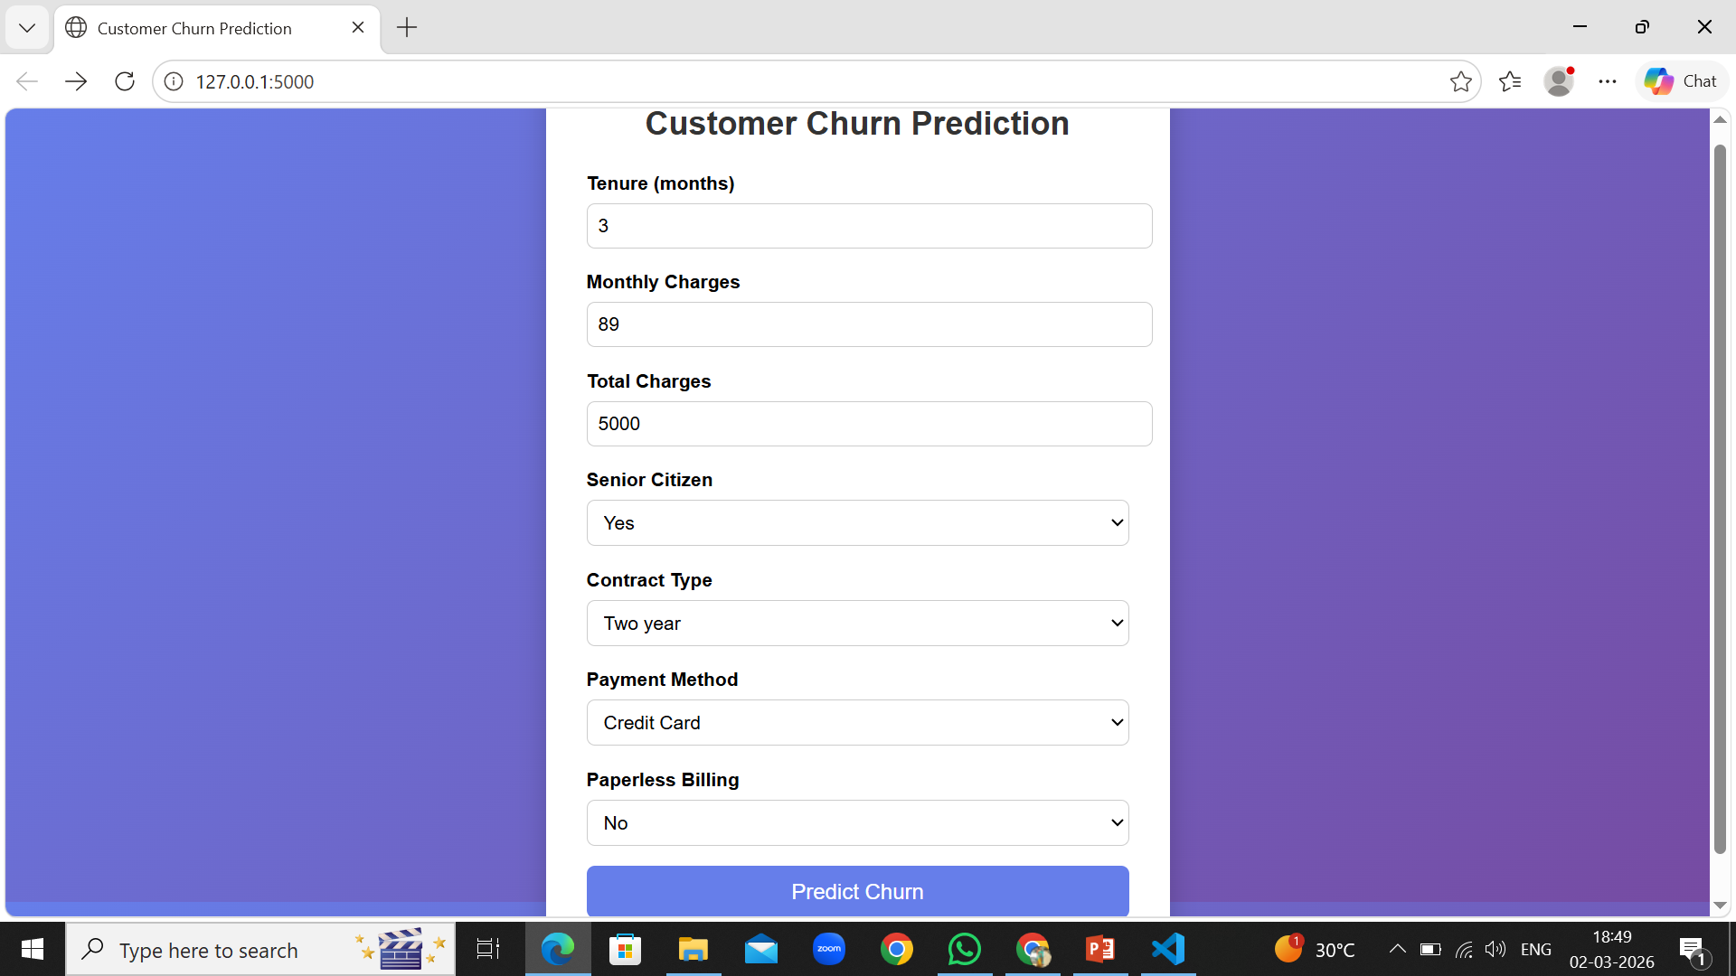
Web Application Demo
User-friendly input form
Real-time prediction
Churn probability display
Clear output message

Slide 17
Business Recommendations
Based on model insights:
Provide loyalty rewards to low-tenure customers
Offer discounts to high-risk customers
Design targeted retention campaigns
Monitor customers with high monthly charges
Expected Impact:
Reduced churn rate
Improved revenue retention
Increased customer lifetime value

Slide 18
Conclusion
Successfully built and deployed a complete ML system:
✔ Data preprocessing ✔ Model training ✔ Evaluation ✔ Model serialization ✔ Flask web deployment ✔ Cloud hosting
Achieved: 95% Accuracy 0.97 ROC-AUC

Slide 19
Thank you

