Slide 1
Team members
Vinay Kumar Tadepalli (2018101048)
Santhosh Reddy Mylaram (2018101030)
Umesh Chandra Pola (2018101103)
Samartha S M (2018101094)
Mentor TA
Pulkit Gera
Project Title
Image Colorization
Repo URL
https://github.com/Computer-Vision-IIITH-2021/project-game-of-vision
Team Name
Game Of Vision

Slide 2
TABLE OF CONTENTS
01
Objective
02
Method Overview
03
Progress
04
Experiments & Results
05
Road Ahead

Slide 3
Objective
Image colorization is an age old problem in Computer Vision domain
It is a computerized technique to add color and style to an image which is originally black and white (grayscale) image.
It can be used to restore colors from old black and white photos or movies.

Slide 4
2. Method Overview
We first send the input gray-scaled image through a convolutional network to obtain low-level features of the image.
Then we use this as an input to another convolutional network to obtain mid-level features.
Also, we use the low-level features to obtain global features by passing the low-level features through a series of convolutional and linear fully-connected layers.
We then fuse the global features with the mid-level features and send it to the colorization network.

Slide 5
2. Method Overview(Contd.)
The colorization network consists of a set of colvolutional and upsampling layers which produces a chromiance output which can be merged with the given grayscale image to produce the final colored image.
The global features contains the high level information about the scene like what time of the day the image has been taken, is it an indoor image or an outdoor image
The local features represent the local texture or object at a given location
We can use a style transfer technique where the global features of an image can be used to color another image to get a different scene coloring of the same image
Due to the constraints on the input size fully connected layer in the global feature network, the input image should be scaled to 224X224 before computing the low-level features

Slide 6
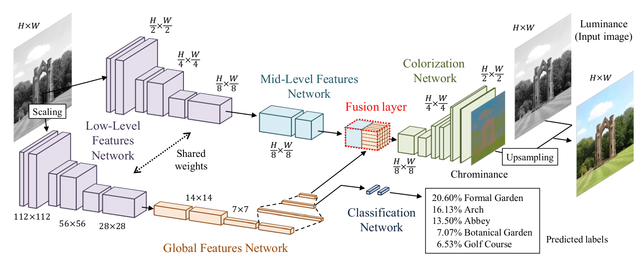

Slide 7
3. Progress
We have completed almost all the things which have planned except adding the classification labels.
Performed training and obtained reasonable results.
Tried improving the model by adding batch norm but later removed it as the normal model was performing better.

Slide 8
4. Experiments and
Results
A private dataset of gray scale images and LAB target images was used for training.
Link for dataset. The dataset doesn’t contain classification labels
The model was trained on 10k images due to logistical issues.
Batch size of 32 was used and the model was trained for 10 epochs.
Adam optimizer with default learning rate (0.001) is used to train the model which produced slightly better results compared Adadelta optimizer mentioned in the paper.
Loss function used was MSE loss as mentioned in the paper.
The results for some of the selected images was as mentioned in the next slide.
The validation loss vs epoch number curve obtained is also shown in next slide.

Slide 9
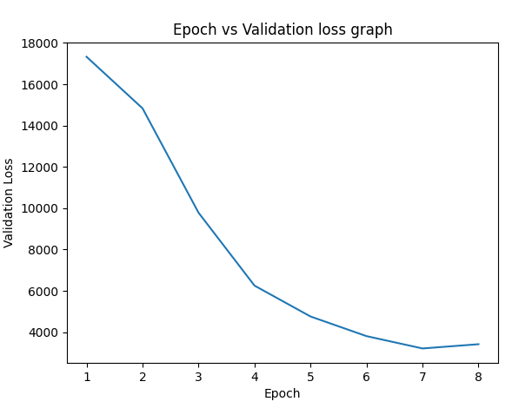
5. Results
Epoch vs validation loss graph

Slide 10
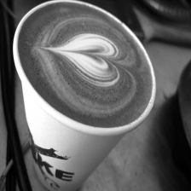
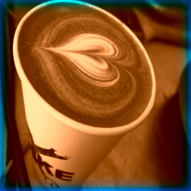
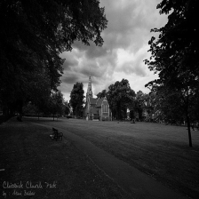
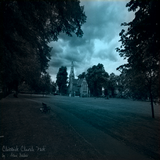
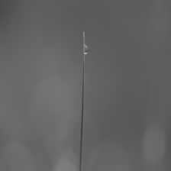
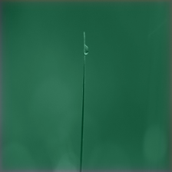
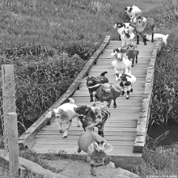
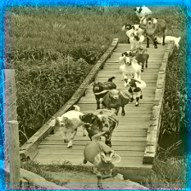
Results

Slide 11
6. Observations
We can see that the model was predicting the major colour component correctly.
The major colour components like sky, grass are coloured appropriately.
But in most of the cases, it failed to capture the low level texture features correctly.
The reason for that may be because of small dataset size used and comparatively training for less epochs.
The model has large scope of improvement if trained on larger dataset and for more number of epochs.
Also, adding classifica

Slide 12
7. Scope ahead
The model has large scope of improvement if trained on larger dataset and for more number of epochs.
Also, adding classification labels by using a dataset with classification labels can also improve the model’s performance drastically.

Slide 13


Roadmap
Obtain dataset for training
Perform basic training using small dataset
Finish coding the deep learning model
1
2
3
4
Train the model using a large dataset and analyse the outputs

Slide 14
Thank You

Slide 15

A Picture is worth a Thousand words

