Slide 1
Team members
Vinay Kumar Tadepalli (2018101048)
Santhosh Reddy Mylaram (2018101030)
Umesh Chandra Pola (2018101103)
Samartha S M (2018101094)
Mentor TA
Pulkit Gera
Project Title
Image Colorization
Repo URL
https://github.com/Computer-Vision-IIITH-2021/project-game-of-vision
Team Name
Game Of Vision

Slide 2
TABLE OF CONTENTS
01
Objective
02
Method Overview
03
Progress
04
Experiments & Results
05
Road Ahead

Slide 3
Objective
Image colorization is an age old problem in Computer Vision domain
It is a computerized technique to add color and style to an image which is originally black and white (grayscale) image.
It can be used to restore colors from old black and white photos or movies.

Slide 4
2. Method Overview
We first send the input gray-scaled image through a convolutional network to obtain low-level features of the image.
Then we use this as an input to another convolutional network to obtain mid-level features.
Also, we use the low-level features to obtain global features by passing the low-level features through a series of convolutional and linear fully-connected layers.
We then fuse the global features with the mid-level features and send it to the colorization network.

Slide 5
2. Method Overview(Contd.)
The colorization network consists of a set of colvolutional and upsampling layers which produces a chromiance output which can be merged with the given grayscale image to produce the final colored image.
The global features contains the high level information about the scene like what time of the day the image has been taken, is it an indoor image or an outdoor image
The local features represent the local texture or object at a given location
We can use a style transfer technique where the global features of an image can be used to color another image to get a different scene coloring of the same image
Due to the constraints on the input size fully connected layer in the global feature network, the input image should be scaled to 224X224 before computing the low-level features

Slide 6
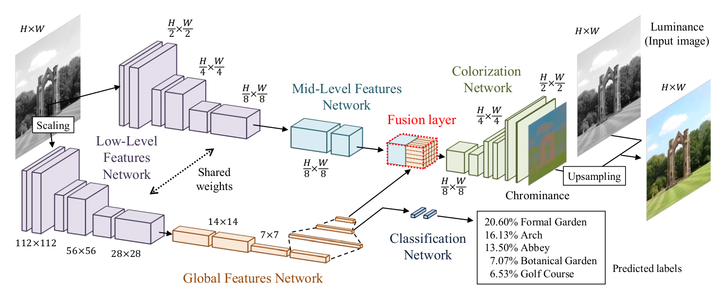

Slide 7
3. Progress
In contrast to our originally proposed plan, we finished coding the model and wrote the basic training code.
The model is trained without using the classification labels and the loss used does not include the classification loss.

Slide 8
4. Experiments and
Results
A private dataset of gray scale images and LAB target images was used for training.
Link for dataset. The dataset doesn’t contain classification labels
The initially trained model was trained on a small dataset of 160 images.
Batch size of 16 was used and the model was trained for 8 epochs.
Adadelta optimizer was used as mentioned in the paper with 0.1 as learning rate.
Loss function used was MSE loss as mentioned in the paper.
The predicted output in LAB space for an image is shown in next slide.
The validation loss vs epoch number curve obtained is also shown in next slide.

Slide 9
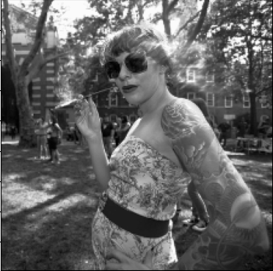
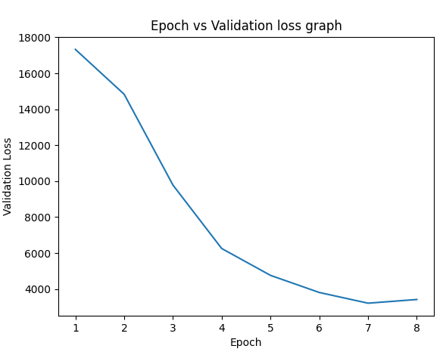
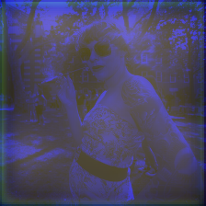
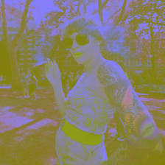
4. Results
Input Image
Epoch vs validation loss graph
Target Image
Predicted Image

Slide 10
4. Road Ahead
Further improvements can be made to the current model.
Using a dataset containing classification labels, the model accuracy can be improved by adding classification loss to the loss function by using the classification labels.
The training phase can be optimized by using batch normalization at every layer of the model.
Randomly flipping some of the training images can improve robustness of the model.

Slide 11
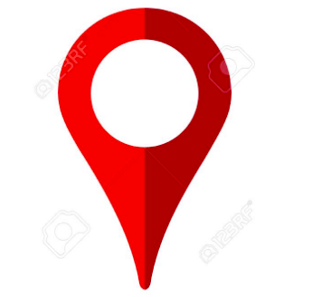

Roadmap
Obtain dataset for training
Perform basic training using small dataset
Further optimize training using the proposed methods
1
3
5
2
4
6
Finish coding the deep learning model
Obtain a dataset with classification labels to improve training
Train the model using a large dataset and analyse the outputs

Slide 12
Thank You

Slide 13
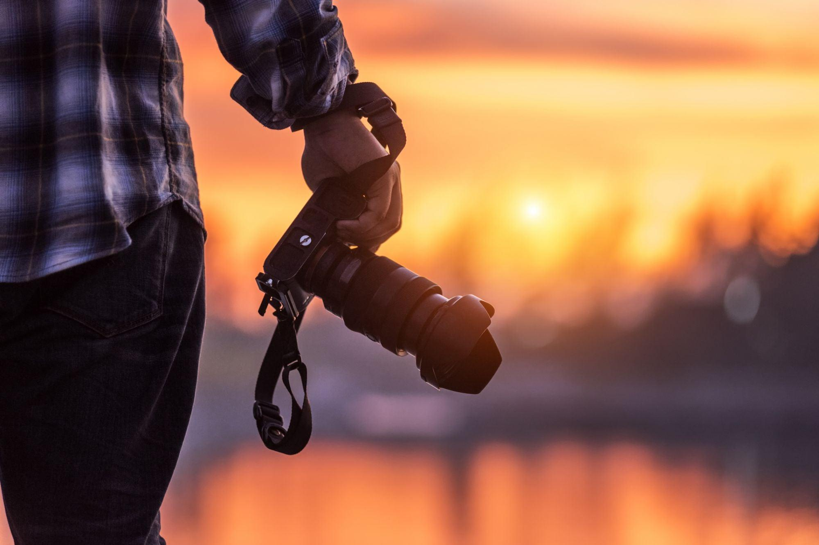
A Picture is worth a Thousand words

