Slide 1
BUILDING MANAGEMENT SYSTEM (BMS)

Slide 2
GROUP: TEAM C9
TEAM MEMBERS:
SAMARTHRAJ BALACHANDRA HEGDE (sh4636)
SIVAKUMAR SRIKUMAR (ss11437)
TENZING RABGYAL (tr1440)

Slide 3
WHAT IS BMS?
CENTRALIZED BUILDING SYSTEM CONSISTING OF HARDWARE AND SOFTWARE
AUTOMATION OF BUILDING SECURITY AND CLIMATE CONTROL
PROVIDES BUILDING OWNER WITH:
GREATER MANAGEMENT CONTROL
REDUCED OPERATIONAL COST

Slide 4
WHY IS BMS NEEDED? Part. 1
STRONGER AND MORE FLEXIBLE SECURITY
TO STOP UNAUTHORIZED ACCESS
TO MODIFY SECURITY LEVELS
PROVIDE STABLE TEMPERATURE
EXTERME TEMPERATURES COULD AFFECT OFFICE EQUIPMENT

Slide 5
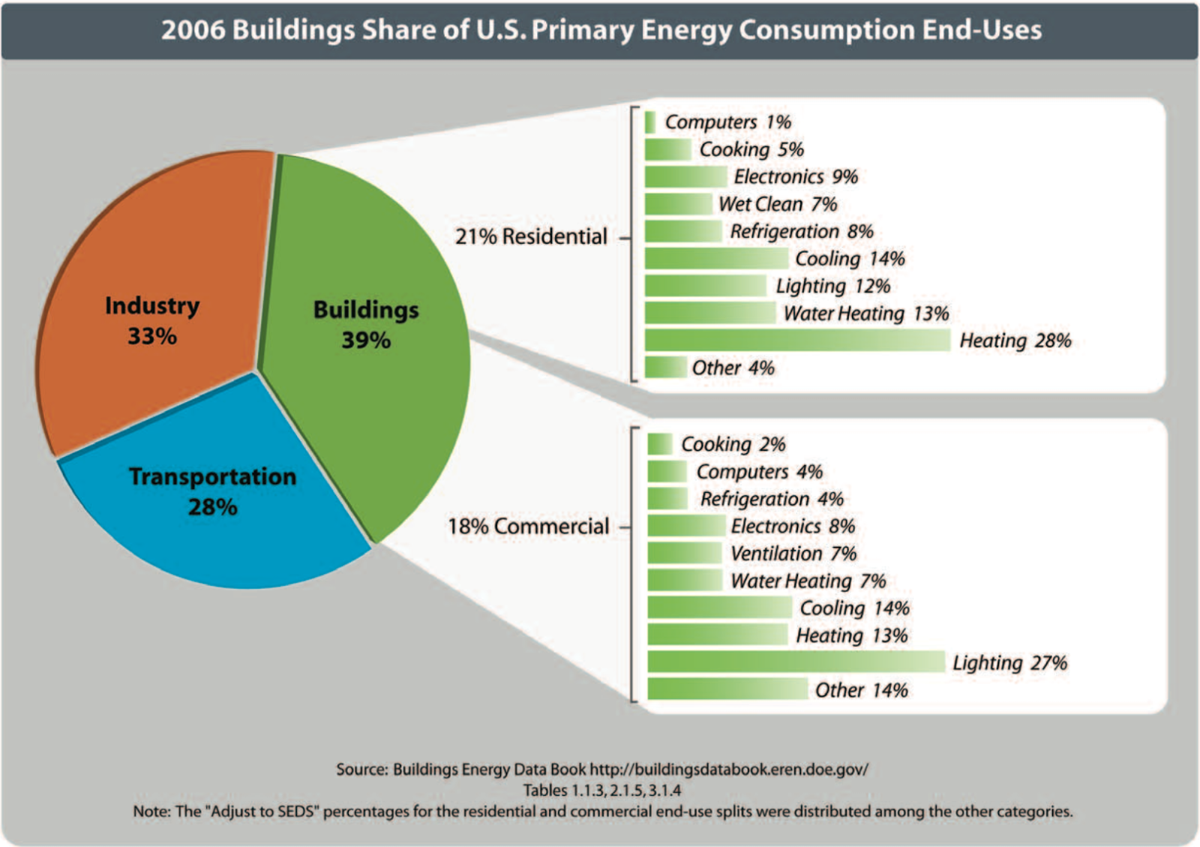
WHY IS BMS NEEDED? Part. 2
COST SAVING
25% TO 30% SAVINGS ON ENERGY AND MAINTENANCE COSTS
LESS ENERGY USAGE == A GREENER EARTH 🌎

Slide 6
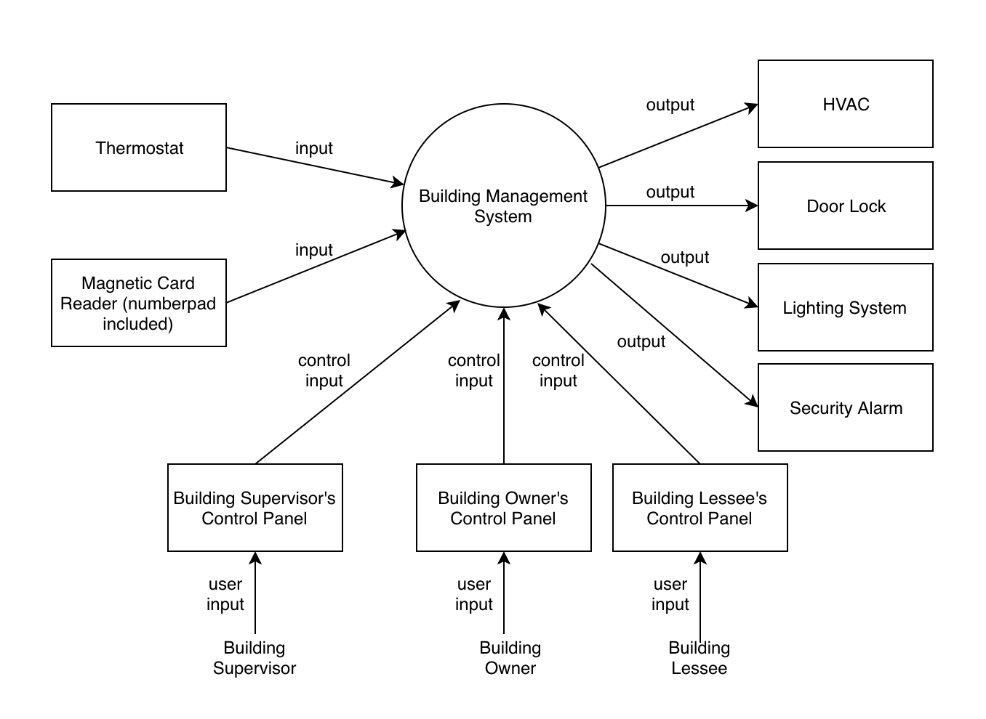
CONTEXT DIAGRAM (DFD Level 0)

Slide 7
NON FUNCTIONAL REQUIREMENTS
Physical Resource Requirements
Thermostats
Alarm
Door Locks
Magnetic badge Reader with number pad on it
HVAC
Lights

Slide 8
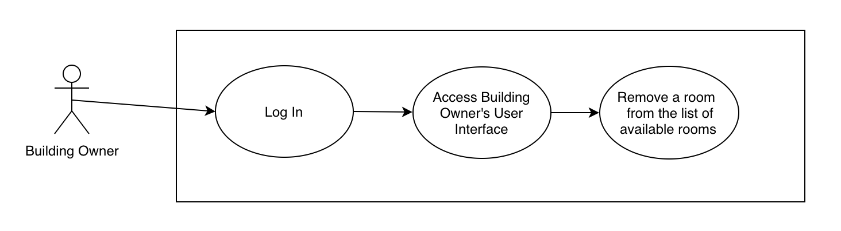
FUNCTIONAL USE CASE PART. 1
DESCRIPTION: Building Owner removes a room from being able to be leased.
PRE-CONDITION: The actor (Building Owner) has access to BMS via Building Owner’s Control Panel (User Interface).
POST-CONDITION: The actor (Building Owner) has successfully removed a room from the list of available rooms.

Slide 9
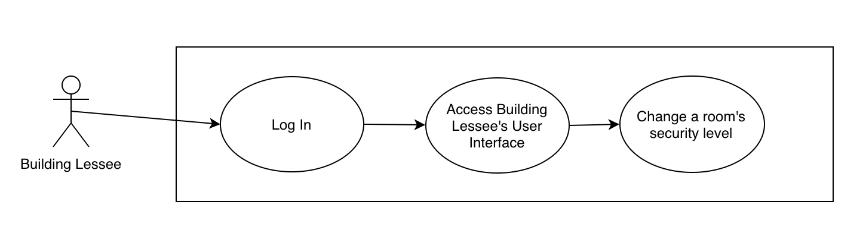
FUNCTIONAL USE CASE PART. 2
DESCRIPTION: Building Lessee changes the security level of a room.
PRE-CONDITION: The actor (Building Lessee) has access to BMS via Building Lessee’s Control Panel (User Interface).
POST-CONDITION: The actor (Building Lessee) has successfully changed the room’s security level.

Slide 10
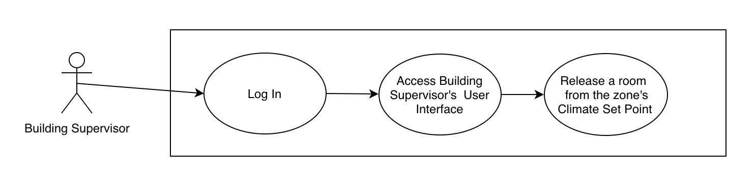
FUNCTIONAL USE CASE PART. 3
DESCRIPTION: Building Supervisor releases the climate set point of a room.
PRE-CONDITION: The actor (Building Supervisor) has access to BMS via Building Supervisor’s Control Panel (User Interface).
POST-CONDITION: The actor (Building Supervisor) has successfully released a room from the zone’s Climate Set Point.

Slide 11
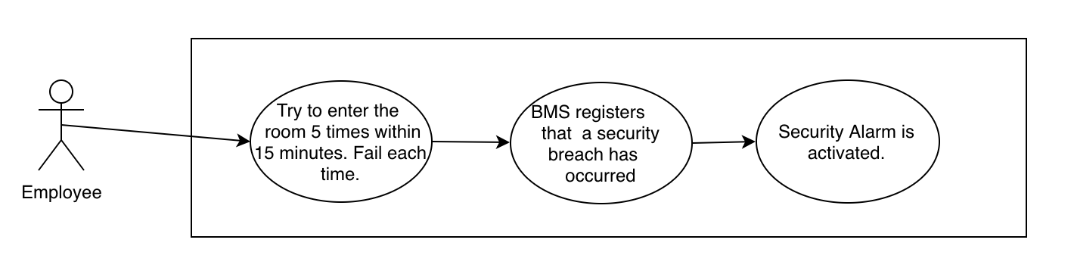
FUNCTIONAL USE CASE PART. 4
DESCRIPTION: Employee tries to enter a room unsuccessfully 5 times within 15 minutes, which sets off the security alarm.
PRE-CONDITION: The actor (Employee) has a magnetic card.
POST-CONDITION: Security guards investigate the Employee.

Slide 12
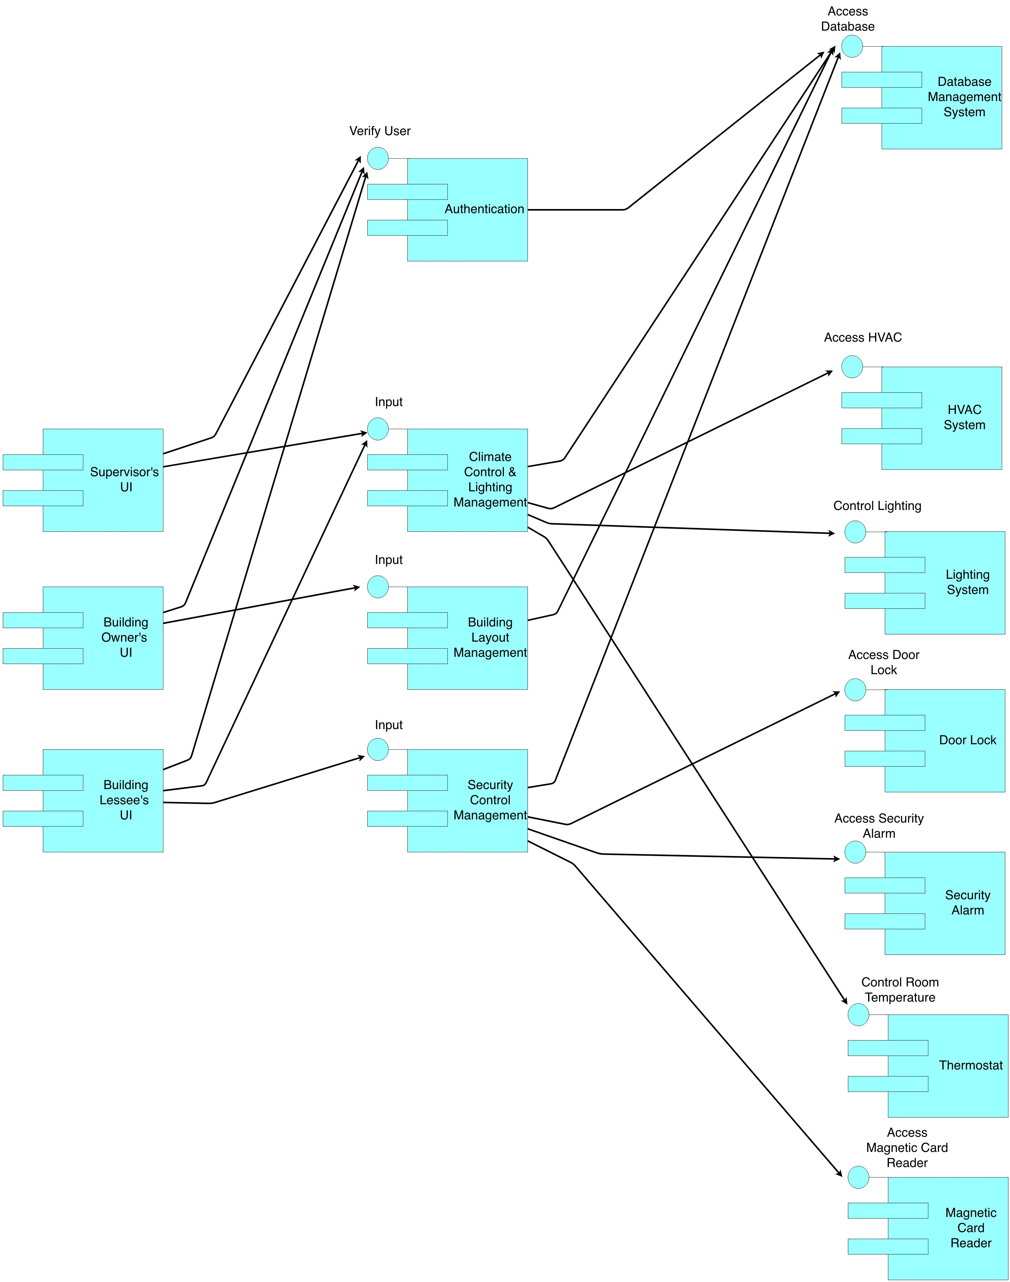
COMPONENT ARCHITECTURE DIAGRAM

Slide 13
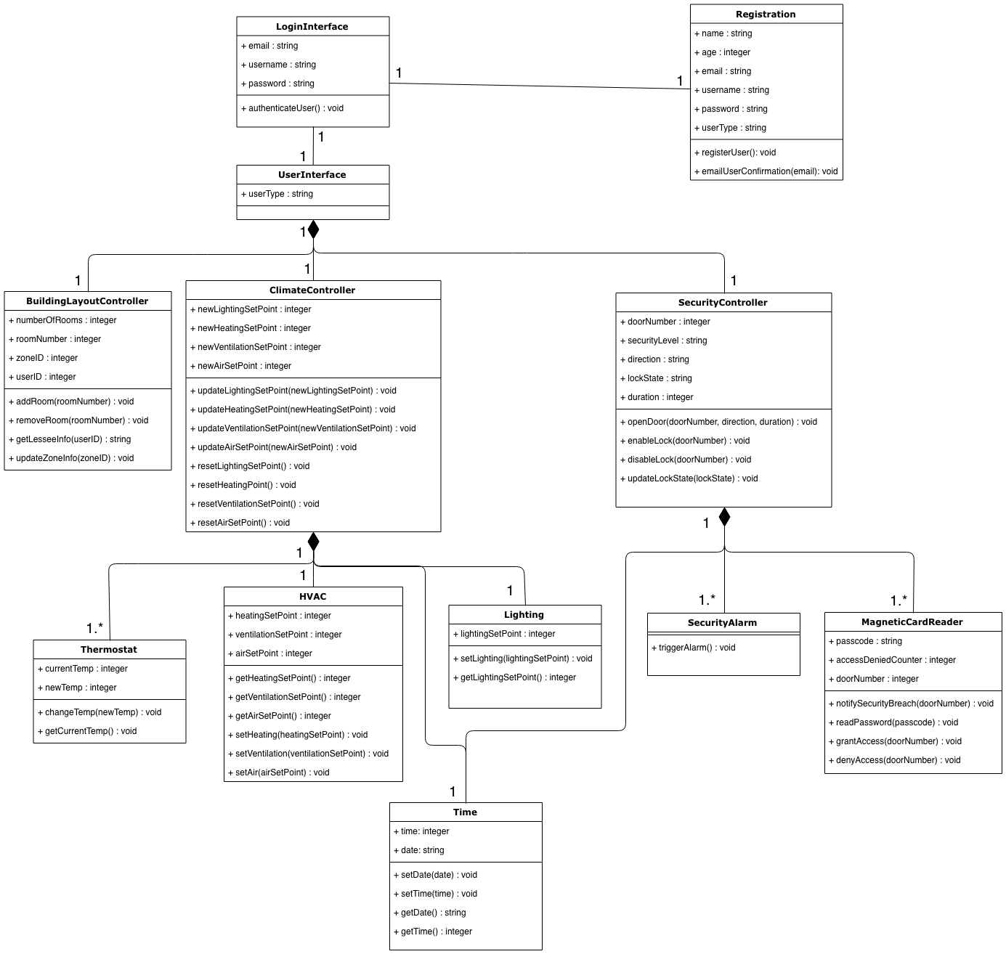

Slide 14
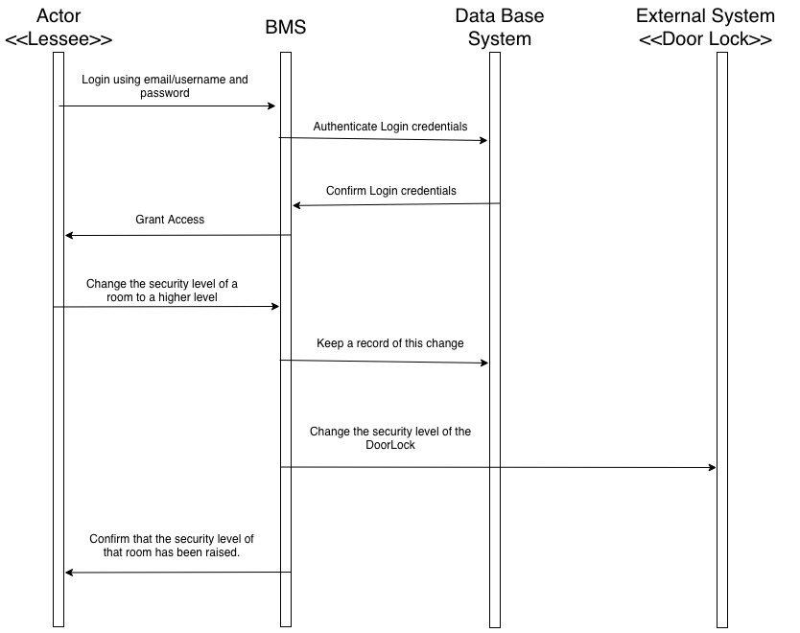
SEQUENCE DIAGRAM #1

Slide 15
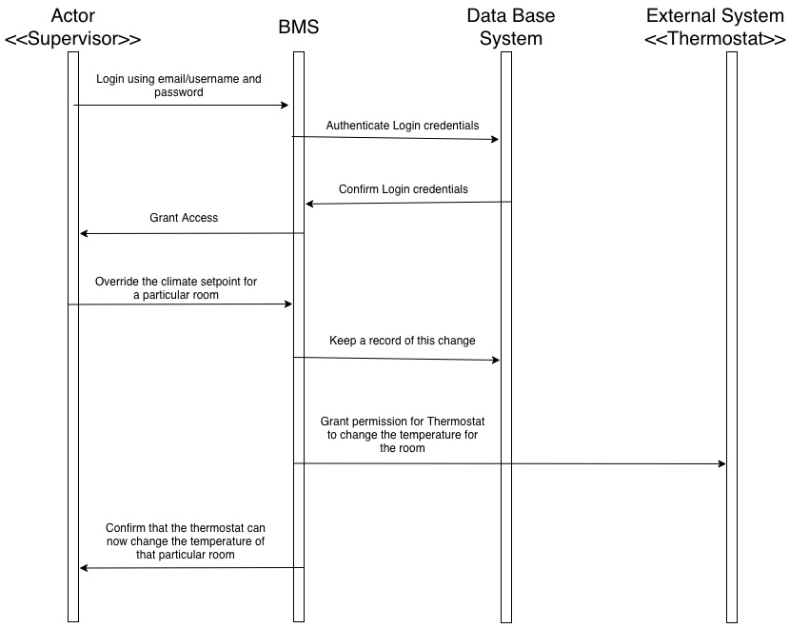
SEQUENCE DIAGRAM #2

Slide 16
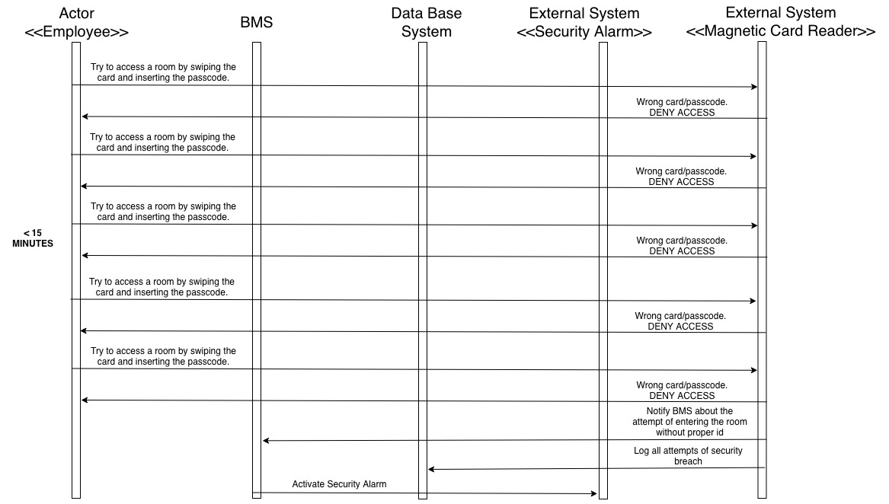
SEQUENCE DIAGRAM #3

Slide 17
FUTURE WORK
EASY
FACE/FINGERPRINT IDENTIFICATION
SENSORS ON HALLWAYS
MODERATE
MOBILE APPLICATION FOR BUILDING OWNER AND BUILDING LESSEE
INCORPORTATE DATA ANALYTICS
CHALLENGING
THIS SYSTEM CAN BE EXTENDED TO RESIDENTIAL BUILDINGS.

Slide 18
TEAM ORGANIZATION AND WORK MANAGEMENT
In person on Sunday
Discussed the document that needed to be written
Divided the work.
15 Minute FaceTime call from Monday to Friday
Each person spent around 5 minutes explaining their progress
In person on Saturday and Sunday
Fixed errors
Integrated the divided work into a single document
Reviewed the final document

Slide 19
THE GOOD AND THE NOT GOOD
GOOD
Functional Requirements, Use Cases, and Sequence Diagrams
Teamwork
COULD HAVE DONE BETTER
COMBINING THE DOOR LOCK AND MAGNETIC CARD READER COMPONENTS
HORRIBLE
CARPAL

Slide 20
QUESTIONS?

