Slide 1
Angular Essentials
-By Samarth Chadda

Slide 2
What and Why?
Angular is a JS framework which allows us to create reactive Single Page Applications(SPAs).
SPA means an application in which we seems to navigate different pages, but actually there is only ONE SINGLE HTML file, and a bunch of JS code from server.

Slide 3
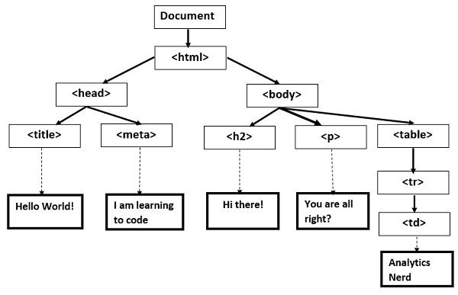
DOM(Document Object Model) :

Slide 4
Create First Project :
In CMD/Terminal –
> ng new my-first-app
…….
…….
TO create without node_modules :
> ng new myProject --skip-install

Slide 5
To Run Angular Project :
Locate to suitable folder (using ‘cd’ command etc)
In terminal –
> ng serve
……..
OR
> npm start
……..

Slide 6
TypeScript :
Angular use TYPESCRIPT( superset of JS) , and it is compiled to JS ultimately.
Typescript
Javascript

Slide 7
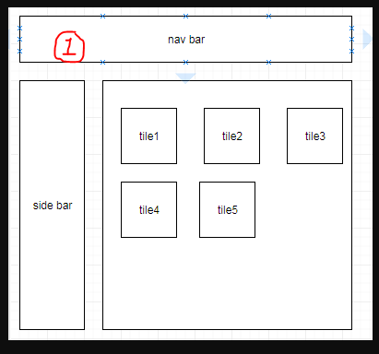
Components :

Slide 8
Components :
Components are the basic building block of our angular application.
The ‘AppComponent’ is considered as the ROOT component of our project.
In this AppComponent, we later add( or nest) the other components.

Slide 9
Components :
Each of component can be divided as –
product.component.html
product.component.ts
product.component.css
product.component.spec.ts

Slide 10
Creating a New Component :
In terminal –
> ng generate component comp_name
……
OR
> ng g c comp_name
……
Using this CLI approach, the component will be automatically declared in AppModule.

Slide 11


