Slide 1



Photonic multigrid for Poisson problems
A digital iterative solver with
photonic matrix–vector products
Fixed matrices and changing correction vectors solve Ax = b
Measure mismatch
Find correction
Update solution
Project implementation inspired by Lee et al. (2025)
1
Notes:
20-minute technical discussion. The contribution is a working numerical emulation and an inspectable architecture demonstrator. No experimental photonic processor or measured hardware speedup is claimed. Primary paper: https://arxiv.org/pdf/2511.01005.
Sources: Project implementation inspired by Lee et al. (2025)

Slide 2
The paper assigns smoothing products to optics
Numerical structure adopted here
Current project
Digital residual correction
Noisy 2D emulation
+
ideal 1D demonstrator
Digital PCG + multigrid control
Photonic smoothing MVM
Hardware diagrams show
functional assignments.
Research question: can approximate smoothing reduce digital work while reliable residuals retain accuracy?
Lee et al., arXiv:2511.01005, pp. 3–6, 15–16
2
Notes:
Lee combines multigrid preconditioning with digital Krylov iteration and residual correction. The demonstrated Poisson case uses two AMG levels. Its optical core stores weights and computes smoothing products. We adopt that computational partition. Source: https://arxiv.org/pdf/2511.01005. The deck explains repository code rather than copying the paper figures.
Sources: Lee et al., arXiv:2511.01005, pp. 3–6, 15–16

Slide 3
Three implementations, different settings
 | Lee Poisson experiment | main.py | Browser demonstrator
Role | Research foundation | Noisy numerical evidence | Explanatory model
Problem | 2D capacitor | 64 × 64 = 4096 unknowns | 1D, 64 unknowns
AMG levels | 2 | 4096 → 704 in this run | 64 → 22 → 8 → 3
Hybrid sweeps | 4 pre / 0 post | 4 pre / 0 post | 3 pre / 3 post
MVM behavior | Physical measurements | Input quantization + noise | Ideal floating point
Main explanation: browser’s 1D model. Research evidence: main.py’s separate 2D run.
Lee et al.; main.py; web/index.html; smoother.py
3
Notes:
Keep every later result attached to its implementation. The browser is based more closely on the 1D smoother.py algorithm but uses N=64. smoother.py currently reaches its solve output then raises a ValueError in the final residual expression because A is a list. No results here are attributed to that failing report. Paper: https://arxiv.org/pdf/2511.01005.
Sources: Lee et al.; main.py; web/index.html; smoother.py

Slide 4
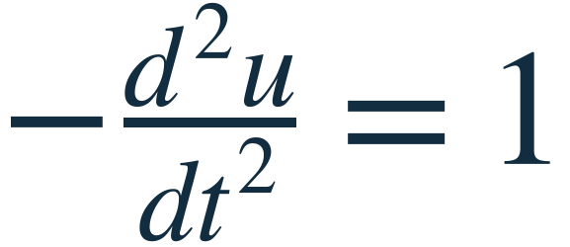
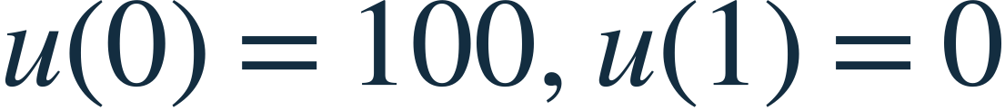
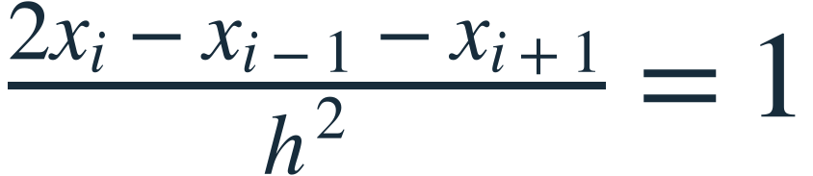
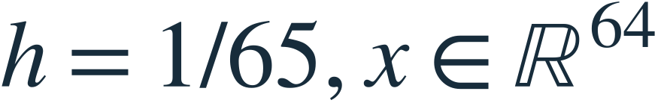
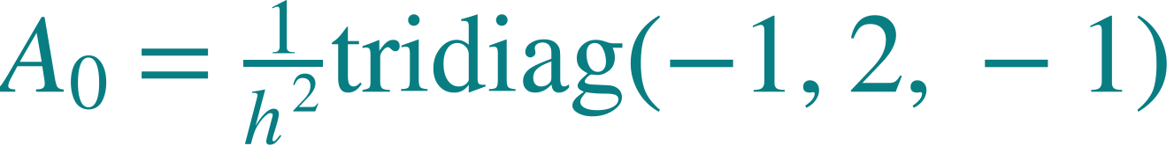
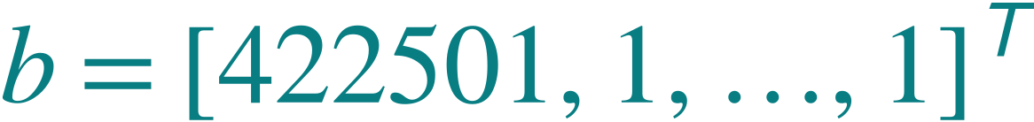
The unknown vector stores sampled solution values
Ideal 1D teaching model
x = [u(t₁), …, u(t₆₄)]ᵀ. Iteration improves an equilibrium estimate; it is not physical time.
Browser solver
4
Notes:
The teaching problem is a 1D Poisson boundary-value problem, mathematically an ODE reduction of the PDE. Interior unknowns only are in x. Known boundaries enter b. h=1/65. The analytic quadratic is also the exact discrete solution for this stencil up to floating-point error. Its samples are a reference, never solver input.
Sources: web/index.html: PhotonicSolver numerical core and embedded sparse matrix data

Slide 5
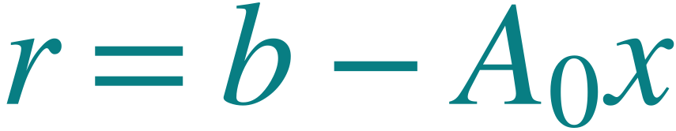
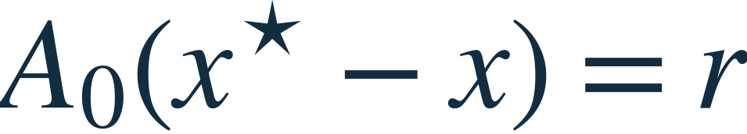
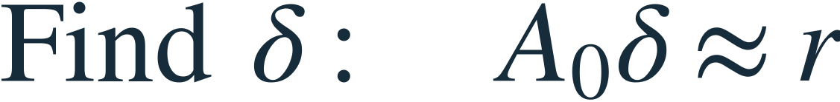
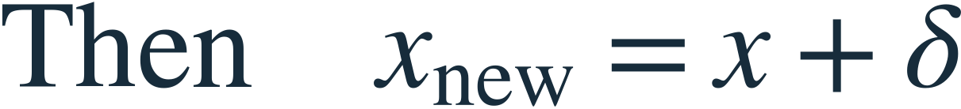
The residual becomes the next correction problem
True residual check
Known: A₀, b, current x
Solve for a correction δ
while current x stays in memory
Updated true residual
rnew = b − A₀(x + δ)
The exact solution x* is only a reference for evaluation. The algorithm uses the computable residual.
Browser solver; Lee Methods p. 16
5
Notes:
Let x* denote the exact discrete solution. Then A(x*−x)=b−Ax. We can measure r without knowing x*. PCG approximately solves for δ. Corrections change only interior values; boundary changes are zero. A small true residual certifies equations are closely satisfied, not by itself a universal solution-error bound.
Sources: web/index.html: PhotonicSolver numerical core and embedded sparse matrix data; Lee Methods p. 16

Slide 6
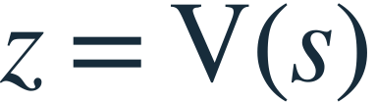

One solver map connects all four routines
Read downward for calls; read upward for returned values
1 Outer correction
full solution x
2 PCG correction
accumulated correction δ
3 Multigrid V-cycle
Optics returns yℓ.
CPU updates eℓ.
CPU selects next request.
4 Richardson smoothing
Changing vectors: x → δ → s → eℓ. Fixed operators: Aℓ, Pℓ, Rℓ.
Browser solver
6
Notes:
This is a call hierarchy, not four physical chips. Each routine returns to its caller. Subsequent slides expand these same four blocks. Only the product inside the last block is assigned to optics. V-cycle is an action approximating A inverse, not an explicitly stored inverse or matrix M.
Sources: web/index.html: PhotonicSolver numerical core and embedded sparse matrix data

Slide 7
The CPU closes every optical smoothing loop
Optical smoothing
Light source
A₀ 64 × 64
eℓ
DAC +
encoder
Detector +
ADC
CPU
state +
updates
A₁ 22 × 22
A₂ 8 × 8
Select one Aℓ
electrical yℓ = Aℓeℓ
Amber: optical product. Teal: electrical data and CPU work. The full solution x is not the encoded vector.
Browser solver; web/README.md hardware mapping
7
Notes:
Functional hardware proposal for the browser. The CPU selects a level, retains e and g, and sends only e through shared DAC/modulator. Source illumination is not an extra numerical operation. Optical matrix weights act on the signed numerical representation; no specific signed encoding, sparse tiling, or physical switch is specified. Detector/ADC returns y, then CPU applies the Richardson update. CPU-only work does not require an extra trip through optics.
Sources: web/index.html: PhotonicSolver numerical core and embedded sparse matrix data; web/README.md hardware mapping

Slide 8
A real smoothing request changes the local vector
Optical smoothing
Stored or transferred quantity | Actual first three entries
g₀, retained on CPU | [4.225e+05, 1, 1, …]ᵀ
e₀, encoded input | [25.01, 5.921e-05, 5.921e-05, …]ᵀ
y₀ = A₀e₀, detected product | [2.114e+05, -1.057e+05, 0, …]ᵀ
new e₀ = e₀ + ω₀(g₀ − y₀) | [37.51, 6.257, 0.0001184, …]ᵀ
ω₀ = 5.9206167e-05 · 64 entries · full x unchanged
Next sweep encodes the updated e₀ through the same fixed matrix A₀.
Browser solver; zero-start event trace
8
Notes:
Numbers from the actual second pre-sweep on level zero in the first browser V-cycle, rounded for display. First sweep sends a zero vector and returns zero, giving e=ωg. The browser retains this zero-input MVM in its counters. x remains zero throughout the first correction solve; only local e changes here. All vector excerpts use indices1–3 of64.
Sources: web/index.html: PhotonicSolver numerical core and embedded sparse matrix data; zero-start event trace

Slide 9



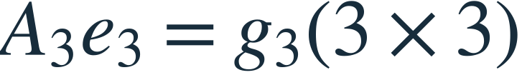
The multigrid V-cycle
Multigrid V-cycle
Level 0: 64 values
3 pre-sweeps
Add P₀e₁
3 post-sweeps
At every level:
save gℓ and eℓ
Only smoothing MVMs
use the optical route.
Level 1: 22 values
3 pre-sweeps
Add P₁e₂
3 post-sweeps
Level 2: 8 values
3 pre-sweeps
Add P₂e₃
3 post-sweeps
CPU direct solve
Return z = e₀ to PCG. The V-cycle supplies an approximate correction, not the final PDE solution.
Browser solver
9
Notes:
Actual browser schedule, 3 pre and3 post sweeps at each noncoarsest level. On entry initialize e_l=0. After pre-smoothing compute d_l=g_l−A_l e_l digitally, restrict g_next=R_l d_l, recurse. On return add P_l e_next to retained e_l and post-smooth. At the top return z=e0. AMG levels are algebraic spaces, not uniformly subsampled physical meshes. In main.py the hybrid schedule is a different two-level4/0 cycle.
Sources: web/index.html: PhotonicSolver numerical core and embedded sparse matrix data

Slide 10

Smoothing and coarse correction
Multigrid V-cycle
Mode j: 1 − ωλⱼ
Error norm
6.04 → 5.70 → 0.50
Three post-sweeps reduce the norm further to 0.422. The initial error is prescribed for this test.
Browser solver; derived.json controlled error experiment
10
Notes:
This is a controlled numerical teaching experiment using the stored browser operators, not a physical measurement. Choose an initial error sin(πt)+0.35sin(32πt), solve homogeneous error equation with three Richardson sweeps, apply the recursive coarse correction, then three post-sweeps. Display error profiles against zero. Norms are independently computed. The amplification relation follows directly from the Richardson update.
Sources: web/index.html: PhotonicSolver numerical core and embedded sparse matrix data; derived.json controlled error experiment

Slide 11
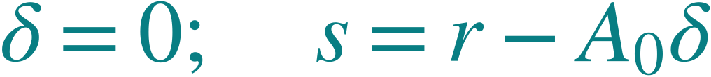
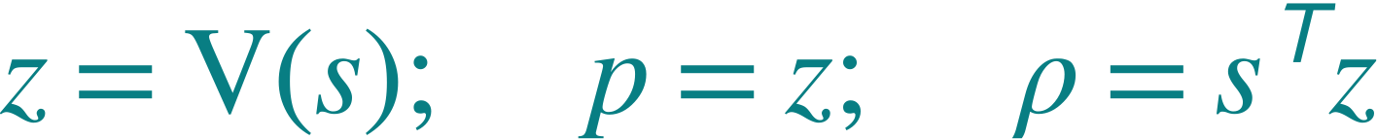
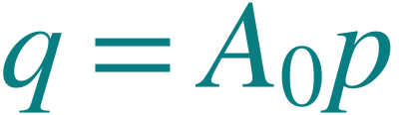
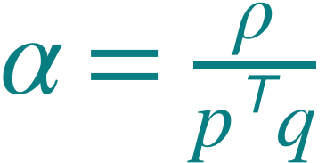
PCG turns a V-cycle correction into a search step
PCG correction
Initialize
p: direction
α: step length
δ: correction so far
Precondition
CPU MVM
PCG arithmetic: CPU
Vcycle invokes
optical products.
Step length
Update
The original full estimate x stays fixed until this correction solve returns δ.
Browser solver; PCG recurrence
11
Notes:
The fixed RHS r is the outer residual for this PCG call. δ starts at zero. s is the residual of this correction problem. z is one V-cycle result. q=A0p is a high-precision CPU MVM, not the optical smoothing MVM. The ordering q before alpha is essential. The next slide completes the recurrence and stopping branches.
Sources: web/index.html: PhotonicSolver numerical core and embedded sparse matrix data; PCG recurrence

Slide 12
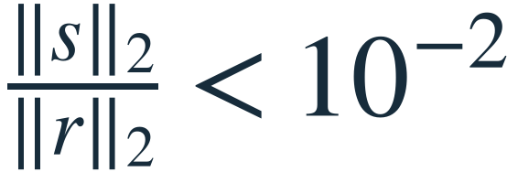
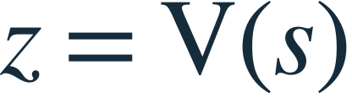
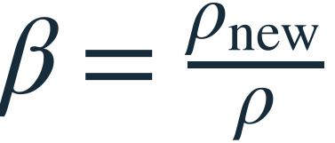
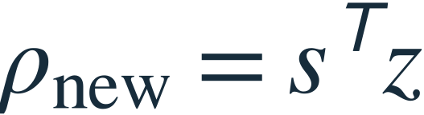
PCG stopping and direction updates
PCG correction
yes
Return δ to outer loop
no
At the cap, return current δ.
Outer true residual
still decides success.
Next iteration: q = A₀p
z = Vcycle(s) is an action approximating A₀⁻¹s. No inverse matrix is explicitly stored.
Browser solver; browser inner limit: 20 iterations
12
Notes:
Browser exact branch order: after δ and s updates compute ||s||/||r||. If below1e-2 returnδ. Otherwise compute another V-cycle, beta and direction update even on the final capped iteration, then the loop exits after20. The appendix records this detail. main.py instead calls SciPy CG with maxiter5 and rtol1e-12. Numerical breakdown is distinct from convergence.
Sources: web/index.html: PhotonicSolver numerical core and embedded sparse matrix data; browser inner limit: 20 iterations

Slide 13
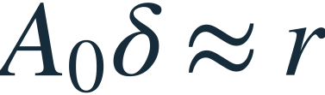

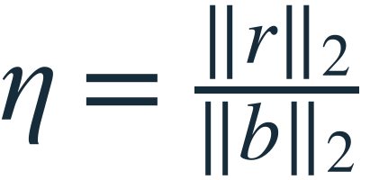

Outer correction and true-residual checks
True residual check
Start with current x
PCG correction solve
η below outer tolerance?
yes
Return converged x
no, and budget remains
Limit or numerical error: return an unverified approximation with its status, never label it converged.
Browser solver; main.py solve_with_restarts
13
Notes:
Browser: outer loop at most10 corrections; tolerance1e-12; after the final correction it recomputes true residual and distinguishes converged/limit. main.py uses at most100 restarts, tolerance1e-10, and the run report recomputes final residual. Breakdown is a separate failure state. Fresh outer r is not a recycled inner residual. This is how correction quality is checked despite approximate inner products.
Sources: web/index.html: PhotonicSolver numerical core and embedded sparse matrix data; main.py solve_with_restarts

Slide 14
The hierarchy is fixed while its vectors change
Browser operator inventory: 4 A matrices + 3 P matrices + 3 R matrices
Level | Operator and nonzeros | Prolongation Pℓ | Restriction Rℓ | Assignment
0 | A₀: 64 × 64, 190 | 64 × 22 | 22 × 64 | A: optics + CPU
1 | A₁: 22 × 22, 64 | 22 × 8 | 8 × 22 | A: optics + CPU
2 | A₂: 8 × 8, 22 | 8 × 3 | 3 × 8 | A: optics + CPU
3 | A₃: 3 × 3, 7 | — | — | CPU direct solve
The CPU retains separate local vectors at each level. Coarse vectors are coefficients in algebraic spaces.
Browser solver; Galerkin and transpose identities verified
14
Notes:
Setup creates all A,P,R and omega values. A_next=R A P and R=P transpose are verified against the stored browser matrices. Optical copies of A0,A1,A2 serve smoothing; CPU copies compute reliable level residuals. A3 is a CPU direct solve. P,R are only digital. All ten browser operators appear in the appendix with values and sparsity. Coarsest omega is stored but unused.
Sources: web/index.html: PhotonicSolver numerical core and embedded sparse matrix data; Galerkin and transpose identities verified

Slide 15
Convergence of the ideal browser model
Ideal 1D model. Zero starting guess. Target 10⁻¹².
Final η = 3.17 × 10⁻¹³ 180 optical calls 111 digital calls 10 V-cycles
Browser solver; fresh zero-start execution
15
Notes:
Reproduced the browser core without modifying it. Five outer corrections, ten top-level V-cycles,180 optical and111 digital calls, relative residual3.1704180357133085e-13. Plot left shows actual true residual history. Right shows final error against the analytic quadratic, not merely two visually overlapping solution curves. Counts include different matrix sizes and are not runtime weights.
Sources: web/index.html: PhotonicSolver numerical core and embedded sparse matrix data; fresh zero-start execution

Slide 16
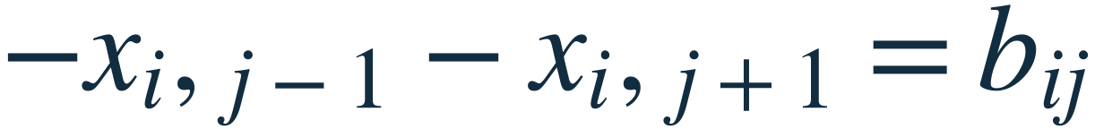
The separate 2D noisy experiment
main.py: 4096 unknowns, two AMG levels, input quantization and output noise
4xᵢⱼ − xᵢ₋₁,ⱼ − xᵢ₊₁,ⱼ
+2
−2
64 × 64 interior grid; exterior x = 0
Verified relative residual: 3.96 × 10⁻¹¹. Relative solution error: 6.95e-13.
main.py · recorded numerical run
16
Notes:
Actual64×64 positive discrete Laplacian with zero exterior values and signed source strips at rows21 and42, columns16through47. These are source terms, not prescribed-potential internal boundaries. Coordinates and amplitudes use the code unscaled stencil units. Displayed center-column profile is taken from the full computed2D field. Independent sparse direct solution is used only as evaluation reference. Main source SHA and versions are in research/main-data.json.
Sources: main.py: original solver, observed by presentation/build/collect_python.py

Slide 17
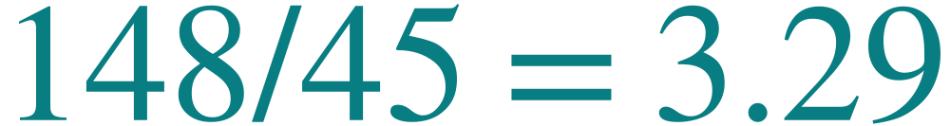
Counted digital products in the 2D run
Same 2D problem and final relative-residual target 10⁻¹⁰. Counter scope matters.
Method | Digital A calls | Analog A calls | True relative residual
Plain CG | 148 | 0 | 7.8 × 10⁻¹¹
Digital MG–CG | 60 | 0 | 6.1 × 10⁻¹¹
Noisy hybrid + restarts | 45 | 60 | 4.0 × 10⁻¹¹
Ratio of counted digital products
No measured hardware speedup
Transfers and repeated 704 × 704 coarse solves are excluded. Browser counts use a different convention.
main.py · recorded numerical run; one controlled run, setup seed 0
17
Notes:
Plain148, digitalMG60, hybrid45 counted digital products; hybrid60 analog calls. Relative residuals independently observed: plain7.8e-11,digital6.1e-11,hybrid3.961e-11. Hybrid is69.6% fewer fine-grid digital products versusplain,25% versusdigitalMG. Excluded costs: setup,power iteration,P/R transfers,coarse spsolve, scalar/vector work, reporting residual,DAC/ADC,memory,calibration. Coarse matrix704×704 means excluded coarse cost can be material. No runtime or energy claim.
Sources: main.py: original solver, observed by presentation/build/collect_python.py; one controlled run, setup seed 0

Slide 18
Implemented behavior and open questions
Implemented and checked | Still to establish
Nested residual / CG / multigrid computation | Variable-preconditioner convergence across trials
Input quantization and additive noise in main.py | Calibration against measured optical errors
Fixed matrix blocks and CPU feedback in demonstrator | Signed encoding, sparse tiling, and physical routing
True residuals and algorithmic counters | End-to-end latency and energy, including transfers
Related work: Zhu et al. (2024) provides a coherent signed-MVM architecture with digital memory and control.
main.py · recorded numerical run; web/README.md; Lee Methods
18
Notes:
Paper-inspired structure is implemented, not an exact hardware reproduction. main.py quantizes the input and adds fresh Gaussian output noise. It has no matrix quantization, physical encoding, averaging or timing. Browser uses ideal MVMs and a functional shared-converter diagram. Classical PCG assumptions are not guaranteed under noisy variable asymmetric preconditioning. Zhu related work supports coherent signed multiplication with digital memory/reconfiguration, not a claimed replacement for the current multigrid code. References: https://arxiv.org/pdf/2511.01005; https://doi.org/10.1021/acsphotonics.3c01694.
Sources: main.py: original solver, observed by presentation/build/collect_python.py; web/README.md; Lee Methods

Slide 19
Next validation: full computational cost
Optics computes matrix–vector products.
The CPU builds and verifies the solution.
Residual check
What remains unsatisfied?
Approximate correction
Which inexpensive products help?
True-residual verification
Did the equations improve?
Next: calibrated noise + repeated trials + full cost accounting, with the same sparse operators.
main.py · recorded numerical run; web/README.md
19
Notes:
Close on the scientific contribution and next validation. The method works for the reported cases. A next experiment should retain identical matrices and compare calibrated noisy MVM/preconditioner variants over repeated seeds, use independently recomputed residuals, and include coarse factorization, transfers, memory/conversion overhead in time/energy accounting. Do not promise an outcome. Main talk ends here; the following slides are technical backup.
Sources: main.py: original solver, observed by presentation/build/collect_python.py; web/README.md

Slide 20
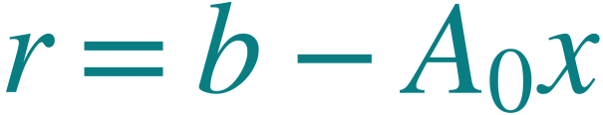
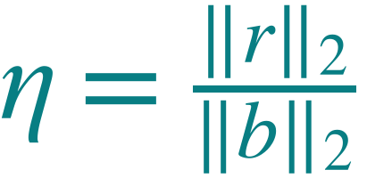
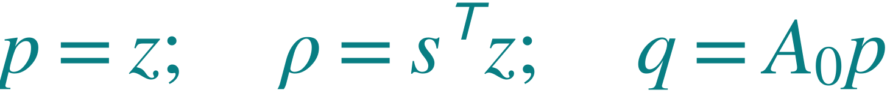


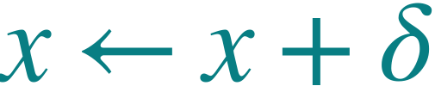
Complete recurrence and termination conditions
Technical appendix: browser configuration
Outer correction
PCG correction
Measure the true residual
Initialize and precondition
Check convergence
Choose direction and step
Approximately solve
Calculate step length
Update the full solution
Update correction and residual
Outer: 10⁻¹² target, 10 corrections. PCG: 10⁻² relative target, 20 steps; direction update on slide 12.
Technical appendix / Browser solver
20
Notes:
Exact algebraic recurrence of the browser core. Index k counts completed PCG iterations. rho_new overwrites rho after beta. At the capped final iteration, the source still computes its next V-cycle and direction before returning. Breakdown checks nonfinite alpha and positive pTq. Outer loop distinguishes convergence and limit.
Sources: web/index.html: PhotonicSolver numerical core and embedded sparse matrix data

Slide 21
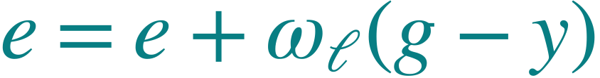
Recursive V-cycle and smoothing pseudocode
Every operation belongs to a CPU or optical assignment
V(l, g):
if l = 3: return solve(A₃, g)
e = 0
repeat 3 times: e = Smooth(l, e, g)
d = g − Aℓe [CPU]
gc = Rℓd [CPU]
ec = V(l + 1, gc)
e = e + Pℓec [CPU]
repeat 3 times: e = Smooth(l, e, g)
return e
Smooth(l, e, g):
encode e
y = Aℓe [optical]
detect y
[CPU]
return e
At level 0, g₀ = s and V(0, s) returns z. The outer solution x is separate.
Technical appendix / Browser solver
21
Notes:
V(l,g) returns a local correction. R_l=P_l transpose. The coarse solve uses elimination, not an explicit inverse. CPU computes d and all transfer products. e starts at zero only on V-cycle entry; post-smoothing starts from the corrected value. Main2D cycle differs and is shown later.
Sources: web/index.html: PhotonicSolver numerical core and embedded sparse matrix data

Slide 22
Fine operators A₀ and A₁
A₀: 64 × 64, 190 nonzeros. A₁: 22 × 22, 64 nonzeros.
A₀ fixed
CPU residuals
Optical smoothing
A₁ fixed
CPU residuals
Optical smoothing
i / j | 1 | 2 | 3 | 4
1 | 8450.000 | -4225.000 | 0.000 | 0.000
2 | -4225.000 | 8450.000 | -4225.000 | 0.000
3 | 0.000 | -4225.000 | 8450.000 | -4225.000
4 | 0.000 | 0.000 | -4225.000 | 8450.000
i / j | 1 | 2 | 3 | 4
1 | 1313.952 | -401.563 | 0.000 | 0.000
2 | -401.563 | 938.692 | -466.913 | 0.000
3 | 0.000 | -466.913 | 938.836 | -469.236
4 | 0.000 | 0.000 | -469.236 | 938.884
Upper-left 4 × 4 excerpt; rounded to 3 decimals
Upper-left 4 × 4 excerpt; rounded to 3 decimals
Technical appendix / Browser solver
22
Notes:
Actual stored matrices. Sparsity panels show every nonzero; tables are labeled excerpts, not complete matrices. A0=h^-2 tridiag(−1,2,−1), h=1/65. All entries are retained in embedded browser CSR data.
Sources: web/index.html: PhotonicSolver numerical core and embedded sparse matrix data

Slide 23
Coarse operators A₂ and A₃
Full matrices shown. Entries rounded to 3 decimals.
i / j | 1 | 2 | 3 | 4 | 5 | 6 | 7 | 8
1 | 151.590 | -25.182 | 0.000 | 0.000 | 0.000 | 0.000 | 0.000 | 0.000
2 | -25.182 | 104.692 | -52.098 | 0.000 | 0.000 | 0.000 | 0.000 | 0.000
3 | 0.000 | -52.098 | 104.328 | -52.164 | 0.000 | 0.000 | 0.000 | 0.000
4 | 0.000 | 0.000 | -52.164 | 104.328 | -52.164 | 0.000 | 0.000 | 0.000
5 | 0.000 | 0.000 | 0.000 | -52.164 | 104.328 | -52.164 | 0.000 | 0.000
6 | 0.000 | 0.000 | 0.000 | 0.000 | -52.164 | 104.328 | -52.111 | 0.000
7 | 0.000 | 0.000 | 0.000 | 0.000 | 0.000 | -52.111 | 104.642 | -25.125
8 | 0.000 | 0.000 | 0.000 | 0.000 | 0.000 | 0.000 | -25.125 | 153.967
i / j | 1 | 2 | 3
1 | 15.416 | -1.094 | 0.000
2 | -1.094 | 11.671 | -4.847
3 | 0.000 | -4.847 | 17.878
A₃ (3 × 3)
CPU direct solve
A₂ (8 × 8): optical smoothing + digital residuals
Technical appendix / Browser solver
23
Notes:
Complete numerical matrices, rounded to3decimals. A2 has22 nonzeros, A3 has7. Original sparse matrices remain full precision. A3 direct solve is CPU-only. No inverse is formed.
Sources: web/index.html: PhotonicSolver numerical core and embedded sparse matrix data

Slide 24
Transfer operators P₀ and R₀
P₀: 64 × 22. R₀: 22 × 64. Fixed algebraic transfer operators.
coarse
correction
to fine
fine residual to coarse: gnext = R d
i / j | 1 | 2 | 3 | 4
1 | 0.447 | 0.000 | 0.000 | 0.000
2 | 0.446 | 0.156 | 0.000 | 0.000
3 | 0.299 | 0.349 | 0.000 | 0.000
4 | 0.000 | 0.572 | 0.000 | 0.000
5 | 0.000 | 0.415 | 0.183 | 0.000
i / j | 1 | 2 | 3 | 4 | 5
1 | 0.447 | 0.446 | 0.299 | 0.000 | 0.000
2 | 0.000 | 0.156 | 0.349 | 0.572 | 0.415
3 | 0.000 | 0.000 | 0.000 | 0.000 | 0.183
4 | 0.000 | 0.000 | 0.000 | 0.000 | 0.000
Numerical excerpts: first rows / columns. Full patterns above; zeros outside these excerpts are not implied.
Technical appendix / Browser solver
24
Notes:
Every nonzero is shown in the sparsity views. Selected numerical entries below are excerpts. R=P transpose exactly in stored data. These operators do not change during the solve, and both matrix-vector operations are digital.
Sources: web/index.html: PhotonicSolver numerical core and embedded sparse matrix data

Slide 25
Transfer operators P₁ and R₁
P₁: 22 × 8. R₁: 8 × 22. Fixed algebraic transfer operators.
coarse
correction
to fine
fine residual to coarse: gnext = R d
i / j | 1 | 2 | 3 | 4
1 | 0.306 | 0.000 | 0.000 | 0.000
2 | 0.408 | 0.181 | 0.000 | 0.000
3 | 0.313 | 0.376 | 0.000 | 0.000
4 | 0.000 | 0.577 | 0.000 | 0.000
5 | 0.000 | 0.395 | 0.193 | 0.000
i / j | 1 | 2 | 3 | 4 | 5
1 | 0.306 | 0.408 | 0.313 | 0.000 | 0.000
2 | 0.000 | 0.181 | 0.376 | 0.577 | 0.395
3 | 0.000 | 0.000 | 0.000 | 0.000 | 0.193
4 | 0.000 | 0.000 | 0.000 | 0.000 | 0.000
Numerical excerpts: first rows / columns. Full patterns above; zeros outside these excerpts are not implied.
Technical appendix / Browser solver
25
Notes:
Every nonzero is shown in the sparsity views. Selected numerical entries below are excerpts. R=P transpose exactly in stored data. These operators do not change during the solve, and both matrix-vector operations are digital.
Sources: web/index.html: PhotonicSolver numerical core and embedded sparse matrix data

Slide 26
Transfer operators P₂ and R₂
Full final transfer pair. R₂ = P₂ᵀ. Both operations run on the CPU.
i / j | 1 | 2 | 3
1 | 0.2263 | 0.0000 | 0.0000
2 | 0.3424 | 0.2010 | 0.0000
3 | 0.3205 | 0.3753 | 0.0000
4 | 0.0000 | 0.5773 | 0.0000
5 | 0.0000 | 0.3754 | 0.2405
6 | 0.0000 | 0.2020 | 0.4377
7 | 0.0000 | 0.0000 | 0.4885
8 | 0.0000 | 0.0000 | 0.1654
i / j | 1 | 2 | 3 | 4 | 5 | 6 | 7 | 8
1 | 0.2263 | 0.3424 | 0.3205 | 0.0000 | 0.0000 | 0.0000 | 0.0000 | 0.0000
2 | 0.0000 | 0.2010 | 0.3753 | 0.5773 | 0.3754 | 0.2020 | 0.0000 | 0.0000
3 | 0.0000 | 0.0000 | 0.0000 | 0.0000 | 0.2405 | 0.4377 | 0.4885 | 0.1654
P₂e₃ has 8 entries.
R₂d₂ has 3 entries.
Technical appendix / Browser solver
26
Notes:
Complete final transfer pair rounded to4decimals. This is an algebraically constructed interpolation matrix, not simple averaging or selection of every nth physical sample.
Sources: web/index.html: PhotonicSolver numerical core and embedded sparse matrix data

Slide 27
The 2D experiment uses four fixed sparse matrices
main.py hierarchy from the measured run; distinct from the browser matrices
A: 4096 × 4096
20,224 nonzeros
P: 4096 × 704
10,116 nonzeros
R: 704 × 4096
10,116 nonzeros
Ac: 704 × 704
6,096 nonzeros
A = I₆₄ ⊗ T₆₄ + T₆₄ ⊗ I₆₄ Ac = RAP R = Pᵀ
T₆₄ = tridiag(−1, 2, −1). Patterns use 64 × 64 occupancy bins. Coarse solve: CPU.
Technical appendix / main.py · recorded numerical run
27
Notes:
All four stored matrices of main.py: A,P,R,Ac. Matrix A has4096rows,20224nnz. P4096x704 with10116nnz, R transpose, Ac704square6096nnz. A=I64 kronT64 +T64 kronI64 with T tridiag−1,2,−1. The occupancy views bin sparse indices into64x64 cells for legibility; a colored bin indicates at least one nonzero, not a literal matrix entry. Identity is notation, not a separately allocated solver matrix.
Sources: main.py: original solver, observed by presentation/build/collect_python.py

Slide 28
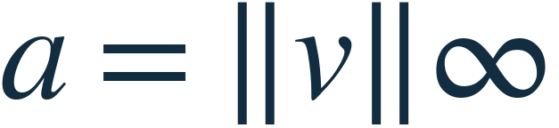
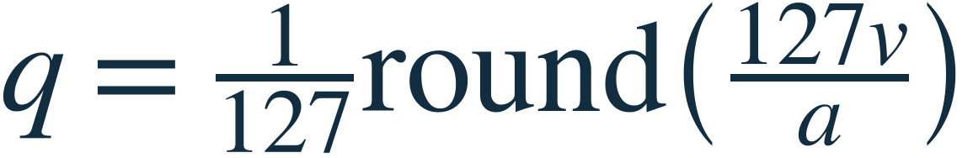
The noisy smoother has a specific software model
main.py: input quantization + independent Gaussian output noise
If a = 0, return zero.
Four pre-sweeps begin with e = ωg, then use three analog MVMs.
No post-smoothing in the hybrid configuration.
Not modeled: matrix quantization, optical averaging, device drift, saturation, conversion timing, or energy.
Technical appendix / main.py · recorded numerical run
28
Notes:
Exact noisy_mvm implementation: scale ismaxabs(v), zero input returnszeros; q=round(127v/scale)/127; y=4scale[(Aq)/4+Gaussian(0,.045²)]. No separate matrix quantization or256-repeat averaging. Main smooth initializes e=omega*rhs, algebraically skippingA@0, so4pre sweeps callanalogMVM3times. Each hybrid V-cycle computes residualdigitally, restricts, does spsolve, prolongs, and returns withoutpostsmoothing.
Sources: main.py: original solver, observed by presentation/build/collect_python.py

Slide 29
Settings and counter definitions
Setting | main.py hybrid | Browser
Outer target / cap | 10⁻¹⁰ / 100 restarts | 10⁻¹² / 10 corrections
Inner CG target / cap | 10⁻¹² / 5 steps | 10⁻² / 20 steps
Smoothing | 4 pre / 0 post | 3 pre / 3 post
Digital counter | Fine A wrapper calls | Aℓ, Pℓ and Rℓ calls
Zero-input smoothing | First product skipped | Explicitly counted
Coarse solve | 704 × 704 sparse solve | 3 × 3 direct solve
Convergence evidence | Independent true residual | True residual + terminal status
Technical appendix / main.py; web/index.html; source-level review
29
Notes:
main.py uses SciPy CG with inner rtol1e-12 and maximum5steps in each outer restart, tolerance1e-10 maximum100restarts. Browser inner rtol1e-2maximum20,outer1e-12maximum10. main counter includes fineA exact/noisy wrappers only; excludes setup/diagnostics/transfers/coarsesolve. Browser countsdigital A,R,P, plus opticalA and convertercalls. Neither is a complete hardware cost model. main.py ignores info codes; reported convergence independently checked.
Sources: main.py; web/index.html; source-level review

Slide 30
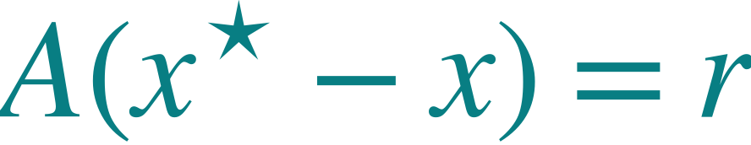
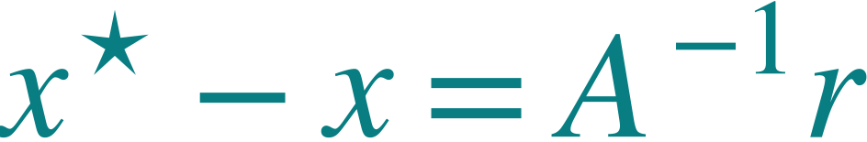
Convergence theory and observed results
Classical PCG assumes a fixed, linear, SPD preconditioner.
Noise and quantization make this V-cycle variable.
A small residual measures satisfaction of the discrete equations.
Solution error also depends on conditioning. PDE error also depends on discretization.
Technical appendix / SciPy CG documentation; main.py; web/index.html
30
Notes:
SciPy CG requires Hermitian positive definiteA and a Hermitian positive definite preconditioner. The standard fixed linear SPD-preconditioner argument doesnot transfer automatically to this noisy, quantized, asymmetric action. This run converges empirically. A nextcomparison should include flexibleKrylov formulations and multiple noise realizations. https://docs.scipy.org/doc/scipy/reference/generated/scipy.sparse.linalg.cg.html . Residual-error relation is exact for invertibleA; conditioning and discretization remain distinct.
Sources: SciPy CG documentation; main.py; web/index.html

Slide 31
Related work: Zhu’s coherent processor
Aspect | Lee-inspired project | Zhu related work
Numerical emphasis | Multigrid inside Krylov + residual correction | Fixed-point iteration with error management
Optical assignment | Smoothing matrix–vector products | Coherent signed products
Electronics | Residuals, vectors, transfers, control | Memory, reconfiguration, control
Project status | Numerical emulation and ideal demonstrator | Architecture reference; not reproduced
Common principle: approximate optical linear operations cooperate with digital state and correction.
Technical appendix / Zhu et al., ACS Photonics 11, 1189–1196 (2024)
31
Notes:
Relatedwork only. Verified publisherabstract describes coherent analogue cores that perform signed multiplication, digital electronics for memory/reconfigurability, and error management for finite-difference PDEs. The supplementary-information listing explicitly covers fixed-point Richardson and Jacobi with residuecorrection. We do not claim a reproduction of that hardware, exact PDE geometry, bitdepth, or iteration schedule. Source:https://doi.org/10.1021/acsphotonics.3c01694. Fullpaywalledarticle wasnotused for detailednumericalclaims.
Sources: Zhu et al., ACS Photonics 11, 1189–1196 (2024)

Slide 32
The actual two-level cycle in main.py
4096 → 704. Hybrid: four pre-sweeps, no post-smoothing.
e = Smooth(g, 4 sweeps) [3 analog calls]
Digital baseline:
2 pre + 2 post
Plain / digital CG:
solve Ax = b
Hybrid only:
short correction solves
with outer restarts
d = g − Ae [digital residual]
gc = Rd; solve Ac ec = gc [CPU]
e ← e + Pec [digital prolongation]
Hybrid: return e [no post-smoothing]
The coarse solver runs on a 704 × 704 matrix each cycle. Its cost is absent from the MVM counters.
Technical appendix / main.py · recorded numerical run
32
Notes:
Exact main.py V-cycle. smooth(g,mvm,pre) starts e=omega*g, then applies pre-1 updates. The residual d=g−A e is digital. RestrictionR, coarse spsolveAc, and prolongationP are digital. For digital2/2, post smoothing is applied as a correction to the existing e: e+=smooth(g−A e,exact_mvm,2). This equals two Richardson post-updates in exact arithmetic. Hybrid4/0returnswithoutpost. PlainCG anddigitalMGCGsolveAx=bdirectly; onlyhybridusesouterrestartscorrectionloop.
Sources: main.py: original solver, observed by presentation/build/collect_python.py

Slide 33

Setup constructs operators before iteration starts
Discretize: A, b
Build AMG: P, R, RAP
Choose ω; load fixed weights
Browser level | Stored relaxation weight | Use
0 | 5.92061673e-05 | Richardson smoothing
1 | 0.000534826731 | Richardson smoothing
2 | 0.0049999113 | Richardson smoothing
3 | 0.0485813754 | Unused: direct solve
main.py
30 power iterations
During the solve: A, P, R, and ω stay fixed. Only solution, residual, and correction vectors change.
Technical appendix / Browser solver; main.py PyAMG setup
33
Notes:
Hierarchy is constructed before reported solver counters. PyAMG smoothed aggregation formsP,R and Galerkincoarseoperators. Browser ships these matrices asCSRarrays; allsetupiscompletebeforevisualized solve. Source smoother.py computesweightsbyeigsh. main.py estimatesfineoperator spectralradiusby30poweriterationsusing itsseededgenerator. Stored browsercoarsestomega isunusedbecauselevel3directsolve. Setup isnot countedinthe reportedMVMs.
Sources: web/index.html: PhotonicSolver numerical core and embedded sparse matrix data; main.py PyAMG setup

Slide 34
True residuals contract across noisy restarts
main.py noisy hybrid. Each correction solve has at most five CG steps.
Four corrections
20 V-cycles
60 analog calls
Observed convergence for this seeded run; robustness across noise realizations remains to be measured.
Technical appendix / main.py · recorded numerical run; independently recomputed residual history
34
Notes:
The histogram is not reconstructed from CG recursive residuals. At each accumulatedoutercorrection,weindependentlycompute||b−Ax||/||b||withthesparseA. FourcorrectioncallswithfiveCGstepseachproduce20Vcycles and60analogcalls. Theouterloopthenchecksconvergence. Monitoring MVMs areanalysisdiagnostics andnotinsertedintotheoriginalcounter. Plot usesa truelogarithmicverticalaxis.
Sources: main.py: original solver, observed by presentation/build/collect_python.py; independently recomputed residual history

Slide 35
Sources and reproducibility
Lee et al. (2025), Integrated photonic multigrid solver for partial differential equations
arXiv:2511.01005
Zhu et al. (2024), Coherent General-Purpose Photonic Matrix Processor
ACS Photonics 11, 1189–1196. DOI: 10.1021/acsphotonics.3c01694
Repository evidence: main.py and web/index.html
Browser: all three initial guesses reproduced.
2D: original noise generator seed 0; PyAMG setup fixed with NumPy seed 0.
Run environment: numpy 2.5.2, scipy 1.18.1, pyamg 5.3.0
Source SHA-256: 1dd6d0bcfa05058dbdf3730a…
Technical appendix / Primary papers, current source code, and recorded numerical runs
35
Notes:
Primarymethodsource Leehttps://arxiv.org/pdf/2511.01005. Zhuhttps://doi.org/10.1021/acsphotonics.3c01694. BackgroundShewchukhttps://www.cs.cmu.edu/~quake-papers/painless-conjugate-gradient.pdf. Presentationdesignreferenceshttps://writing.engr.psu.edu/AE_Student_Classroom_Notes.pdf andhttps://catalyst.harvard.edu/writing-communication-center/visualize-science/slides/. Compared publicmultigridtutorialhttps://sites.cs.ucsb.edu/~gilbert/cs219/cs219Spr2018/Slides/cs219-12-mgtut_part2.pdf. No publishedslideartworkcopied. All numericalcharts use recordedsourcevalues.
Sources: Primary papers, current source code, and recorded numerical runs

