Slide 1
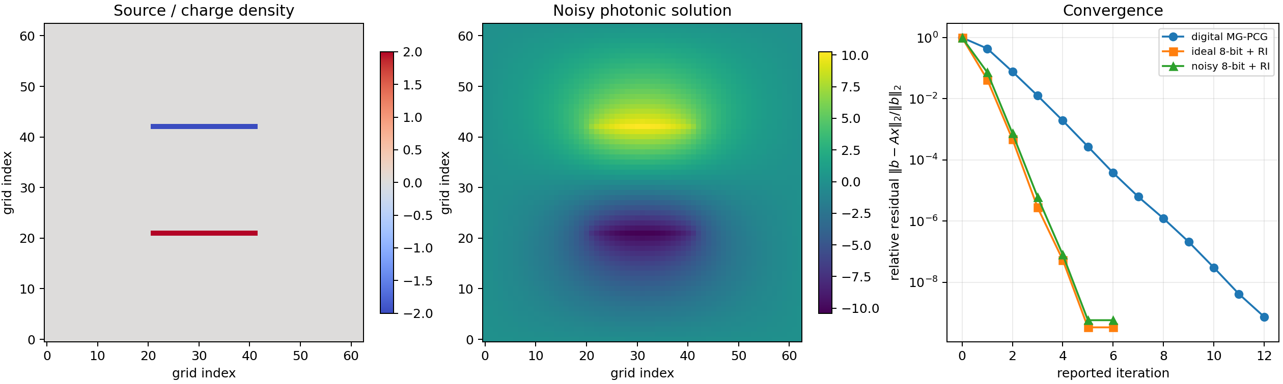
RESEARCH PROGRESS • SEPTEMBER 2026
Mixed-Precision
Photonic PDE Solver
From a finite-difference PDE to multigrid-PCG, then to a noisy low-precision photonic smoother.
Samarth Dubey
01
Notes:
Open with the goal: not merely solving a PDE digitally, but identifying exactly which repeated linear operation can be executed by photonic hardware without sacrificing final accuracy.
[Sources]
- Lee et al., Integrated photonic multigrid solver for partial differential equations (uploaded manuscript).
- Simulation results generated from photonic_pde_solver.py.

Slide 2
CURRENT STATE
The project now has a working algorithmic spine
PDE
Sparse Ax = b
Multigrid + PCG
Photonic MVM model
What the uploaded code already did
What is implemented now
• 1D Poisson operator
• PyAMG hierarchy and V-cycle
• Richardson smoother
• Hand-written PCG and outer residual correction
• 2D parallel-plate Poisson problem
• Explicit digital vs photonic MVM paths
• 8-bit quantization + Gaussian noise
• Asymmetric photonic V-cycle + MVM accounting
Uploaded smoother.py; extended simulation
02
Notes:
Be precise: the old script was a valid 1D Poisson/steady-heat skeleton, not a 2D heat-transfer simulation. The new version upgrades the dimensionality and, more importantly, makes the hardware approximation explicit.
[Sources]
- Uploaded smoother.py.
- Lee et al., Methods: Richardson smoother, residual iteration, noisy fixed-point operations.

Slide 3
PHYSICS → NUMERICS
The PDE becomes one sparse linear system
Why the matrix is photonics-friendly
Continuous equation
∇²u(y,z) = f(y,z)
3,969
unknowns on a 63×63 interior grid
Five-point finite difference
−4uᵢⱼ + uᵢ₊₁,ⱼ + uᵢ₋₁,ⱼ
+ uᵢ,ⱼ₊₁ + uᵢ,ⱼ₋₁ = h²fᵢⱼ
≈5 nonzeros
per row for the Laplacian stencil
Electrostatics: u = potential, f = charge.
Heat: u = temperature, f = heat generation.
Flatten (i,j) into one index → A u = b
Lee et al., Eq. 9–10; simulation grid N=63
03
Notes:
Explain that the photonic hardware never 'sees a PDE'. It receives vectors and stored/streamed matrix coefficients. The physics enters while constructing A and b; the accelerator only performs matrix-vector products.
[Sources]
- Lee et al., Parallel capacitor method, Eqs. (9)–(10).
- Zhu et al., ACS Photonics 2024, finite-difference Poisson example.

Slide 4
MULTIGRID
Multigrid attacks each error at the scale where it is easy
Fine grid
pre-smooth
Updated fine
solution
Restrict
residual
Prolongate
correction
Coarse
solve
Richardson smoother
Fine grid: oscillatory error is rapidly damped.
xₖ₊₁ = xₖ + ω(b − Axₖ)
Coarse grid: slowly varying error becomes oscillatory and easy.
Photonic paper: four pre-smoothing steps, no post-smoothing
04
Notes:
Use the language of Fourier/error modes. Richardson smoothing suppresses eigenmodes associated with large eigenvalues, which correspond to high spatial frequencies for the Laplacian. Restriction moves the remaining smooth error to a coarse grid.
[Sources]
- Lee et al., Fig. 1c, Fig. 2a and Eq. (3).
- Lee et al., asymmetric mixed-precision V-cycle description.

Slide 5
KRYLOV SOLVER
CG avoids undoing its own work; PCG supplies better directions
PCG iteration
CG minimizes a quadratic
φ(x) = ½xᵀAx − bᵀx
1 rₖ = b − Axₖ
2 zₖ = M⁻¹rₖ ← multigrid V-cycle
3 αₖ = (rₖᵀzₖ)/(pₖᵀApₖ)
4 xₖ₊₁ = xₖ + αₖpₖ
5 pₖ₊₁ = zₖ₊₁ + βₖpₖ
Residual = negative gradient
rₖ = b − Axₖ
Conjugacy condition
pᵢᵀ A pⱼ = 0 for i ≠ j
Each exact direction corrects one independent component without reviving earlier error.
Important caveat
A noisy asymmetric preconditioner weakens standard PCG guarantees; practical restarts or flexible Krylov methods should be tested.
M⁻¹ is one approximate multigrid solve, not an explicit matrix inverse
05
Notes:
Teach the central idea: steepest descent repeatedly zig-zags; CG selects A-conjugate directions. Preconditioning changes coordinates so the eigenvalues cluster and the quadratic becomes more spherical. In code, z=v_cycle(r).
[Sources]
- Standard conjugate-gradient and preconditioned conjugate-gradient recurrences.
- Lee et al., photonic multigrid preconditioner with CG.

Slide 6
OLD PAPER ARCHITECTURE
The old paper accelerates only the multigrid smoother
Digital CG
residual + scalars
Photonic V-cycle
Aₗx in Richardson
Digital P / R
coarse solve
Better search
direction zₖ
9×3 optical crossbar
Mixed precision is the bargain
EAMs encode vector amplitudes; tunable absorbers store matrix weights; photodetectors sum the products.
Low precision removes enough error quickly. High-precision digital residuals prevent analog error from setting the final accuracy floor.
2 GS/s
8-bit + σ = 0.045
DAC / ADC interface
paper’s noisy fixed-point emulation
Lee et al., Figs. 1d and 2b; Methods
06
Notes:
Stress that optics is not replacing the whole solver. It offloads the repeated fixed-weight A_l x inside smoothing. The host still computes reliable residuals, restrictions, prolongations, scalar products, and the tiny coarse solve.
[Sources]
- Lee et al., Integrated photonic multigrid solver, Figs. 1d and 2b.
- Lee et al., Experimental setup and Digital Noisy Fixed-Point Operations.

Slide 7
IMPLEMENTATION
The simulation now separates the algorithm from hardware error
Digital high precision
Photonic low precision
Digital coarse solve
• A p in PCG
• true residual b − Ax
• restriction / prolongation
• vector dot products
• normalize to [−1,1]
• signed 8-bit quantization
• detector noise σ=0.045
• Aₗx inside smoothing
• smallest AMG level
• dense direct solve
• negligible at scale
• clean correction anchor
Paper-like V-cycle: 4 pre-sweeps, 0 post-sweeps
Reproducible RNG, MVM counters, reference solution, convergence plot
photonic_pde_solver.py
07
Notes:
Walk through the call graph: residual_refinement → inner PCG → preconditioner(r) → V-cycle → photonic A_l x. This makes it possible to swap in a measured hardware transfer function later without rewriting the solver.
[Sources]
- Extended photonic_pde_solver.py generated for this project.
- Lee et al., Methods for fixed-point emulation and residual iteration.

Slide 8
SIMULATION RESULT
Noisy 8-bit smoothing still reaches high precision after correction
5.7×10⁻¹⁰
final relative residual
119
digital MVMs
324
photonic MVMs
One seeded run; architecture model, not a calibrated hardware prediction.
N=63; 8-bit operands; σ=0.045; residual refinement enabled
08
Notes:
Do not oversell the number. The useful result is qualitative: analog-like smoothing can be inaccurate locally yet useful globally when wrapped by reliable residual replacement. The exact speedup is not established because ADC/DAC, data movement, and noise calibration are not yet modeled.
[Sources]
- Simulation output generated by photonic_pde_solver.py.
- Lee et al., noisy 8-bit emulation parameter sigma=0.045.

Slide 9
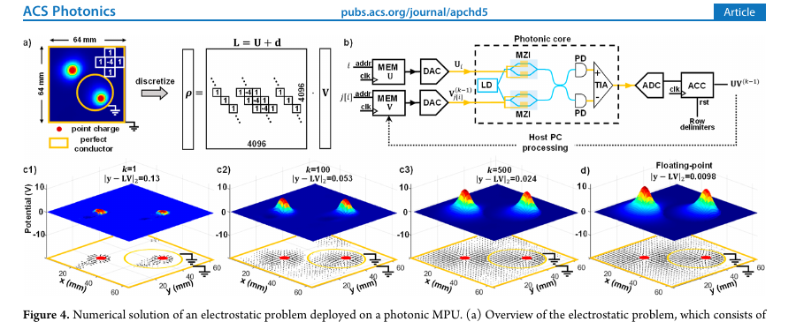
NEW PAPER: ZHU ET AL.
The new paper streams a sparse matrix through a coherent core
1 CSR streaming
Nonzero Uᵢ values go to one optical port; column indices fetch Vⱼ from FPGA memory.
2 Coherent signed MAC
Balanced detection produces 2 Re(Eₐ*Eₓ); optical modes accumulate the dot product.
3 Weighted Jacobi
Only U V is optical. Every five iterations, a digital residual correction resets drift.
Zhu et al., ACS Photonics 11, 1189–1196 (2024), Fig. 4
09
Notes:
Contrast with the old paper. Here the photonic core is general-purpose and dynamically programmed: both matrix nonzeros and vector values are streamed. The old paper stores fixed matrix weights in an in-memory crossbar and uses the core specifically as a multigrid smoother.
[Sources]
- Zhu et al., Coherent General-Purpose Photonic Matrix Processor, ACS Photonics 2024, Fig. 4 and Eq. (6).
- Zhu et al., Principle of Operation and Software Backend sections.

Slide 10
NEXT STEPS
Four experiments will test the architecture
Noise model
Fit quantization and output noise to measured NMSE / bit-equivalent precision.
Solver theory
Compare PCG with flexible CG or FGMRES under stochastic asymmetric preconditioning.
Paper reproduction
Implement Zhu et al.’s 64×64 CSR weighted-Jacobi solver and 5-step residual correction.
Hardware budget
Count DAC/ADC, memory movement, optical averaging, latency, and energy—not only MVMs.
Working conclusion
Photonics is most useful as an imperfect, extremely fast operator inside a numerically disciplined digital solver.
10
Notes:
Close by asking for guidance on the most valuable next reproduction: exact old-paper photonic multigrid calibration, or the newer sparse-Jacobi coherent MPU. Mention the PCG-theory caveat as a possible research direction rather than a flaw to hide.
[Sources]
- Synthesis of Lee et al. and Zhu et al.
- Proposed next experiments derived from current simulation gaps.

