Slide 1
Construction Crew Scheduling Project
Site preparation
Framing
Using a QUBO model and simulated annealing
Final inspection
The results are compared with a CPM-based scheduler.

Slide 2
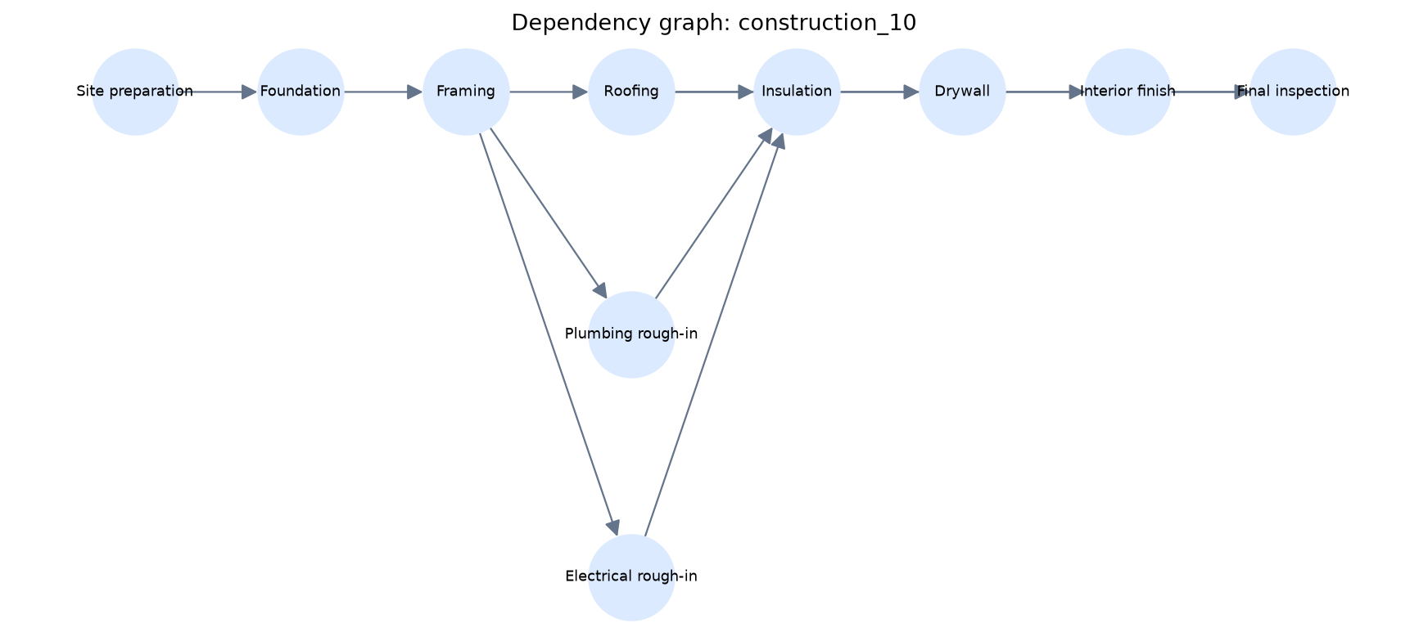
The construction schedule
Task order
Each task takes a set amount of time. Some tasks must wait for earlier work to finish.
Crew limit
Three crews are available. A task may be ready but still have to wait.
The arrows show the order of the work.

Slide 3
How the project works
1
2
3
4
Set up the tasks
Make the QUBO
Run both methods
Check the schedules
Enter each task length and dependency.
Turn each possible start time into a yes or no choice.
Create a classical schedule and an annealing schedule.
Confirm that each schedule follows the rules.

Slide 4
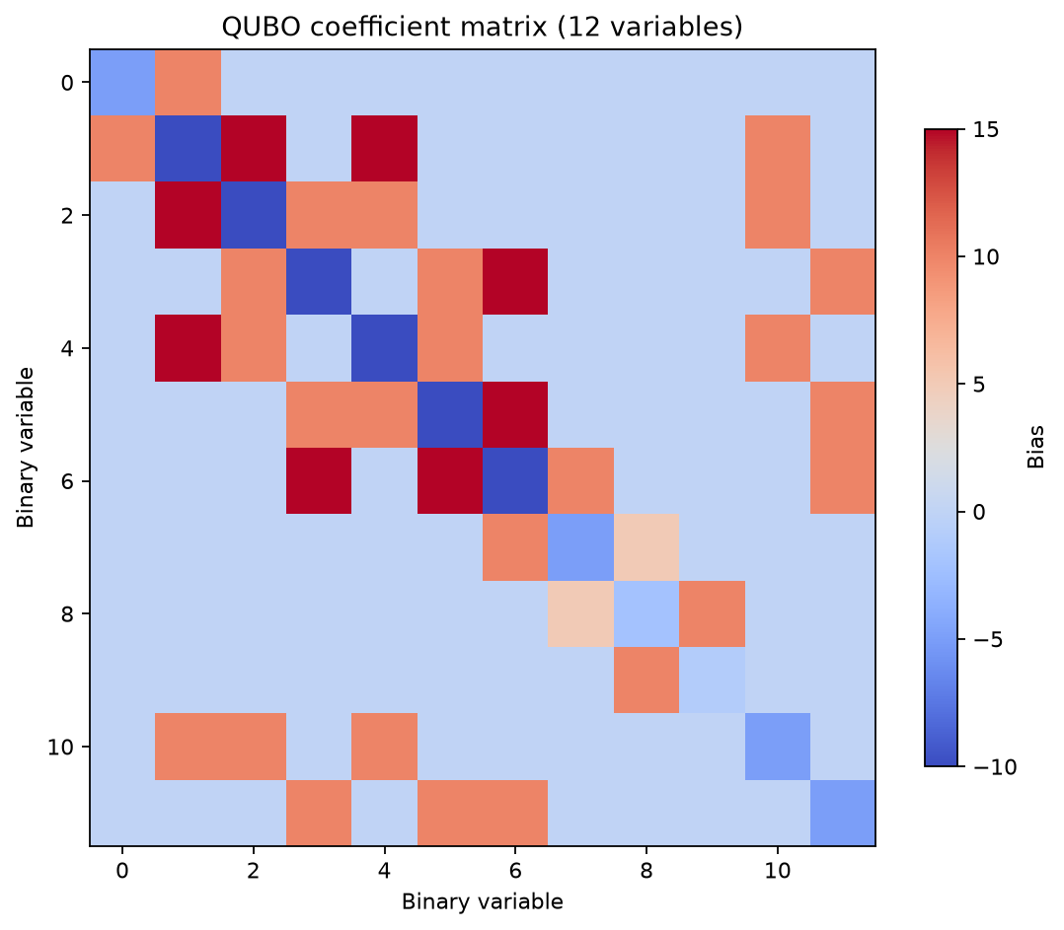
How the QUBO represents the schedule
Each variable represents one start-time choice.
1 means the task starts here. 0 means it does not.
The score goes up if:
• a task is scheduled twice • a task starts too early • more than three crews are working
This matrix holds the scores for a small four-task example.

Slide 5
The two scheduling methods
CPM-based scheduler
Simulated annealing
Ranks ready tasks by how much they affect the finish date. Starts the highest-ranked work first. Gives the same result on every run.
Tries many possible schedules. Keeps some worse options for a while so it does not get stuck. Returns the best valid schedule it found.
Both methods use the same task order and the same three-crew limit.

Slide 6
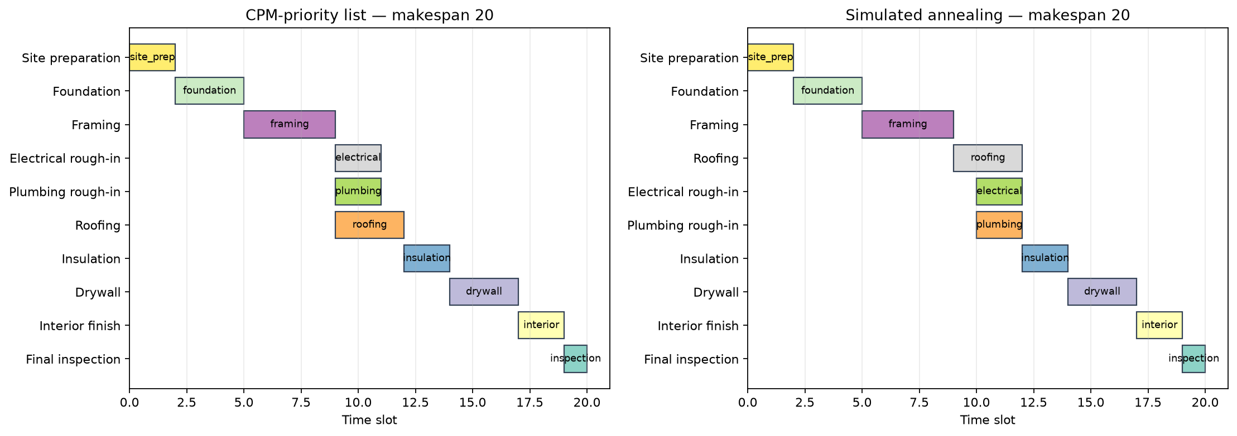
Ten-task schedule results
Both methods finished the project in 20 time slots.
20
Classical makespan
20
Annealing makespan
20
Lower bound

Slide 7
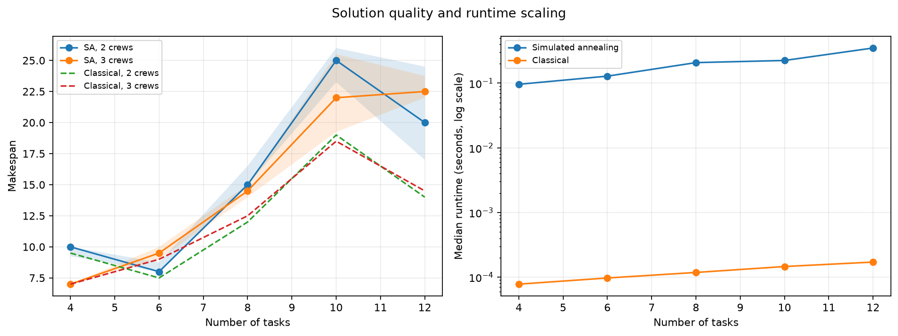
Random test case results
The classical scheduler was faster. It matched or beat annealing in all 60 runs.
60 / 60
valid annealing schedules
16
same finish time
44
annealing took longer
0
annealing finished sooner
Tests used 4 to 12 tasks with 2 or 3 crews.

Slide 8
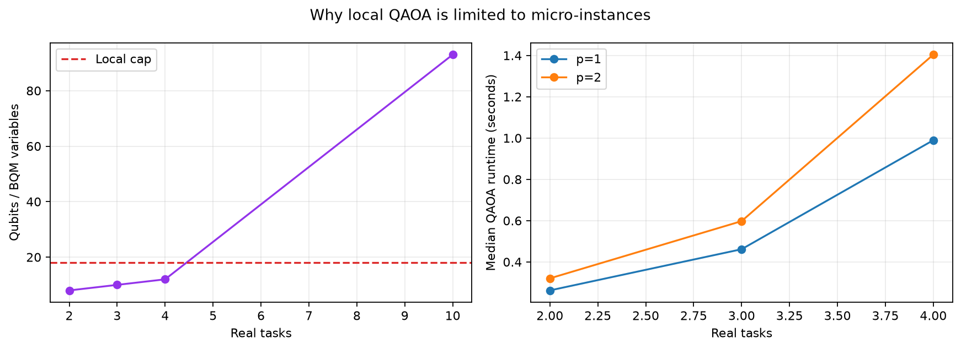
QAOA test results
QAOA was only run on the small examples.
Each QUBO variable needs one qubit.
The model size grows quickly.
Local limit: 18 qubits
The projects with two to four tasks stayed under this limit.
Ten-task project: 93 qubits
This case was not run.

Slide 9
What I learned
The QUBO model produced valid schedules.
Annealing matched the classical result on the main project.
The classical method was better on the random test cases.
A larger study should include more projects and stronger classical methods.

