Slide 1
Capstone Project
Cardiovascular-Risk-Prediction
1.Lalit Ahirrao
2.Aniket Gajmal
3.Rushikesh Pawar
4.Prasad Ghegade
5.Samarth Gangurde

Slide 2
Table of Content
What is Cardiovascular Risk ?
Facts Regarding Cardiovascular risk
Reason Behind the Project Dataset Information Data Summary Features Analysis Data Preprocessing Exploratory Data Analysis Implementing Algorithms
Challenges Conclusion

Slide 3
It is Heart and blood vessel disease (also called heart disease) includes numerous problems, many of which are related to a process called atherosclerosis
Atherosclerosis is a condition that develops when a substance called plaque builds up in the walls of the arteries. This buildup narrows the arteries, making it harder for blood to flow through. If a blood clot forms, it can block the blood flow. This can cause a heart attack or stroke.
What is Cardiovascular Risk ?

Slide 4
Facts Regarding Cardiovascular risk
Cardiovascular diseases are the leading cause of death globally.
An estimated 17.9 million people died from CVDs in 2019, representing 32% of all global deaths. Of these deaths, 85% were due to heart attack and stroke.
Over three quarters of CVD deaths take place in low- and middle-income countries.
Out of the 17 million premature deaths (under the age of 70) due to noncommunicable diseases in 2019, 38% were caused by CVDs.

Slide 5
Reason behind the project
As Cardiovascular disease is a significant and ever-growing problem in all over nations. It pressing interest as developing countries experience a change in lifestyle which introduces novel risk factors for cardiovascular disease. The early prognosis of cardiovascular diseases can aid in making decisions on lifestyle changes in high risk patients and in turn reduce the complications. This research intends to pinpoint the most relevant/risk factors of heart disease as well as predict the overall risk

Slide 6
Dataset Information
The dataset is from an ongoing cardiovascular study on residents of the town of Framingham ,Massachusetts. The classification goal is to predict whether the patient has a 10-year risk of future coronary heart disease (CHD). The dataset provides the patients’ information. It includes over 4,000 records and 15 attributes.

Slide 7
Data Summary
Demographic
sex:- male or female
age:- age of the patient
Behavioural
Is_smoking( do person smoke currently)
cigsPerDay( number of cigarettes person prefers, even half a cigarette)
Medical( history)
BPMeds: whether or not the patient was on blood pressure medication
prevalentStroke: whether or not the patient had previously had a stroke
prevalent Hyp: whether or not the patient was hypertensive
diabetes: whether or not the patient had diabetes

Slide 8
Data Summary
Medical(current)
totChol: total cholesterol level
sysBP: systolic blood pressure
diaBP: diastolic blood pressure
BMI: Body Mass Index
heartRate: heart rate
glucose: glucose level
Predict variable
10 year risk of coronary heart disease TenYearCHD ( 1 means 'Yes', 0 means 'NO')

Slide 9
Data Preprocessing
We started our preprocessing by handling missing values.Drop the missing values of columns which having negligible percent( missing values). Replaced missing values with the median values for max percent.AS there were no duplicates to preprocess.it helped us to more focus on outliers. We removed outliers by defining the quartile range 25% and 75% in the column

Slide 10
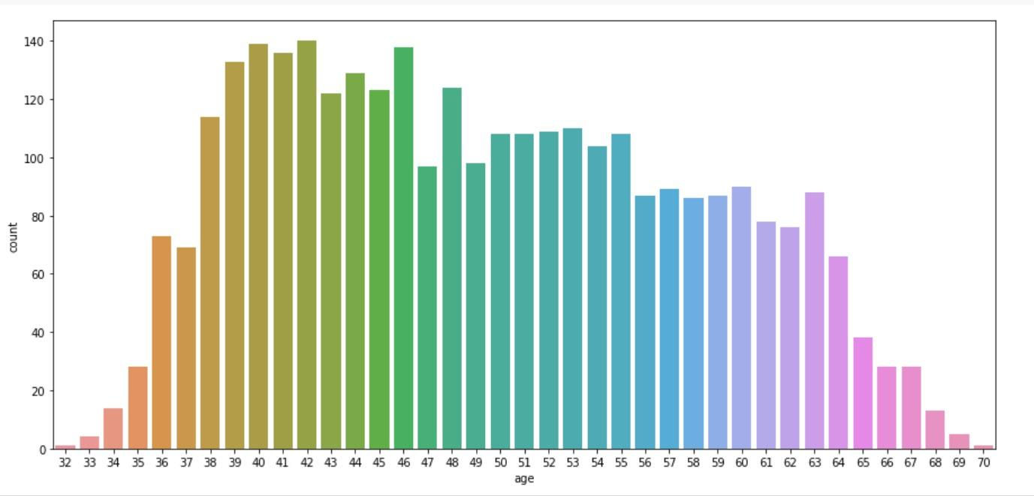
Exploratory Data Analysis
Most of Patients belongs to age group 38-64

Slide 11
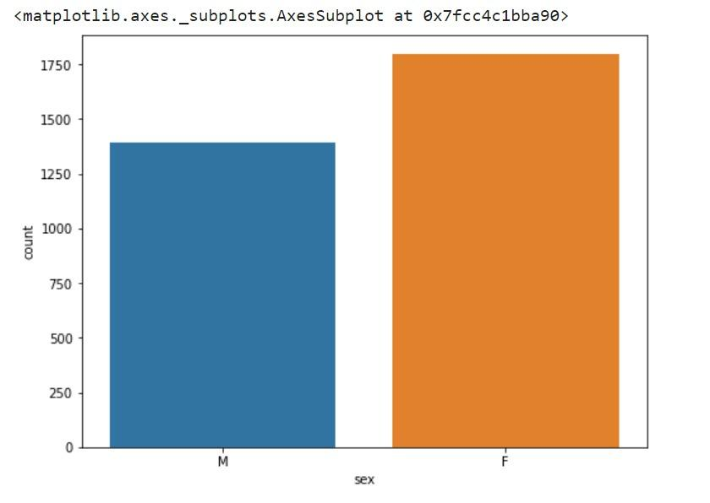
ANALYSIS OF GENDER VARIABLE
Ratio Females is more than ratio of Males

Slide 12
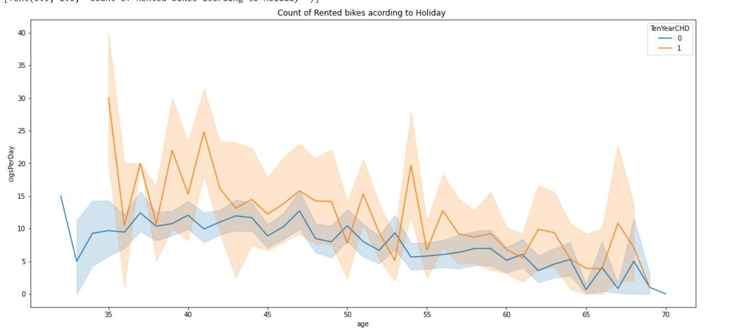
ANALYSIS OF CIGPERDAY VARIABLE W.R.T AGE
Most of the person who smokes more than 10 cigarettes showing risk of cardio ascular more

Slide 13
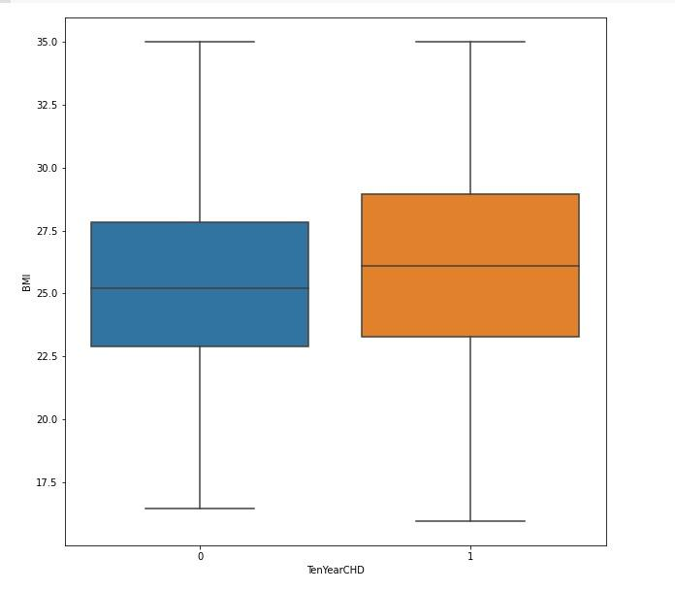
ANALYSIS OF BMI VARIABLE
BMI(Body Mass Index)of most of people is between approx 20-30 and for tenyearCHD it is showing some more

Slide 14
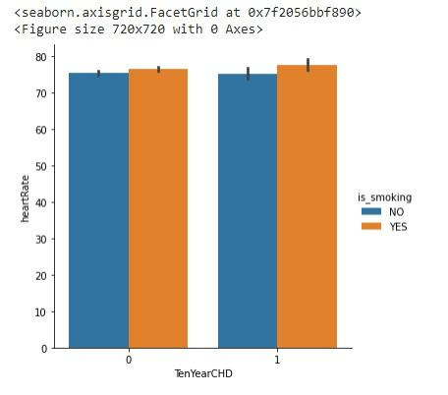
ANALYSIS OF HEARTRATE VARIABLE
As we can see heart rate of most of people is between approx 75-110 & heartrate of smokers shows more than non smokers

Slide 15
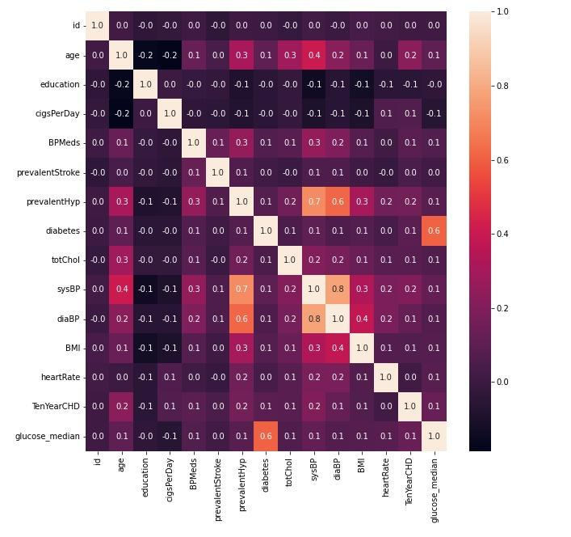
Heatmap

Slide 16
Algorithms Used
KNN classifier
Random Forests
Logistic Regression
We used 3 algorithms with GridsearchCV(Hyperparameter tuning) for better accuracy

Slide 17
KNeighborsClassifier with GridsearchCV
The accuracy on test data is 0.8845437616387337
The precision on test data is 0.931098696461825
The recall on test data is 0.8517887563884157
The f1 on test data is 0.8896797153024911
The roc_score on test data is 0.88790669852275

Slide 18
accuracy 0.904096834264432
precision 0.8789571694599627
recall 0.9254901960784314
f1 0.9016236867239732
Roc_score 0.9051209845640383
Random Forests Classifier
accuracy 0.785847299813780
precision 0.6685288640595903
recall 0.8734793187347932
f1 0.7573839662447257
Roc_score 0.8025013486584978
Logistic Regression
From the above classifiers we can say that RANDOM FOREST CLASSIFIER is working well as compare to the LOGISTIC REGRESSION

Slide 19
Challenges
Handled row dataset with outliers and missing values.
plotting of Graphs to analyse.
Feature engineering
Feature selection
Optimising the model
Hyper Parameter Tuning for improving accuracy
Calculation of Accuracy score.

Slide 20
CONCLUSION
Number of females showing cardiovascular risk was more than number of male
A people showing cardiovascular risk as well as prevalentstroke were very few
Age was the most important feature for our machine learning models
Logistic Regression gave the accuracy of 87% on test dataset.
In general, all models have comparable accuracy. Nevertheless, because the classes were imbalanced this metric was misleading.
KNeighbors classifier and Logistic Regression are gave us the best_score 86.10, 87.00 among other algorithms
ROC Score values of KNeighbors classifier,Random Forests,Logistic Regression 60.46, 64.74, and 69.56 approx equal
We can conclude that these two algorithms KNeighbors classifier,Logistic Regression are the best to predict whether the person showing cardiovascular risk or not from our analysis.

Slide 21
THANK YOU

