Slide 1
Capstone Project
Project Title

Slide 2

Table of Content
Reason Behind the Project
Dataset Information
Data Summary
Data Description
Features Analysis
Data Preprocessing
Exploratory Data Analysis
Challenges
Conclusion

Slide 3
Reason behind the project
Every year, more than 140 million bookings were made on the internet and many hotel bookings were booked through top-visited travel websites like Booking.com, Expedia.com, Hotels.com, etc. but Booking cancellations have a substantial impact on demand management decisions in the hospitality industry to avoid cancellations of bookings.To find out Methods they prefer for bookings,Months of the traffic, Days they will stay, meal they will prefer To know statistical measure of these segments we will deep dive into the Exploratory Data Analysis

Slide 4

Dataset Information
This data set contains booking information for a city hotel and a resort hotel and includes information such as when the booking was made, length of stay, the number of adults, children, and/or babies, and the number of available parking spaces, among other things. All personally identifying information has removed from the data.

Slide 5
Data Description
Hotel:Hotel (H1 = Resort Hotel or H2 = City Hotel)
is_canceled:Value indicating if the booking was canceled (1) or not (0)
lead_time:Number of days that elapsed between the entering date of the booking into the PMS and the arrival date
arrival_date_year:Year of arrival date
arrival_date_month:Month of arrival date
arrival_date_week_number:Week number of year for arrival date
rrival_date_day_of_month:Day of arrival
stays_in_weekend_nights:Number of weekend nights (Saturday or Sunday) the guest stayed or booked to stay at the hotel
adults:Number of adults

Slide 6
stays_in_week_nights:Number of week nights (Monday to Friday) the guest stayed or booked to stay at the hotel
children:Number of children
babies:Number of babies
meal:BB – Bed & Breakfast HB – only two meals including breakfast meal* FB – breakfast, lunch, and dinner text
country:Country from they belong
market_segment:TA: Travel agents: Tour operators
is_repeated_guest:is guest repeated
previous_cancellations:Have they canceled previous bookings
previous_bookings_not_canceled:
reserved_room_type:Type of room they reserved
assigned_room_type:Type of room they assigned

Slide 7
booking_changes:booking changed or not
deposit_type:deposit type they preferred
agent:was there any agent between for hotel recommendation
company:
days_in_waiting_list:-Number of days in waiting lists
Customer_type:-is it reserved or not
adr:Average daily rate
required_car_parking_spaces:Spaces required for car parking
total_of_special_requests:total number of special requests
reservation_status:Status of reservation is it canceled,waiting,confirmed
reservation_status_date:date of reservation

Slide 8
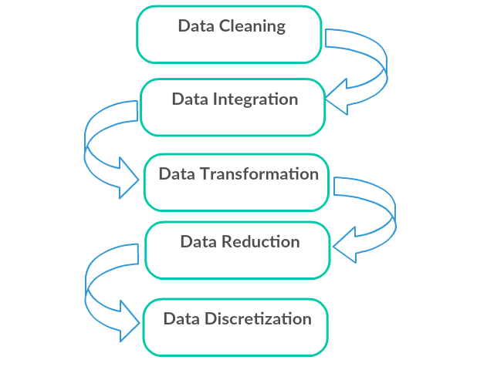
Preprocessing
Imported dataset was about 119390 rows in which we found the 4 columns [ children, country , agent , company ] had missing values.
but as The columns country ,agent ,children had a less number of missing values. We w removed the missing values.But when it came to The columns “company” it had a high number of missing values, we dropped the column,as there were no duplicates we found our data ready for EDA

Slide 9
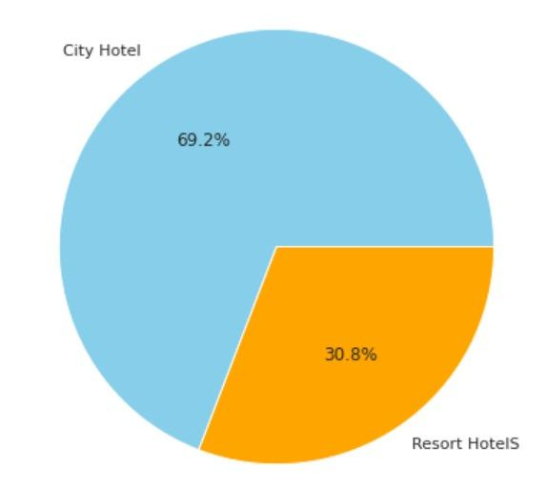
Exploratory Analysis
Out of total hotels 71181 were City Hotel
Resort Hotel were less as compare to city hotels precisely 31713 hotels
approx. 69.2 % People were booking city hotels which was more than Resort hotels.

Slide 10
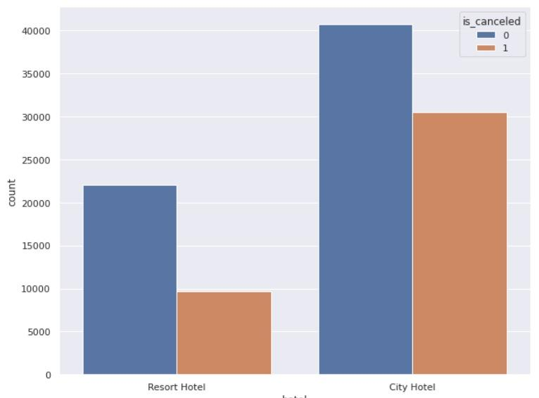
Feature is_canceled
According to the bar graph, around 40000 of bookings from city hotel and around 23000 bookings from Resort hotel were not canceled

Slide 11
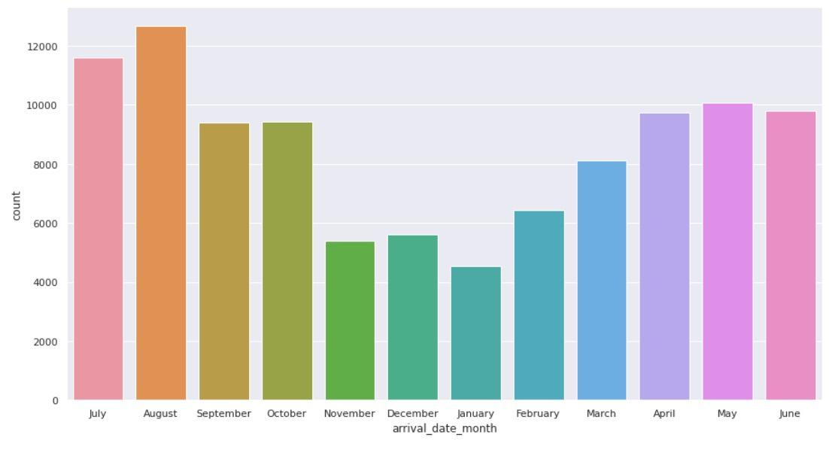
Feature arrival date month
AS you can see traffic in the january and November is less as compare to the other months

Slide 12
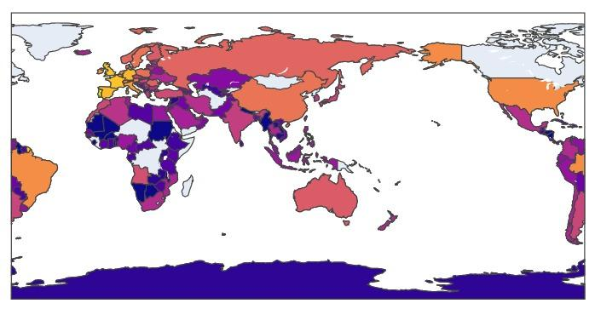
Feature country
As we can see, Portugal tops the list with approx. 37k of the cases, followed by Great Britain with approx. 12k and France with approx 10k
There are 10 countries in our bar that can be considered as the most common country of origin

Slide 13
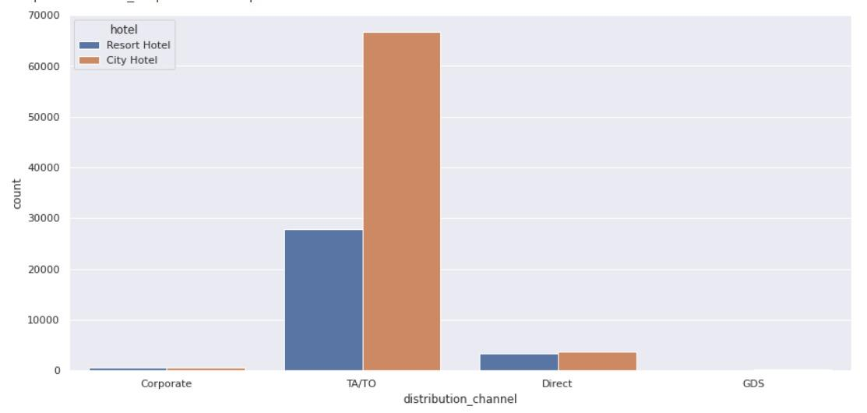
Feature distribution channel
Bookings through Travel Agents,Tour Operators is preferred by most of the people
approx. 70000 city hotels are book by Travel Agents & Tour Operators
approx. 30000 resort hotels are book by Travel Agents & Tour Operators

Slide 14
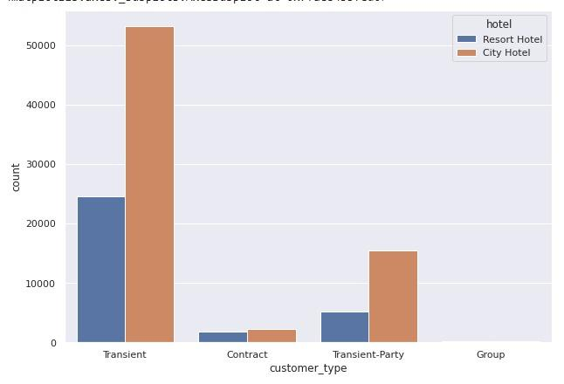
Feature Customer Type
Transients are the most common customer type, they represent count more than 50000 for city hotel and approx. 24000 for resort hotel.

Slide 15
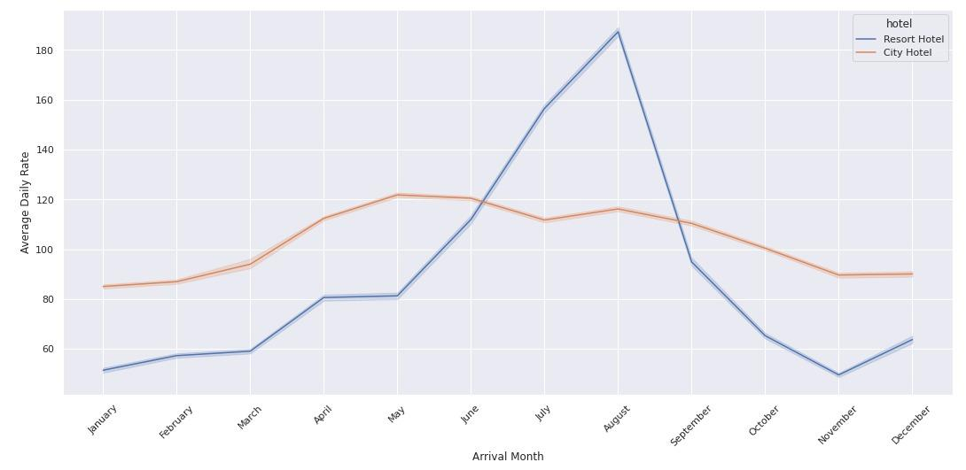
Relation between prices and month
For resort hotels, the average daily rate is more expensive during august, july and september.
For city hotels, the average daily rate is more expensive during august, july, june and may.

Slide 16
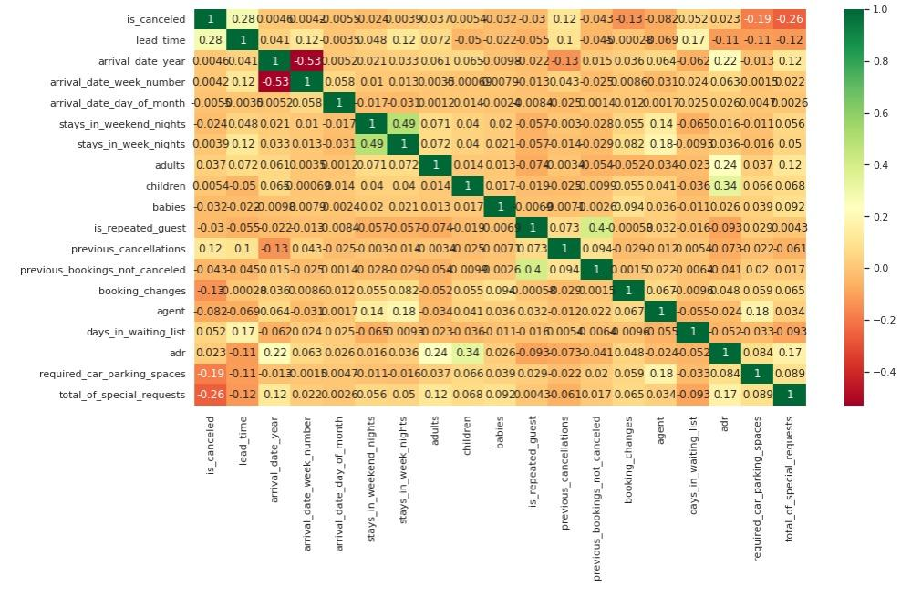
Heatmap
We can see our features,stays in week nights and stays in weekend nights have a correlation as compare to the most of the other columns.
arrival date week number is negatively correlated to the arrival date year

Slide 17
Conclusion
From our EDA, we have observed that the top most important patterns in the data set which will helps in Hotel booking business
Reasons for booking cancellations across various parameters
Almost 35% of bookings were canceled and that's great number to concern.
Approx 30% bookings were cancelled by guests with no deposit type & 50% bookings were cancelled by guests with Refundable policy
the guests with no modifications cancelled bookings Around 42%
AS highest ADR in August may be it could be one of the reasons for more canceled bookings in August

Slide 18
Strategies to Counter High Cancellations at the Hotel
Encourage Direct bookings by offering special discounts
Monitor where the cancellations are coming from such as High ADR , Deposit type, etc.
Set Non-refundable Rates, Collect deposits, and implement more rigid cancellation policies
Best time to book hotel
Couple (or 2 adults) is the most popular accommodation type. So hotels can make arrangement plans accordingly
Most bookings were made from July to August. And the least bookings were made at the start and end of the year
More than 60% of the population booked the City hotel.
The majority of guests come from western europe countries.Portugal, the UK, and France, Spain and Germany are the top countries from most guests come, more than 80% come from these 5 countries.

