Slide 1
BLDEA’S V.P. Dr .P.G. HALAKATTI COLLEGE OF ENGINEERING AND TECHNOLOGY VIJAYAPURA – 586103
DEPARTMENT OF COMPUTER SCIENCE PRESENTATION ON
Intelligent Recipe Recommendation With Nutritional Insights Using Machine Learning
UNDER THE GUIDANCE OF
Prof. Anupama Inamdar
Omkar Chavan (2BL21CS085)
Prasad Patil (2BL21CS094)
Rahul Patil (2BL21CS107)
Samarth Hitnalli(2BL21CS133)

Slide 2
CONTENTS
Introduction
Literature Survay
Drawbacks of Existing Work
Problem Definition and Objective
Methodology
Algorithms
Implementation Results and Discussion
Conclusion
References

Slide 3
Introduction
NutriMate is an intelligent AI-powered Recipe Recommendation System designed to help users discover personalized recipes based on ingredients, dietary preferences, and even food images. The system seamlessly combines Natural Language Processing (NLP), Computer Vision, and Content-Based Recommendation Algorithms to offer smart, tailored cooking suggestions.
Users can interact with the platform in three ways:
Text Input: Describe available ingredients or diet needs (e.g., “I have paneer and spinach, need something low-calorie”).
Image Input: Upload a picture of food to identify dish type or ingredients.
Form Input: Select filters like cuisine, diet type, and excluded ingredients.
The backend processes these inputs using AI models like OpenAI GPT for text extraction and Gemini Vision for image analysis, then matches them with a curated dataset of recipes using TF-IDF vectorization and cosine similarity. Matching recipes are ranked and returned along with relevant images and nutritional info.
This project is built using:
Frontend: Next.js + Tailwind CSS for modern UI/UX
Backend: Python Flask API
AI Services: OpenAI, Gemini (Google)
Database: MongoDB
Authentication: Appwrite

Slide 4
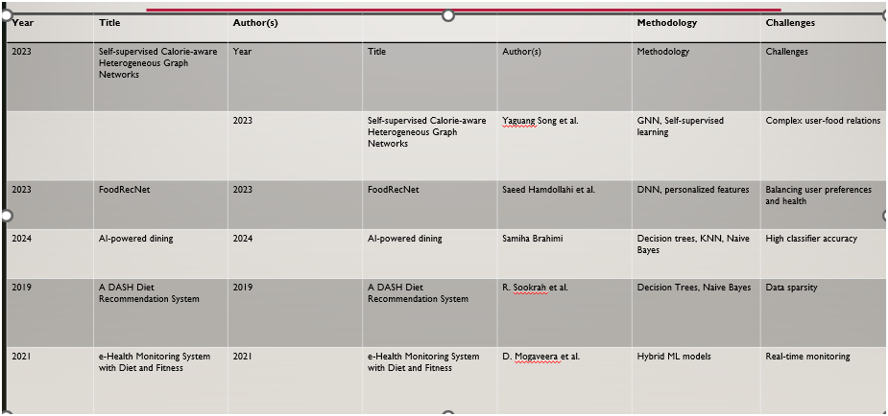
Literature Survey

Slide 5
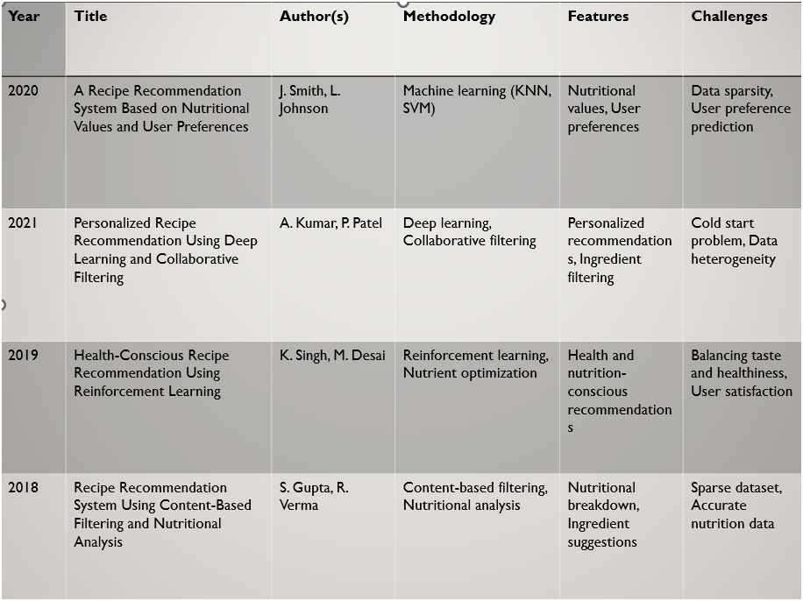

Slide 6
Literature Survay
Numerous recipe recommendation platforms exist, such as Yummly and Tasty, which rely on basic keyword search or predefined tags. Previous research includes:
Bongrub: A hybrid recommendation model combining content-based and collaborative filtering.
Deep Food: CNN-based model for food image recognition.
Use of NLP techniques for review-based filtering.
However, most systems lack integration of multimodal inputs like image and text, and don’t support protein or vitamin-based filtering.

Slide 7
Drawbacks of Existing Work
🔍 Limited Input Types Most platforms rely only on keyword or category-based searches, ignoring advanced inputs like images or natural language.
🤖 Lack of Intelligence Existing systems rarely use AI or ML for understanding user preferences, context, or dietary needs.
❌ No Personalization Recommendations are generic and do not adapt to user history, health goals, or ingredient availability.
🗂️ Weak Integration of Search History Many apps don’t store or leverage past searches, reducing the potential for learning-based recommendations.
📱 Poor User Experience Outdated UIs, non-responsive designs, and inconsistent navigation make them hard to use, especially on mobile devices.
🧠 No Visual Understanding Image-based recipe suggestions are almost non-existent, limiting accessibility for users who prefer visual inputs.

Slide 8
Problem Definition and Objective
Problem: In today’s fast-paced world, users often struggle to decide what to cook based on the limited ingredients they have, specific dietary needs, or health goals. Traditional recipe apps rely heavily on keyword searches and fail to offer personalized or intelligent suggestions based on unstructured inputs like natural language descriptions or food images. This lack of smart interactivity and user adaptation limits the cooking experience for modern users.
Objective:
The main objective of this project is to develop an AI-powered Recipe Recommendation System that:
📸 Identifies food items from images using computer vision
📝 Extracts recipe attributes from natural language using NLP
📊 Generates personalized recipe recommendations based on ingredients, diet, and preferences
🔐 Stores and retrieves user-specific search history for a tailored experience
🌐 Provides a responsive, user-friendly web interface for easy access across devices
This system aims to bridge the gap between user input and intelligent recipe discovery using the latest in AI, Machine Learning, and Web Technologies.

Slide 9
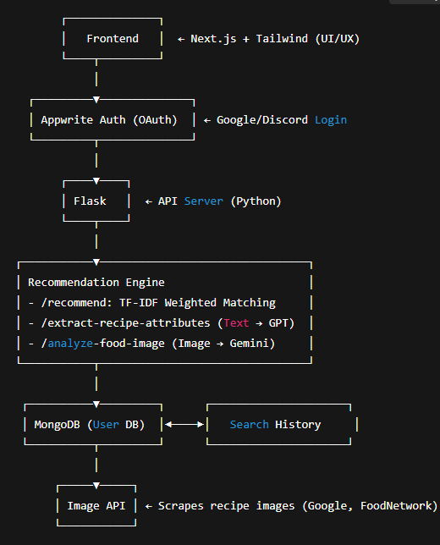

Slide 10
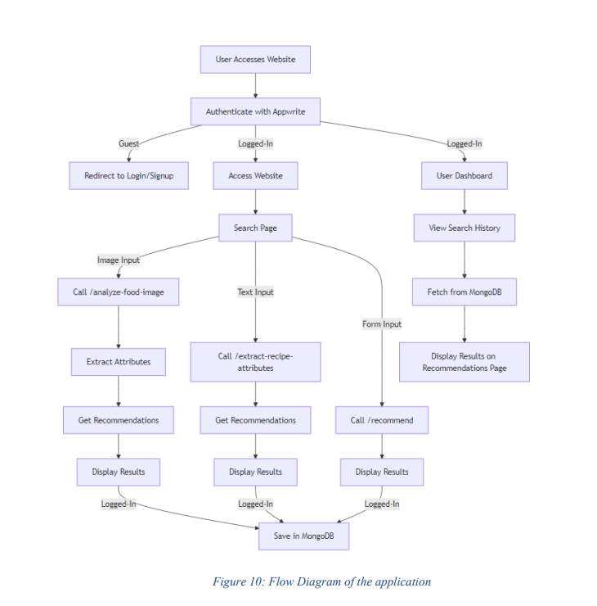
Methodology

Slide 11
Frontend
Built using Next.js, React, and Tailwind CSS
Modular component architecture
Fully responsive UI
Integrated with Appwrite for authentication

Slide 12
Backend:
Developed using Flask (Python)
AI-driven logic with OpenAI GPT-3.5 and Gemini AI
TF-IDF + feature weighting recommendation algorithm
Organized routing: /recommend, /analyze-food-image, /extract-recipe-attributes, etc.

Slide 13
Algorithms and Techniques Used
TF-IDF (Term Frequency-Inverse Document Frequency) Used to vectorize recipe text attributes (like ingredients, category, and instructions) for similarity comparison.
Cosine Similarity Calculates similarity scores between user input and stored recipes to rank recommendations effectively.
Weighted Feature Scoring Combines multiple features (e.g., ingredients, calories, category) with adjustable weights to fine-tune results.
Fuzzy String Matching (with fuzzywuzzy) Enhances text-based extraction by correcting or matching similar-looking terms (e.g., "vegitarian" → "vegetarian").
OpenAI GPT-3.5-turbo Parses natural language text to extract structured recipe attributes like ingredients, category, cooking time, etc.
Gemini Image Model (via Google AI) Analyzes uploaded food images to identify dishes and ingredients visually for image-based recommendations.
Asynchronous Web Scraping Uses async scrapers to fetch relevant images from websites like Google, AllRecipes, and FoodNetwork for visual support.

Slide 14
DEMO

Slide 15
CONCLUSION
The Recipe Recommendation System successfully combines AI, machine learning, and modern web technologies to deliver personalized and intelligent recipe suggestions.
By supporting multiple input modes—image, text, and form—the system enhances user flexibility and accessibility.
Integration with GPT-3.5, Gemini, and TF-IDF-based recommendation logic ensures accurate, relevant, and tailored results.
With Appwrite authentication, MongoDB storage, and a user-friendly Next.js frontend, the platform is secure, scalable, and user-centric.
This system not only simplifies meal planning but also showcases the potential of AI in enhancing everyday digital experiences.

Slide 16
References
Food.com. "Recipes, Food Ideas, and Cooking Tips." https://www.food.com/
UI Aceternity. "User Interface Platform." https://ui.aceternity.com/
OpenAI. "Artificial Intelligence Research and Deployment." https://openai.com/
Google. "Gemini App." https://gemini.google.com/app?hl=en-IN 5. GitHub. "The World’s Leading Software Development Platform." https://github.com/

