Slide 1
Breast Cancer Detection using Machine Learning

Slide 2
INTRODUCTION:
Breast cancer starts when cells in the breast begin to grow out of control. These cells usually form a tumor that can often be seen on an x-ray or felt as a lump.
There are two main kinds of tumors: benign, which means the tumor is non-cancerous and malignant, tumors that are cancerous.
Goals:
To classify whether the breast cancer is benign or malignant.
Comparing the accuracy of two supervised and one unsupervised machine learning algorithms.

Slide 3

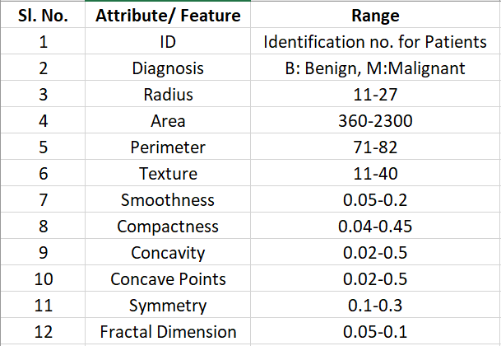
DATASET: Breast Cancer Wisconsin Data Set
The dataset contains 569 instances, 357 are labeled as B (benign) and 212 as M (malignant).
30 features that are computed here come from a digitized image of a fine needle aspirate (FNA) of breast mass and they describe characteristics of the cell nuclei present in the image.
Dataset Characteristic: Multivariate and Attribute Characteristics: Integer

Slide 4
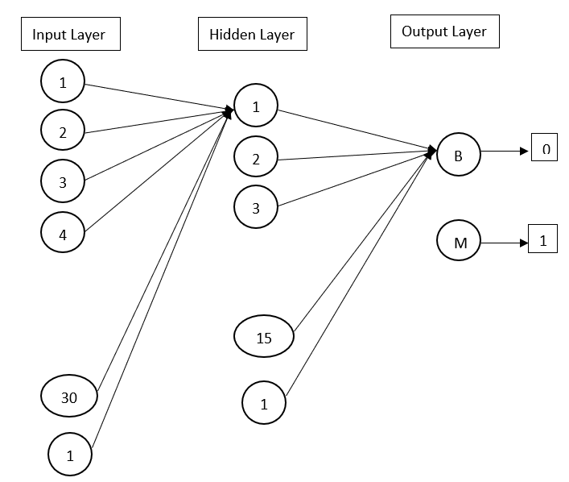
Multi-Layer Perceptron:

Slide 5

Multi-Layer Perceptron:
Steps in MLP:
Data Preprocessing: Split the data into train and test set (80:20). Then apply Minmax normalization which scales all the feature values to lie in the range of 0 to 1.
Forward propagation: Activation Function Sigmoid
Backpropagation

Slide 6
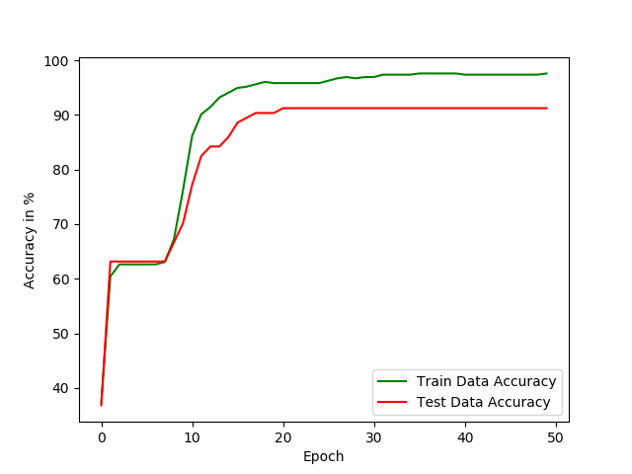
Multi-Layer Perceptron:
Parameters: Learning rate: 0.05, Momentum: 0, Number of hidden layers: 1, Number of hidden units: 15+ 1 (Bias Input=1)
Training Confusion Matrix
[[283 2]
[ 9 161]]
Testing Confusion Matrix
[[72 0]
[10 32]]
Final accuracy of Train data at 50th epoch is 97.58 %
Final accuracy of Test data at 50th epoch is 91.23 %

Slide 7
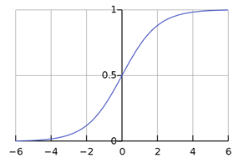

Logistic Regression:
Data Split: We Split the data into train and test set in (80:20) proportion.
Data Preprocessing: We applied standardization, which centers the values of each feature column, setting it to have a mean of 0 and a standard deviation of 1.
new_x = (x - mean)/std
Forward Propagation
Cost function or Cross Entropy or Likelihood function
Gradient Descent & Back Propagation
Classification

Slide 8
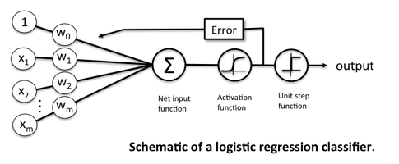

Logistic Regression:
In logistic regression transforms its output which are real values using the logistic sigmoid function to return a probability value which can then be mapped to 0/1 class.
P(Y=1|X) =
F(x) is commonly interpreted as the probability of the dependent variable (Y) equaling a “success”, i.e., P(Y=1|x).
Classification:
if P(Y=1|x) >= 0.5
return 1
elif P(Y=1|x) > 0.5
return 0

Slide 9





Logistic Regression:
Cost function or likelihood function:
Logarithms smooth monotonic functions and makes it easy to calculate the gradient and maximize cost.
Gradient Descent: Back Propagation:
Maximize the log likelihood of the data

Slide 10
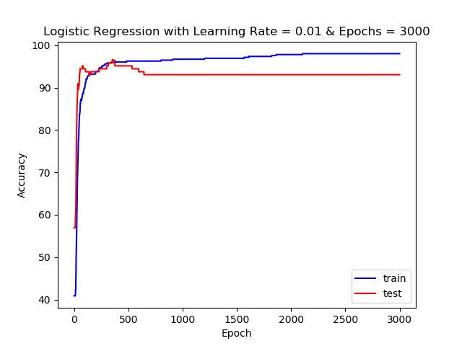
Logistic Regression:
Training Confusion Matrix:
[[265 4]
[ 5 181]]
Testing Confusion Matrix:
[[62 10]
[ 0 72]]
Final accuracy of Train data at 3000th epoch is 98.02 %
Final accuracy of Test data at 3000th epoch is 93.05 %

Slide 11
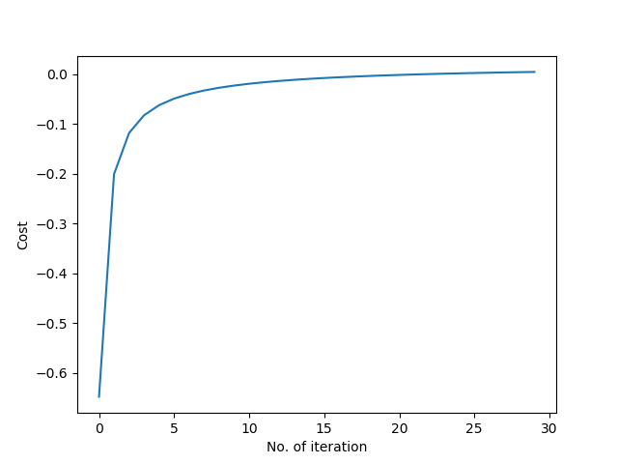
Cost Graph:
The likelihood function is maximized for each epoch.

Slide 12
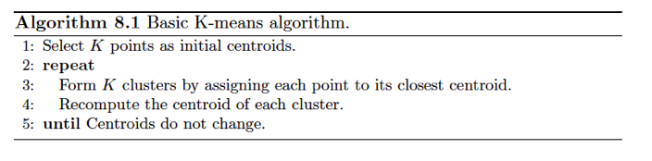
K-Means:
The k-means algorithm involves randomly selecting k initial centroids where k is a user defined number of desired clusters. Each point is then assigned to a closest centroid and the collection of points close to a centroid form a cluster. The centroid gets updated according to the points in the cluster and this process continues until the points stop changing their clusters.

Slide 13
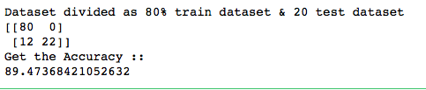
K Means Clustering
To find accuracy of data in kmeans
Step 1. Mapped M = malignant or B = benign to 1 or 0 respectively and preprocess the data by min max normalization
Step 2. Create train and test data by splitting
Step 3. Initialize the KMeans cluster module.
clusters = KMeans(n_clusters=2, n_init=10,max_iter=300)
n_init :Number of time the k-means algorithm will be run with different centroid seeds.
max_iterations: Maximum number of iterations of the k-means algorithm for a single run
Step4. Results :

Slide 14
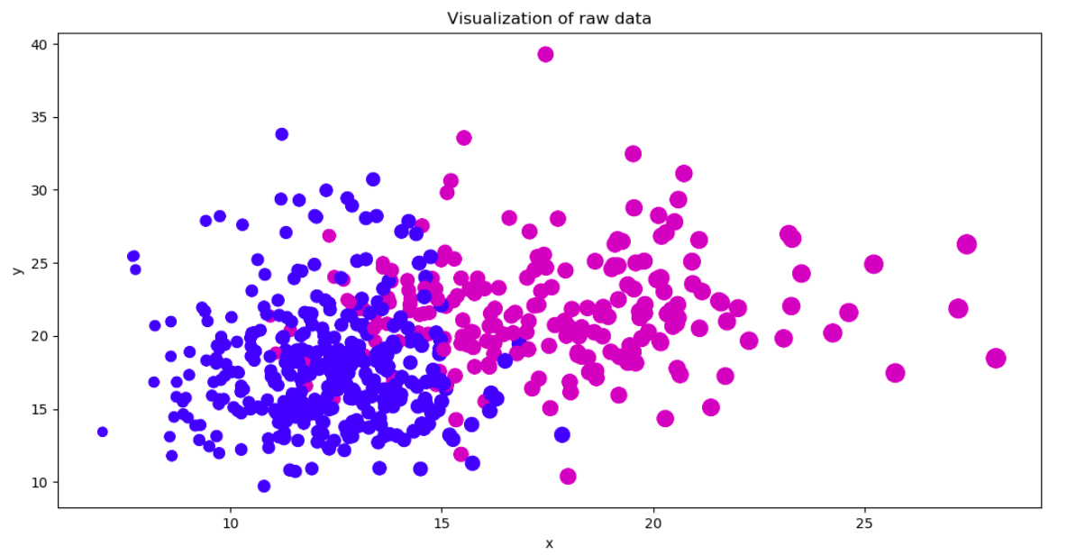
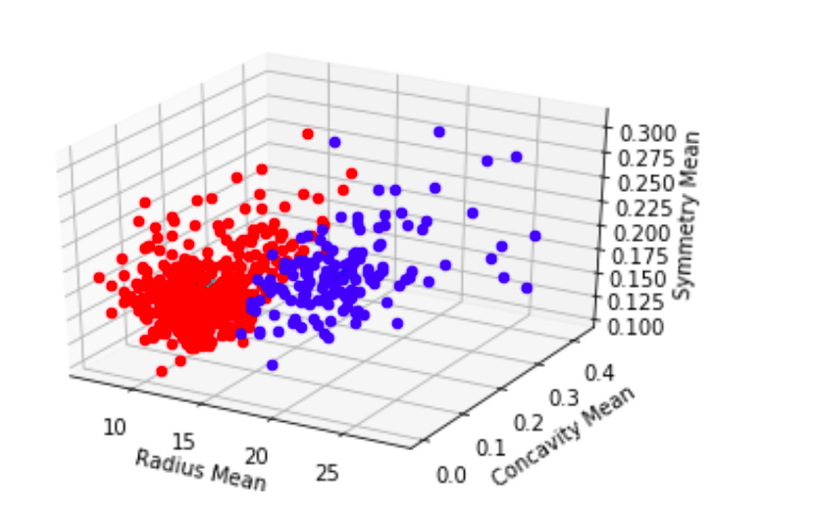
Scatter Plot
Scatter plot by taking three features.
Setting it to find two clusters, hoping to find malignant vs benign.
centroids = clusters.cluster_centers_
[[12.44571194,0.06207506,0.17827541]
[19.18387324,0.16916028 0.18984155]]

Slide 15
Observations:

Slide 16
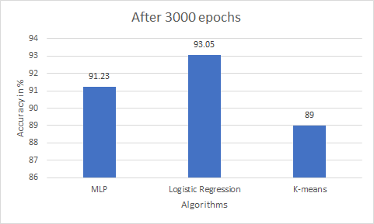
Observations:

Slide 17
Future scope...

Slide 18
Thank You

