Slide 1

SMS Spam Classifier Using Machine Learning
Team Members' Names: 1. Samarth Khanna (108) 2. Mohit Rana (120) 3. Sonu Sharma (127)

Slide 2
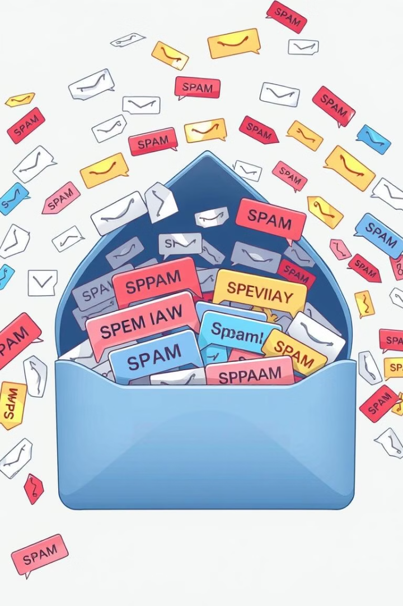
Introduction to SMS Spam and ML-Based Spam Classification
1
SMS Spam
Unwanted promotional or fraudulent messages
2
Importance of Spam Classification
Prevent scams, improve user experience
3
Role of Machine Learning (ML) Models
In detecting spam
4
Common techniques
Used in ML-based spam classification

Slide 3
Research Paper 1 - "Email Spam Detection Using Machine Learning"
Objective
Key Findings
Use ML and NLP to detect email spam
Naive Bayes had the highest accuracy (99%)
Methodology
ML models outperform traditional rule-based systems
Preprocessing: Tokenization, Stop-word Removal, Stemming
Conclusion
ML and NLP techniques effectively classify spam
ML Models: Naive Bayes, SVM, KNN

Slide 4
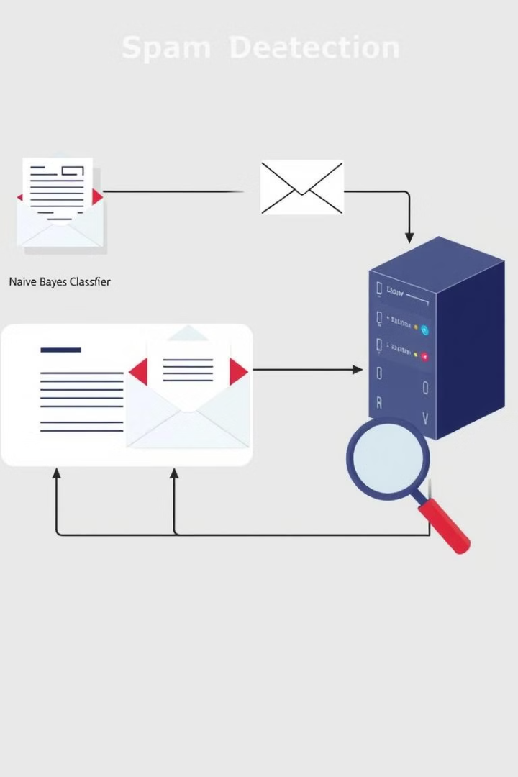
Research Paper 2 - "Email-Based Spam Detection"
1
Objective
Automate email spam detection using Naive Bayes & IP tracking
2
Methodology
Preprocessing: Tokenization, TF-IDF
Model Training: 75% training, 25% testing (Naive Bayes Classifier)
Additional Feature: Sender IP tracking for blocking spammers
3
Key Findings
Effective spam filtering with probability-based classification
IP Blacklisting prevents future spam attacks
4
Conclusion
Combining text analysis with IP tracking enhances security

Slide 5
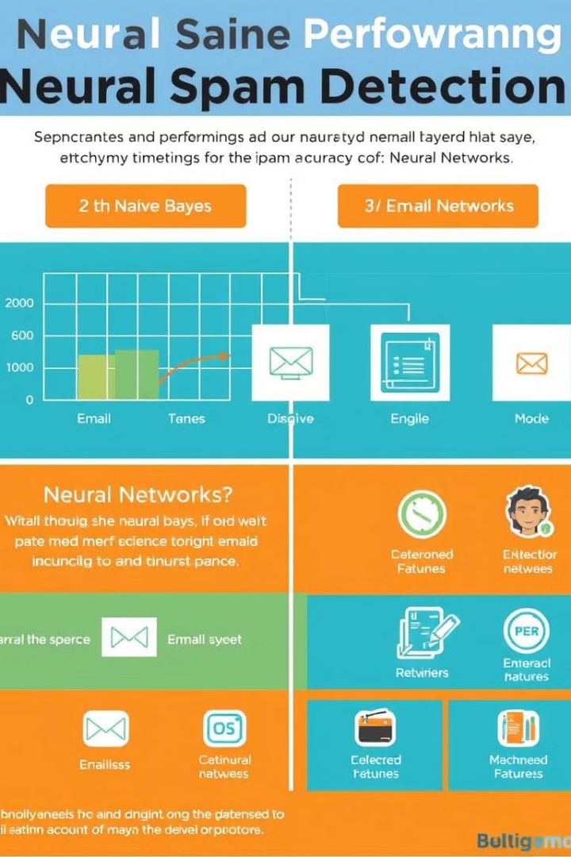

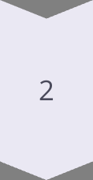


Research Paper 3 - "Email Spam Detection Using Neural Networks"
Objective
Compare Naive Bayes and Neural Networks for spam detection
Methodology
Data: Kaggle, SpamAssassin datasets
Preprocessing: NLTK, TF-IDF, CountVectorizer
Models: KNN, Naive Bayes, Neural Networks
Key Findings
Naive Bayes (93.2% accuracy), struggles with precision
Neural Networks (98.8% accuracy) outperform Naive Bayes
Conclusion
Neural Networks + feature engineering improve spam classification

Slide 6
Research Gaps in these Research Papers
SMS Spam Focus
Real-time Detection
Deep Learning
Limited focus on SMS spam (study was on emails)
No mention of real-time detection capabilities
Lacks deep learning approaches for improved accuracy
Model Exploration
IP Tracking Limitations
Real-world Deployment
Focuses only on Naive Bayes, no exploration of deep learning models
IP tracking may not be effective for SMS spam (phone numbers change often)
No real-world deployment analysis
SMS Focus
Computational Power
Real-world Testing
Focuses only on email spam, not SMS spam
Neural Networks require high computational power, which may not be ideal for SMS filtering
Lacks testing on real-world SMS datasets

Slide 7
Technologies Used
Naïve Bayes ML Model
Jupyter Notebooks
Python Libraries:
Numpy
Pandas
Sklearn
Matplotlib
Nltk
Seaborn
Wordcloud

Slide 8
Footnotes and References
Email Spam Detection Using Machine Learning
Mrs. Anitha Reddy, Kanthala Harivardhan Reddy, A. Abhishek, Myana Manish, G. Viswa Sai Dattu, Noor Mohammad Ansari
DOI: https://doi.org/10.53555/sfs.v10i1.1249
https://github.com/samarthkhanna27/SMS-Spam-Classifier-ML-Project/blob/main/research%20paper%201.pdf
Email based Spam Detection
Thashina Sultana, K A Sapnaz, Fathima Sana, Mrs. Jamedar Najath
DOI: 10.17577/IJERTV9IS060087
https://github.com/samarthkhanna27/SMS-Spam-Classifier-ML-Project/blob/main/research%20paper%202.pdf
Email Spam Detection using Machine Learning
Dr. Nilesh Jain, Dr. B. K. Sharma
DOI: https://doi.org/10.56452/7-12-46
https://github.com/samarthkhanna27/SMS-Spam-Classifier-ML-Project/blob/main/research%20paper%203.pdf
UCI SMS Spam Collection Dataset
https://www.kaggle.com/datasets/uciml/sms-spam-collection-dataset

Slide 9
Thank You
Thank you for your time and attention. I hope this presentation was helpful.

