Slide 1
Image Text Extractor
Mini Project II
Developed by:
Abhishek Bhardwaj
Abhishek Sharma
Aman Gulwani
Aman Jadon
Samarth Kulshrestha

Slide 2
Image Text Extractor
The text extractor will allow you to extract text from any image. You may upload an image or document (.doc, .pdf) and the tool will pull text from the image. Once extracted, you can copy to your clipboard with one click.
Advantages:
Tilt text is detected.
High accuracy in natural scene.
Requires less text extraction database.
Most relevant and accurate data is retrieved from the web.

Slide 3
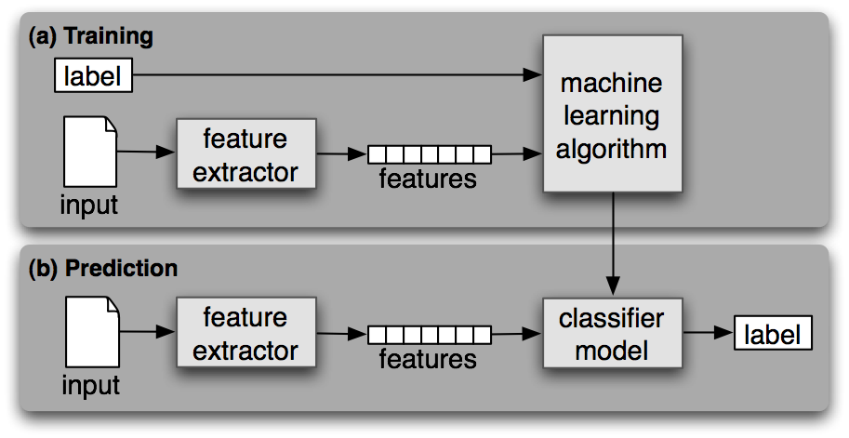
Working Diagram:

Slide 4
Libraries used:
Torch
Torchvision>=0.5
OpenCV-python
Scipy
Numpy
Pillow
Scikit-image
Pyhton-bidi
pyYaml
kivy

Slide 5
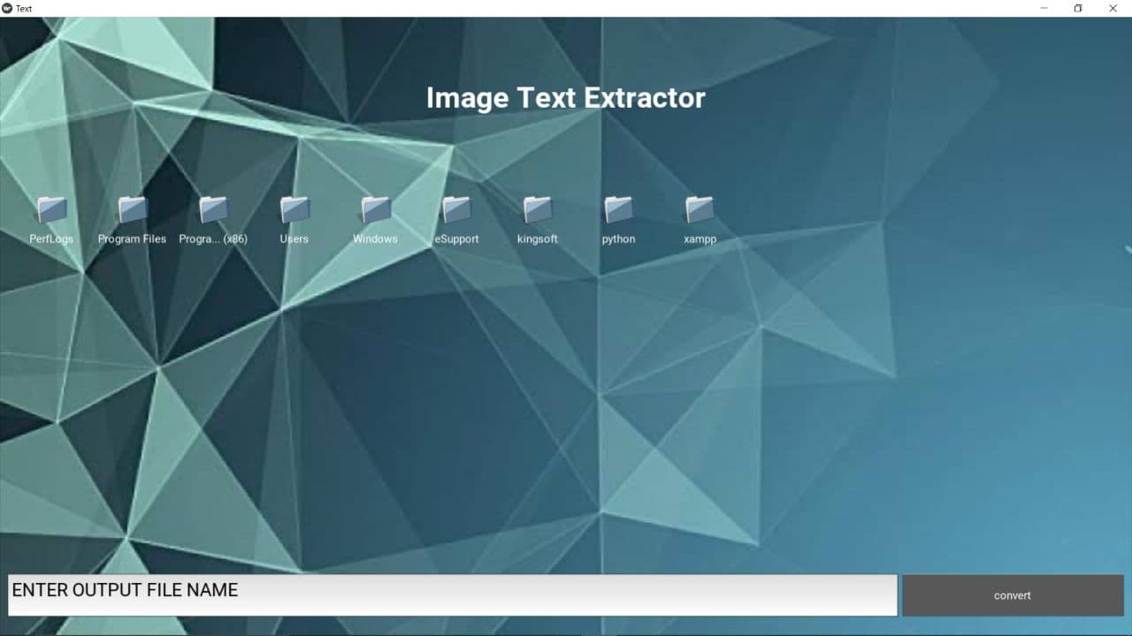
Screenshot:

