Slide 1

Mutual Fund Analytics Capstone Project
Submitted by: Samarth Magadum
Internship: Bluestock Fintech
Tools Used: Python, SQL, SQLite, Power BI
Year: 2026

Slide 2
Problem Statement & Objective
Problem Statement
Mutual fund data is scattered across multiple sources.
Fund comparison is difficult due to complex metrics.
Benchmark tracking is not available.
Investor behaviour analysis is limited.
Manual reporting is slow and time-consuming.
Objectives
Integrate all datasets into one database.
Analyse fund performance and risk.
Compare funds with benchmark indices.
Study investor investment trends.
Build interactive Power BI dashboards.

Slide 3
Data Sources
Dataset | Description
Fund Master | Fund details and category information
NAV History | Daily Net Asset Value (NAV) records
AUM | Assets Under Management of fund houses
SIP | Monthly Systematic Investment Plan inflows
Category | Category-wise investment inflows
Folio | Industry folio (investor account) count
Transactions | Investor purchase and redemption details
Performance | Fund return and performance metrics
Portfolio | Portfolio holdings of mutual funds
Benchmark | Nifty 50 and Nifty 100 market index data

Slide 4
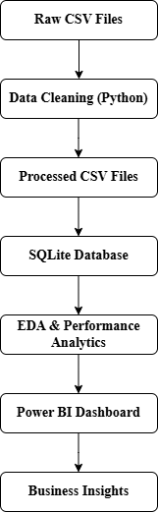
Project Architecture
Tools Used
Python
Pandas
SQLAlchemy
SQLite
Power BI
Git & GitHub

Slide 5
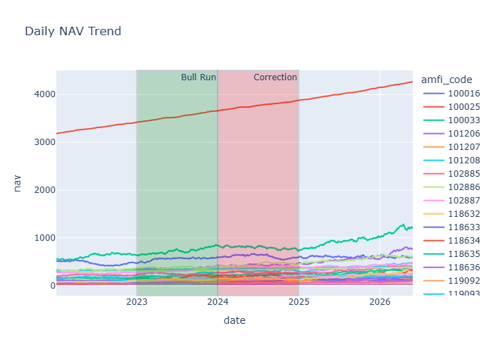
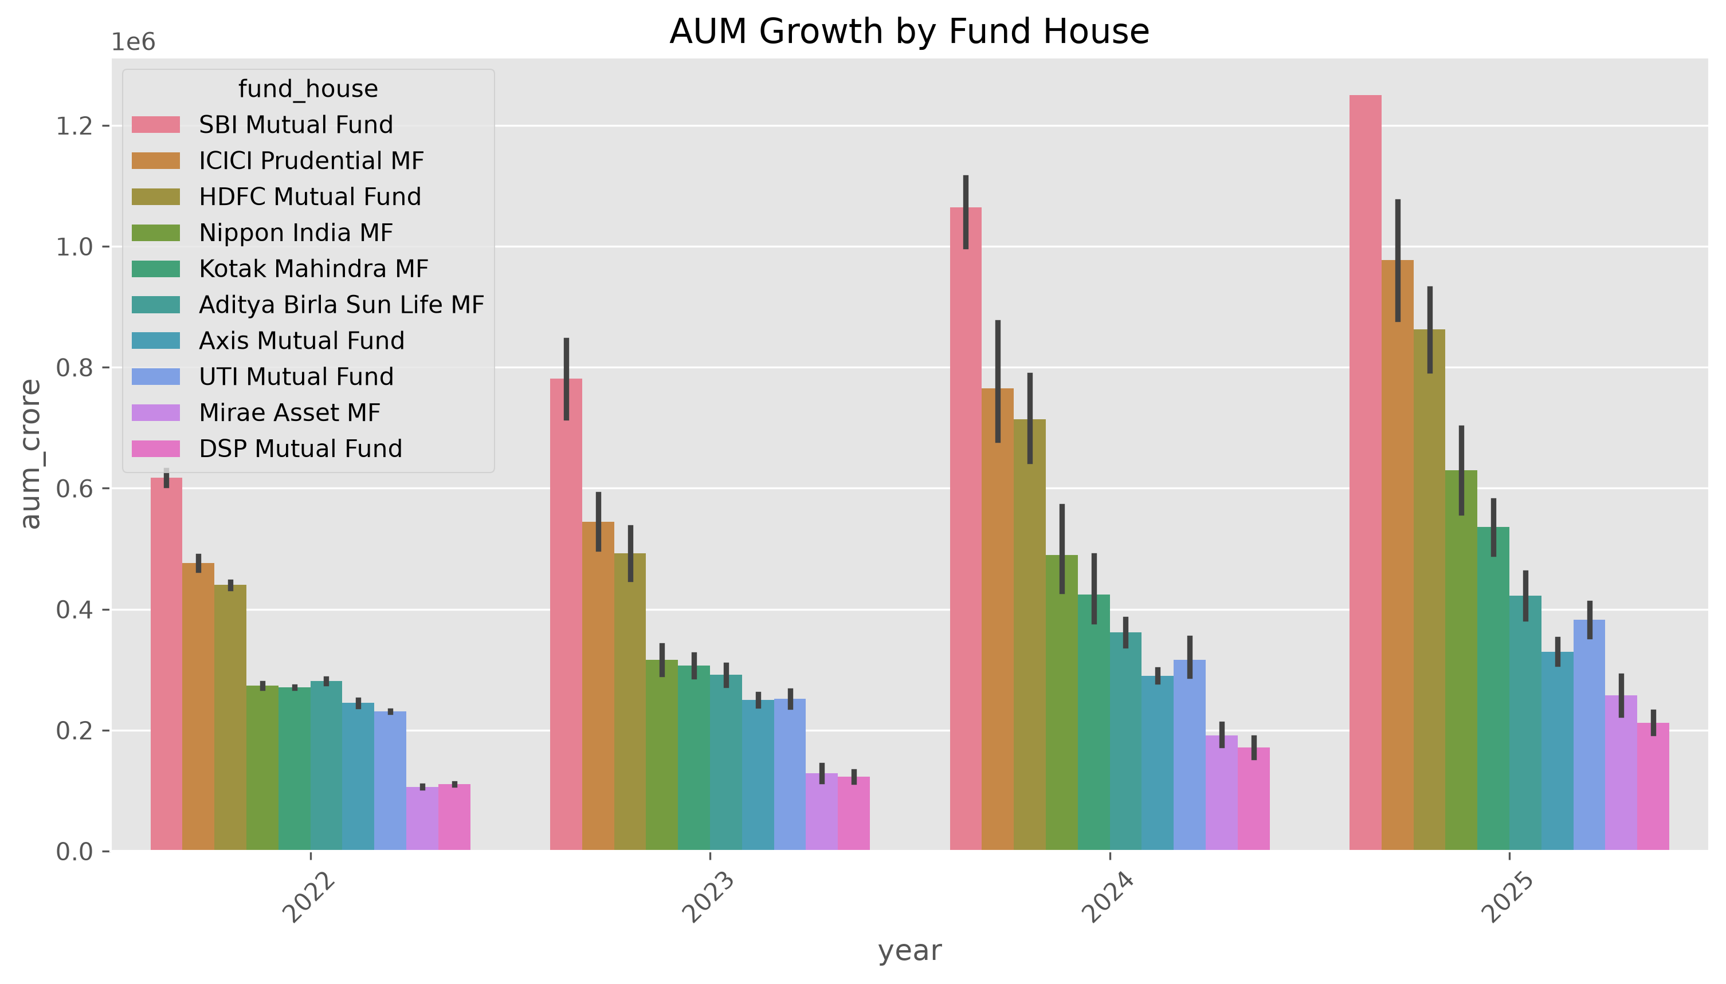
EDA Highlights - Industry
Key Findings
NAV increased steadily.
AUM showed continuous growth.
SIP investments increased yearly.
Investor participation improved.
Industry showed positive growth.

Slide 6
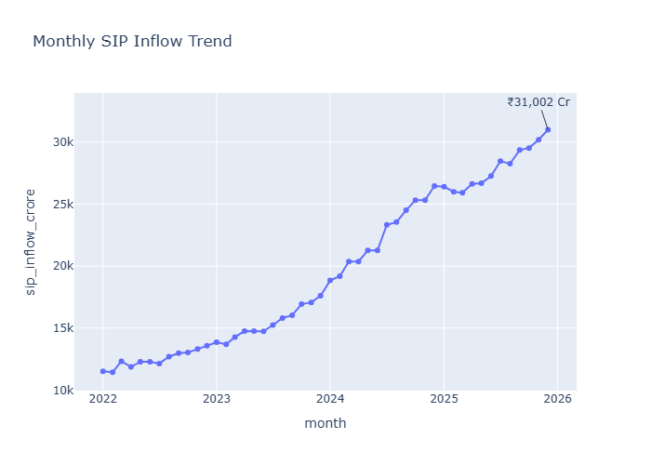
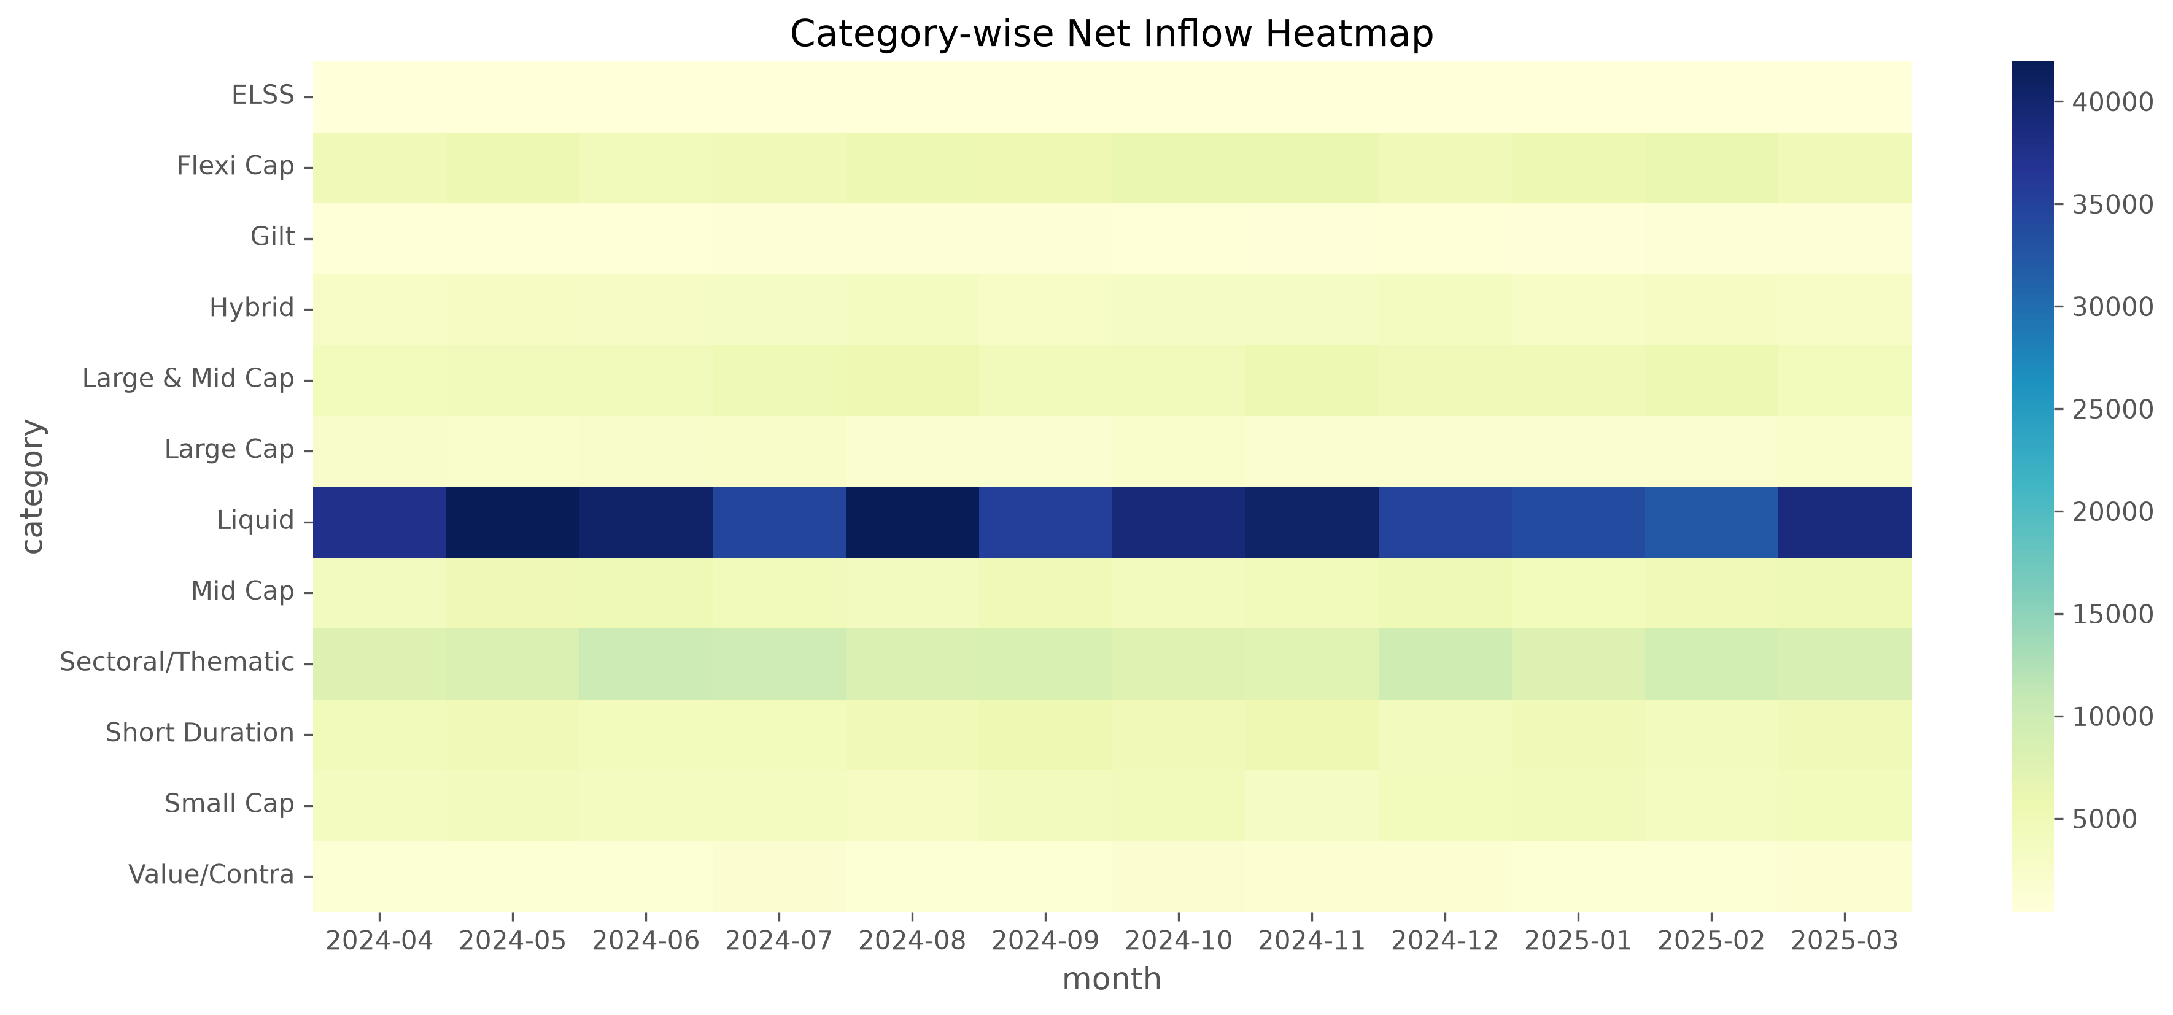
EDA Highlights – Investment Patterns
Key Findings
Equity funds received more investments.
Category inflows changed monthly.
Long-term investments increased.
Market trends affected fund inflows.
Investment patterns became clearer.

Slide 7
Performance Metrics
Financial Metrics Calculated
Daily Returns – Measured daily fund performance.
CAGR (1, 3 & 5 Years) – Calculated long-term annual growth.
Sharpe Ratio – Measured return compared to total risk.
Sortino Ratio – Evaluated return considering downside risk only.
Alpha – Measured fund performance against the benchmark.
Beta – Measured fund sensitivity to market movements.
Maximum Drawdown – Calculated the largest loss from peak value.
Fund Scorecard – Compared mutual funds based on overall performance.

Slide 8
Advanced Analytics & Risk Analysis
Advanced Analytics
Risk Metrics Calculated
Value at Risk (VaR) – Estimated the maximum expected loss at a given confidence level.
Conditional Value at Risk (CVaR) – Measured the average loss beyond the VaR limit.
Rolling 90-Day Sharpe Ratio – Evaluated changes in risk-adjusted returns over time.
Investor Cohort & SIP Analysis – Studied investor behaviour and SIP continuity.
Fund Recommendation System – Ranked mutual funds based on return, risk, and performance.
Benefits
Identified high-risk and low-risk mutual funds.
Measured downside risk more accurately.
Analysed investor investment patterns.
Compared funds using advanced financial metrics.
Helped investors choose suitable mutual fund schemes.

Slide 9
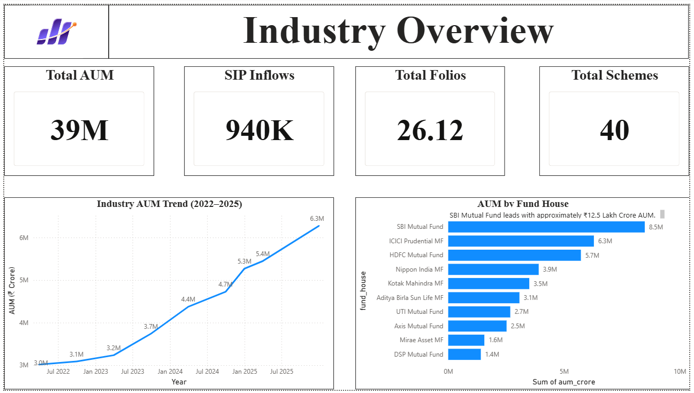
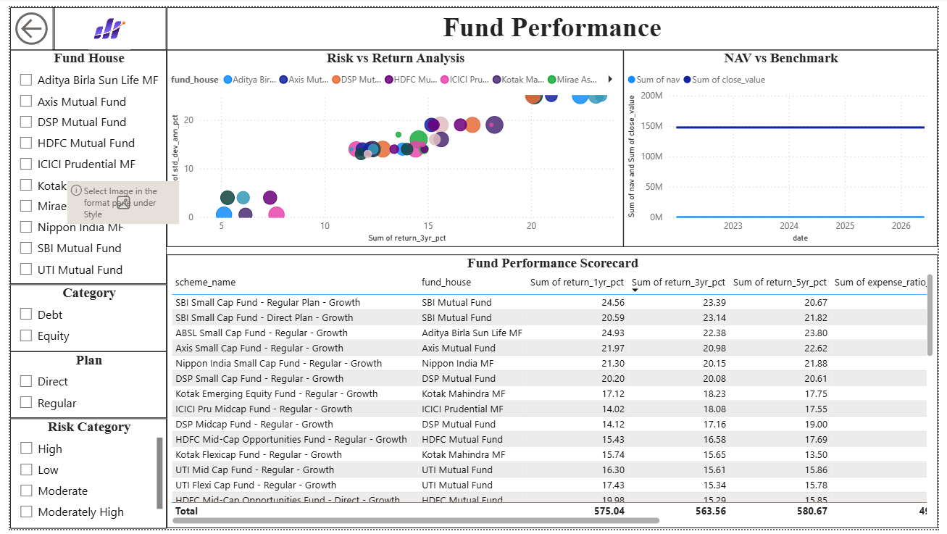
Dashboard 1 & 2
Industry Overview
1.Total AUM 2.Total SIP 3.Total Folios 4.Industry Growth
Fund Performance
1.Risk vs Return 2.NAV Trend 3.Benchmark Comparison 4.Fund Filters

Slide 10
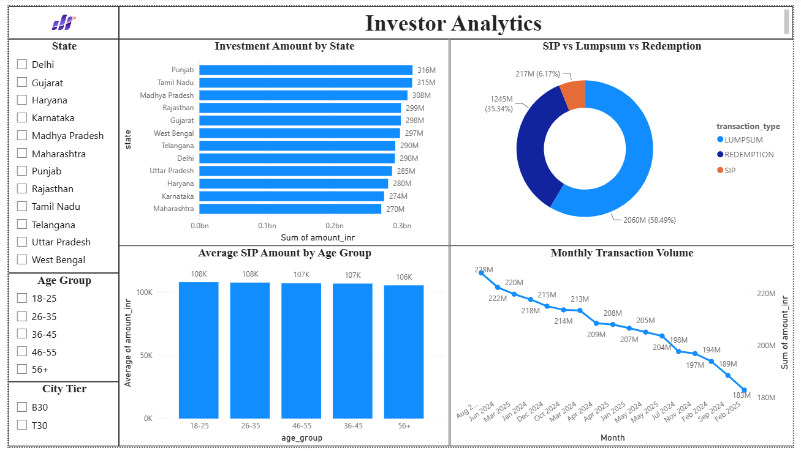
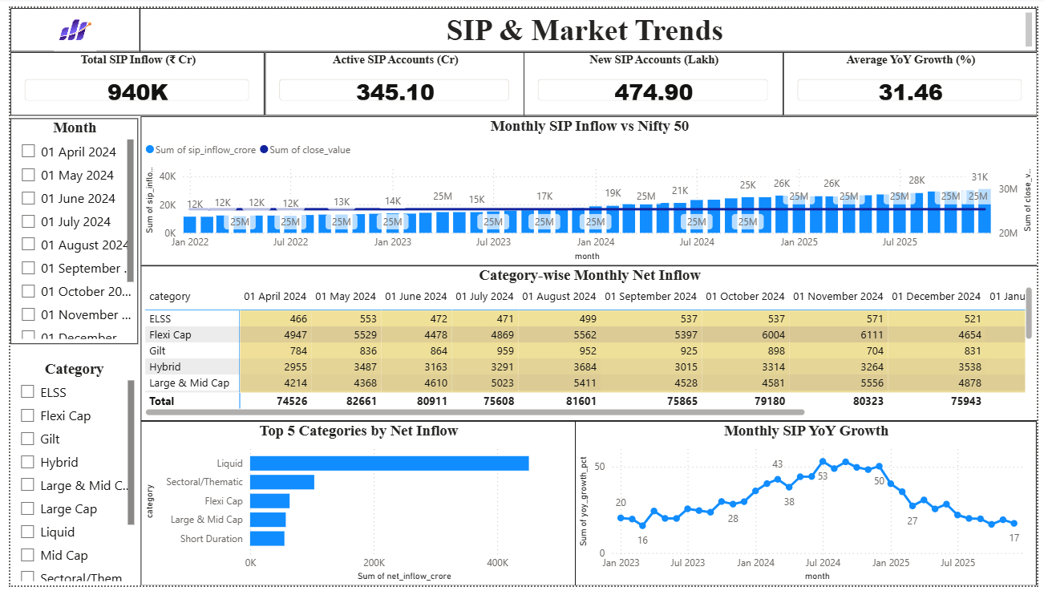
Dashboard 3 & 4
Investor Analytics
1.State-wise Investments 2.Age Group 3.AnalysisTransactions 4.Monthly Trends
SIP & Market Trends
1.SIP Growth 2.Nifty 50 Trend 3.Category Heatmap 4.Top Categories

Slide 11
Key Findings
Mutual fund AUM and SIP inflows showed consistent growth, indicating increasing investor participation.
Equity funds delivered better long-term returns compared to debt funds.
Large-cap funds demonstrated more stable performance with lower risk.
Performance metrics such as CAGR, Sharpe Ratio, Alpha, and Beta helped identify the best-performing funds.
Interactive Power BI dashboards simplified fund comparison and supported better investment decisions.

Slide 12
Thank You

