Slide 1

End User Problems

Slide 2

Future demands, reduce time to close the request
Utilize and engage existing talent pool
Current talent pool skill set visibility to hiring team
Look at their carrier path and work on employee retention
Pain Points
Notes:
Current challenge: How can Telstra more efficiently match employee skills with future demands to better utilise, engage and retain our people and help reimagine career paths across business lines.

Slide 3

Proposed solution
Proactive model to list down the future demands for talents, based on Historical data Analytics.
Recommendation engine based on Machine learning (Multi-dimension vector), to look on the internal talent pool for skills sets, availability/current utilization, cost and performance metrics.
Recommendation engine for employee on technology training to build their career path and improve overall profile score.
Visibility of open project for employees desired technology/skills
Flexibility to employee to pitch in for small or adhoc assignment to improve the profile score system.

Slide 4




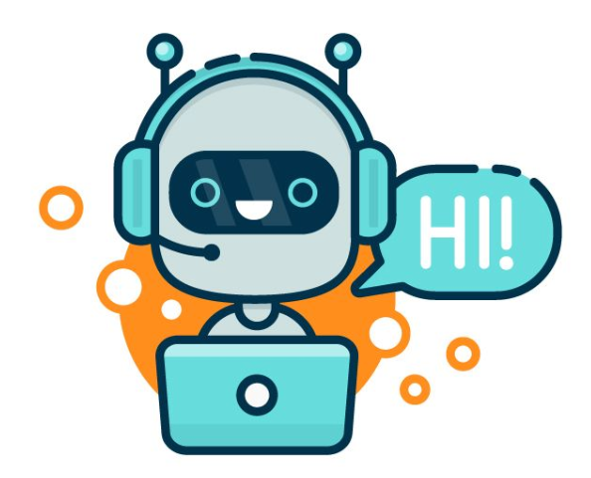
High Level Architecture
UI Interface
Recommendation engine
Master Database
API Gateway
CHAT BOT
Present Technologies used:
  Python
  Angular
  Azure & .Net core (BOT)

Slide 5
Business Benefits
Visibility to internal talent pool skill sets
Quick access to top recommended talent/employee list based on qualifying factors like (availability, performance, cost etc.) for demands.
Happy Employee: Platform for employee to work on cross business and desired technology project.
Employee driven, build carrier path.
Mobility: with interactive interface like chat bot.

Slide 6




Recruitment team to Analyse the existing talent pool’s skill set to match with demands.
  Manual efforts may take half a day to list down the employees with matching (or nearest technology)
  based on availability, cost and performance.
solution provides: the desired list with in a second.
Cost saving: half day man efforts
Employee career – list of training to scale-up desired skill set.
  Currently it’s difficult to find the desired list of training and mentor in organization to help in building career path.
solution provides: relevant list of training based on current skill level along with mentor.
Helping building career path

Slide 7


Estimated time & cost
Interface: UI & Dashboard (4 weeks)
BOT Interface development and Integration with LUIS (4 weeks)
Rec. Engine: 4 weeks Development
Database and integration with other system: 4 Weeks
Approx.: 4 Months = $80k

Slide 8
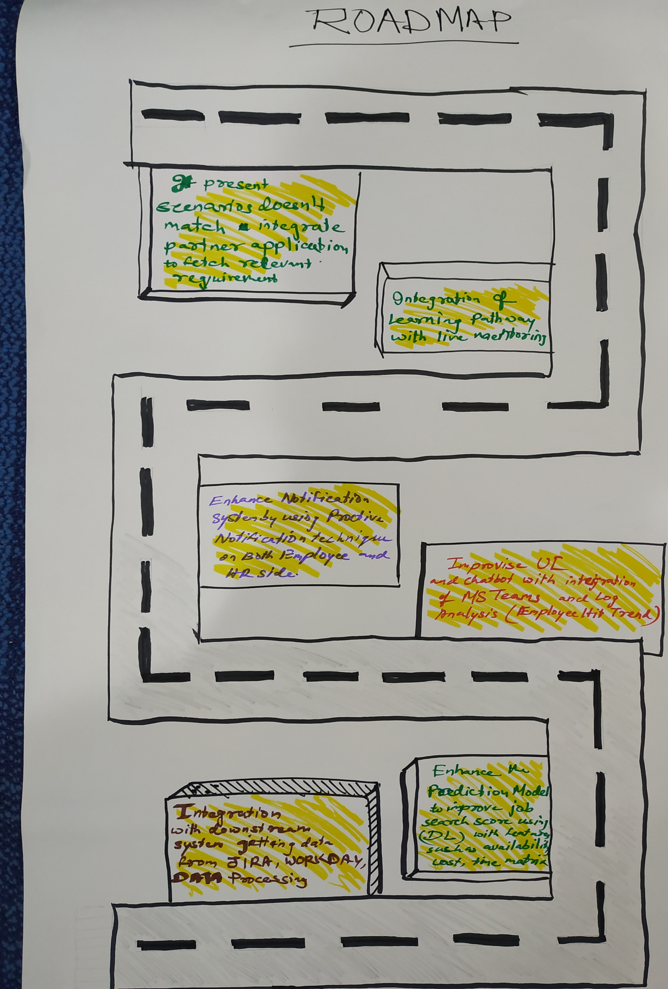
RoadMap

