Slide 1
Cascadia Robotics, Inc.
Company Overview - Fiscal Year 2026
Prepared by Corporate Strategy | July 2026

Slide 2
Agenda
Who we are and what we build
FY2026 performance snapshot
Revenue by business segment
Fulfillment network at a glance
Priorities for the next twelve months
Questions and discussion

Slide 3
Who We Are
Founded 2014 in Portland, Oregon; 640 employees across 6 sites
We design and build warehouse automation robots
  Line-side tote shuttles (Kestrel series)
  Autonomous pallet movers (Osprey series)
  Fleet orchestration software (Skyway platform)
212 customer deployments in North America and Europe
FY2026 revenue of $148.6M, up 22% year over year

Slide 4
Revenue by Segment (FY2026)
Segment | FY2025 ($M) | FY2026 ($M) | Growth | Share
Kestrel shuttles | 58.1 | 71.4 | +22.9% | 48.1%
Osprey pallet movers | 36.9 | 43.2 | +17.1% | 29.1%
Skyway software | 18.3 | 24.7 | +35.0% | 16.6%
Service and spares | 8.5 | 9.3 | +9.4% | 6.2%
Total | 121.8 | 148.6 | +22.0% | 100.0%

Slide 5
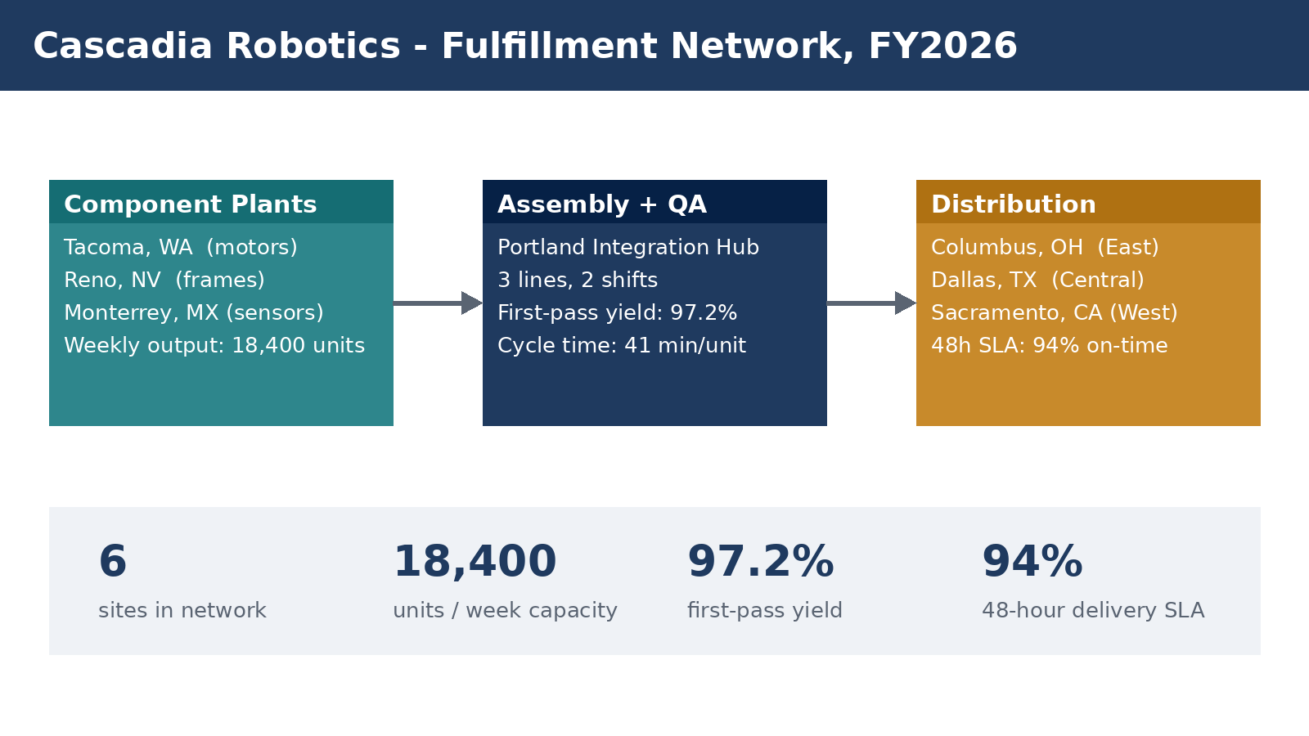
Fulfillment Network at a Glance

Slide 6
Priorities for FY2027
Scale Skyway platform to 40% software attach on new deployments
Open the Rotterdam integration hub to serve EU customers locally
  Target: first EU-assembled units shipping by March 2027
Reduce unit cost of the Kestrel K-300 by 11% via redesign
Grow service contract renewals from 81% to 90%
Maintain first-pass yield above 97% while adding a third line

