Slide 1
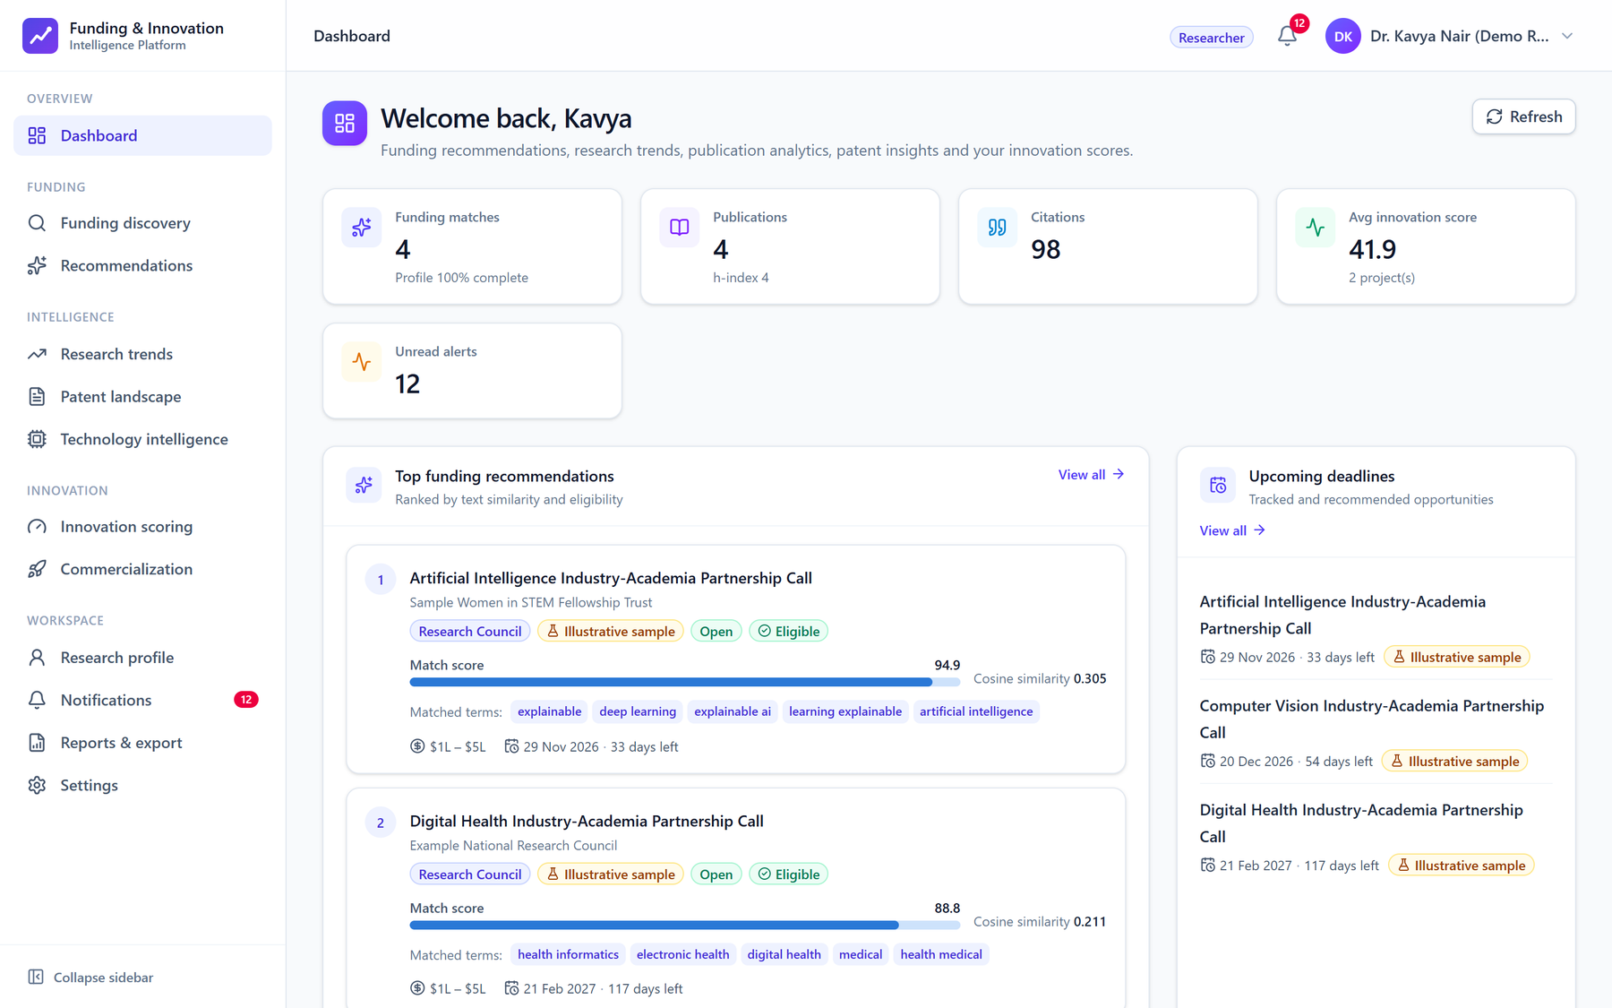
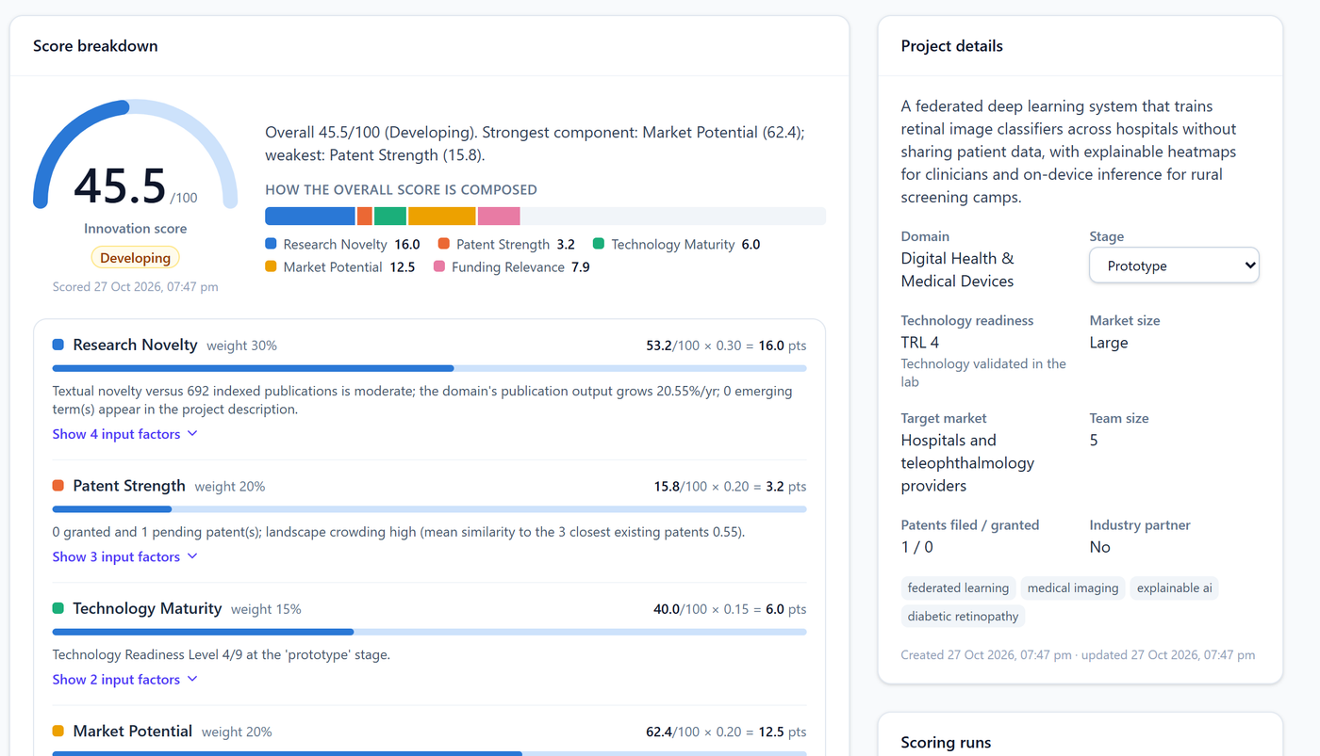
Research Funding &
Innovation Intelligence
Platform
CAPSTONE PROJECT · 2026
Find the right funding. See where innovation is heading.
Funding discovery, research and patent intelligence, innovation scoring and commercialization guidance for researchers, startups and innovation teams.
FastAPI
React
PostgreSQL
scikit-learn
Docker
Notes:
Introduce the project: a full-stack platform that helps researchers, startup founders and innovation managers find relevant funding, understand research and patent landscapes, score innovations and plan commercialization. The screenshots are from the running application.

Slide 2




Funding and innovation signals are scattered
Fragmented funding
Fast-moving landscapes
Gut-feel decisions
Calls live on many portals, each with its own eligibility rules, deadlines and formats.
Research topics and patent activity shift faster than small teams can monitor.
Licensing, spin-out or partnership choices are made without comparable evidence.
Objective Give researchers, startup founders and innovation managers one place to find relevant funding, read research and patent landscapes, and decide what to commercialize.
Notes:
Three pain points motivated the project: funding information is fragmented, research and patent landscapes move quickly, and commercialization choices lack comparable evidence. The objective comes straight from the project brief.

Slide 3
















One platform: 12 modules for 4 roles
WHO IT SERVES
WHAT IT DOES
Researcher
Funding matches, research trends, publication analytics
01
02
03
04
Authentication & roles
Research profile
Funding discovery
Recommendations
Startup founder
Accelerators, white-space areas, competitor patents
05
06
07
08
Innovation manager
Research trends
Patent landscape
Technology intelligence
Innovation scoring
Portfolio, pipeline board, funding analytics
Administrator
09
10
11
12
Users, datasets, monitoring, audit trail
Commercialization
Role dashboards
Alerts & notifications
Reports & admin
Notes:
All twelve modules from the specification are implemented and integrated. Each role gets its own dashboard; managers and administrators can preview the other views.

Slide 4







Architecture: React client, modular FastAPI core
FastAPI service
86 endpoints · Python 3.13 · SQLAlchemy 2
ORM
PostgreSQL / SQLite
Auth · JWT · RBAC
Profiles & publications
17 tables · Alembic migrations
React SPA
REST/JSON
Vite · Tailwind · Recharts
24 pages, 4 role dashboards
JWT sent with every request
Funding & tracking
Recommender (TF-IDF)
Research analytics
Patent landscape
Public data sources
Technology intelligence
Innovation score
data sync
Grants.gov · OpenAlex
Crossref · PatentsView (API key)
Snapshots keep it working offline
Commercialization
Alerts · reports · admin
Docker: PostgreSQL + API + nginx
GitHub Actions: tests, migrations, build
bcrypt · JWT · role checks · audit log
Notes:
A single FastAPI service hosts every module behind clean package boundaries; the React SPA talks to it over REST with JWT. The same Alembic migration runs on SQLite for development and PostgreSQL in Docker. Public APIs are optional: bundled snapshots make the app work offline.

Slide 5
Real data first, synthetic data always labeled
VERIFIED
REAL
93
692
funding calls from Grants.gov, with official links and retrieval dates
publications from OpenAlex (CC0) with abstracts, venues and citations
REAL
ILLUSTRATIVE
210
545
yearly trend points across 15 technology areas
patents numbered ILLUS-*; no real patent numbers invented
Source: OpenAlex snapshot of 27 Oct 2026; yearly counts of works matching each area's title/abstract query, CAGR 2020→2025 with 2-year-averaged end points.
Notes:
Real data comes from official or open sources: 93 open or forecasted Grants.gov opportunities with links and retrieval timestamps, 692 OpenAlex works and yearly trend counts. Where no free source exists (patents) the data is synthetic and labeled everywhere, so nothing fabricated can be mistaken for a real record. The chart is real OpenAlex data.

Slide 6
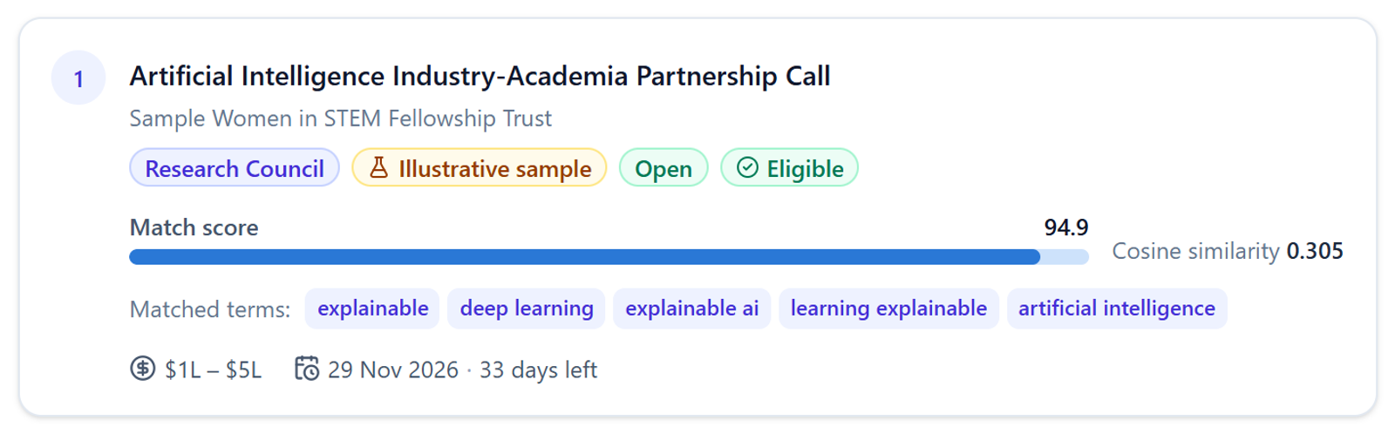
Explainable funding recommendations
1
2
3
4
5
Profile text
TF-IDF vectors
Cosine similarity
Eligibility rules
Match + reasons
Keywords, domains, bio and publication titles
Uni- and bi-grams; domain stop-words removed
Against every open or forecasted call
Deadline, applicant type, country, career stage
Score with matched terms and a checklist
match = 100 × (0.65 · relevance + 0.15 · domain overlap + 0.20 · eligibility) where relevance = 1 − e^{−cosine/0.12}
Example: the demo researcher's top match, with its matched terms
OFFLINE EVALUATION · 15 PERSONAS
0.947
0.973
12/12
precision@5
recall@5
eligibility rules
Persona = one technology area; relevant = calls tagged with it.
Notes:
The recommender is deliberately explainable: TF-IDF and cosine similarity give topical relevance, rule-based eligibility checks hide calls the user cannot apply for, and every match lists the terms that drove it. Offline evaluation with one synthetic persona per area gives precision@5 of 0.947 and recall@5 of 0.973; the eligibility engine passes all 12 labeled rule scenarios.

Slide 7
Innovation Score: a transparent weighted model
30%
Research novelty
TF-IDF distance from 692 publications, field growth, emerging terms
20%
Patent strength
Own patents and citations, freedom-to-operate proxy
15%
Technology maturity
Technology readiness level (1–9) and pipeline stage
20%
Market potential
Market size, adoption and funding signals, industry partner
15%
Funding relevance
45.5 / 100 “Developing” — demo retinopathy-screening project
Strength and number of eligible funding matches
Bands: Early < 40 ≤ Developing < 60 ≤ Promising < 75 ≤ High. A heuristic decision-support score with visible factors — not a validated prediction of commercial success.
Notes:
The weights are exactly those in the brief. Each component blends data-driven signals with project inputs, and the UI shows every factor. Example: the demo retinopathy project scores 45.5 — strong market and funding relevance, weak patent position. The score supports decisions; it is not a prediction.

Slide 8
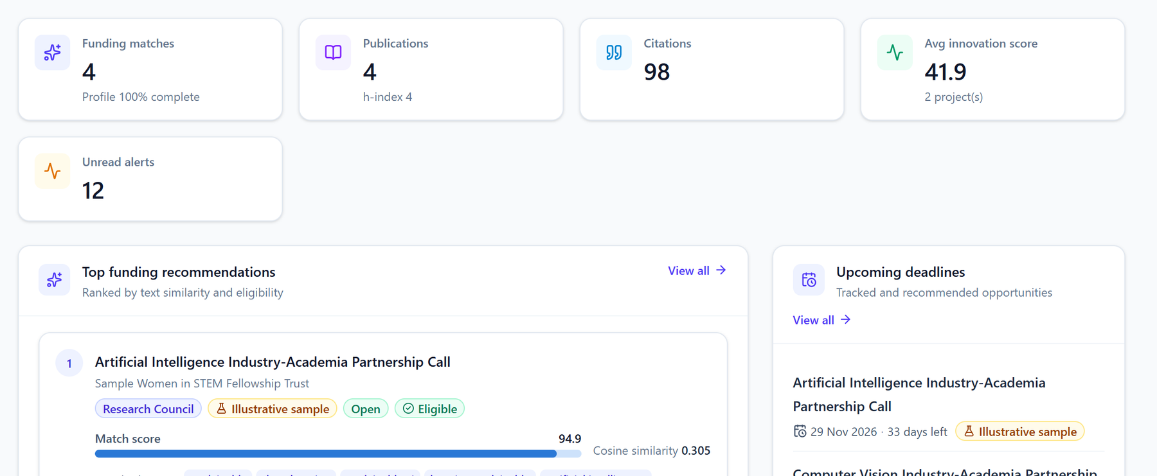
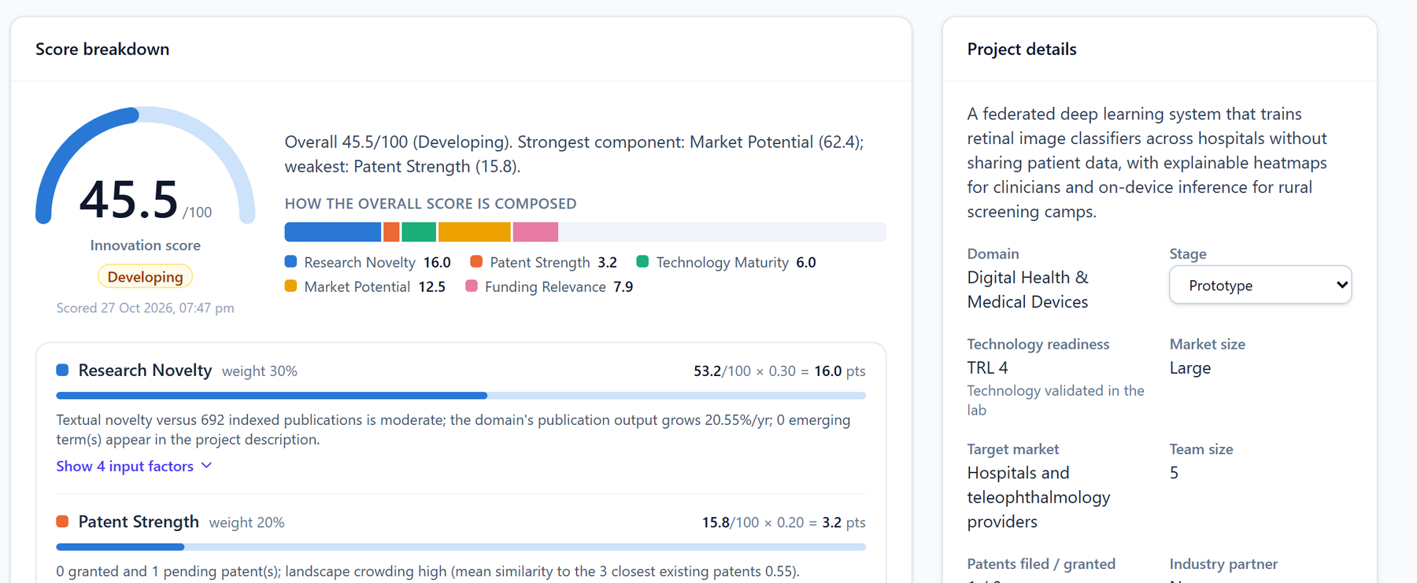
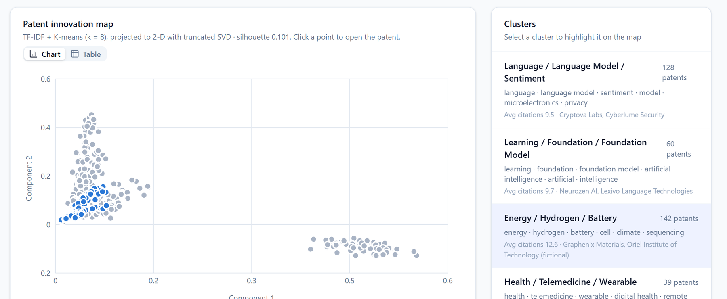
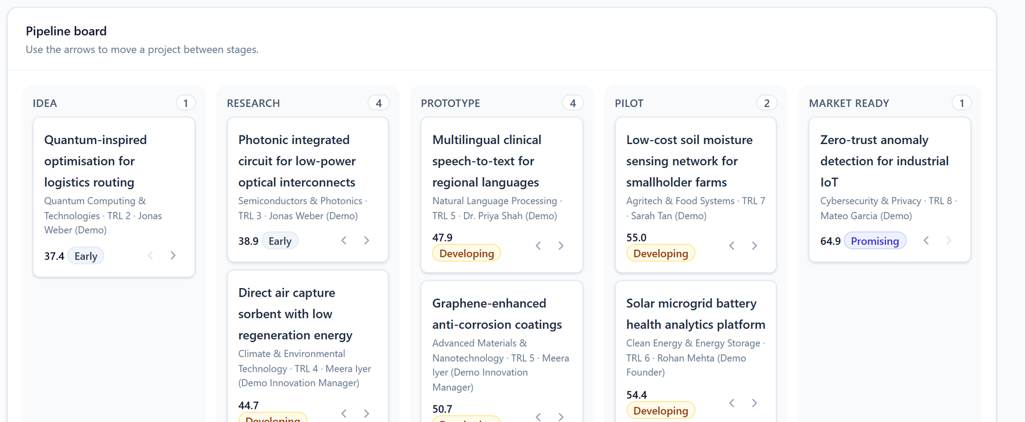
One workspace, four role views
Researcher dashboard
Innovation score breakdown
Patent cluster map
Manager pipeline board
Notes:
Screenshots of the running application. Researchers see ranked, explained matches; every project gets a score breakdown; the patent module clusters filings into technology groups (illustrative data, clearly bannered in the app); innovation managers move projects through a pipeline board.

Slide 9
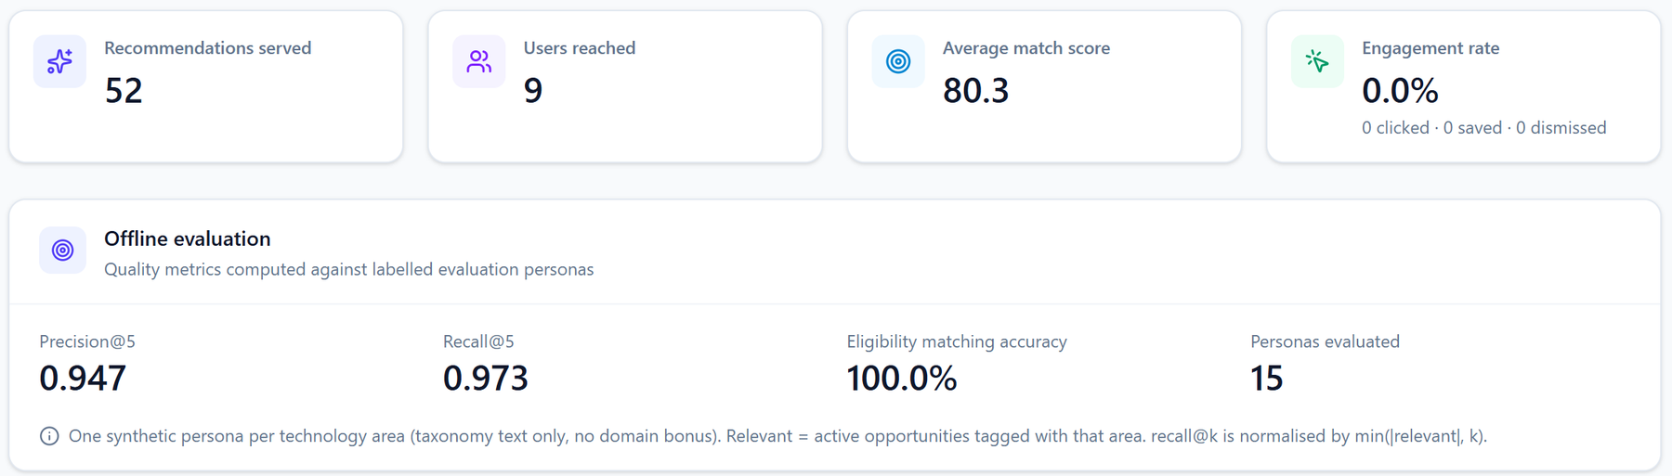
Tested end to end before handover
70 / 70
27 / 27
42
15
backend unit and API tests passing (pytest)
end-to-end workflow steps on a live server
route, tab and role views checked at 375 px phone width
defects found by a browser walkthrough and fixed
Admin console → Recommendation monitoring (live)
Automated tests cover
Auth, RBAC and login throttling
Eligibility rules and scoring formula
Analytics, clustering, alerts
PDF, Excel and CSV exports
CSV/JSON imports and offline fallbacks
Notes:
Quality was checked at three levels: 70 automated backend tests, a 27-step end-to-end script against a live server, and a manual browser walkthrough of every page for all four roles, including phone width. The walkthrough found 15 issues the tests had missed — data quality, labels, ranking and layout — all fixed.

Slide 10



Outcomes and next steps
Delivered
Honest limits
Next steps
86 API endpoints, 24 UI pages
Docker Compose and CI workflow
One-command Windows setup
Docs: architecture, API, viva Q&A
Scores are heuristics, not predictions
Patents illustrative until real data is imported
Verified funding is U.S. federal only
Docker stack not yet run end to end
Embedding search (FAISS / pgvector)
Learning-to-rank from user feedback
More official funding connectors
Real patent ingestion, user study
Thank you — questions welcome
Setup guide, architecture, API reference, demo script and viva Q&A are in the project’s docs folder.
Notes:
Summarize what was delivered, be upfront about the limits (heuristic scores, illustrative patents, U.S.-only verified funding, Docker not run on the build machine), and close with the most valuable next steps.

