Slide 1
Project Report: CrewAI 6-Month Marketing Plan

Slide 2
Summary
Detailed marketing plan for CrewAI covering Q2-Q3 2025, focusing on lead generation and conversion. Includes strategy, tactics, budget, and KPIs.

Slide 3
Target Audience
Tech leaders, data scientists, and developers interested in AI automation and multi-agent systems

Slide 4
Marketing Campaigns
Content Marketing (LinkedIn focus, blog posts, whitepapers, webinars), Paid Advertising (Google Ads, LinkedIn Ads), Email Marketing, Social Media (LinkedIn, Twitter, YouTube), Website Optimization

Slide 5
Campaign 1
Content pillars: Thought Leadership

Slide 6
Campaign 2
Technical Deep Dives

Slide 7
Campaign 3
Case Studies. Budget Allocation: Content Marketing 35%

Slide 8
Campaign 4
Paid Advertising 30%

Slide 9
Campaign 5
Email Marketing 15%

Slide 10
Campaign 6
Social Media 10%

Slide 11
Campaign 7
Website Optimization 10%.

Slide 12
Budget Allocation
$100,000 (6-month budget). KPIs: Website Traffic, Lead Generation, Lead Conversion Rate, Cost Per Lead, Customer Acquisition Cost (CAC), Return on Investment (ROI).

Slide 13
KPIs
Increase Qualified Leads by 30%, Improve Lead Conversion Rate by 15%, Increase Website Traffic by 20%, Establish CrewAI as a thought leader.

Slide 14
Conclusion
Comprehensive plan with detailed strategies, tactics, budget, and KPIs for Q2-Q3 2025, aiming for significant lead generation and conversion growth.

Slide 15
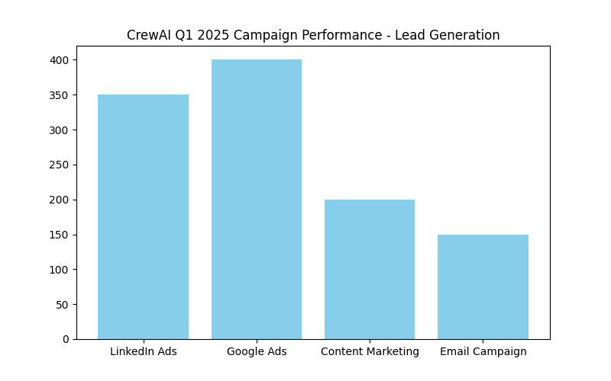
Campaign Performance

Slide 16
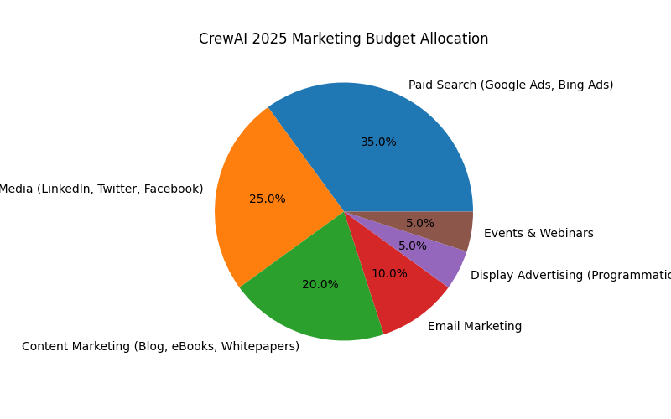
Budget Allocation

Slide 17
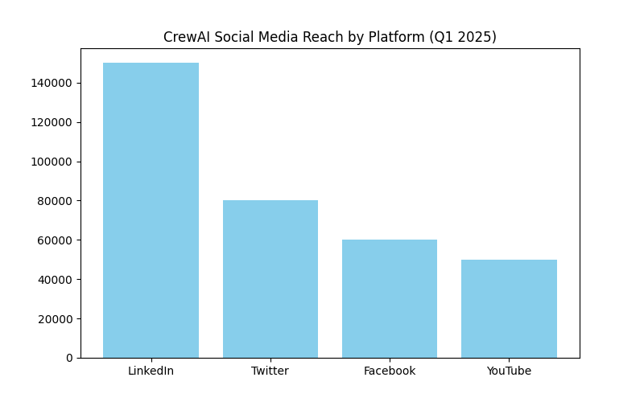
Social Media Reach

