Slide 1
Project Report: CrewAI Marketing Plan

Slide 2
Summary
Comprehensive marketing plan for CrewAI targeting Financial Services, Healthcare, and Marketing & Sales verticals. Focuses on LinkedIn advertising, website content, and performance measurement.

Slide 3
Target Audience
Marketing professionals, decision-makers in Financial Services, Healthcare, and Marketing & Sales.

Slide 4
Marketing Campaigns
LinkedIn Advertising, Website Content (Case Studies, Blog Posts, “Evaluate Your Use Case” tool), Email Marketing, Webinars

Slide 5
Campaign 1
LinkedIn Ads (Sponsored Content

Slide 6
Campaign 2
InMail

Slide 7
Campaign 3
Lead Gen Forms)

Slide 8
Campaign 4
High-Value Website Content (Case Studies

Slide 9
Campaign 5
Blog Posts

Slide 10
Campaign 6
White Papers

Slide 11
Campaign 7
Webinars

Slide 12
Campaign 8
Landing Pages)

Slide 13
Campaign 9
“Evaluate Your Use Case” tool with personalized questions and lead magnets

Slide 14
Budget Allocation
40% LinkedIn Ads, 25% Content Creation, 15% Marketing Automation, 10% CRM, 10% Contingency

Slide 15
KPIs
Website Traffic, MQLs, SQLs, Conversion Rates, CAC, LTV, Revenue per Vertical

Slide 16
Conclusion
This comprehensive plan provides a roadmap for CrewAI’s marketing success. Consistent implementation, rigorous measurement, and ongoing optimization are crucial for achieving desired results and establishing CrewAI as the leader in multi-agent AI solutions.

Slide 17
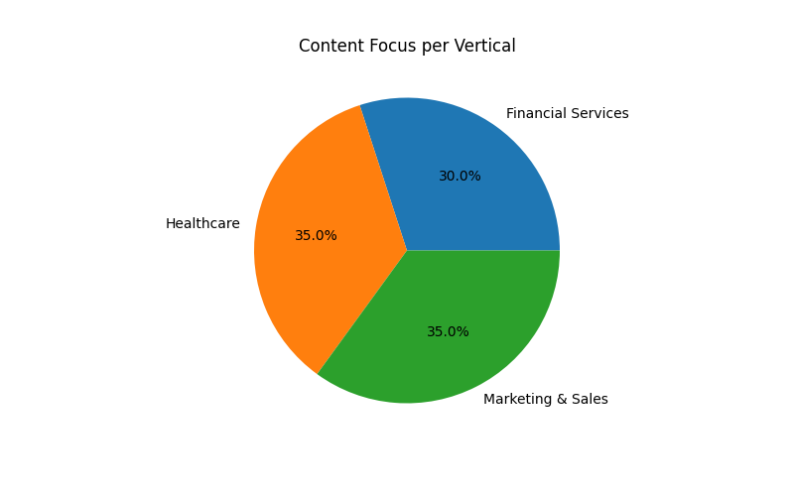
Content Focus

Slide 18
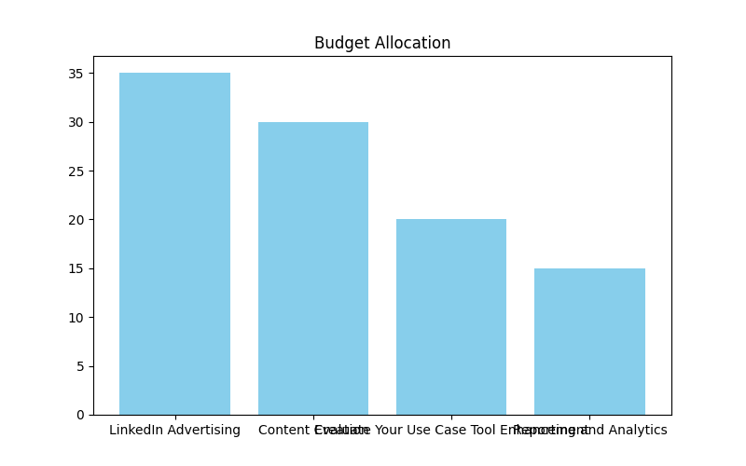
Budget Allocation

Slide 19
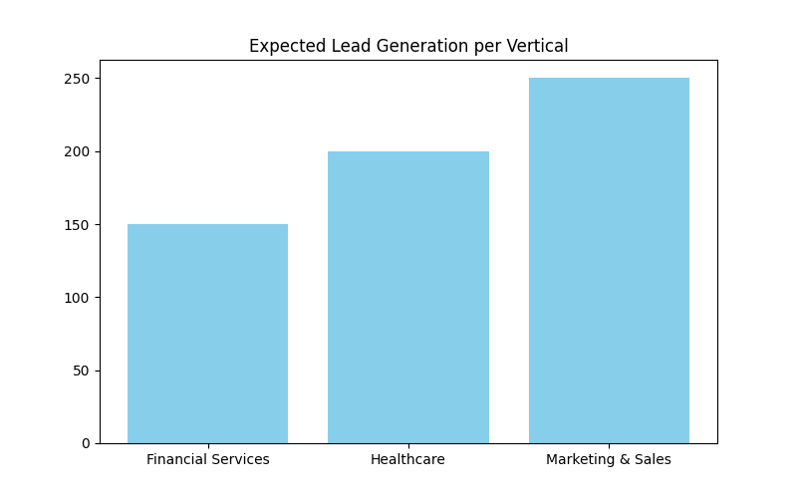
Lead Generation

