Slide 1
Composer Classification from MIDI
Six machine-learning models on 186 music-theory features
UE24CS352A Machine Learning | Mini-Project
Notes:
Introduce the problem in one sentence: given a MIDI file of a classical piece, predict the composer. We compare six classic ML models on 186 music-theory features, based on a Stanford CS229 paper.

Slide 2
The task: name the composer from notes
The idea
Composers have a style, like handwriting. Bach: many small steps with melodies woven together. Liszt: fast, leaping, tense. Debussy: clashing, dreamy harmonies.
A computer can't hear style, but it can count: how often notes jump, how many sound at once, how loud the piece is. If composers have different counts, a program can learn to tell them apart.
Why is it hard?
Same-period composers (e.g. Mozart and Haydn) sound alike. Humans got only 57% right in one study.
Why MIDI, not MP3?
A MIDI file is sheet music for a computer: which notes, when, how long, how hard. No recording quality or singer, so the program must judge the music itself.
MIDI file
>
Count 186 things
>
186 numbers
>
ML model
>
Composer
Notes:
Composers have a style like handwriting. A computer cannot hear style but it can count things, so we count 186 properties of each piece and let machine-learning models learn which counts go with which composer. It is hard because same-period composers sound alike; humans only got 57% on Mozart vs Haydn in one study. MIDI is sheet music for a computer, so there is no recording quality or performer sound to rely on.

Slide 3
Data: MAESTRO piano performances
1,276
recordings; many pianists play the same piece
785
unique pieces: one recording kept per piece
725
pieces by 13 composers with 20+ pieces each
Then split into three piles
435 to learn from (train)
145 to pick the best model (dev)
145 as the final exam (test)
Notes:
MAESTRO v3.0.0 has 1,276 recordings. The same piece is played by several pianists, so we kept one recording per piece, removed 54 arrangements credited to two composers, and dropped composers with fewer than 20 pieces. Result: 725 pieces by 13 composers. We then split them into three piles: 435 to learn from, 145 to choose the best model, 145 as the final exam. Keeping one recording per piece means the test pieces are never music the model has already seen.

Slide 4
Pipeline: from MIDI file to composer
1
2
3
4
5
MIDI file
186 features
Split + scale
Six models
Composer
>
>
>
>
list of notes
style counts
60/20/20, train-only scaler
fit and compare
top-5 guesses
Notes:
Walk left to right. Parse the MIDI into a list of notes, compute 186 features, split 60/20/20 and scale using training pieces only, train and compare the six models, then predict the composer of a new file. Each stage is a separate script (midi_utils, features, prepare_data, train_tabular, predict) so it can be re-run on its own.

Slide 5
186 features in six families
64
35
19
Pitch
Melodic intervals
Vertical intervals
which notes and key; range
steps, leaps, direction
chords, dissonance, parallel fifths
34
8
26
Rhythm
Dynamics
Texture
note lengths, density, tempo
loudness and its variation
voices at once, instruments
Notes:
Each piece is summarised by fixed-size statistics so every piece becomes a vector of the same length. Pitch features are rotated to the detected tonic, so a piece and its transposition look alike. Vertical features include the dissonance ratio and parallel fifths/octaves.

Slide 6
Six models, one job
Softmax regression
SVM (RBF kernel)
LDA
Weights each feature, sums them into a score per composer and picks the highest. Straight-line boundaries only.
Finds the boundary with the widest empty gap between composers; a kernel lets it curve around clusters.
Treats each composer's pieces as a bell-shaped cloud and assigns a piece to the nearest cloud.
k-NN
Neural net (MLP)
LightGBM
Looks up the 5 most similar training pieces and lets them vote. Nothing is learned in advance.
A small network: 150 hidden units learn useful combinations of features by trial and error.
Builds many small decision trees one after another, each trained to fix the previous trees' mistakes.
Notes:
All six receive the same standardised 186-number vector and output a composer. They differ in how they find the rule: a weighted sum (softmax), a maximum-margin boundary (SVM), Gaussian classes (LDA), nearest neighbours (k-NN), a one-hidden-layer network (MLP), and boosted decision trees (LightGBM).

Slide 7
Settings used for each model
Model | How it decides | Settings
Softmax | Highest softmax score | L2 penalty, C = 0.1
SVM (RBF) | One-vs-one votes (78 pair SVMs) | C = 5.5, gamma = 1/186
LDA | Nearest class mean, shared covariance | shrinkage = auto
k-NN | Distance-weighted vote | k = 5
MLP | 150 ReLU units then softmax | SGD, lr 0.04, momentum 0.9, batch 50, L2 1e-3
LightGBM | Sum of 700 rounds of trees | lr 0.05, lambda 10, row 0.6, column 0.5
Notes:
Values follow the paper where it gives them (SVM C=5.5, MLP 1x150 with SGD lr 0.04 momentum 0.9, LightGBM 700 rounds with L2 10 and bagging 0.6). LDA and k-NN settings were our choice. These were not re-tuned on our features.

Slide 8
How we keep the evaluation honest
1
60 / 20 / 20
Stratified train / dev / test split, every composer in all three
2
Train-only scaling
Means and standard deviations come from training pieces only
3
Select on dev
The best model is chosen on dev accuracy, never on test
4
Test once
Test accuracy plus macro precision, recall and F1 are reported once
Notes:
Dev picks the model, test is touched once. The scaler is fit on training pieces only so test statistics cannot leak. Macro averaging gives rare composers like Brahms the same weight as Chopin.

Slide 9
Results: LightGBM leads, top three tie
0.869
LightGBM test accuracy, 13 composers
0.7 pts
one test piece, so the top three are tied
Notes:
LightGBM has the highest test accuracy at 0.869, then SVM and Softmax at 0.855. With only 145 test pieces one piece is about 0.7 points, so these three are statistically tied. k-NN is weakest because distances degrade in 186 dimensions. LDA had the best dev accuracy, so it is the model predict.py loads by default.

Slide 10
Precision, recall and F1 per model
Model | Train acc. | Dev acc. | Test acc. | Precision | Recall | F1
LightGBM | 1.000 | 0.834 | 0.869 | 0.880 | 0.785 | 0.800
SVM (RBF) | 1.000 | 0.848 | 0.855 | 0.890 | 0.806 | 0.807
Softmax | 0.998 | 0.793 | 0.855 | 0.857 | 0.776 | 0.790
MLP | 1.000 | 0.841 | 0.841 | 0.820 | 0.779 | 0.784
LDA | 0.961 | 0.862 | 0.814 | 0.823 | 0.755 | 0.759
k-NN | 1.000 | 0.697 | 0.759 | 0.672 | 0.688 | 0.660
Test-set precision, recall and F1 are macro-averaged: each composer counts equally. Bold = best in column.
Precision
Of the pieces predicted as a composer, the share that really are.
Recall
Of a composer's real pieces, the share we found.
F1
A single score that balances precision and recall.
Notes:
Test-set accuracy plus macro-averaged precision, recall and F1: each score is computed per composer and then averaged, so rare composers like Brahms count as much as Chopin. Precision: of the pieces predicted as a composer, how many truly are. Recall: of a composer's true pieces, how many we found. F1 balances the two. SVM has the best macro-F1 (0.807) even though LightGBM has the best accuracy.

Slide 11
What the best model relies on
What is gain share?
LightGBM measures how much each split reduces its error (the gain). Gains are added up per feature family and divided by the total.
Pitch 47% means almost half of the error reduction came from pitch features.
Per feature, pitch, melodic and vertical are alike and over twice as useful as rhythm. Texture is near zero: piano only.
Notes:
Gain is the training-error reduction from splits on a feature, summed over all trees, then summed per family and divided by the total. Pitch is largest partly because it has 64 features. Per feature, melodic and pitch and vertical are similar and more than twice as useful as rhythm; texture is near zero because MAESTRO is piano only.

Slide 12
Era from one feature family at a time
Baseline 0.62
82 test pieces: 51 romantic, 18 baroque, 13 classical.
Texture is close to the baseline: piano only.
Notes:
We relabel pieces as baroque, classical or romantic and train LightGBM using only one feature family. The test set has 82 pieces: 51 romantic, 18 baroque, 13 classical, so always guessing romantic scores 0.622. Pitch and melodic features alone nearly match all features; texture is barely above the baseline because the data is piano only.

Slide 13
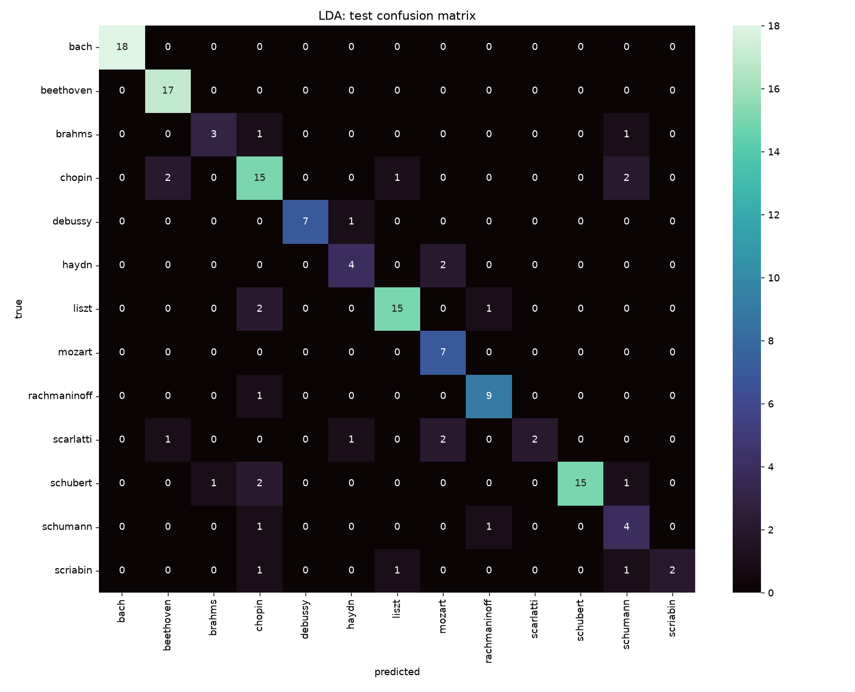
Where the models get confused
What it shows
Distant styles are rarely confused: Bach 18/18, Beethoven 17/17.
Neighbours mix: Chopin, Schumann, Schubert, Liszt; and Haydn, Mozart, Scarlatti.
Rare composers suffer most: Brahms 3/5, Scarlatti 2/6, Scriabin 2/5.
Similar statistics make same-era composers hard to tell apart.
Notes:
This is the test confusion matrix of the model chosen on dev, which is LDA. Most pieces sit on the diagonal. Distant styles are almost never confused (Bach 18/18, Beethoven 17/17). Mistakes concentrate between neighbouring composers and on composers with few pieces (Brahms 3/5, Scarlatti 2/6, Scriabin 2/5).

Slide 14
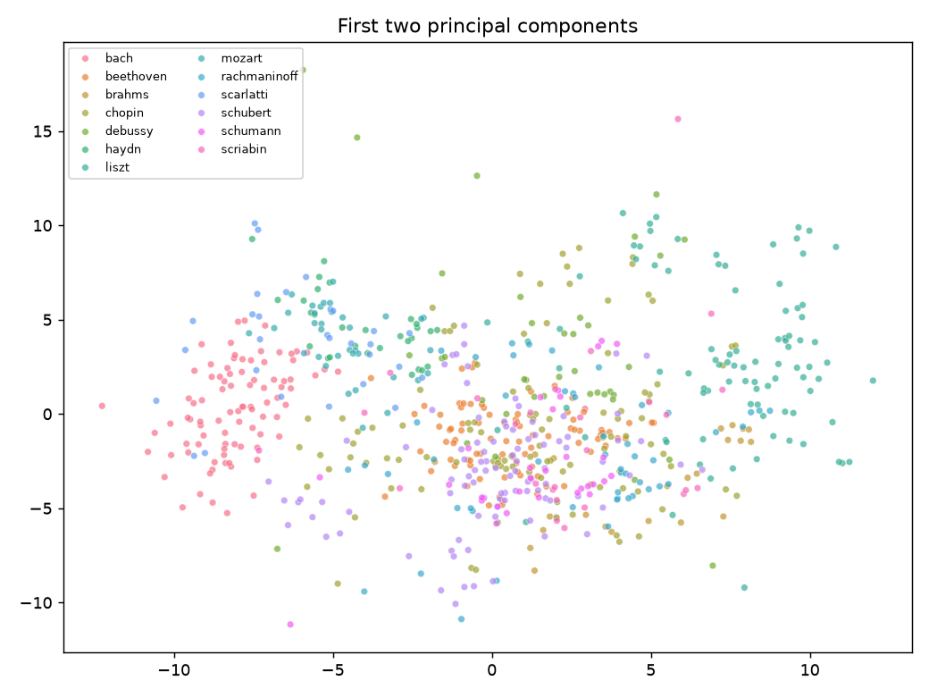
PCA scatter: what it shows
Each dot is a piece; close dots have similar statistics.
Distant styles separate: Bach far left, Liszt far right.
Same-era neighbours overlap: Haydn, Mozart, Scarlatti, and the romantic pianists in the middle.
Rough era order: baroque and classical left, romantic right.
Axes are PC1 and PC2 (27% of variance); colours were added after.
Notes:
Each dot is one piece placed by the first two principal components of its 186 standardised features. PCA is unsupervised: colours were added afterwards. Bach and Liszt separate, while Haydn, Mozart and Scarlatti overlap and the romantic pianists sit mixed in the middle. The two axes explain only 27% of the variance, so overlap here does not mean two composers cannot be separated in all 186 dimensions.

Slide 15
PCA and pairwise experiments
0.97
mean accuracy over 78 composer pairs
Dev accuracy rises with components: 0.45 at 2, 0.86 at 100.
Notes:
PCA squeezes the 186 features into k axes before an SVM. Training accuracy hits 1.0 by 50 components but dev accuracy keeps rising to about 0.85 at 100, so style information is spread across many directions. Pairwise: one logistic regression per pair of composers, 78 pairs, mean test accuracy 0.97.

