Slide 1
B.TECH MAJOR PROJECT
AWS Compute Optimizer Driven Rightsizing Programme
Team Members:
2400032408 - Prem Prakash
2400031777 - Tentu Divya Amrutha
2400031637 - Chimakurthi Lakshmi Janani
2400031630 - Samarth V Ratnam

Slide 2
Abstract
Cloud computing lets organizations rent resources on demand, but choosing the right size for those resources is difficult. Rightsizing is the process of matching a resource, such as an EC2 instance, to what its workload actually needs. When a resource is larger than needed, the organization pays for capacity it never uses; when it is too small, applications slow down and users are affected. Because workloads change over time, a configuration that was correct at launch often becomes inefficient later.
AWS Compute Optimizer addresses this by analyzing usage metrics such as CPU, memory and network activity and recommending better configurations. The proposed programme builds on these recommendations: it collects them, evaluates each one against its savings and performance risk, and applies suitable changes to rightsize the resources, repeating the process regularly. The expected outcome is higher resource utilization, lower unnecessary spending and a more reliable, easier to manage cloud environment.
2

Slide 3
Introduction
AWS Compute Optimizer is an AWS service that analyzes resource usage and recommends optimal configurations.
Rightsizing means changing a resource to the size that fits its real workload.
Over-provisioned resources waste money; under-provisioned ones slow down applications. Workloads change over time, so resources drift away from the right size.
Organizations need continuous optimization, not a one-time check.
AWS Resources
↓
Resource Usage
↓
Compute Optimizer
↓
Optimization Recommendations
↓
Rightsizing
3

Slide 4
Problem Statement
Cost / Resource Problems
Management / Optimization Problems
Cloud resources are often provisioned larger than necessary because teams prefer to be on the safe side. For example, an EC2 instance may run at very low CPU use for months and still be billed in full. The bottleneck is that unused capacity stays invisible unless usage is examined, so resources remain over-provisioned or underutilized and spending grows without adding value. The possible approach is to measure actual utilization and move each resource to the smaller size that still meets the workload, which reduces waste directly.
Finding these inefficiencies by hand is slow and error-prone, especially when an organization runs many instances across several accounts. Workload demand also keeps changing, so a size that was right once soon becomes outdated. The bottleneck is that manual analysis cannot keep up with the number of resources or the pace of change. The possible approach is to use AWS Compute Optimizer to analyze usage automatically and to review its recommendations regularly, so optimization becomes a continuous process instead of a one-time exercise.
4

Slide 5





Objectives
01
02
03
Identify over-provisioned resources
Detect underutilized resources
Use AWS Compute Optimizer recommendations
04
05
Improve resource utilization
Reduce unnecessary cloud expenditure
5

Slide 6
Proposed Solution / Core Idea
Continuous lifecycle: repeat
AWS Resources
Monitor / Collect Usage
AWS Compute Optimizer
Generate Recommendations
Evaluate Recommendation
Rightsize Resource
Monitor Again
›
›
›
›
›
›
EC2 instances running workloads
CPU, memory, network usage is recorded
Analyzes the usage data
Suggests better sizes
Check savings and performance risk
Apply the chosen size
Verify and repeat regularly
The cycle repeats, so resources stay matched to the workload.
6

Slide 7
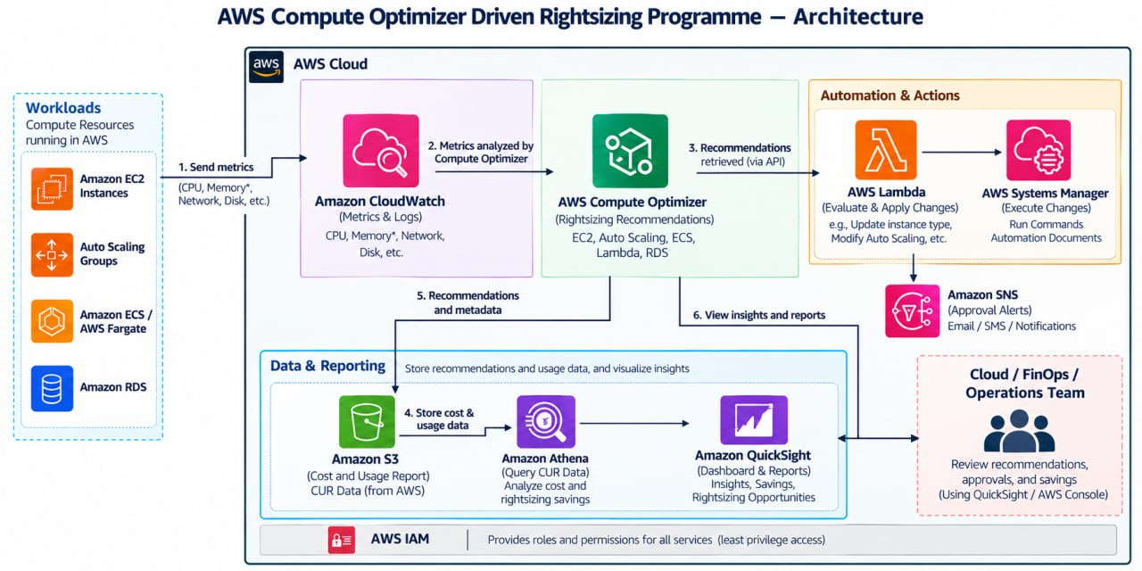
System Architecture & Resources Used
7

Slide 8
Conclusion & Future Scope
CONCLUSION
FUTURE SCOPE
Identifies inefficient resource allocation
Uses Compute Optimizer recommendations
Supports better resource utilization
Helps organizations optimize cloud costs
More automated rightsizing
Better monitoring
Support for more AWS resource types
Integration with automated approval / deployment workflows
THANK YOU | Questions?
8

