Slide 1
B.TECH MAJOR PROJECT | IMPLEMENTATION
AWS Compute Optimizer Driven Rightsizing Programme
Practical deployment: from an empty account to live CloudWatch metrics
Team Members:
2400032408 - Prem Prakash
2400031777 - Tentu Divya Amrutha
2400031637 - Chimakurthi Lakshmi Janani
2400031630 - Samarth V Ratnam
Notes:
Opening slide. This deck documents the hands-on part of the project that follows the earlier action plan.

Slide 2
Problem Statement Analysis
Cost / Resource Problems
Management / Optimization Problems
Problem: Resources are provisioned larger than needed, so unused capacity is billed in full.
Bottleneck: Unused capacity stays invisible unless usage is examined.
Our approach: Launched a measurable t3.micro and tracked CPU and network in CloudWatch.
What we observed: CPU stayed between 0.07% and 0.17% over about three hours: a lightly used server.
Problem: Finding inefficiencies by hand is slow and error-prone across many resources.
Bottleneck: Manual analysis cannot keep up with the number of resources or changing demand.
Our approach: Used Compute Optimizer to analyse CloudWatch history, and tagged resources so they are easy to filter.
What we observed: Compute Optimizer needs a workload and time to build history before it reports; the recommendation is pending.
Usage looks low so far; Compute Optimizer will confirm whether the instance is over-provisioned.
Notes:
Each problem from the problem statement, its bottleneck, how we approached it, and what the implementation showed so far.

Slide 3
What We Implemented
01
02
03
04
05
Check the starting point
Launch the instance
Secure and tag
Collect metrics
Read the readings
Compute Optimizer and EC2 dashboards
t3.micro, Amazon Linux 2023
SSH from my IP only, four tags
CloudWatch CPU and network data
Evidence for rightsizing
Practical deployment completed: a live EC2 demo instance now feeds CloudWatch metrics to Compute Optimizer.
Notes:
Five stages: check the starting point, launch the instance, secure and tag it, collect metrics, read the readings.

Slide 4
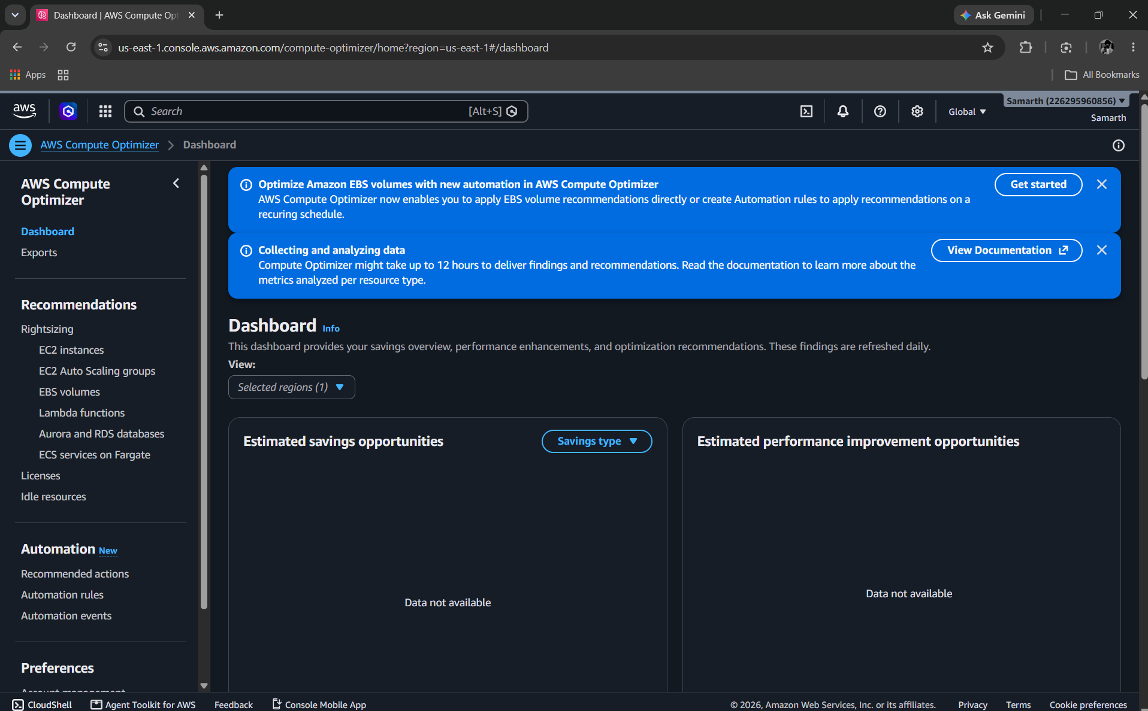
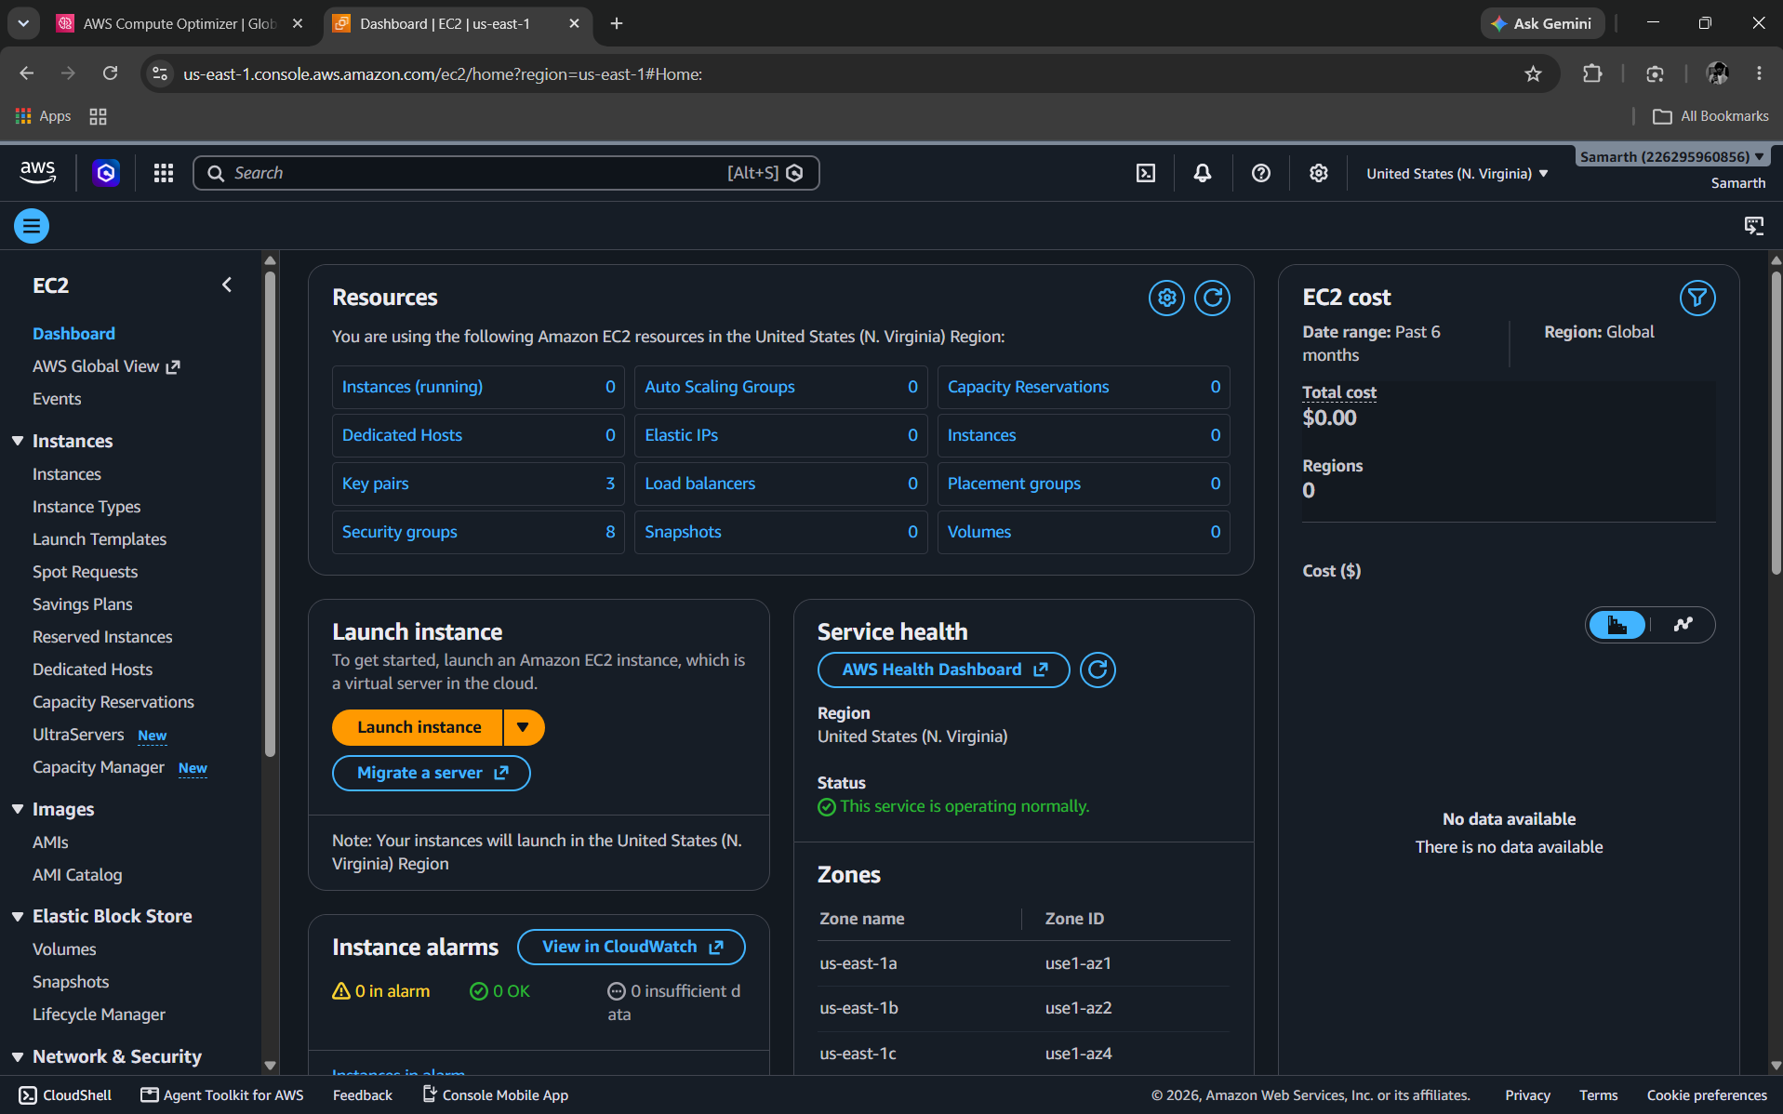
Starting Point: Data Will Come 12 Hours Later
Compute Optimizer: Both panels read "Data not available".
EC2 (us-east-1): 0 running instances, 0 volumes.
Compute Optimizer needs a workload, and findings can take up to 12 hours to appear.
Notes:
Compute Optimizer showed Data not available because the account had no running instances.

Slide 5
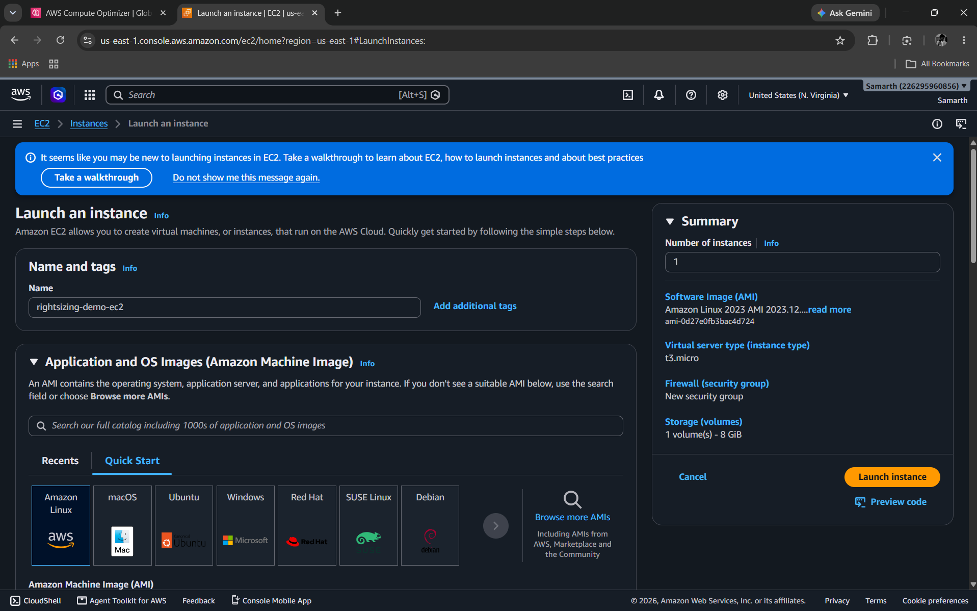
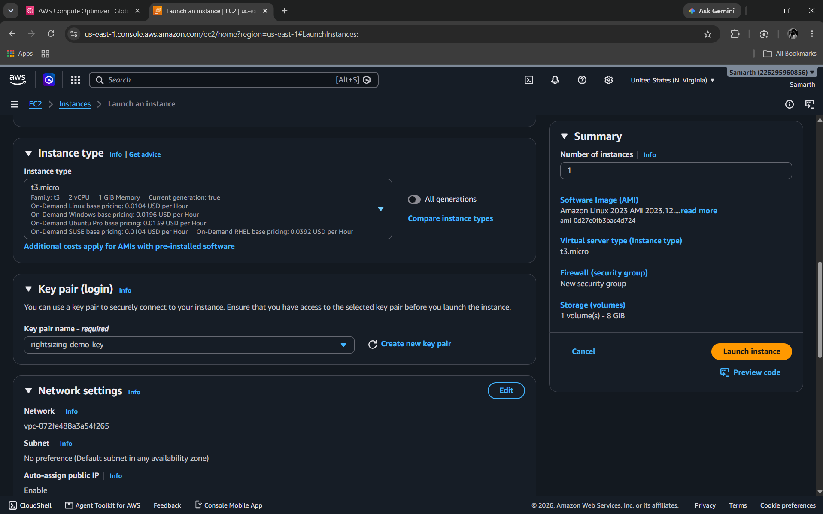
Launching rightsizing-demo-ec2
Name and image: rightsizing-demo-ec2 on Amazon Linux 2023.
Type and key: t3.micro (2 vCPU, 1 GiB), key pair rightsizing-demo-key.
A small, low-cost instance: 0.0104 USD per hour on-demand for Linux.
Notes:
Name, image and instance type chosen for a cheap, measurable demo workload.

Slide 6
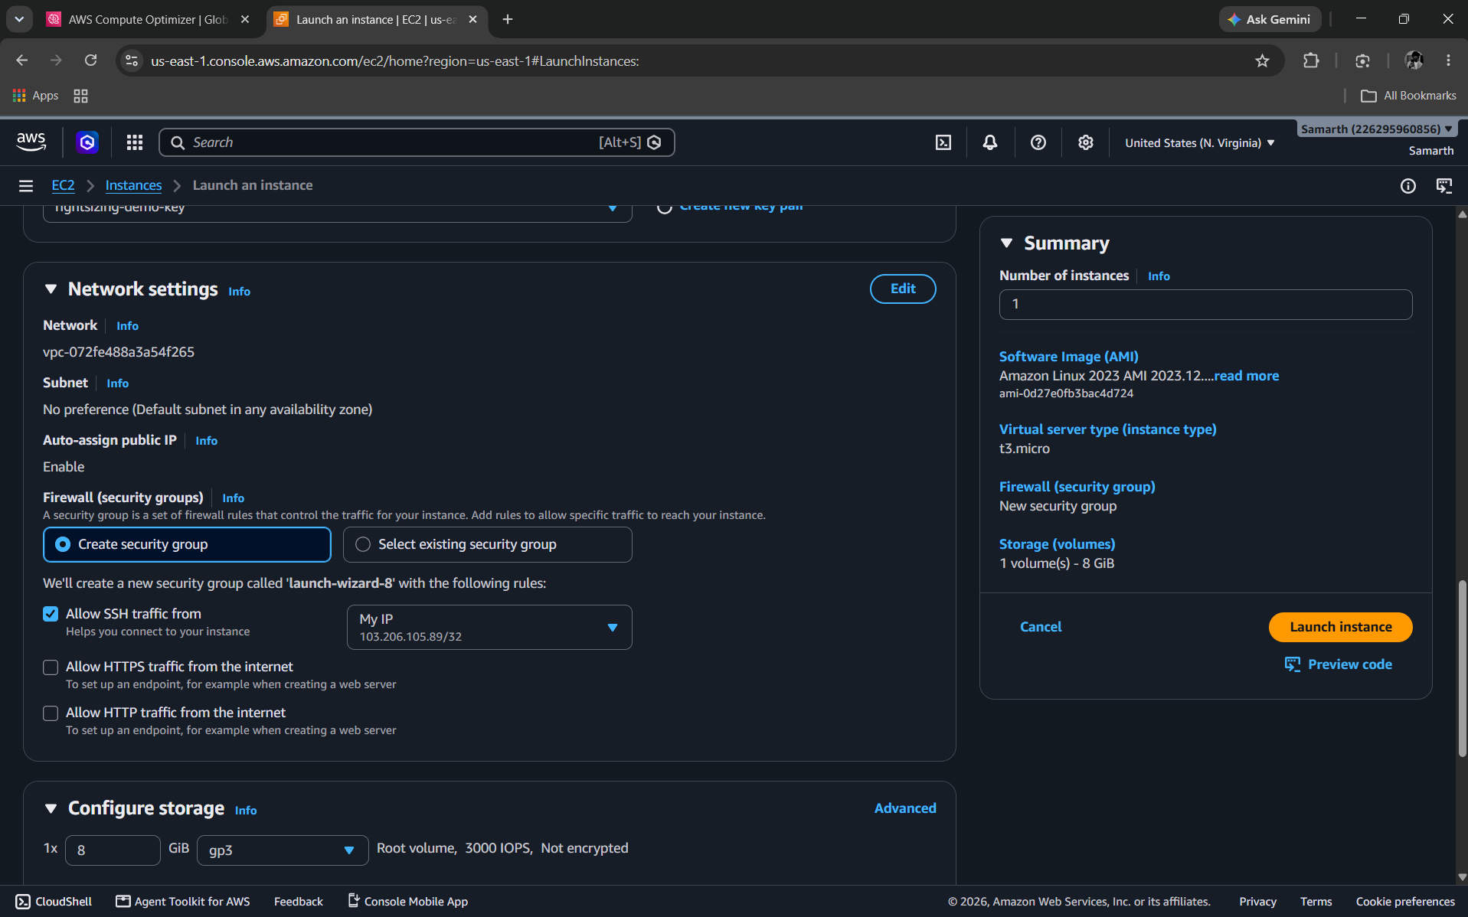
Network, Security and Storage
SSH from My IP only
A /32 rule on a new security group
HTTP and HTTPS closed
No web traffic is needed for the demo
8 GiB gp3 root volume
3000 IOPS, not encrypted
Only what the demo needs is open, which keeps a test server safe at no extra cost.
Notes:
SSH is restricted to one IP; web ports stay closed because this is not a web server.

Slide 7
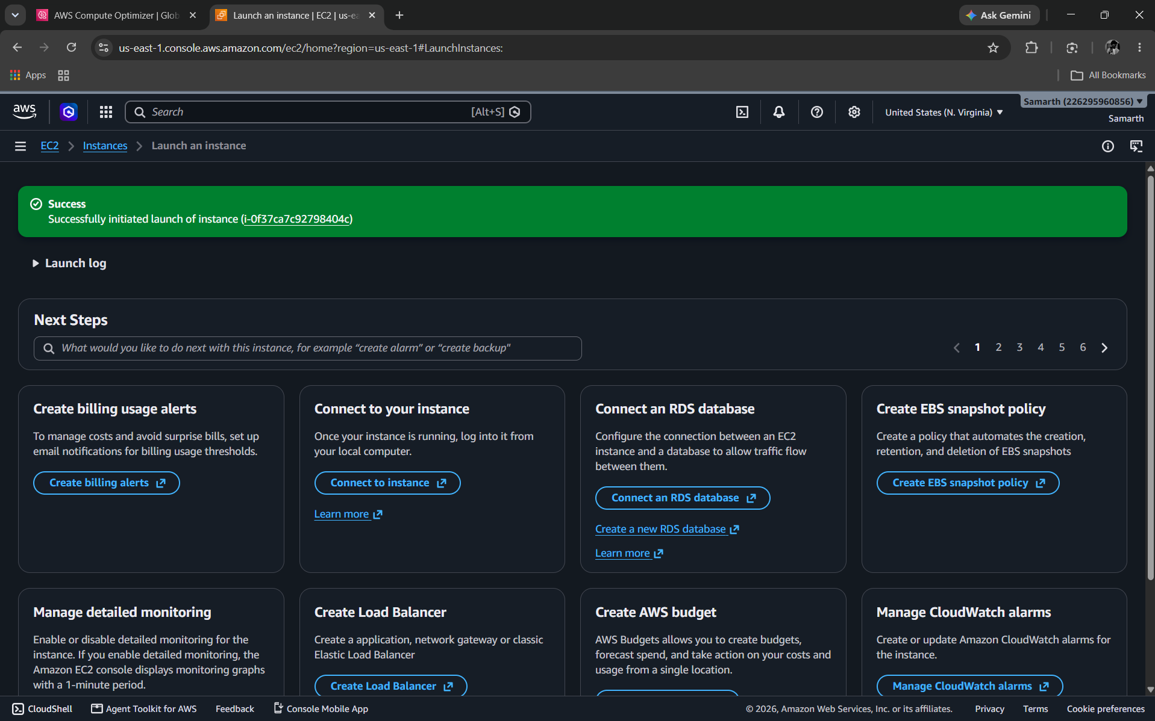
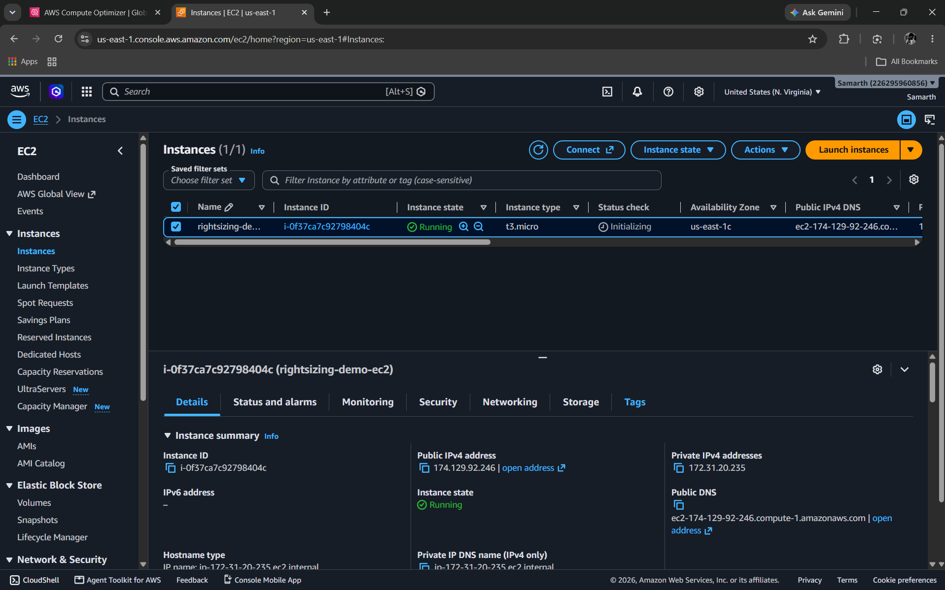
Launch Succeeded: Instance Running
Success: Launch of instance i-0f37ca7c92798404c initiated.
Running: t3.micro in us-east-1c, status check initializing.
The status check moves from Initializing to passed within a few minutes of boot.
Notes:
The Initializing status check is normal right after boot.

Slide 8
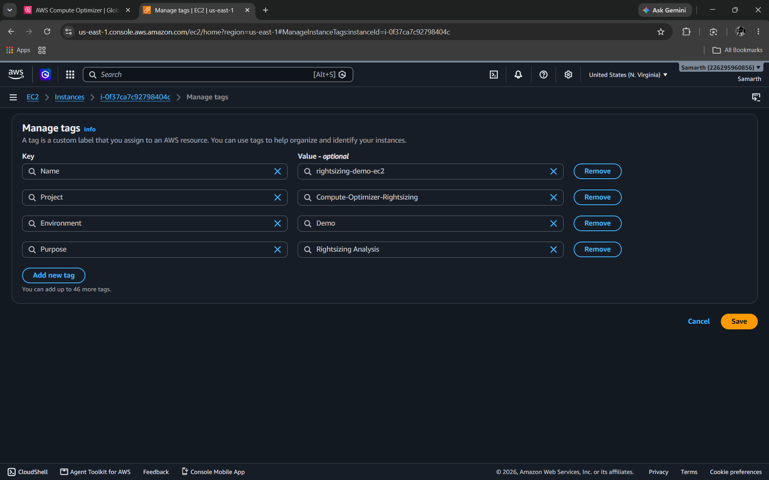
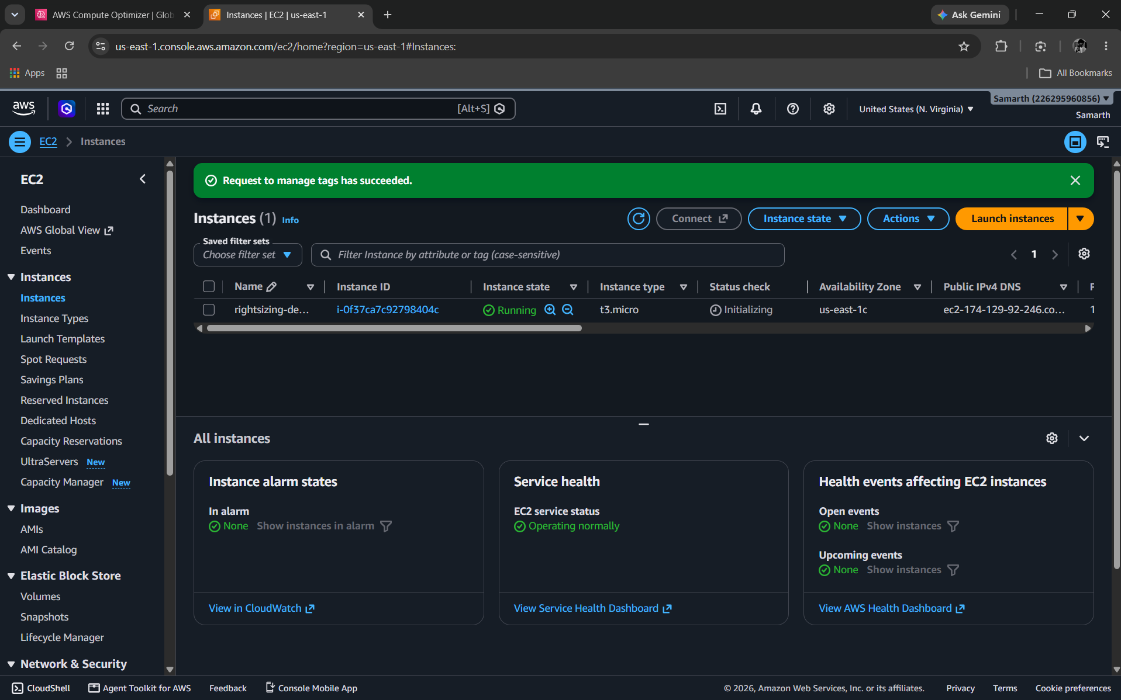
Tagging the Instance
Manage tags: Name, Project, Environment and Purpose.
Saved: "Request to manage tags has succeeded".
Project: Compute-Optimizer-Rightsizing | Environment: Demo | Purpose: Rightsizing Analysis
Notes:
Tags make the resource easy to find and filter by project.

Slide 9
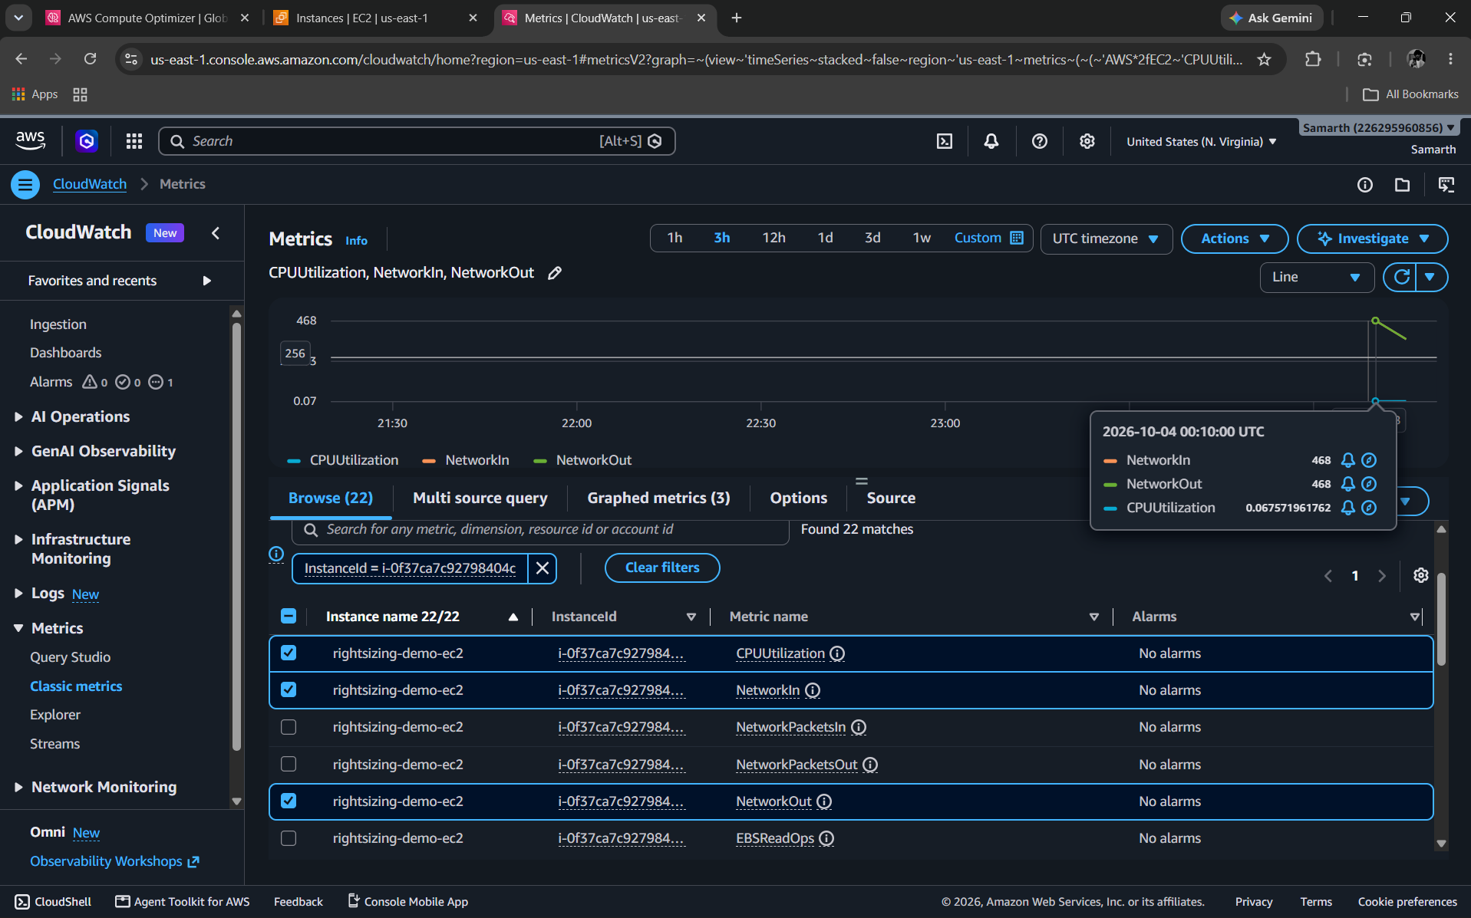
CloudWatch: First Readings
0.07%
CPUUtilization at 00:10 UTC
468
NetworkIn at 00:10 UTC
468
NetworkOut at 00:10 UTC
A freshly booted, idle server: the raw evidence Compute Optimizer will weigh.
Notes:
First data points at 00:10 UTC on 4 October 2026. CloudWatch had already recorded metrics for the instance.

Slide 10
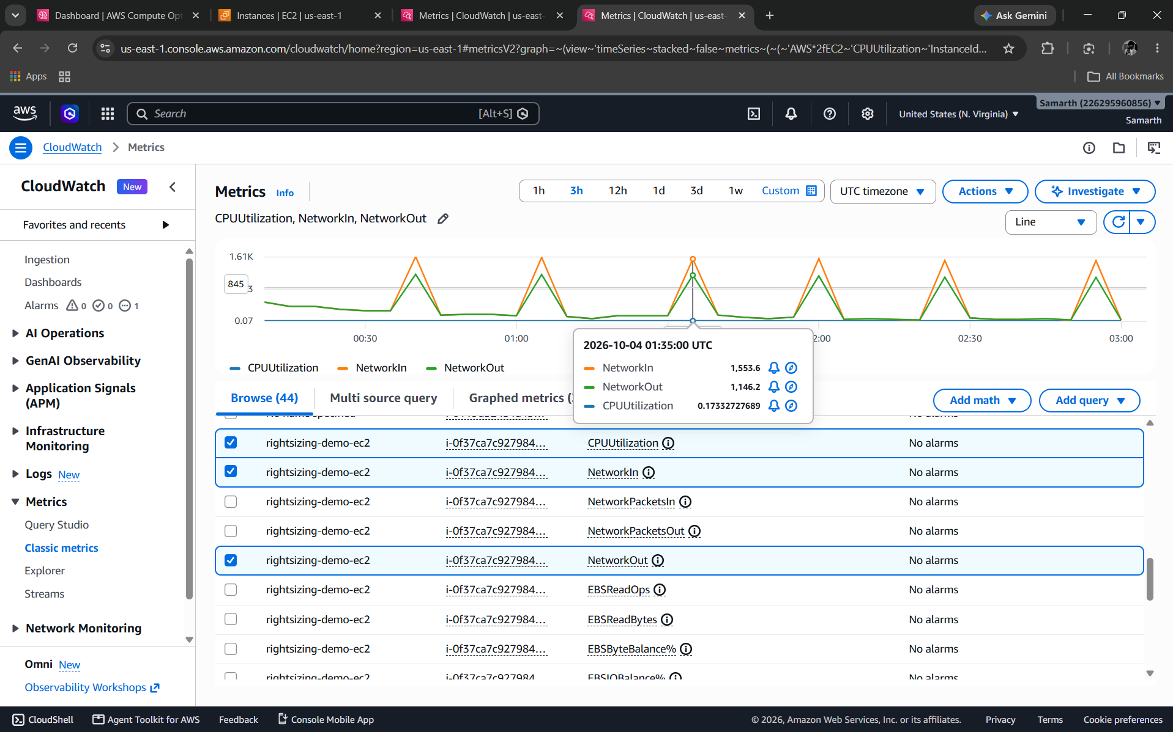
CloudWatch: Readings Over Three Hours
0.173%
CPUUtilization at 01:35 UTC
1,553.6
NetworkIn at 01:35 UTC
1,146.2
NetworkOut at 01:35 UTC
Network spikes about every 30 minutes; CPU never rises above about 0.17%.
Notes:
Network traffic peaks about every 30 minutes while CPU stays flat near zero.

Slide 11
Challenges Faced and How We Handled Them
Issue | Cause | Resolution
"Data not available" on dashboard | No workload yet; findings take up to 12 hours | Launched the demo instance and waited for data
Empty EC2 account | No instances in us-east-1 | Created rightsizing-demo-ec2
Status check "Initializing" | Checks run after a new boot | Waited and refreshed; not a fault
Tags not set at launch | Wizard only offered the Name tag | Added three tags afterwards
Almost no activity in metrics | Idle instance: CPU 0.07 to 0.17% | Expected for a demo; add load if needed
Notes:
Each issue had an ordinary explanation.

Slide 12
Conclusion and Next Steps
Conclusion
Next Steps
EC2 demo instance is running, labelled and tagged
CloudWatch metrics are flowing for CPU and network
Readings show a lightly used t3.micro
The foundation for Compute Optimizer analysis is in place
Let utilization history build (about 30 hours)
Open Rightsizing, then EC2 instances in Compute Optimizer
Optionally add a controlled load test
Record the recommendation and savings
Stop or terminate the instance after the demo
THANK YOU | Questions?
Notes:
Close by pointing to the Compute Optimizer recommendation as the next result.

