Slide 1

COURSE
CSCI 6234 — Object-Oriented Design
SEMESTER
Spring 2026
OOAD PROJECT
PROJECT STATUS
Fully Implemented & Tested Prototype
BudgetFlow
DEVELOPMENT TEAM
Intelligent Personal Finance Management System
Samarth Shete
Karan Patel
George Washington University

Slide 2

PROJECT VISION
SCALABLE FINANCIAL INTELLIGENCE VIA OOAD
PROBLEM STATEMENT
FUNCTIONAL SCOPE
WHY OOAD?
Fragmented financial data across multiple platforms
>
Accounts Dashboard: Multi-account tracking
>
Encapsulation: Protecting financial entity integrity and state
>
Transaction Engine: CSV Import & Auto-categorization
>
Lack of centralized spending and budget visibility
>
Modularity: Decoupling core services (Analytics, Import, Alerts)
>
Budgeting: Threshold-based monitoring
>
Delayed awareness of overspending risks
>
Extensibility: Supporting new account types and institutions
Analytics: Temporal trend analysis
>
>
Investment Gating: Health-based logic
>
Reusability: Standardized patterns for transaction processing
AI Advisor: LLM-driven financial insights
>
>
Maintainability: Clear separation of concerns via layered design
SYSTEM BOUNDARY DEFINITION
>
In-Scope: Transaction processing, budget management, analytics, AI advisory.
>
Out-of-Scope: Direct financial transactions (e.g., payments, transfers).
>
Integration Points: External banking APIs (mocked), LLM services.
FUNCTIONAL REQUIREMENTS
>
NON-FUNCTIONAL REQUIREMENTS
Secure user authentication and authorization.
>
Performance: Sub-second response for dashboard loads.
CRUD operations for accounts, transactions, budgets.
>
>
Scalability: Support for 100k+ concurrent users.
Real-time budget tracking and alert generation.
>
>
Security: OAuth2, data encryption (at rest/in transit).
CORE OBJECTIVES
AI-driven financial insights and recommendations.
>
>
Build a scalable, intelligent management system
>
Reliability: 99.9% uptime, idempotent operations.
>
Automate transaction import and classification
>
Provide proactive risk control through alerts
>

Slide 3

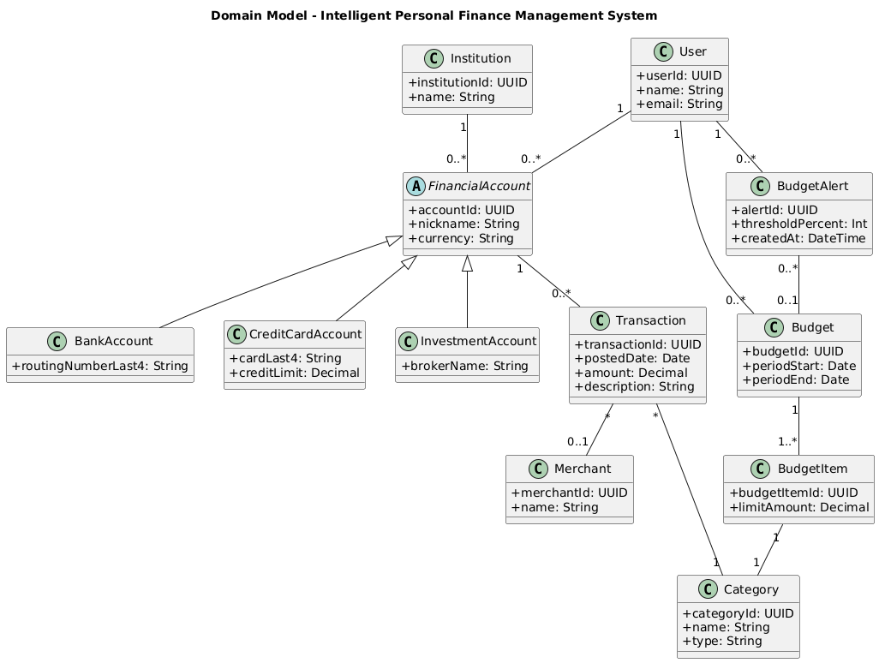
REQUIREMENTS MODEL
USE CASE ANALYSIS & SYSTEM BOUNDARIES
ACTORS
User (Primary): Individual managing personal finances.
•
CORE USE CASES
Authenticate User
•
Set Budget Thresholds
[ INSERT USE CASE DIAGRAM ] Visualizing interactions between the Primary Actor (User) and core system functionalities.
•
Manage Accounts
•
Receive Budget Alerts
•
Import Transactions
•
View Analytics
•
Categorize Expenses
•
SYSTEM RESPONSIBILITIES
Data Persistence: Ensure ACID compliance for all financial transactions and user data via PostgreSQL.
•
Transaction Processing: Implement robust classification and normalization algorithms for diverse data sources.
KEY REQUIREMENTS INSIGHTS
•
Problem-Driven Use Cases: Each use case directly addresses a pain point identified in the problem statement.
•
Real-time Monitoring: Continuously evaluate spending patterns against defined budget thresholds for proactive alerting.
•
Scalability Focus: Requirements anticipate growth in user base and transaction volume.
•
AI-driven Intelligence: Integrate LLM for contextual financial advice and Monte Carlo simulations for investment insights.
•
Security-First: Implicit requirements for data encryption and access control underpin all functional specifications.
•
User Isolation: Enforce strict multi-tenancy for data segregation and privacy.
•

Slide 4
ACTIVITY MODEL
FUNCTIONAL WORKFLOWS & DYNAMIC BEHAVIOR
TRANSACTION IMPORT
DESIGN JUSTIFICATION: ASYNC WORKERS
CATEGORIZATION LOGIC
01
User Initiates Upload/Sync
•
Non-blocking UI:
Prevents UI freeze during long-running imports.
01
System Applies Rule-based Matching
02
System Validates Data Integrity & Format
02
Assigns
Category
to
Transaction
Entity
03
Worker Parses & Maps to
Transaction
Entity
•
Scalability:
Distributes load, processes multiple imports concurrently.
03
Triggers
AnalyticsService
Update
04
System Commits to Persistent Storage (ACID)
•
Resilience:
Retries failed jobs, ensures eventual consistency.
04
Recalculates
Budget
Health & Status
DESIGN JUSTIFICATION: RULE-BASED CATEGORIZATION
ALERT GENERATION
01
AlertManager
Monitors
Budget
State
•
Predictability:
Clear, auditable logic for financial classification.
02
Detects Threshold Breach (80% / 100%)
03
Creates
BudgetAlert
Entity
•
User Control:
Allows explicit user-defined rules and overrides.
04
Dispatches Notification via
NotificationService
•
Performance:
Efficient for high-volume transaction processing.
SYSTEM BEHAVIOR
Activity diagrams model the dynamic workflows of BudgetFlow, ensuring that event-driven updates and continuous analytics recalculations maintain system-wide data consistency.

Slide 5
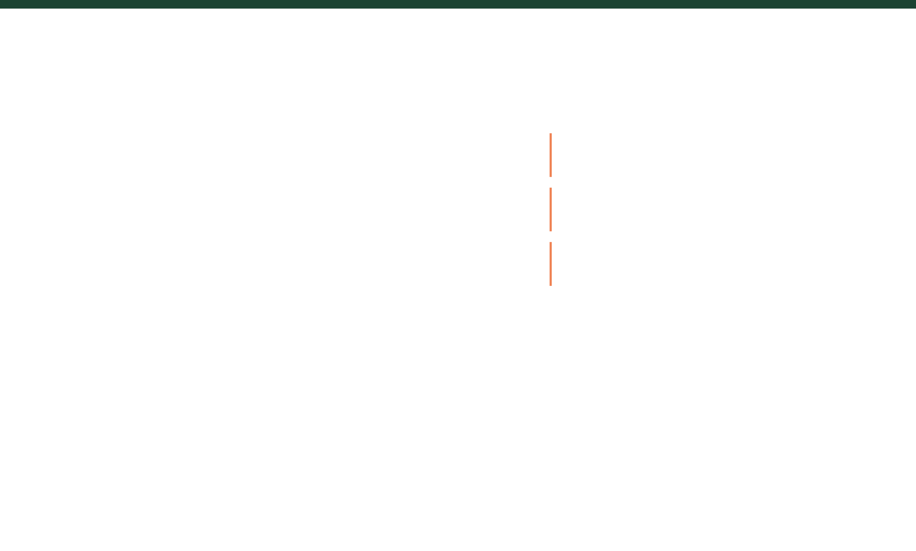
ANALYSIS MODEL
DOMAIN ENTITIES & ROBUSTNESS ANALYSIS
DOMAIN MODEL ENTITIES
ROBUSTNESS MODEL (BCE)
User
FinancialAccount
Institution
Boundary Objects
Transaction
Merchant
Category
Interface elements and API endpoints that facilitate interaction between actors and the system (e.g., Dashboard UI, Transaction API).
Budget
BudgetItem
BudgetAlert
Control Objects
The 'glue' containing business logic and coordination (e.g., AnalyticsService, AlertManager, RecommendationEngine).
Entity Objects
"The Analysis Model bridges the gap between 'what' the system does (Use Cases) and 'how' it is structured (Design), ensuring a stable conceptual foundation before implementation."
Passive data structures representing persistent system state (e.g., Transaction records, Budget configurations).
KEY RELATIONSHIPS
Design Justification: PostgreSQL Selection
User owns 1..* Accounts
ACID Compliance: Guarantees data integrity for financial transactions.
Account contains * Transactions
Relational Integrity: Enforces schema and relationships critical for financial data.
Transaction belongs to 1 Category
Extensibility: Supports advanced features like JSONB for flexible schema evolution.
Budget linked to 1..* Categories

Slide 6

SYSTEM ARCHITECTURE
MODULAR LAYERED DESIGN & TECHNICAL STACK
PRESENTATION LAYER
FRONTEND (NEXT.JS)
Next.js / React / TypeScript
Responsive UI components for financial visualization and user interaction. Handles client-side state and secure API communication.
API & LOGIC LAYER
BACKEND (FASTAPI)
FastAPI / Python
High-performance RESTful endpoints. Manages authentication, transaction ingestion, and core business logic orchestration.
SERVICE & ENGINE LAYER
SERVICE & WORKER LAYERS
Analytics / Recommendation / Advisor
Decoupled services for heavy computation. Workers handle asynchronous tasks like PDF report generation and LLM-based advisor queries.
ASYNC WORKER LAYER
Background Jobs / Report Generation
PERSISTENCE (POSTGRESQL/S3)
Relational schema for structured financial entities. Object storage for generated reports and historical data archives.
DATA & STORAGE LAYER
PostgreSQL / S3 / MinIO
DATA CONSISTENCY & INTEGRITY
ACID Transactions: Ensured via PostgreSQL for all critical financial operations. Idempotent Operations: Async workers designed for retry-safety and unique transaction fingerprinting to prevent data duplication.
CONCURRENCY & USER ISOLATION
Async Workers: Handle concurrent tasks without blocking main API. Multi-tenancy: Strict data segregation per user via database-level partitioning and application-level access control.
Key Insight
The system follows a strictly decoupled, layered architecture, ensuring that changes in the UI or database schema do not compromise the integrity of the core financial logic.

Slide 7
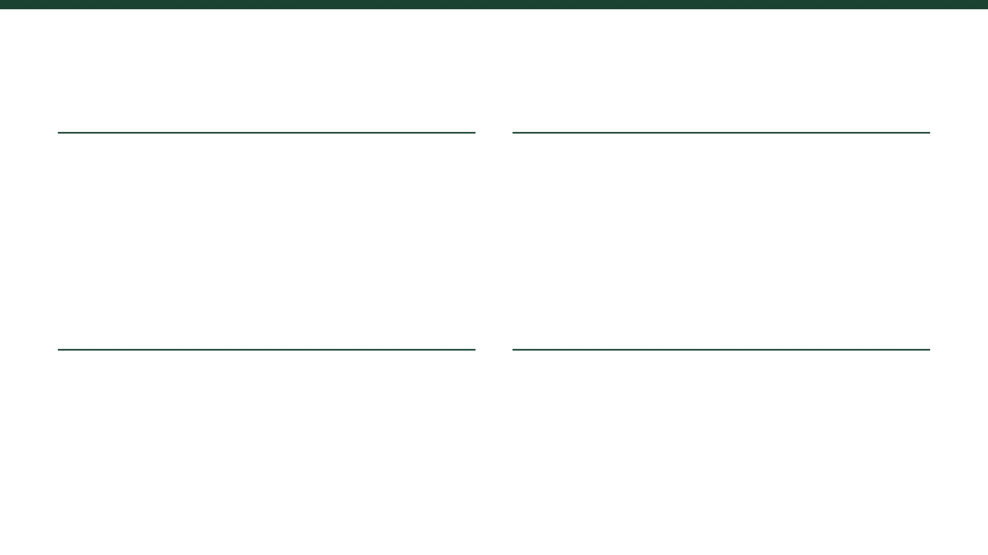
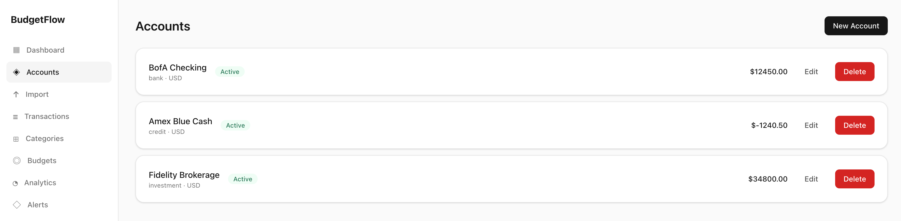
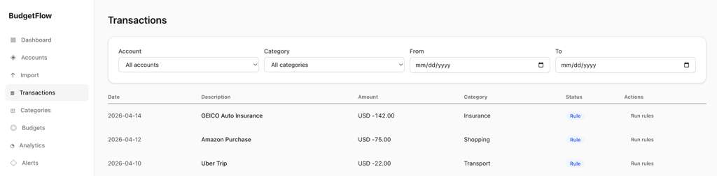
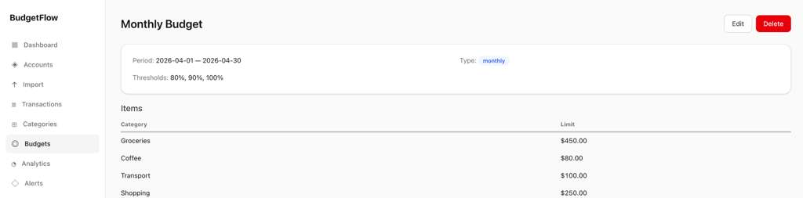
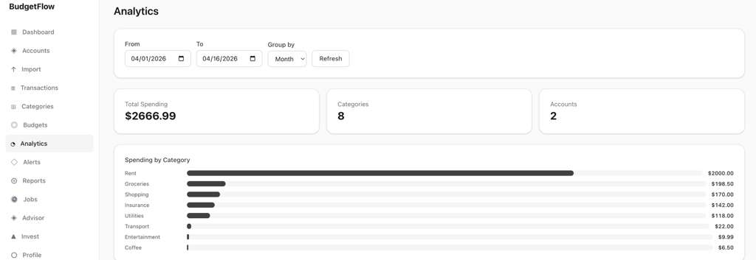
OPERATIONAL PROTOTYPE
CORE FUNCTIONAL MODULES & INTERFACE DESIGN
ACCOUNTS MANAGEMENT
Boundary Object
TRANSACTION ENGINE
Control Object
.
BUDGET CONTROL
Entity Interaction
ANALYTICS DASHBOARD
System Insight
[ INSERT BUDGETS UI MOCK-UP ] Showing threshold configuration and alert status.
Note: UI design follows a modular architecture, separating presentation logic from core financial entities.

Slide 8
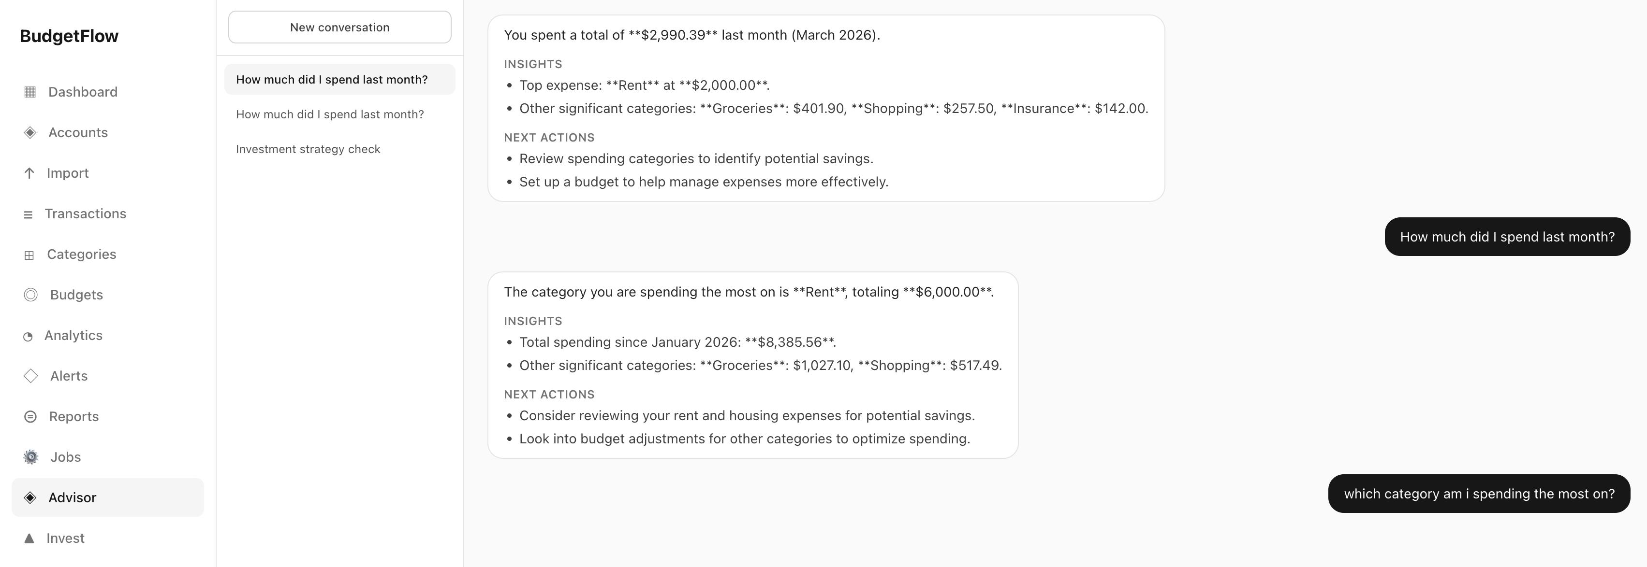
OPERATIONAL PROTOTYPE
INTELLIGENT SYSTEM CAPABILITIES & ADVANCED FEATURES
REAL-TIME ALERTS SYSTEM
Threshold-based monitoring (80% Warning / 100% Exceeded). Implements asynchronous notification dispatch via worker layer. Design Justification: Observer pattern for decoupled event handling.
REPORTING ENGINE
Automated generation of CSV and PDF financial summaries. Leverages background workers for high-latency document processing. Design Justification: Command pattern for encapsulating report generation requests.
[ INSERT PROTOTYPE SCREENS ] Visualizing the Advisor Chat Interface, Alert Notifications, and Investment Recommendation Dashboard.
ADVANCED MODULES
AI ADVISOR (LLM-INTEGRATED)
Natural language interface for financial queries. Uses tool-driven insights to query real-time transaction data and provide advice. Design Justification: Facade pattern for simplifying complex LLM interactions and tool orchestration.
INVESTMENT RECOMMENDATION ENGINE
Risk profiling and portfolio allocation logic. Employs Monte Carlo simulations to project future financial outcomes. Design Justification: Strategy pattern for interchangeable risk models and simulation algorithms.
Key Insight: Moves beyond CRUD → Intelligent System Design
BudgetFlow v1.0 Operational Prototype

Slide 9

DESIGN IMPLEMENTATION
OO DESIGN PRINCIPLES & ARCHITECTURAL PATTERNS
CORE PRINCIPLES
DESIGN PATTERNS IN PRACTICE
PATTERN
SYSTEM IMPLEMENTATION
Encapsulation
Strategy
Protecting financial entity state (e.g., Transaction amounts, Budget limits) through private attributes and controlled accessors.
Recommendation Engine
Swappable algorithms for risk profiling and portfolio allocation based on user budget health.
Observer
Abstraction
Alert Triggering System
Defining high-level interfaces for storage and analytics, decoupling the system from specific database or AI implementations.
Notifies the notification service automatically when budget thresholds (80%/100%) are breached.
Repository
Database Abstraction
Separation of Concerns
Decouples domain entities from SQLAlchemy/PostgreSQL implementation details for cleaner testing.
Strictly isolating UI (Boundary), Business Logic (Control), and Data Persistence (Entity) layers.
Adapter
Storage Abstraction
Standardizes interfaces for local file storage, S3, and MinIO for generated financial reports.
Single Responsibility (SRP)
Each service (e.g., AlertManager) is dedicated to a single functional domain, reducing coupling and increasing testability.
Key Insight: By adhering to pattern-driven development, BudgetFlow achieves a high degree of extensibility, allowing for the seamless addition of new financial institutions and analytical models.

Slide 10
SYSTEM VALIDATION
TECHNICAL CHALLENGES, SOLUTIONS, AND TESTING
ENGINEERING CHALLENGES & OOAD SOLUTIONS
VALIDATION EVIDENCE
Challenge: Transaction Categorization Accuracy
100+
OOAD Solution: Implemented a Strategy pattern for categorization, allowing the system to switch between simple regex matching and more complex heuristic rules without altering the core Transaction entity.
Testing Depth: Unit tests cover 50+ edge-case transaction strings. Integration tests verify correct category assignment and subsequent budget recalculation.
BACKEND TESTS PASSING
Unit Testing: Full coverage of core domain entity logic and state transitions.
Challenge: High-Latency Operations
✓
OOAD Solution: Introduced an asynchronous Worker layer (Command pattern). The API immediately returns a Job ID, while the worker processes the file and updates the Job State (pending → running → succeeded).
Integration Testing: Validated end-to-end flows from CSV import to analytics update.
✓
Reliability: Workers implement exponential backoff for transient failures. Idempotency keys prevent duplicate processing on retries.
System Validation: Verified 80% and 100% budget alert triggers across multiple user scenarios.
✓
Challenge: Concurrency & Data Integrity
OOAD Solution: Leveraged PostgreSQL's ACID properties and implemented optimistic concurrency control within the Entity layer to prevent race conditions during budget updates.
Testing Depth: Load testing with 100+ concurrent requests verified zero data anomalies or lost updates under stress.
Key Insight: Rigorous automated testing and a pattern-driven approach to conflict resolution ensure that BudgetFlow maintains high reliability and data correctness in a production-grade environment.

Slide 11

CONCLUSION
OOAD LIFECYCLE ACHIEVEMENTS & TECHNICAL SUMMARY
PROJECT ACHIEVEMENTS
Technical Summary
Full OOAD Lifecycle
Pattern-Driven: Systematic application of Strategy, Observer, and Command patterns.
•
Successful transformation from Requirements Modeling to Analysis, Design, and Implementation.
Validation Rigor: 100+ tests ensuring reliability and data correctness.
•
Rigorous UML Modeling
Intelligent Architecture: Decoupled LLM and analytics services for future-proof growth.
•
Complete structural and behavioral modeling ensuring architectural integrity and system reliability.
Production Ready: Fully implemented system with real-world engineering depth.
•
Operational Full-Stack System
A working prototype integrating Next.js, FastAPI, and PostgreSQL with advanced AI-driven capabilities.
BudgetFlow: Intelligent Design, Measurable Control.
Questions? | CSCI 6234 Final Presentation

