Slide 1


COURSE PROJECT HEART DISEASE PREDICTION USING MACHINE LEARNING
DATA SCIENCE
Guide : Prof. S.Ballal
Students Names :
1. D26 Aayush Surawar 11910859
2. D27 Samarth Takbhate 11910739
3. D30 Gopal Tapadiya 11911318
4. D31 Shivam tapre 11910774
5. D43 Umesh Wanare 11911112

Slide 2
Content
Abstract
Introduction
Project Objective
Literature Review
Need
Project Domain & Tools used
Design Flow
Solution Strategy
Results
Literature Reference
Conclusion

Slide 3
Abstract
Machine learning can be used to predict the Heart Disease.
We use Cleveland Heart Disease dataset which has some non-linear tendency.
We improved Heart Disease Prediction technique by correctly adjusting the Random Forest Machine Learning Model (fetching 85.81% accuracy).
Health care data contains hidden information which is useful for making effective decisions.
This can help patients in getting a quick diagnosis with a lot less cost.

Slide 4
Introduction
Machine learning allows building models to quickly analyze data and deliver results, leveraging the historical and real-time data, with machine learning that will help healthcare service providers to make better decisions on patient's disease diagnosis.
By analyzing the data we can predict the occurrence of the disease in our project. This intelligent system for disease prediction plays a major role in controlling the disease and maintaining the good health status of people by predicting accurate disease risk.
Machine learning algorithms can also be helpful in providing vital statistics, real-time data and advanced analytics in terms of the patient's disease, lab test results, blood pressure, family history, clinical trial data, etc., to doctors.

Slide 5
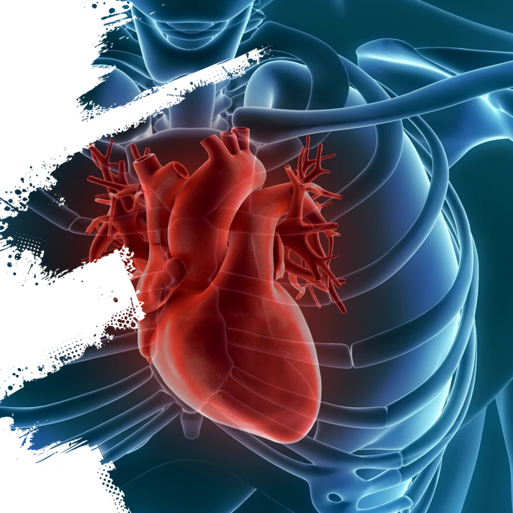
Need
WHO has estimated that 12 million deaths occur worldwide, where heart disease is the major cause of deaths.
Millions of health related data being generated every day which is difficult to be analyzed.
Huge amount of time and cost is required to detect heart disease.

Slide 6
Project Objective
“To build a Heart Disease prediction system to overcome the shortcomings of the prior Heart Disease detection techniques.”
Predict whether a patient should be diagnosed with Heart Disease. This is a binary outcome.
Positive (+) = 1, patient diagnosed with Heart Disease Negative (-) = 0, patient not diagnosed with Heart Disease
Experiment with various Classification Models & see which yields greatest accuracy.
Examine trends & correlations within our data
Determine which features are most important to Positive/Negative Heart Disease diagnosis

Slide 7



Domain , Technology , Tools
Project Domain – Data Analysis
Data Visualisation
Machine learning Modelling
Tool
Dataset- Excel
Data Visualisation – R
ML Model – Python
IDE – Jupyter Notebook

Slide 8
Design Flow
Start
Get dataset
Create training set and testing set
Preprocess dataset
(replace missing value, etc.)
Apply Supervised Learning Algorithm
Analyze dataset for different type of Machine Learning Algorithm
Do cross-validation
Show the accuracy
If supervised
?
Stop
Fig : Flow Chart of implementation

Slide 9
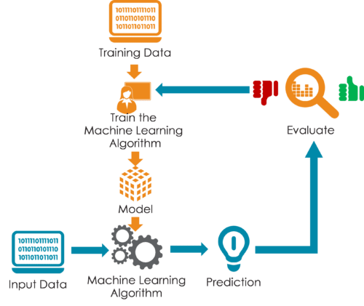
Solution Strategy
Collect a dataset for Heart Disease prediction. ( We have used Cleveland Heart Disease dataset )
Select the dependent attributes from the total number of attributes. The attributes used are :
Age : age in years
Sex : sex (1 = male; 0 = female)
Cp : Chest Pain Type
Value 1: typical angina
Value 2: atypical angina
Value 3: non‐anginal pain
Value 4: asymptomatic
Trestbps : Resting blood pressure
Chol : serum cholestoral in mg/dl
Fbs : (fasting blood sugar > 120 mg/dl)
Thalach : maximum heart rate achieved
Preprocess the dataset.
Apply Machine Learning algorithms
according to the nature of dataset.(Logistic
Regression,Naïve Byas,KNN,Decision Tree,
Random Forest)
Cross-validate the algorithms accuracy.
10-FOLD CROSS VALIDATION

Slide 10
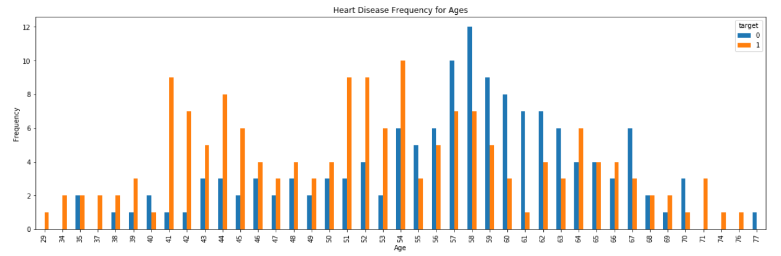
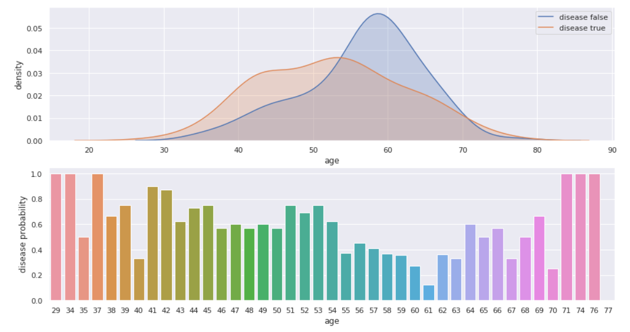
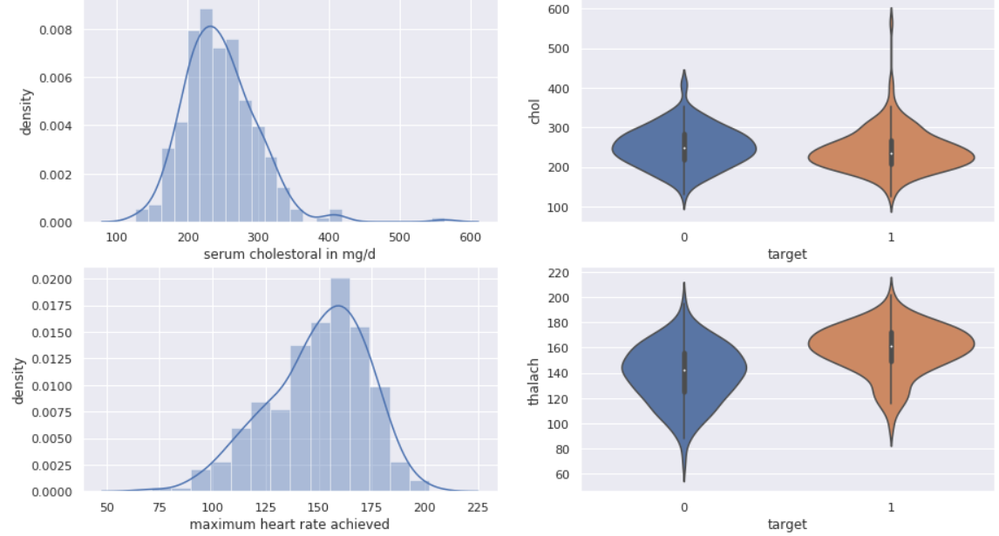
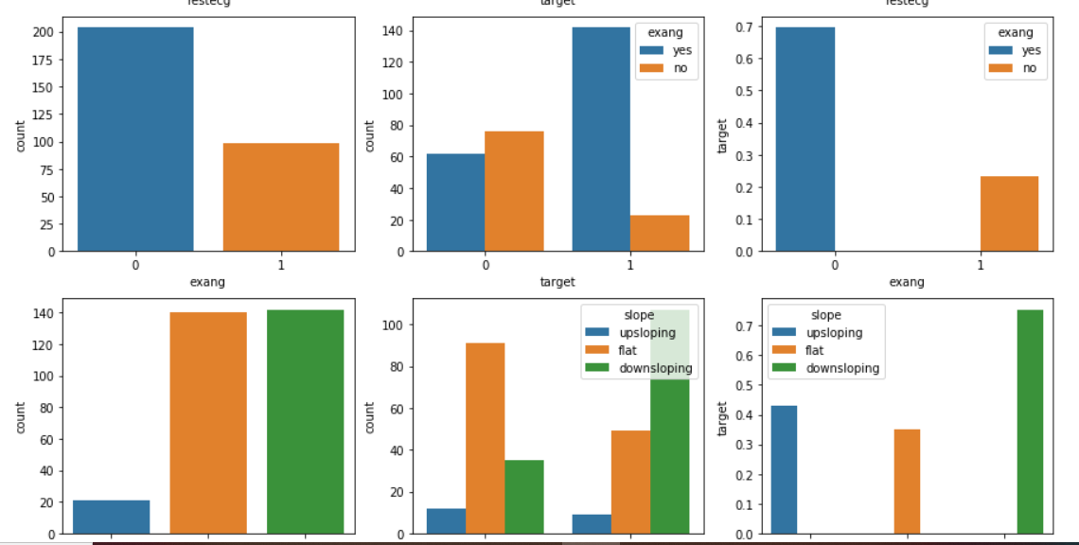
Result

Slide 11
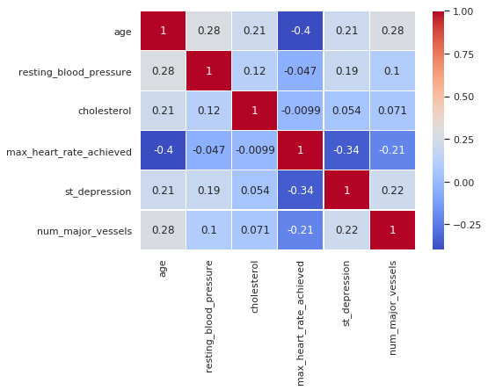
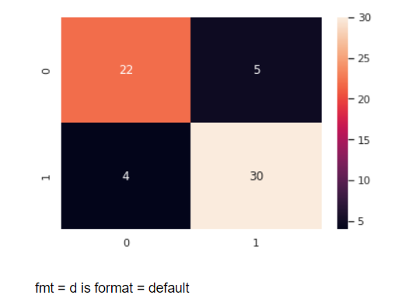
Results
Co-Relation Plot
Confusion Matrix

Slide 12
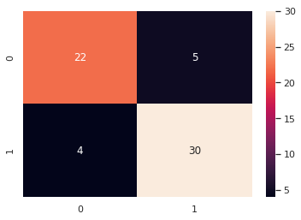
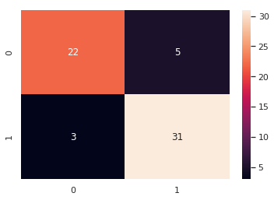

Result
Logistic Regression
Precision: 0.85
Recall is: 0.88
F-Score: 0.86
accuracy score : 85.25 %
Random Forest
Precision: 0.86
Recall is: 0.91
F-Score: 0.88
Accuracy score : 88.5%
Naïve Byas
Precision: 0.83
Recall is: 0.91
F-Score: 0.87
accuracy score : 85.23 %

Slide 13
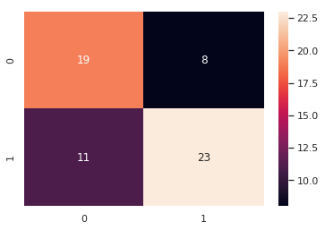
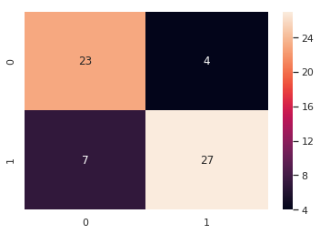
Result
KNN
Precision: 0.74
Recall is: 0.67
F-Score: 0.70
Accuracy Score : 63.93%
Decision Tree
Precision: 0.87
Recall is: 0.79
F-Score: 0.83
Accuracy Sore :82%

Slide 14
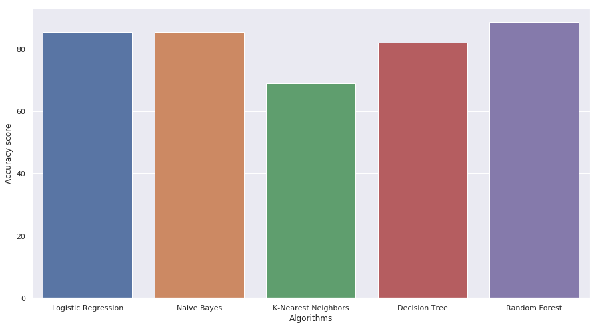
Result

Slide 15
Conclusion
Our dataset set had Non-Linear dependency.
By correctly adjusting the parameters of Random Forest we were able to achieve better accuracy.
We had lesser amount of dataset so 10-fold cross-validation gave us better result.
Our solution strategy is not so Robust in nature, every time it needs a few adjustment in parameter.
The accuracy achieved is satisfactory but can be future improved.
We can use data warehouses in hospital so that the amount of data increases and a greater accuracy could be achieved.

Slide 16
Literature References
S.No. | Name of Paper | Author | Methodology | Limitations
1. | An Artificial Neural Network Model for Neonatal Disease Diagnosis | Dilip Roy Chowdhury, Mridula Chatterjee, R.K. Samanta | Multi-Layered Perceptron | They used 94 attributes(which is a great number) to train the NN which gives a lesser accuracy of 75%
2. | Comparative Study of Data Mining Classification Methods in Cardiovascular Disease Prediction | Milan Kumari, Sunila Godara | Decision Tree, Artificial Neural Network | Accuracy was closer to 80 % which could be improved
3. | Decision Support System for Heart Disease Diagnosis using Neural Network | Niti Guru, Anil Dahiya, Navin Rajpal | Neural Network | Only 78 instances were used to train neural network which tends to be less effective.

Slide 17
References
Santhana Krishnan J and Geetha S, “Prediction of Heart Disease using Machine Learning Algorithms” ICIICT, 2019.
Aditi Gavhane, Gouthami Kokkula, Isha Panday, Prof. Kailash Devadkar, “Prediction of Heart Disease using Machine Learning”, Proceedings of the 2nd International conference on Electronics, Communication and Aerospace Technology(ICECA), 2018.
Senthil kumar mohan, chandrasegar thirumalai and Gautam Srivastva, “Effective Heart Disease Prediction Using Hybrid Machine Learning Techniques” IEEE Access 2019.
Himanshu Sharma and M A Rizvi, “Prediction of Heart Disease using Machine Learning Algorithms: A Survey” International Journal on Recent and Innovation Trends in Computing and Communication Volume: 5 Issue: 8 , IJRITCC August 2017.
M. Nikhil Kumar, K. V. S. Koushik, K. Deepak, “Prediction of Heart Diseases Using Data Mining and Machine Learning Algorithms and Tools” International Journal of Scientific Research in Computer Science, Engineering and Information Technology ,IJSRCSEIT 2019.
Amandeep Kaur and Jyoti Arora,“Heart Diseases Prediction using Data Mining Techniques: A survey” International Journal of Advanced Research in Computer Science , IJARCS 2015-2019.

Slide 18
Thank You !!!

