Slide 1
COURSE PROJECT Student Report Card System
Object Oriented Programming
Guide : Prof. Kanade dnyanesh sir
Students Names :
1. D26 Aayush Surawar 11910859
2. D27 Samarth Takbhate 11910739
3. D30 Gopal Tapadiya 11911318
4. D31 Shivam tapre 11910774
5. D43 Umesh Wanare 11911112

Slide 2
Content
Introduction
Project Objective
Project Domain, Technology and Tools used
Flowchart
Results
Future scope
Conclusion
References

Slide 3
Introduction
Student report card system project is a simple console application built without the use of graphics.
In this project, users can perform typical report card related functions like adding a new student record and displaying, modifying, editing and deleting it.
File handling has been effectively used to perform all these.

Slide 4
Project Objective
The project is aimed to be create a program that can store, retrieve, display, insert, delete and modify a student's marks in their subjects. The program is completely menu driven without any graphical interface.
Also project is aimed to reduce the paper work required for the result of the students.

Slide 5


Domain , Technology , Tools
Project Domain
Education
Technology
Object Oriented Programming C++
File handling in C++
Tool
Compiler: Codeblocks

Slide 6
Flow Chart
Menu
Student
Teacher
Public
Class Statistics
Create Student Record
Class Statistics
Display All Student Record
Student Report Card
Search Student Record
Security Code
Modify Student Record
Roll No.
Class Statistics
Delete Student Record

Slide 7
Results
The main screen will have 3 menu -
Admin / Teacher
Student
Public
In Admin / Teacher menu , there are operations like add a new student record , search for a student record , modify a record , delete a record , display all records and class statistics.
In class statistics , we can check the ascending order of percentage of student and check percentage wise list of students.
In Student menu , the students can see their report cards by entering roll no. and security code and also can see class statistics.
In public menu , the person other than student or teacher are able to check the class statistics .

Slide 8
Output – Admin / Teacher menu
Admin / Teacher menu include :-
Create student report card record: This feature creates a new student record containing him/her marks.. the information to be provided are the name and roll no. of the student, and the marks obtained by him/her in subjects.
2. Class Statistics : Sorting the all data will give the descending order of the percentage and the marks .Also displays the list of student with their percentage

Slide 9
Output – Admin / Teacher menu
Admin / Teacher menu include :-
3. Display all students’ grade report: This feature enlists all the students’ record saved in file. The grade report is displayed in a tabular form with roll no. and name of the students, marks achieved in the subjects, and the grade and percentage obtained by them.
4. Read specific student’s report card record: This feature is same as the one explained above, except it shows the progress report and relevant data related to a particular student.

Slide 10
Output – Admin / Teacher menu
Admin / Teacher menu include :-
5. Modify student’s report card record: This menu is used to edit the report card record of a particular student. For this, the name and roll no. of the student is sought. Upon successful modification, the program will displays the message “Record Updated”. If no record of student is found in file, it displays the message “Record not found”.
6. Delete student record: This menu function deletes the report card record of a particular student; it first of all asks for the name and roll no. of the student whose record is to be deleted.

Slide 11
Output – Student & Public menu
Student menu include :-
Search for student report card :-
In these option student have to enter his/her roll no & the security code assigned by the teacher.
2) Class Statistics :-
In these option students can see the class percentage wise descending list and also topper list.
Public menu include :-
The person outside college can see the performance of student in college.
Class Statistics :-
In these option students can see the class percentage wise descending list and also topper list.

Slide 12
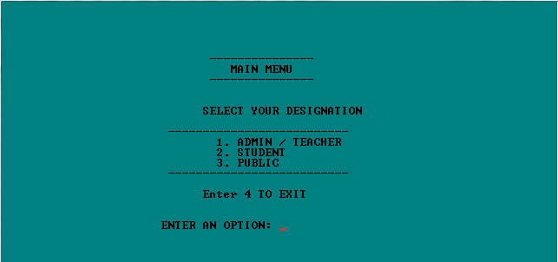
Result Image
Main Menu

Slide 13
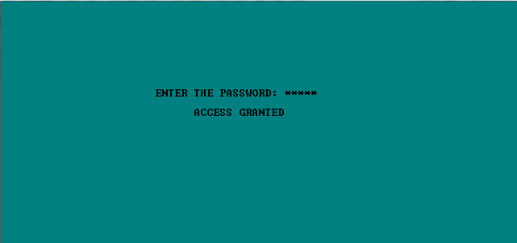
Result Image
Password Screen (Admin menu need password to access)

Slide 14
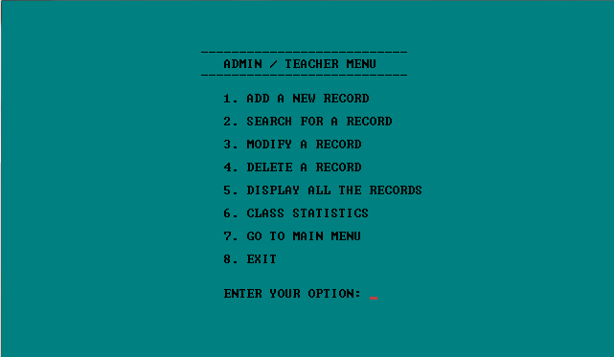
Result Image
Admin / Teacher menu

Slide 15
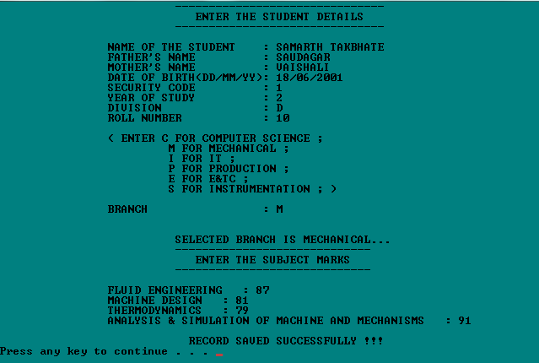
Result Image
Add new student

Slide 16
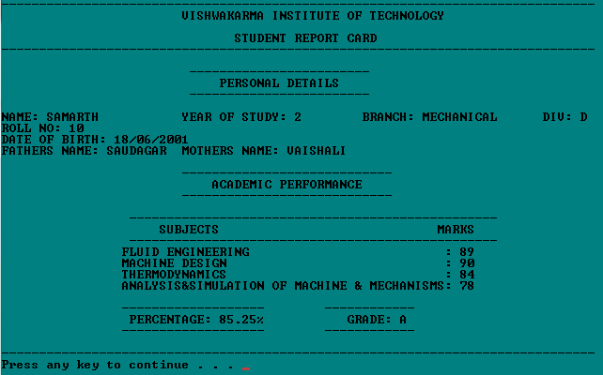
Result Image
Search for a student report card

Slide 17
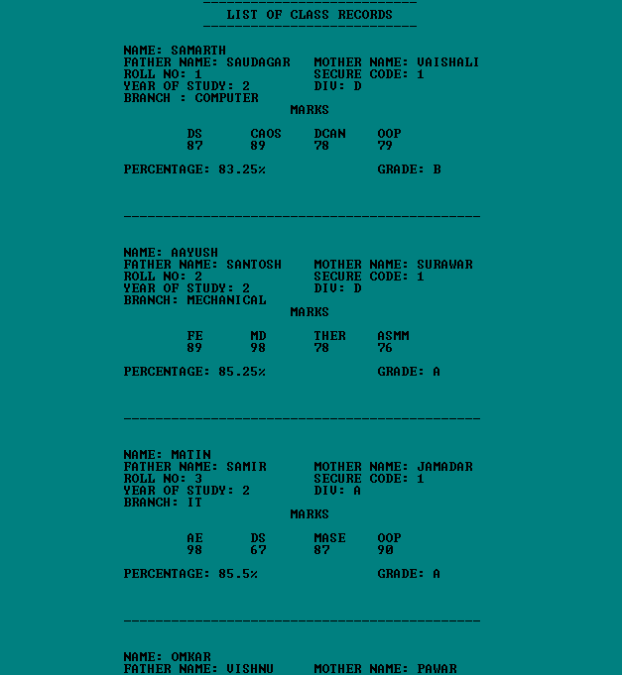
Result Image
Display all records

Slide 18

Result Image
Class Statistics

Slide 19
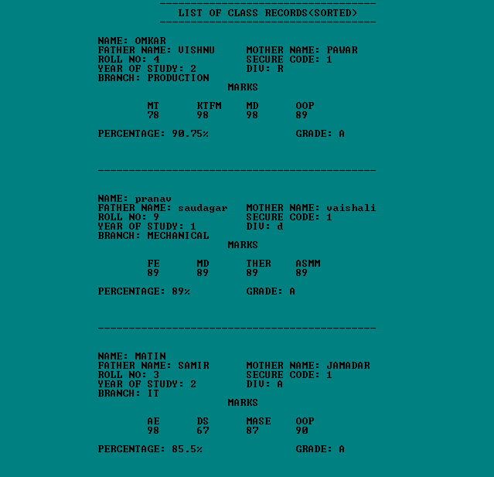
Result Image
Ascending order of percentage with all details

Slide 20
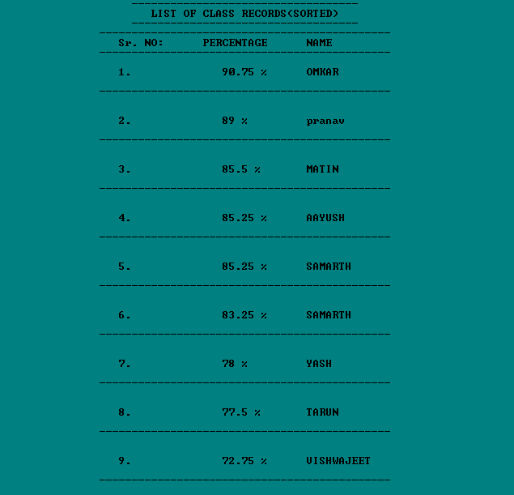
Result Image
Topper Student list with percentage

Slide 21
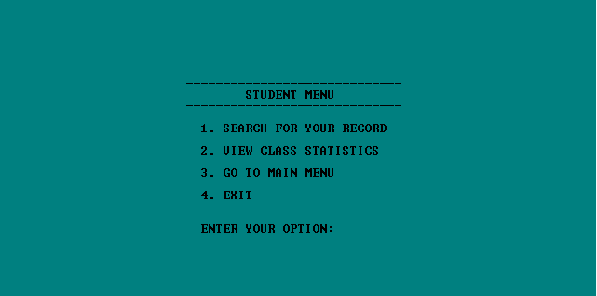
Result Image
Student Menu

Slide 22
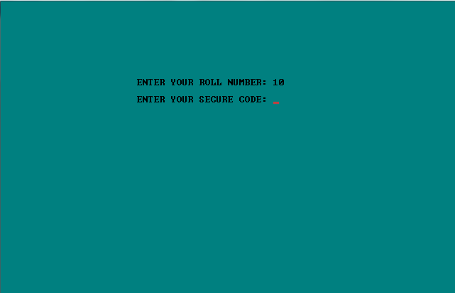
Result Image
Student need security code to see report card

Slide 23
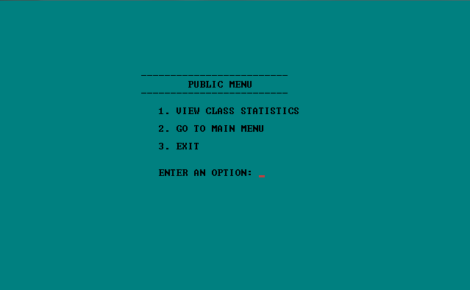
Result Image
Public menu

Slide 24
Future scope
For the project, a graphical user interface can be developed.
This system is designed for small engineering colleges or schools ; however, we will develop a robust system with more functionality and information to manage large data sets for large engineering firms or schools.
Class statistics can be seen by year wise , Branch wise or Division wise.

Slide 25
Conclusion
This project will be efficient in maintaining student’s details and can easily perform operations on student’s records.
This project will also reduces the work load of the of teachers in colleges as all the details are store in computer system and whenever the detail marks of student needed it can be searched and displayed on the screen.
The features like add student , modify , delete , search are already available on internet . We refered that to code our project . The features like password for Admin / Teacher , security code for the students and the class statistics are new features we added in our project.

Slide 26
References
https://www.geeksforgeeks.org/file-handling-c-classes/
https://www.tutorialspoint.com/cplusplus/cpp_files_streams.htm
https://www.javatpoint.com/cpp-files-and-streams
https://www.programiz.com/cpp-programming/friend-function-class
https://www.researchgate.net/publication/348960289_Files_in_C
https://youtu.be/TF2-F2duY6c
https://youtu.be/Ma0P9T4nTDA

Slide 27
Thank You

