Slide 1

Seasonal Agriculture Performance Analysis
Name : Samarth Verma College Name: Shri Shankaracharya Institute of Professional management and technology ,
AICTE STU ID :STU6a5efb128e7271784609554

Slide 2

PROBLEM STATEMENT
Agricultural activities are influenced by seasonal variations in environmental conditions, farming practices, resource availability and market conditions. As a result, agricultural performance may differ from one season to another. However, raw agricultural data does not clearly explain how agricultural performance changes across seasons or what patterns can be observed in different seasonal conditions. The problem is to analyze the given agricultural dataset and investigate seasonal differences in agricultural performance by identifying meaningful patterns, trends, relationships and variations within the available data.

Slide 3
Project Description
Dataset: 4,000 agricultural records covering multiple crops, states and seasons.
Data preparation: checked duplicates, missing values, negative values and formula consistency before analysis.
Seasonal analysis: compared yield, production, profit, water efficiency, environmental conditions and disease/pest risk.
Deeper analysis: crop–season patterns, irrigation mix, state performance, correlations, outliers and statistical significance.
Goal: identify which seasons perform better and explain the patterns without treating correlation as causation.

Slide 4

WHO ARE THE END USERS?
Farmers & Farm Managers Use seasonal yield, profit and water insights to support planning.
Agricultural Advisors Compare crops, risks and resource patterns across seasons.
Researchers & Policy Planners Use evidence on seasonal variation for further study and interventions.

Slide 5

Technology Used
Python Data analysis & automation
Pandas Data cleaning & aggregation
NumPy Numerical operations
Matplotlib / Seaborn Visualization
SciPy ANOVA & Kruskal–Wallis
Scikit-learn Scaling for composite score
Jupyter Notebook Analysis & reproducibility

Slide 6
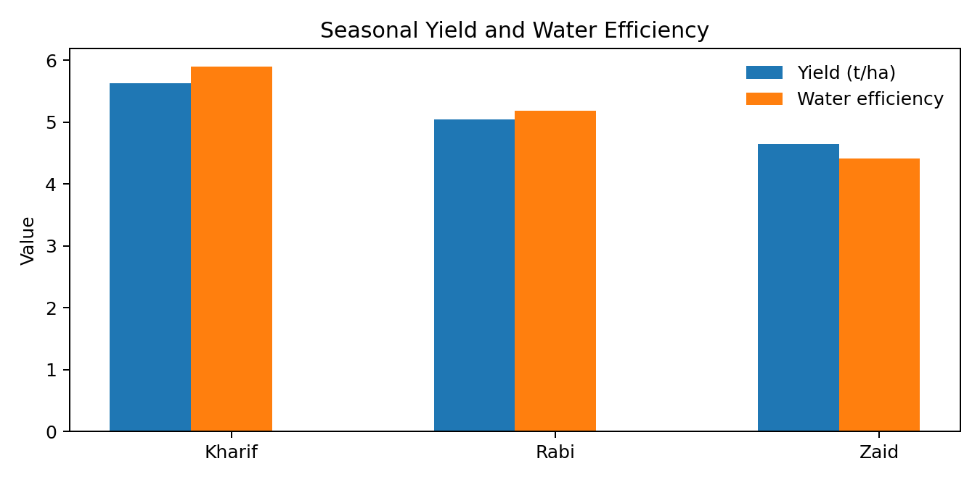
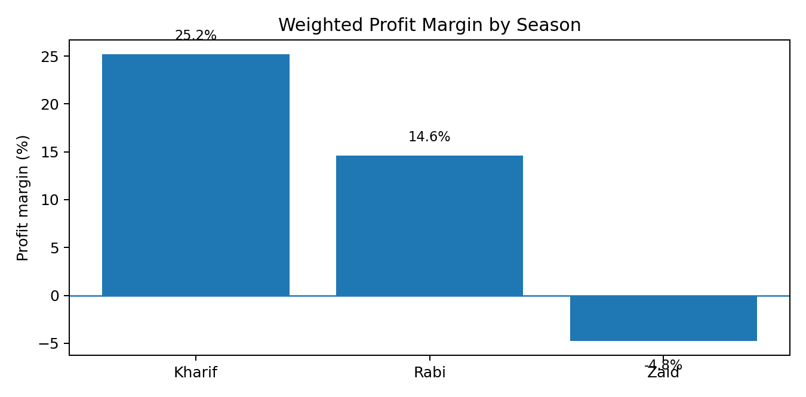
RESULTS
Highest average yield Kharif — 5.63 t/ha
Best weighted margin Kharif — 25.2%
Highest water efficiency Kharif — 5.89 t/1000m³
Overall pattern: Kharif leads on yield, profitability and water efficiency; Zaid is the weakest on these measures.

Slide 7
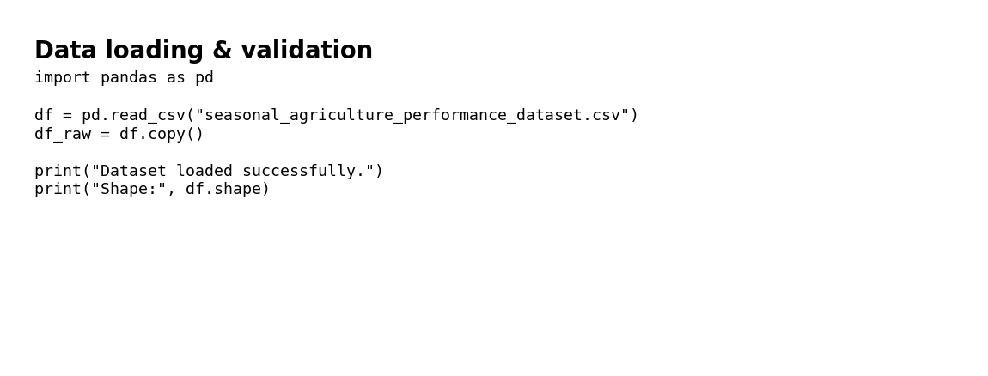
RESULTS
Kharif: 5.63 t/ha average yield.
Rabi: 5.04 t/ha; Zaid: 4.64 t/ha.
Seasonal averages are useful for comparison, but crop mix differs by season, so results should not be read as a pure weather effect.

Slide 8
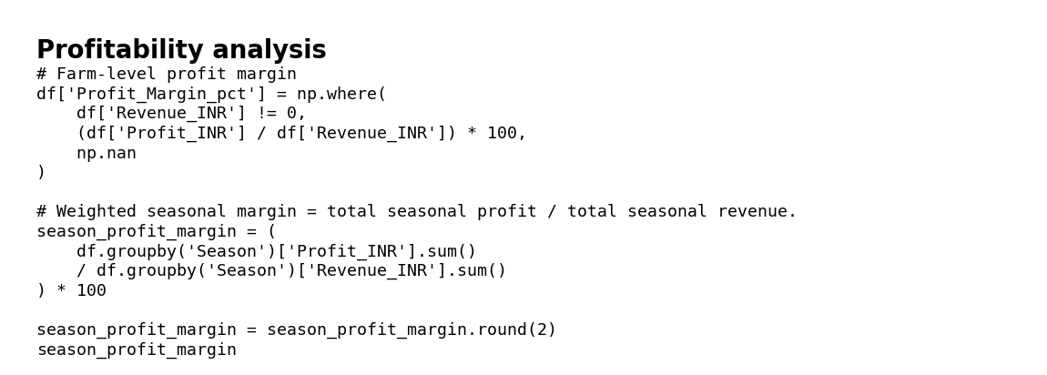
RESULTS
Weighted profit margin: Kharif 25.2%, Rabi 14.6%, Zaid -4.8%.
Average profit: Kharif ₹178,915; Zaid shows an average loss of ₹24,805.
Loss-making records: Kharif 42.2%, Rabi 51.1%, Zaid 64.5%.

Slide 9
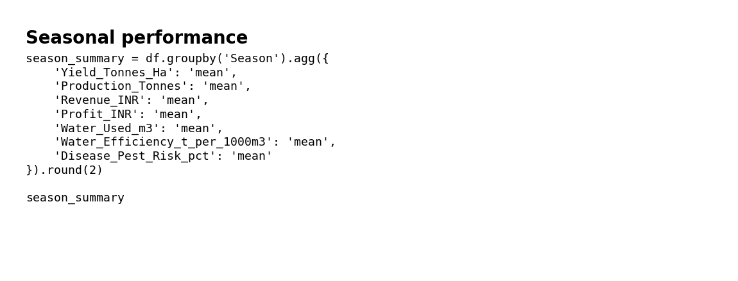
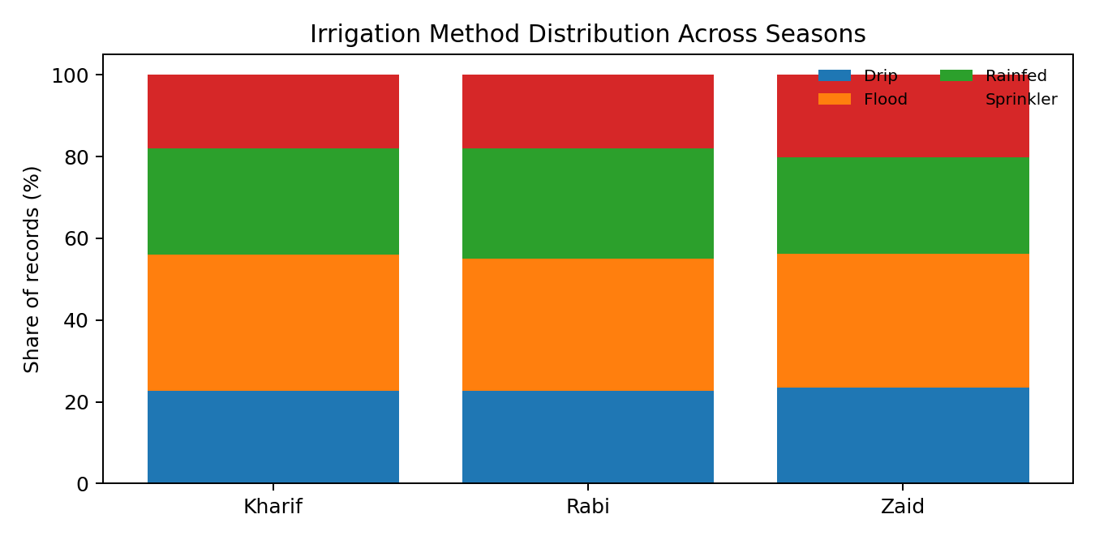
RESULTS
Average water efficiency: Kharif 5.89, Rabi 5.19, Zaid 4.41 tonnes per 1000 m³.
Kharif has the strongest combined yield and water-efficiency performance in this dataset.
Irrigation methods vary across seasons, providing context for resource-use differences.

Slide 10
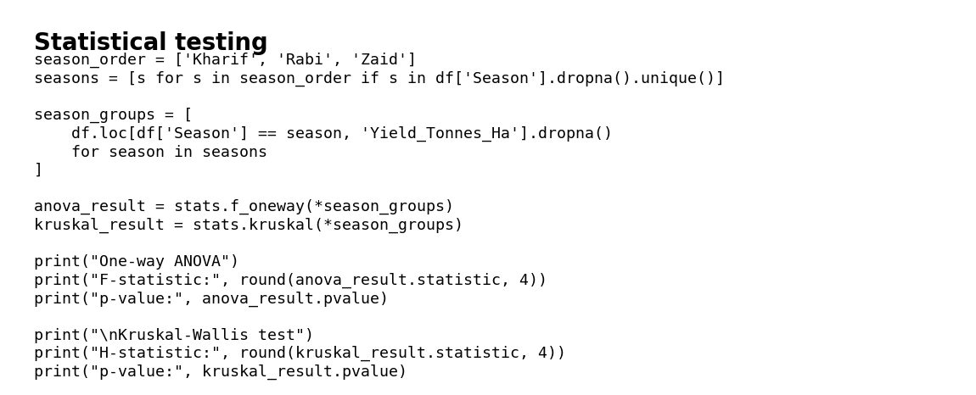
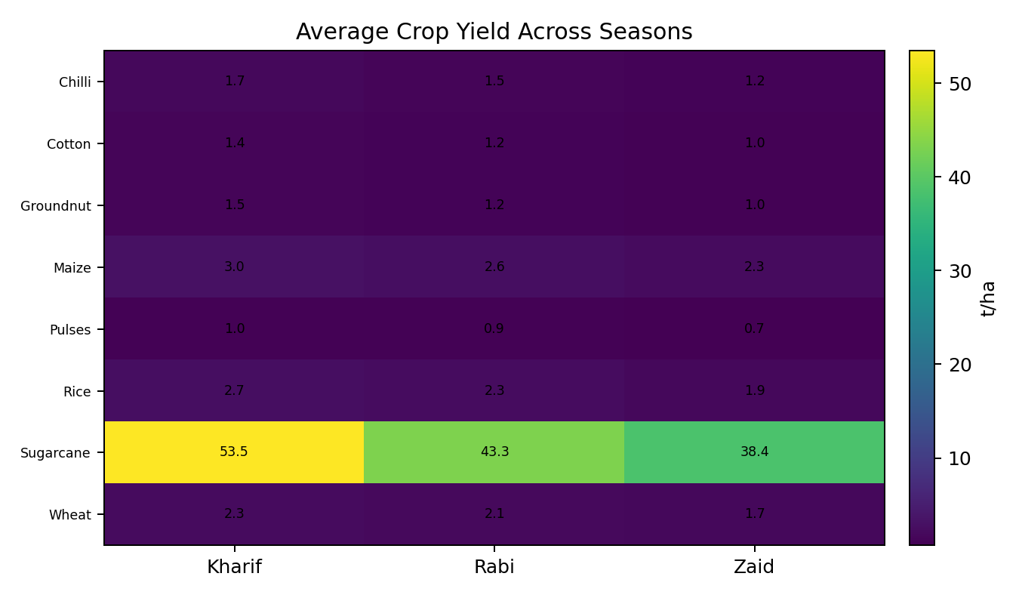
RESULTS
Yield ANOVA: p = 0.214 (not significant at 5%).
Kruskal–Wallis yield test: p < 0.001, indicating a significant difference in yield distributions across seasons.
Profit differences are also statistically significant (ANOVA p < 0.001).
Correlation analysis shows water used has the strongest direct association with yield (r ≈ 0.39); this is an association, not proof of causation.

Slide 11
Future scope
The Seasonal Agriculture Performance Analysis project can be further extended to provide deeper insights and support more effective agricultural planning. Future work can incorporate larger datasets covering multiple years, regions, crops, and farming conditions to identify long-term seasonal trends and improve the reliability of the analysis.
The analysis can further be developed into an interactive dashboard using tools such as Power BI or Tableau, allowing farmers, agricultural planners, and other stakeholders to explore seasonal trends and compare regions or crops easily. Real-time weather and market data could also be incorporated to provide more timely insights.
In the future, the project can be expanded into a decision-support system that provides data-driven recommendations for crop selection, resource allocation, and seasonal planning. Such extensions would make the analysis more practical and useful for improving agricultural productivity and supporting evidence-based decision-making.
.

Slide 12


VOIS Course Completion Certificate Course name – Data Visualization

Slide 13
Thank you
.

