Slide 1


#CODE19INDIA
Prototype Submission Phase

Slide 2
TEAM NAME and MEMBER DETAILS
Venkata.Sama Shreeram. mc
THEME:
Social life, welfare, and awareness

Slide 3
PROBLEM STATEMENT
Icovids.com is a website to provide Self assessment check for Covid-19 (Novel Coronovirus). You can use it to get recommendations for action incase of any symptoms and to know various health care centers nearby based on your location.

Slide 4
SOLUTION
Explain, in brief, how you intend to SOLVE the problem at hand.
The website asks you several Yes/no questions including symptoms and potential contacts. Besides recommendations for action, relevant contacts, and structured results, the purpose of this website is to guide you safely through the various health care centers nearby.
How it helps to solve the problem?
User can take the self assessment test and generate a report which can be submitted to the nearby helpline centers with the help of user location.
Frameworks/Tools/Technologies stacks to be used
Nodejs, AWS, MongoDB, ANgualr9, Dotnet technology.

Slide 5
SOLUTION
Assumptions, constraints, and solution decision points (Reason behind choosing a technology)
We have assumed that the integration with nearest health care center is possible.
Easy to build with the help of open source technologies and easy to scale with monoDB.
How easily can your solution be implemented and how effective will it be?
Helpline Centers would be benefited by knowing about the symptomatic patients before hand and can take decisions effectively.
Based on the self assessment and the user location the Government can put-up the health camps or helpline centers in respective areas.
Further more this app would be able to produce reports based on the users location and there assessment results.
Extent of Scalability/Usability
Since it is developed as a pwa(progressive web app), users can browse the website directly or can install the app on there mobile.
Since it is being hosted on AWS with loadbalancer it is scalable and can handle heavy load.

Slide 6
SOLUTION
Extent of Scalability/Usability
Since it is developed as a pwa(progressive web app), users can browse the website directly or can install the app on there mobile.
Since it is being hosted on AWS with load balancer it is scalable and can handle heavy load.

Slide 7
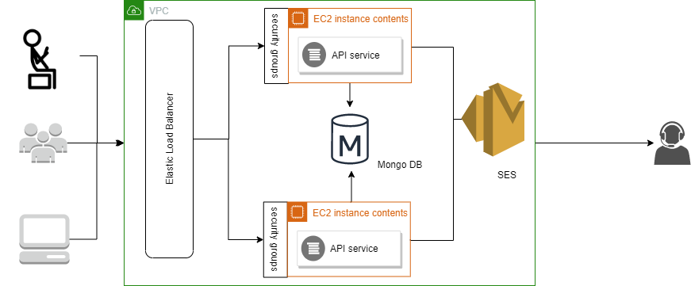
METHODOLOGY

Slide 8
WORKING PROTOTYPE
YouTube Link:
https://youtu.be/yjGPHb5mocA
Demo:
https://icovids.com

Slide 9
ATTACHMENTS
GitHub link:
https://github.com/samateja/covid-hack

Slide 10
SOCIETAL IMPACT/ NOVELTY
FUTURE SCOPE
Business relevance
Optimisation
Scope for modification
Doctors and Helpline Centers would be benefited by knowing about the symptomatic patients before hand and can take decisions effectively.

Slide 11
THANK YOU
#CODE19INDIA

