Slide 1
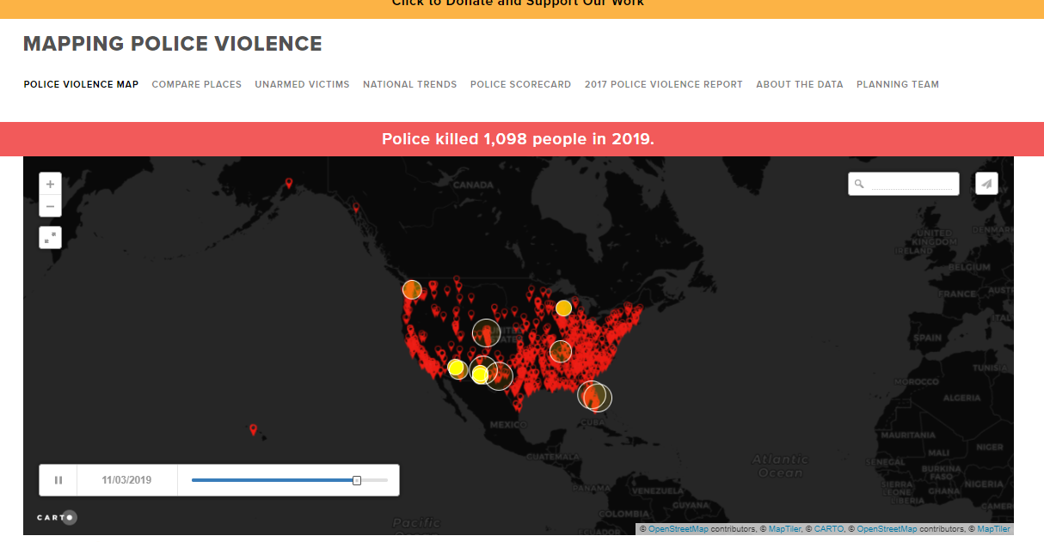
Police Killings in the US
Matthew Enright, Samatha Madur, Maddy McRaven
6/27/2020

Slide 2
Overview
Looking into deaths at hands of police from a variety of different factors:
Race: looking at the disproportionately high death rate of Black people at hands of police
Poverty: looking at correlation of poverty levels
Education: evaluating relationship between education levels

Slide 3
Data Source
Mapping Police Violence .org
National database of deaths by police from 2013 – 2019 with information on race, zip code, city, state, etc.
Census API
Used for area demographics, such as race, education, and poverty levels.
Year = 2016
GeoJSON files
Used for map plotting and visualization.
From census
through google searches
Notes:
Matthew

Slide 4
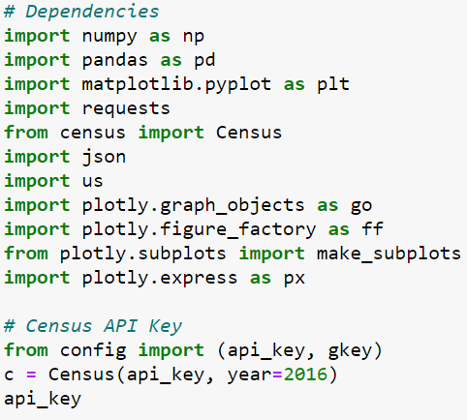
Analysis
Imported
Used a variety of csv, census API, GeoJSON
Cleaned
Deleting missing values
Dropping unneeded columns
Renaming columns or fields
Merged
Joined police killing data to area demographics through zip, city, county, state, or fips
Visualized
Plotly, matplotlib, scipy stats for regression, geopandas
Notes:
Samatha

Slide 5
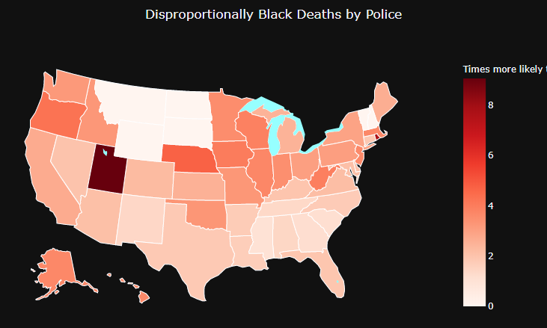
Nationwide Stats
white = 0.733
black = 3.24
native = 0.81
hispanic = 0.93
Calculation:
Time More Likely = Racial Demographics of Death / Racial Demographics of Area

Slide 6
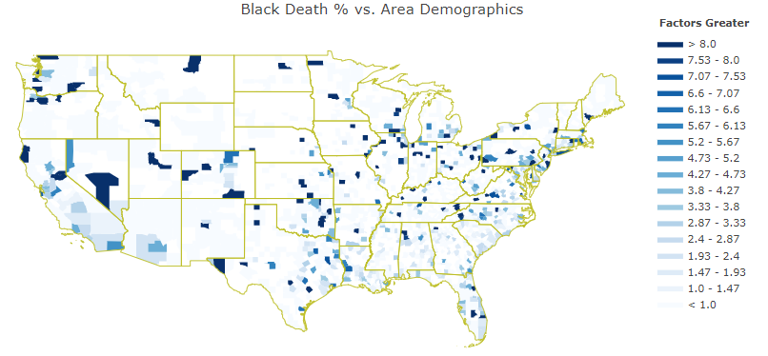
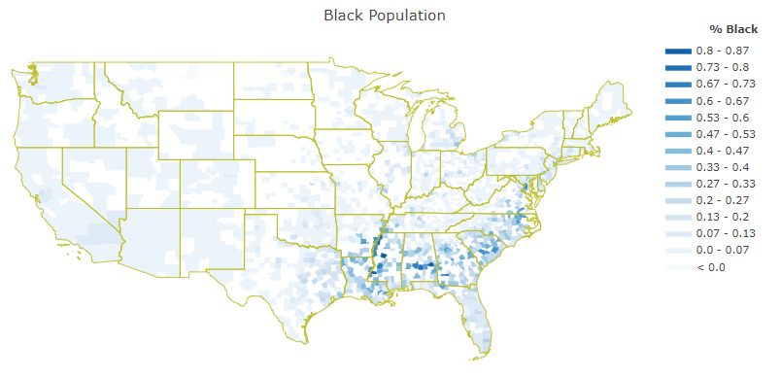

Slide 7
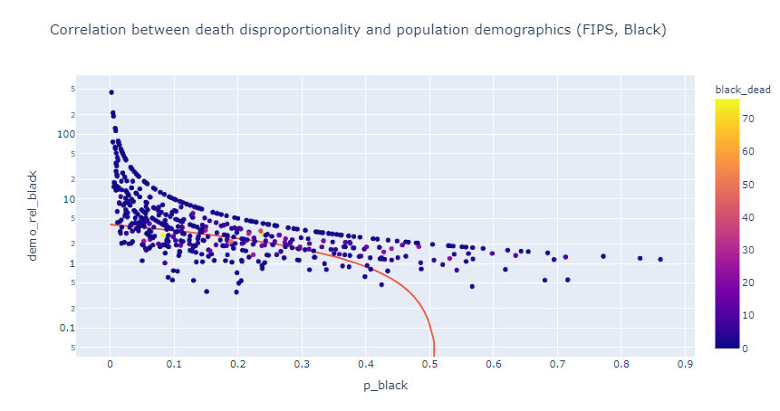

Slide 8
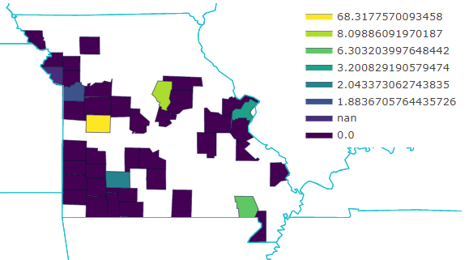
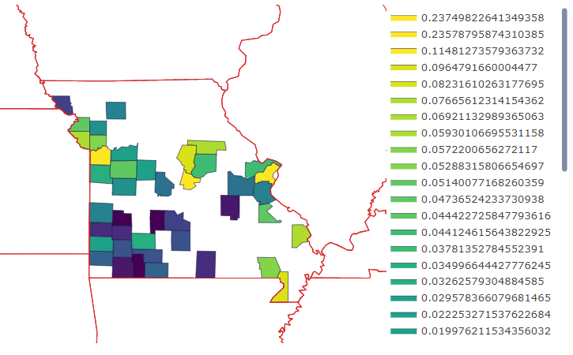
Disproportion compared to demographics
% black population
Henry County, MO: 1 black death, 1.5% black population (321/21930)

Slide 9
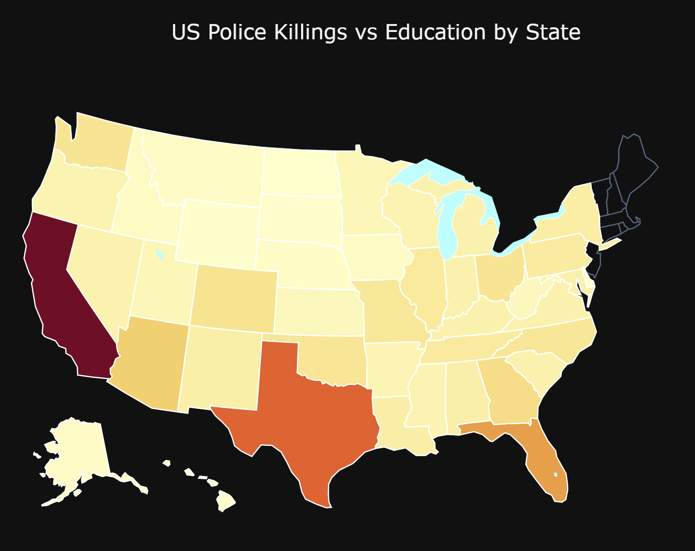
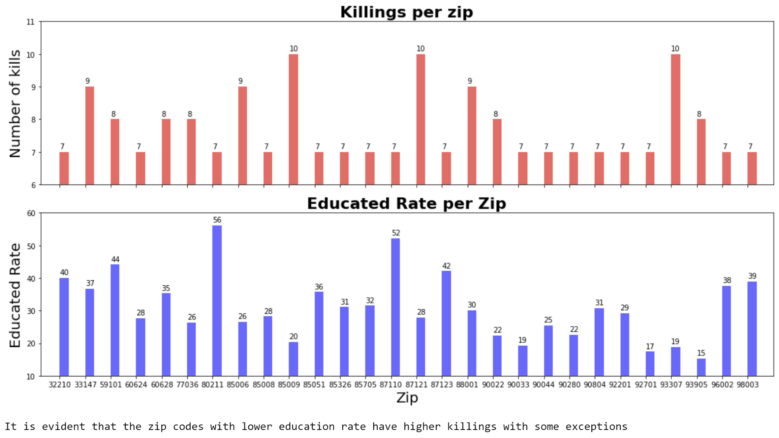
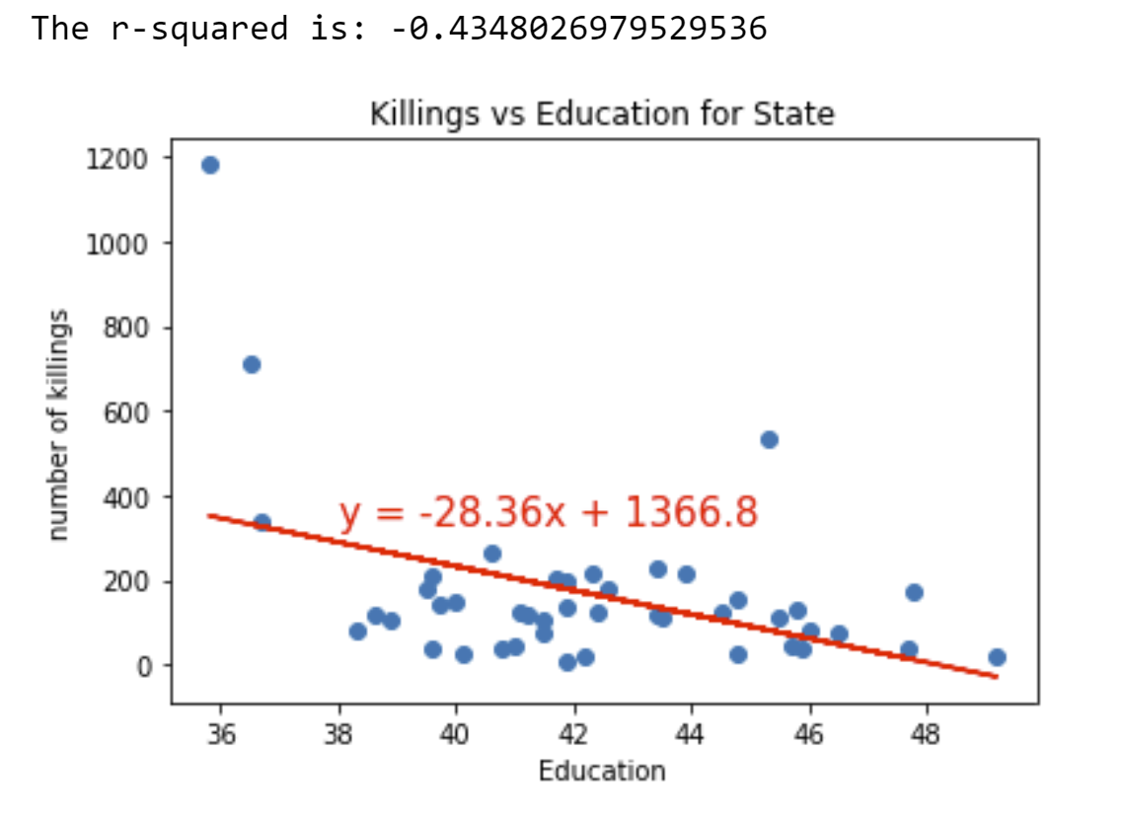
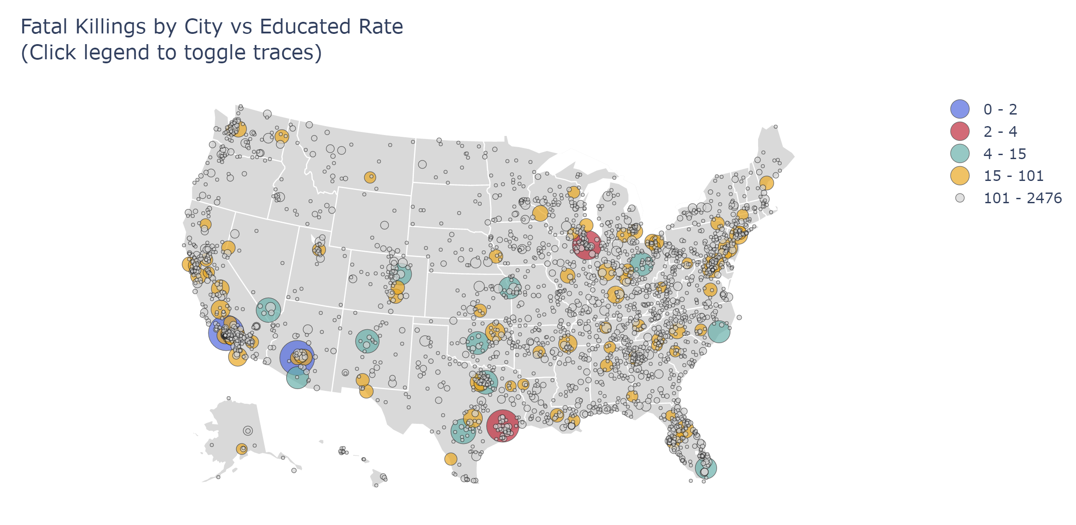
Results – Education
There is a negative relationship between number of killings end the educated %.
The states that have lower educated rate have higher number of kills.
But it is not always true that all the states that have higher education rate does not have higher number of killings.
Model fits better when the number of killings are compared against education rate for State.

Slide 10
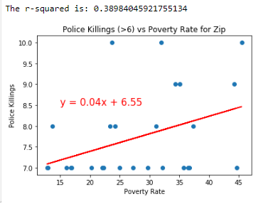
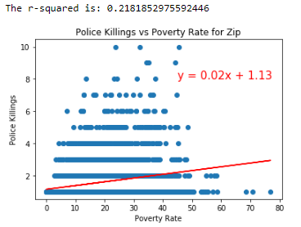
Results – Poverty
Notes:
The linear regression graph shows a positive relationship between police killings and poverty rate. The r-squared values are relatively low, because as you can see there is a lot of variation.

Slide 11
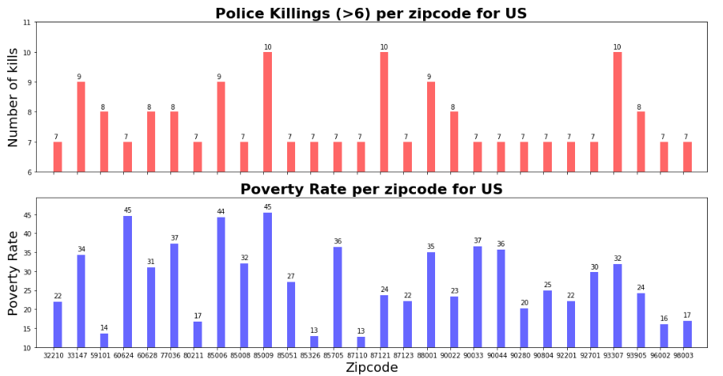
Results – Poverty

Slide 12
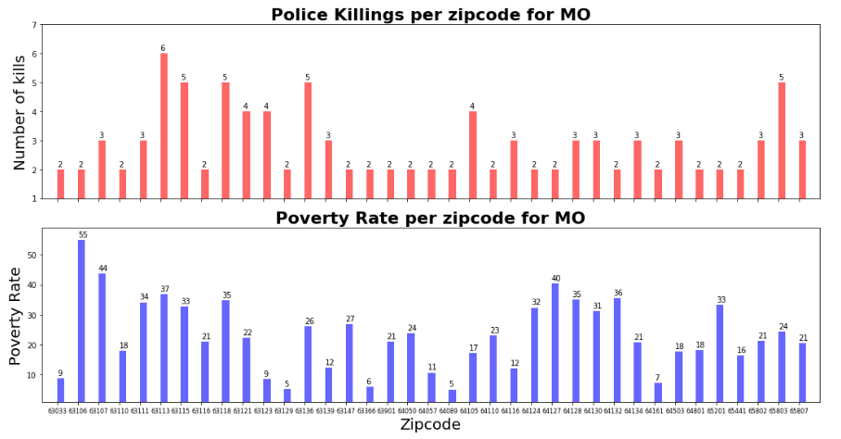
Results – Poverty

Slide 13
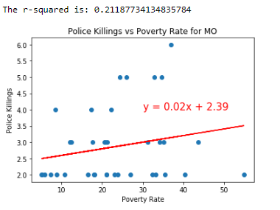
Results – Poverty

Slide 14
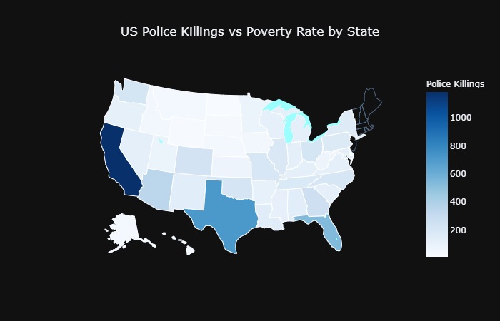
Results – Poverty

Slide 15
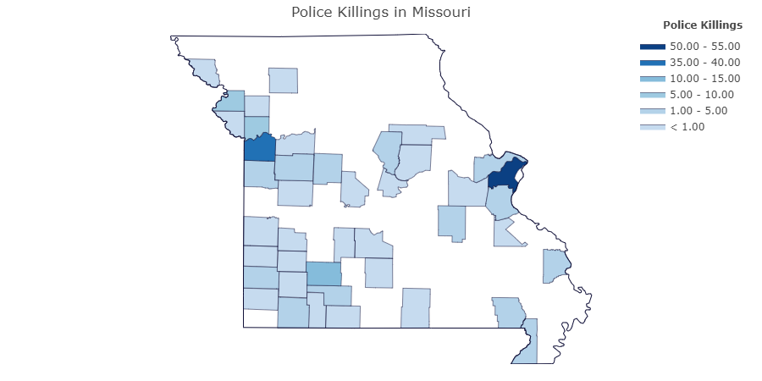
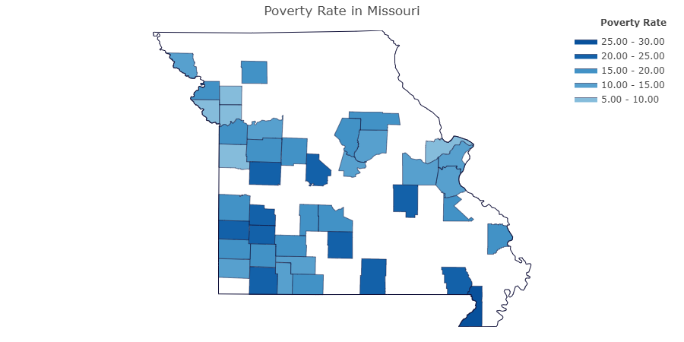
Results – Poverty
Notes:
Choropleth Map is a map composed of colored polygons. It is used to represent spatial variations of a quantity. This page documents how to build outline choropleth maps,

