Slide 1
Project Proposal 6.15.2020
Title: American Police Killings Trends and STL Case Study
Team Members: Maddy McRaven, Samatha Madur, Matthew Enright
Questions:
Police killings vs:
Race: Maddy
Poverty: Matthew
Education: Samatha
Think about intersection of race/poverty/education
Data Sources:
https://mappingpoliceviolence.org/aboutthedata
Census data
https://www.kaggle.com/jpmiller/police-violence-in-the-us/data

Slide 2
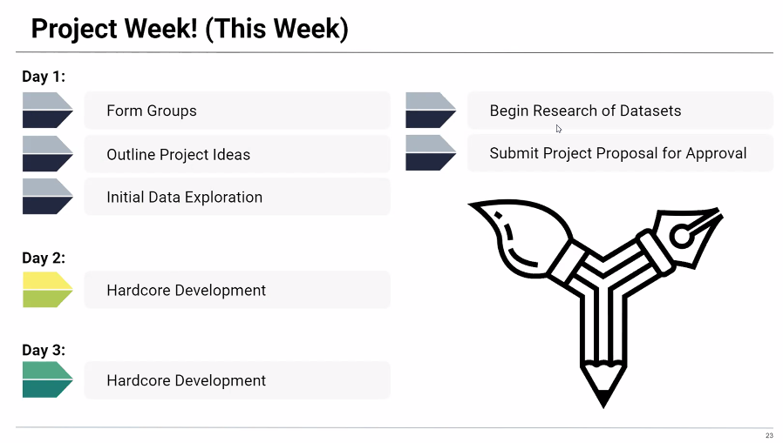
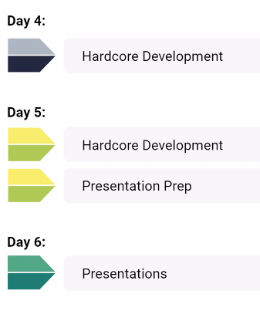
Week 1 Milestones

Slide 3
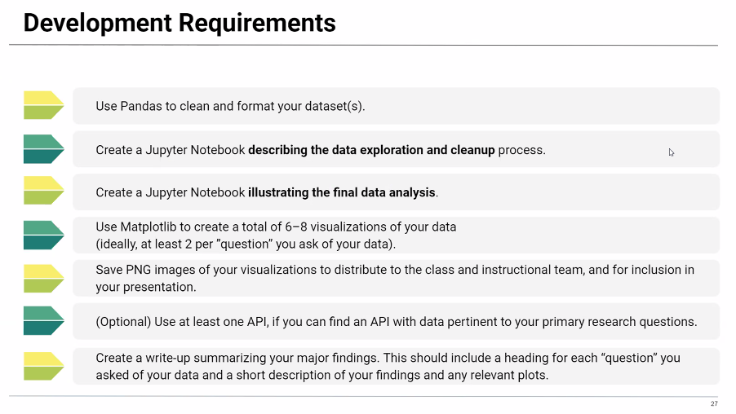
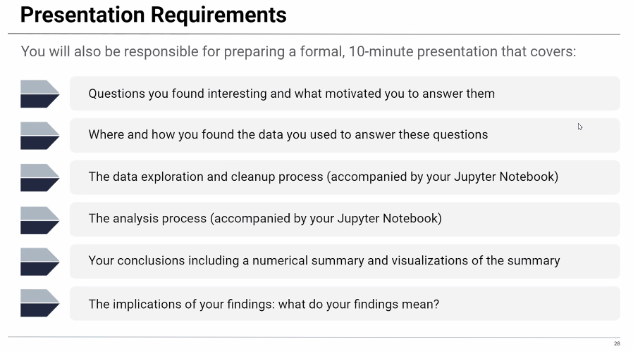
Reqs
Story-telling and truth telling.

Slide 4
