Slide 1

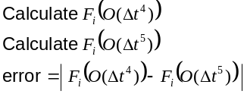
Start
No
No
Simulation complete
End

