Slide 1
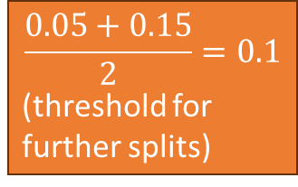
car_age*
> 2
≤ 2
(0.05)
(0.15)
car_power*
(horsepower)
Town
≤ 150
> 150
No
Yes
0.2
0.03
0.09
0.08
0.1
Capped
0.06
$$\frac{0.05+0.15}{2}=0.1$$
(threshold for
further splits)
*Monotonic
constraint

