Slide 1

Steam Game Ratings and Logistic Regression Presented by Sean Amato

Slide 2

OVERVIEW – DATA COLLECTION
Using a dataset found on Kaggle combined with culling data from my friends’ Steam libraries, 553 out of 71,699 games with reviews were curated for the purpose of creating a logistic regression model.
Steam is a video game digital distribution service and storefront developed by Valve Corporation.

Slide 3

OVERVIEW – DATA GLIMPSE
GAME DATA
Rows: 71,700 Columns: 11
$ Title <chr> "Baldur's Gate 3", "Counter-Strike: Global Offensive", "Apex Legends™", "Forza Horizon 5", "Call of Duty®", "PUBG:…
$ Original.Price <chr> "$29.99 ", "$14.99 ", "Free", "$34.78 ", "Free", "Free", "$34.99 ", "$29.99 ", "$19.99 ", "Free", "$33.98 ",…
$ Discounted.Price <chr> "$29.99 ", "$14.99 ", "Free", "$17.39 ", "Free", "Free", "$34.99 ", "$14.99 ", "$19.99 ", "Free", "$25.48 ",…
$ Release.Date <chr> "3 Aug, 2023", "21 Aug, 2012", "4 Nov, 2020", "8 Nov, 2021", "27 Oct, 2022", "21 Dec, 2017", "25 Jul, 2023", "9…
$ Game.Description <chr> "Baldur’s Gate 3 is a story-rich, party-based RPG set in the universe of Dungeons & Dragons, where your choices…
$ Recent.Reviews.Summary <chr> "Overwhelmingly Positive", "Very Positive", "Mixed", "Very Positive", "Mixed", "Mixed", "Very Positive",…
$ All.Reviews.Summary <chr> "Very Positive", "Very Positive", "Very Positive", "Very Positive", "Mixed", "Mixed", "", "Very Positive",…
$ Recent.Reviews.Number <chr> "- 96% of the 128,900 user reviews in the last 30 days are positive.", "- 89% of the 75,284 user reviews…
$ All.Reviews.Number <chr> "- 94% of the 188,617 user reviews for this game are positive.", "- 88% of the 7,428,921 user reviews for this…
$ Popular.Tags <chr> "['RPG', 'Choices Matter', 'Character Customization', 'Story Rich', 'Adventure', 'Online Co-Op', 'CRPG', 'Multiplayer…
$ Game.Features <chr> "['Single-player', 'Online Co-op', 'LAN Co-op', 'Steam Achievements', 'Full controller support', 'Steam Cloud']",…
PLAYER DATA
Rows: 1,580 Columns: 4
$ appid <dbl> 34270, 105600, 72850, 204060, 212680, 224760, 242920, 262060, 285330, 221380, 346110, 407530, 367520, 413150, 427520, …
$ Title <chr> "SEGA Mega Drive & Genesis Classics", "Terraria", "The Elder Scrolls V: Skyrim", "Superbrothers: Sword & Sworcery EP", "FTL:…
$ playtime_forever <dbl> 32, 273, 4616, 403, 4772, 62, 2575, 2256, 30, 1306, 204, 0, 2596, 1018, 3113, 0, 227, 604, 32, 3179, 1904, 602,…
$ player_id <chr> "76561198056383273", "76561198056383273", "76561198056383273", "76561198056383273", "76561198056383273", "765611980…
For logistic regression “Popular Tags” (input) and the Positive Review Percentage (output) extracted from “All Reviews Number” in the Game Data will be left joined to Player Data to get a more manageable subset of games to analyze.

Slide 4

OVERVIEW – REASEARCH QUESTION
Can a logistic model accurately predict the likelihood that a person would like a game based on its tags in Steam?
If the model works well, the average rating per game recommended should exceed the average rating across all Steam games.

Slide 5
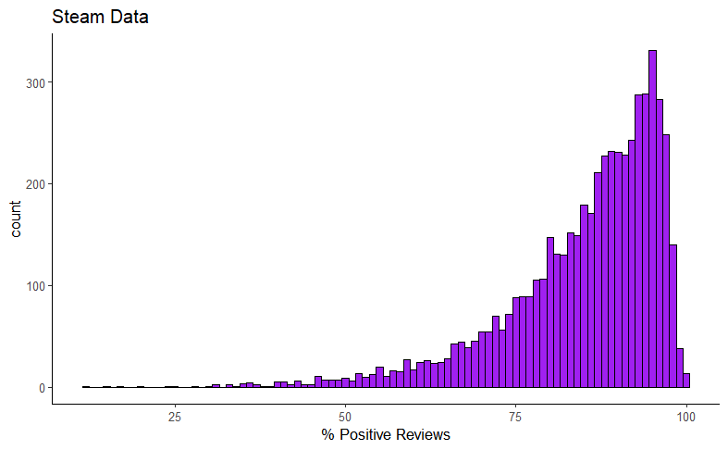

VISUALIZATIONS – STEAM GAME REVIEW DISTRIBUTION
Average Rating per game = 86.4%

Slide 6
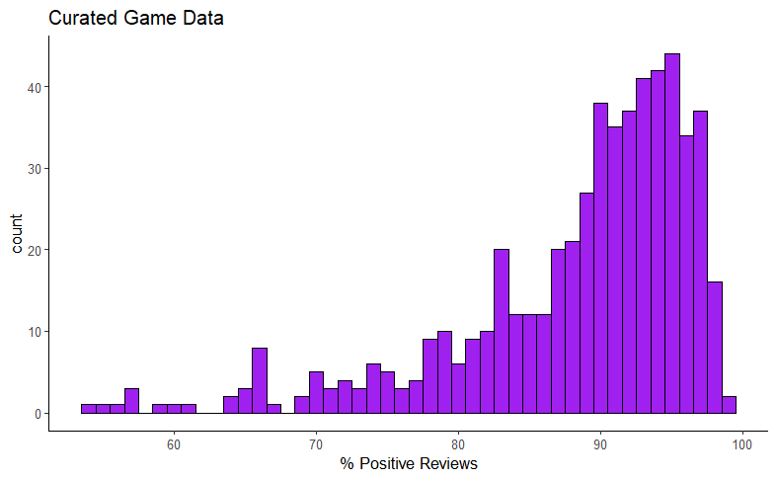

VISUALIZATIONS – CURATED GAME REVIEW DISTRIBUTION
Average Rating per game = 87.8%

Slide 7
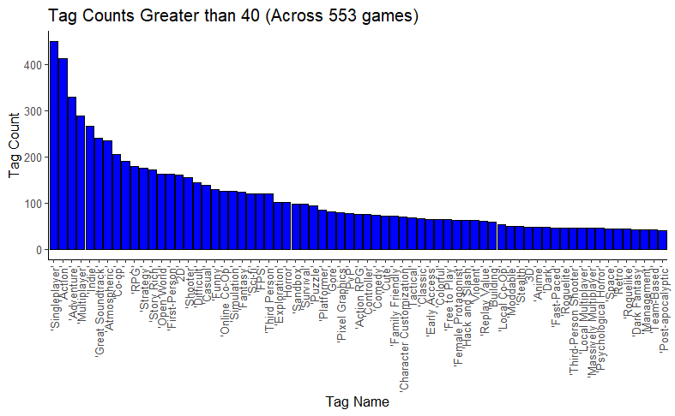

VISUALIZATIONS – TAG COUNTS (300+ UNIQUE TAGS)

Slide 8

MODEL CREATION – SUCCESS CRITERIA OF 80% POSITIVE REVIEWS
The model started with 69 binary inputs but was reduced to 14 binary inputs all with p-values less than 0.10.
Feature/Genre | Model Parameters | P-value
Intercept | 1.9582 | 3.85e-05
Adventure | -1.2178 | 0.001992
Multiplayer | -1.2439 | 0.006281
Great Soundtrack | 1.1251 | 0.005442
Co-op | 1.4097 | 0.000676
Role Play Games | -0.5883 | 0.096709
2D | 2.1190 | 0.000928
Difficult | 1.0610 | 0.037110
Funny | 1.0011 | 0.026389
Exploration | 1.4400 | 0.015431
PvP | -1.1565 | 0.005718
Hack and Slash | 0.9842 | 0.074064
Violent | -1.1628 | 0.011093
Moddable | 1.8570 | 0.079125
Post-apocalyptic | 1.1988 | 0.087435
STEPS: 1. Create an 80/20 split train and test
2. Train the model
3. Eliminate binary inputs that are not statistically significant (alpha level greater than 0.10)
4. Repeat from steps 2 & 3 until all p-values are at or below 0.10
5. Profit!

Slide 9
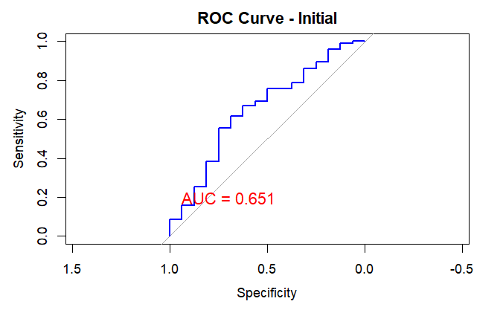
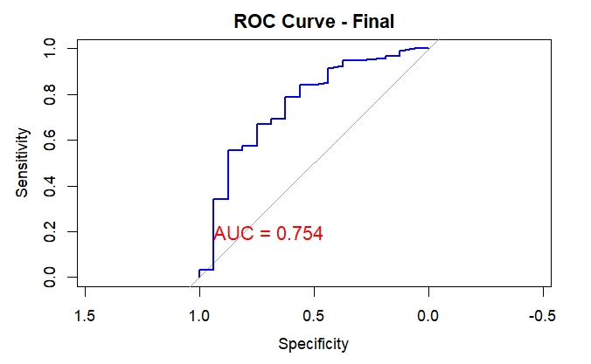


MODEL VALIDATION – INITIAL VS FINAL
ML Standards: 0.5 to 0.6: Poor discrimination; 0.6 to 0.7: Fair discrimination; 0.7 to 0.8: Good discrimination; 0.8 to 0.9: Very good discrimination; 0.9 to 1.0: Excellent discrimination

Slide 10

PREDICTIONS VS GROUND TRUTH
Summary:
91.4% of all the recommended games had positive ratings
79.9% of all the positively rated games were correctly categorized
All the recommended games have an average rating of 90% which is 3.6% greater than Steam’s overall average
NOTE: Positively reviewed games had a rating of 80% or greater | Positively Reviewed Games | Negatively Reviewed Games
Games Recommended | 68.2% (True Positive) | 6.4% (False Positive)
Games Not Recommended | 17.2% (False Negative) | 8.2% (True Negative)

Slide 11


FINAL THOUGHTS AND CONCLUSIONS
Considerations For Steam: The implementation of this type of model can optimize the review process to find more promising titles to put on the platform and using it to make recommendations to players can increase customer satisfaction
Considerations For Players: This model could help players make more informed decisions on which games to purchase through tailored recommendations
Considerations For This Model: This model goes beyond the binary classification of positive and negative reviews, 91.4% accuracy for positive predictions at or above an 80% rating is pretty good compared to the sample which only had 74.6% of it’s games above 80%

