Slide 1
Memory Leak
Samantha Au, Victor Hui, Daniel Li, Jon Ngo, Julia Zeng,

Slide 2
Explanation of the concept
- This project is an android game that aims to assist the player to understand main concepts of C++
- The mechanics of the game involves moving a shooter to destroy falling choices, in order to answer the question posted at the bottom of the screen
- We tried to introduce a theme of progress within the game. The player starts off in the woods but the game levels include a rocket constantly propelling into space. After the player successfully answers all the questions, it reaches the Boss in outer space.

Slide 3

Main Menu
-The first screen the user will see
Button to start the game
Button for settings
Displays a fun fact from the internet about C++
Button for the instructions

Slide 4
Levels
At the time of creating this Powerpoint, the levels are incomplete
The screen after START is pressed
Bullet will spawn and move up the screen if the rocket is tapped
If bullet and the correct answer cloud intersect, a toast message will appear.
The Rocket is able to move side to side.

Slide 5
The Boss Level occurs after every 4 normal levels
Any similarities with Professor Densmore is purely coincidental.

Slide 6
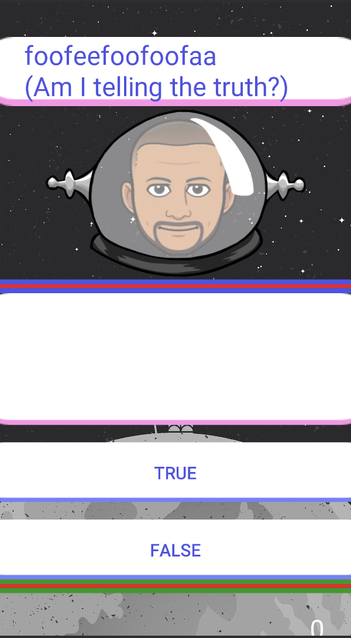
Boss Level
If the player answers the question correctly, the Boss’s health bar would decrease by 20%, and the Player’s score would increase by 1
When this level begins, a statement about C++ would be prompted, and the player has to answer regarding whether or not the statement is correct or incorrect
If either the bosses’ health of the player’s health approaches 0, the level ends
Vice Versa, if the player answers incorrectly, the bar decreases

Slide 7
Question Database + Future Improvement
The database for the questions are located in an Array in the app. This makes it so that it is very easy to update the questions.
Possible future improvement would include moving the question database online, allowing us to remotely update the questions without having to update the app.
But due to time constraints, we could not achieve this feat before the completion of our project.

Slide 8
Challenges
The biggest obstacles for the project is the time constraint and our lack of experience with Java

