Slide 1


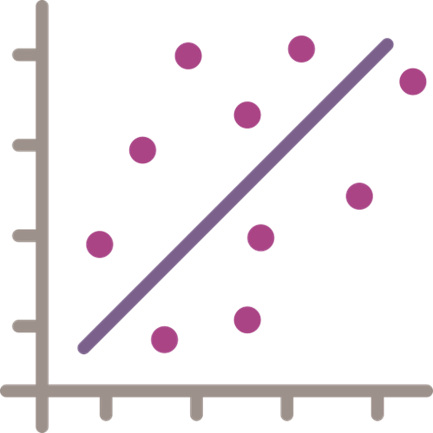











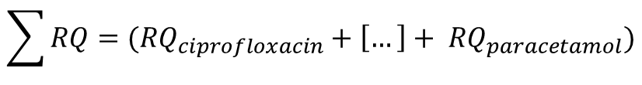

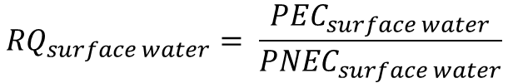

Historic Medicine
Sales Weights
Norwegian Institute
for Public Health
Historic Population
Data
Statistics Norway
a)
b)
c)
Linear Model Fitted to
Sales Data, Population, Year
d)
Medicine Sales Weight
Linear Models
e)
Forecast Population
Scenarios
Statistics Norway
f)
Predicted Medicine
Sales Weights
Predicted Environment
Concentration in Influent
h)
Total Water
Consumption
Statistics Norway
i)
Average Household Water
Consumption Data
Statistics Norway
${PEC}_{influent}= \frac{Predicted Medicine Sales Weights}{Total Water Consumption}$
g)
Wastewater Treatment
Upgrade Scenarios
Theoretical
Predicted Environment
Concentration in Effluent
k)
Medicine Removal Rates
van Dijk et al. (in review)
l)
${PEC}_{effluent}={PEC}_{influent} ×(1−Medicine Removal Rate)$
j)
$${PEC}_{surface water}= \frac{{PEC}_{influent}}{Dilution Factor}$$
Predicted Environment
Concentration in
Surface Water
n)
Dilution Rate
Fixed (10)
m)
Predicted Risk
(Risk Quotient)
o)
Predicted Toxicity
(PNEC)
$${RQ}_{surface water}= \frac{{PEC}_{surface water}}{{PNEC}_{surface water}}$$
l)
$$\sum{RQ}=({RQ}_{ciprofloxacin}+\left[…\right]+ {RQ}_{paracetamol})$$
p)
Σ
q)
⋂
Predicted
Joint Probability of Risk
Threshold Exceedance
Predicted
Sum of Risks
$$P\left(at least one RQ>threshold\right)=P\left({RQ}_{ciprofloxacin}>1\right)∩\left[…\right]∩\left({RQ}_{paracetamol}>1\right)$$

