Slide 1
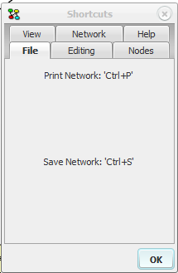
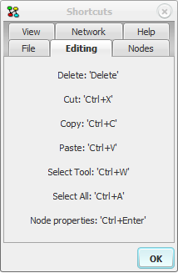
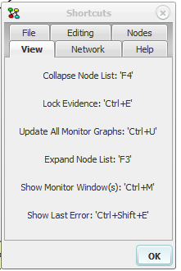
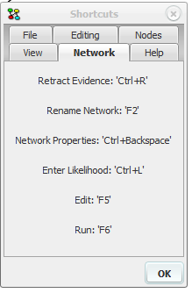
Ctrl + D
Discrete Chance
Binned probability distribution
Ctrl + F
Gaussian probability distribution
Cannot be a parent to Discrete Chance
Continuous Chance
Ctrl + E
Non-probabilistic function with Function, Boolean, Numbers or Continuous parents
Function
Ctrl + I
“a marginal distribution which can be a function of the values of the parents”
Discrete Function
A container for a sub-network
Requires matched inputs/outputs with the same states
Ctrl + K
Instance
Ctrl + J
Decision
Represents a decision to be made by the user
Ctrl + G
Link
A causal link between nodes
Other utility and information uses
Ctrl + U
Utility
Used in Limited Memory Influence Diagrams only
Specifies utility of configurations of parents

