Slide 1
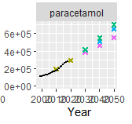





Spatial Variation
County
Year
Norway
Population
WWTP
Scenario
County
County
Year
Norway
Population
WWTP
Scenario
County
Year
Year
Population
Scenario
Norway
Population
API 1
API1
RQ
WWTP
Scenario
Sales
Weight
Influent
Concentration
Effluent
Concentration
Surface Water
Concentration
RQ
Sum RQ
API 2
P(RQ > 1)
API2
RQ
API n

