Slide 1



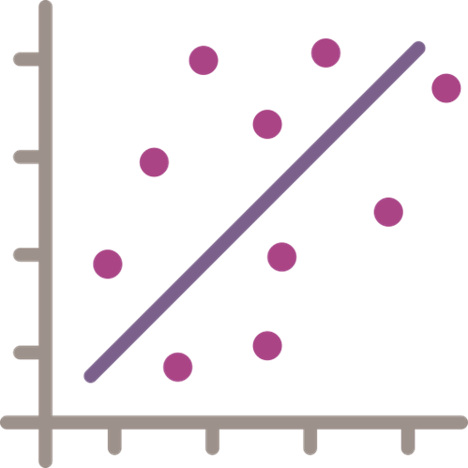









Historic Medicine
Sales Weights
Norwegian Institute
for Public Health
Historic Population
Data
Statistics Norway
Forecast Population
Scenarios
Statistics Norway
Medicine Sales Weight
Linear Models
Predicted Medicine
Sales Weights
Predicted Environment
Concentration in Influent
Water Consumption
Data
Statistics Norway
Wastewater Treatment
Upgrade Scenarios
van Dijk et al. (in production)
Predicted Environment
Concentration in Effluent
Predicted Environment
Concentration in Water
Predicted Risk
(Risk Quotient)
Predicted Toxicity
(PNEC)
Predicted
Combined Risk

