Slide 1


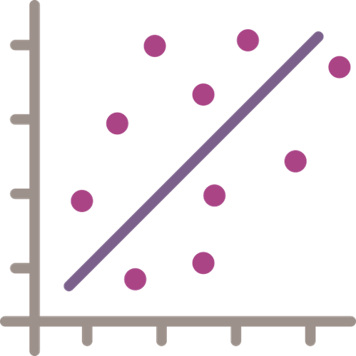











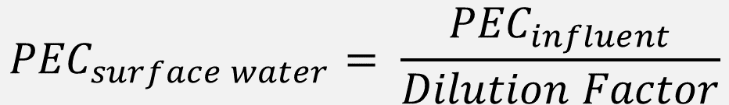
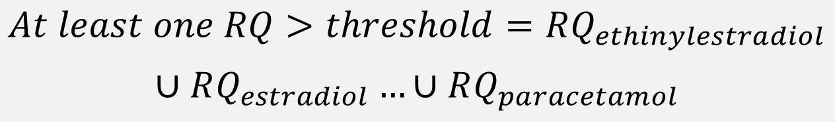
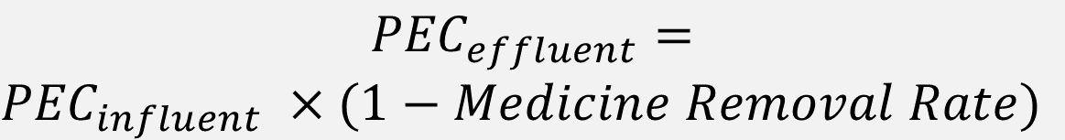
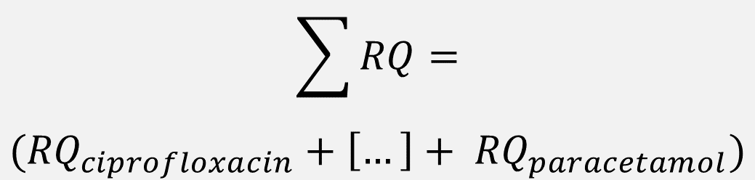
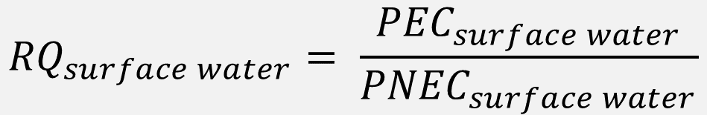
Historic Pharmaceutical
Sales Weights
Norwegian Institute
for Public Health
Historic Population
Data
Statistics Norway
a)
b)
Linear Model Fitted to
Sales Data, Population, Year
c)
Forecast Population
Scenarios
Statistics Norway
d)
Pharmaceutical Sales
Weight Linear Models
e)
Predicted Pharmaceutical
Sales Weights
Wastewater Treatment
Upgrade Scenarios
Theoretical
f)
k)
2020 Water
Consumption
Statistics Norway
Predicted Environmental
Concentration in Influent
${PEC}_{influent}= \frac{Predicted Pharmaceutical Sales Weights}{Total Water Consumption}$
g)
h)
Mean Pharmaceutical
Removal Rates
van Dijk et al. (in review)
$${PEC}_{effluent}=$$
${PEC}_{influent} ×(1−Medicine Removal Rate)$
Predicted Environmental
Concentration in Effluent
i)
j)
Predicted Environmental
Concentration in
Surface Water
$${PEC}_{surface water}= \frac{{PEC}_{influent}}{Dilution Factor}$$
Dilution Factor
Fixed (10)
l)
m)
$${RQ}_{surface water}= \frac{{PEC}_{surface water}}{{PNEC}_{surface water}}$$
Predicted Risk
(Risk Quotient)
Predicted Toxicity
(PNEC)
n)
l)
$$\sum{RQ}=$$
$$({RQ}_{ciprofloxacin}+\left[…\right]+ {RQ}_{paracetamol})$$
Predicted Joint
Probability of Risk
Threshold Exceedance
Predicted
Sum of Risks
$$At least one RQ>threshold=RQ_{ethinylestradiol}$$
$$∪RQ_{estradiol}…∪RQ_{paracetamol}$$
o)
Σ
p)
⋂

Slide 2
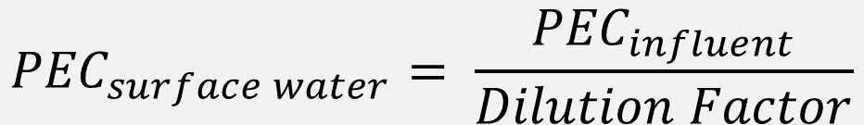




Historic Pharmaceutical
Sales Weights
Norwegian Institute
for Public Health
Historic Population
Data
Statistics Norway
a)
b)
a) Historic Sales
b) Historic Population
Linear Model Fitted to
Sales Data, Population, Year
c)
c) Sales Per Capita Predictions
Forecast Population
Scenarios
Statistics Norway
d)
Pharmaceutical Sales
Weight Linear Models
e)
d) Predicted Sales Weights
e) Forecast Population
Scenarios
Predicted Pharmaceutical
Sales Weights
Wastewater Treatment
Upgrade Scenarios
Theoretical
f) Influent
g) 2020 Water Consumption
f)
k)
Predicted Environmental Concentrations
h) Effluent
i) Theoretical Removal Rates
2020 Water
Consumption
Statistics Norway
Predicted Environmental
Concentration in Influent
${PEC}_{influent}= \frac{Predicted Pharmaceutical Sales Weights}{Total Water Consumption}$
g)
h)
j) Surface Water
k) Estimated Dilution Factors
Mean Pharmaceutical
Removal Rates
van Dijk et al. (in review)
l) Predicted Risk Quotients
$${PEC}_{effluent}=$$
${PEC}_{influent} ×(1−Medicine Removal Rate)$
Predicted Environmental
Concentration in Effluent
i)
j)
m) Sum of Predicted Risk Quotients
Predicted Environmental
Concentration in
Surface Water
$${PEC}_{surface water}= \frac{{PEC}_{influent}}{Dilution Factor}$$
Dilution Factor
Fixed (10)
l)
m)
$${RQ}_{surface water}= \frac{{PEC}_{surface water}}{{PNEC}_{surface water}}$$
Predicted Risk
(Risk Quotient)
Predicted Toxicity
(PNEC)
n)
l)
$$\sum{RQ}=$$
$$({RQ}_{ciprofloxacin}+\left[…\right]+ {RQ}_{paracetamol})$$
Predicted Joint
Probability of Risk
Threshold Exceedance
Predicted
Sum of Risks
$$At least one RQ>threshold=RQ_{ethinylestradiol}$$
$$∪RQ_{estradiol}…∪RQ_{paracetamol}$$
o)
Σ
p)
⋂

