Slide 1
Microbes and Mixtures
Sam Welch

Slide 2
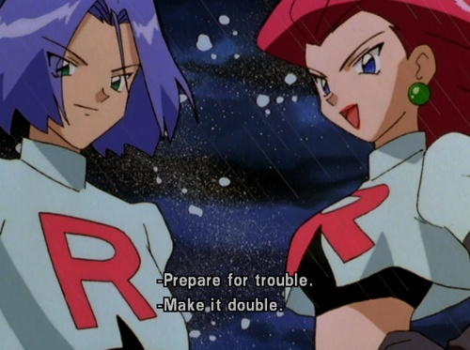
Prepare for trouble…
- Nintendo
Notes:
I’d like to start off by dating this presentation and possible alienating everyone in the room over 25. And I want challenge James’ hypothesis in the statement above: are two team rocket goons twice as dangerous as one?

Slide 3

and make it double?
Je
Ja
Mortality
Gi
Number of Stressors

Slide 4
Iceland Isolates and Simultaneous Stressors
1
1
1
1
1
1
1
1
Cold
2
2
2
2
2
2
2
Cold Treatment
3
3
3
3
3
3
Temp Stress
S2
S3
S2xS3
4
4
4
4
4
Warm Treatment
Mixed
5
5
5
5
Warm + Pulse
6
6
6
Cold + Pulse
Warm
7
7
8
1-8 species RPD
Biodiversity & Ecosystem Functioning?
Eco-evolutionary legacies?

