Slide 1
Parallel K-Medoid Clustering for Customer Segmentation on Apache Spark

Slide 2
Group Members:-
Nilav Shah - 202001025
Samay Ashar - 202001070
Rushabh Patel - 202001419

Slide 3
Problem and Solution
Problem
The problem is that when we are given a dataset, the time taken to sequentially scan the data is large. Running the process one after the other takes a longer execution time and so we aim at reducing the time taken by implementing the process in parallel in Apache Spark.

Slide 4
Problem and Solution
Solution
So, we are solving this problem by implementing the code in Apache Spark and running the code in parallel. The implemented code creates clusters and reduces the runtime of the process in turn making it faster.
The silhouette score when the program is executed sequentially is low as compared to when the program is executed in parallel.

Slide 5
Algorithm implemented
The algorithm implemented is The K-Medoid clustering algorithm. It is a partitional clustering algorithm that is used for partitioning a dataset into K clusters. In contrast to the more widely known K-Means algorithm, K-Medoids works with medoids (the most central data point in a cluster) rather than centroids (the average of all points in a cluster). This makes K-Medoids more robust to outliers.
Implementing K-Medoid clustering in parallel on Apache Spark involves adapting the algorithm to leverage the distributed computing capabilities of Spark.

Slide 6
Results

Slide 7
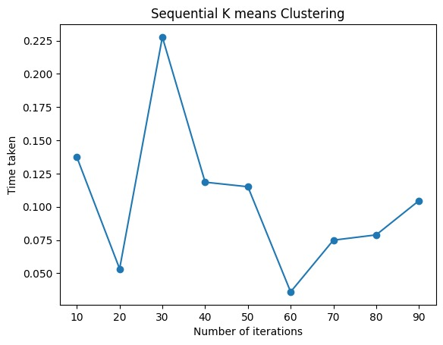
K-Means Clustering Algorithm
Sequential K-Means Clustering

Slide 8
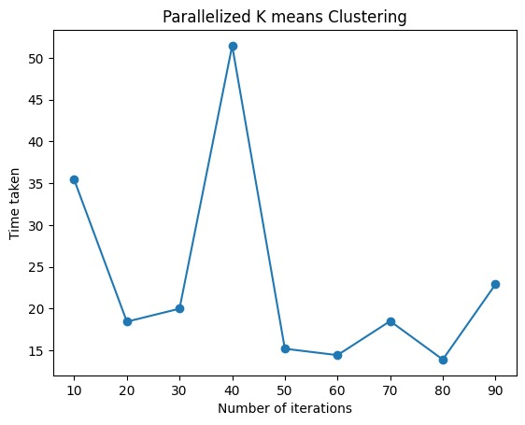
Parallel K-Means Clustering

Slide 9
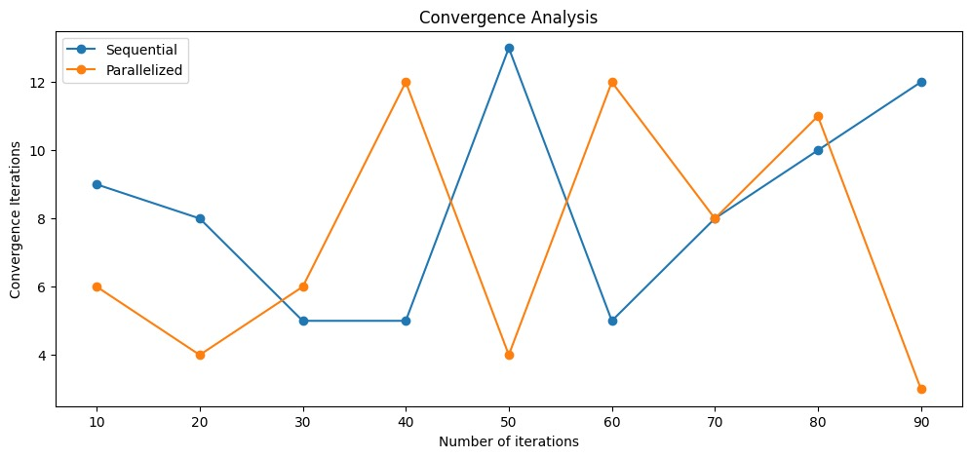
Convergence Analysis

Slide 10
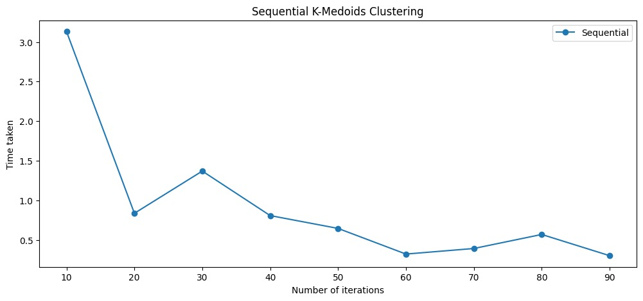
K-Medoid Clustering Algorithm
Sequential K-Medoid Clustering

Slide 11
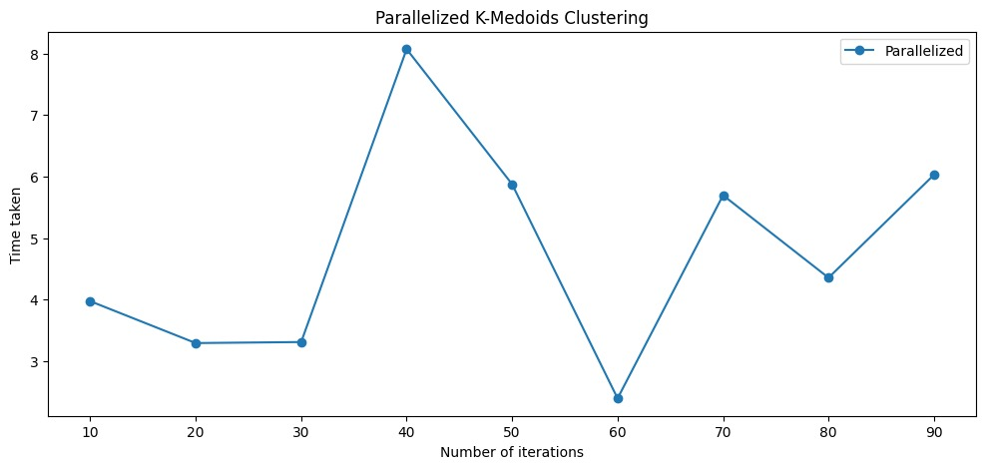
Parallel K-Medoid Clustering

Slide 12
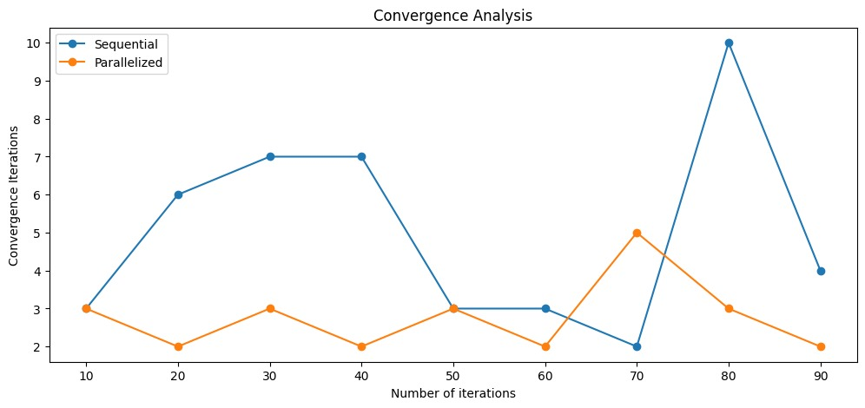
Convergence Analysis

Slide 13
Key findings

Slide 14
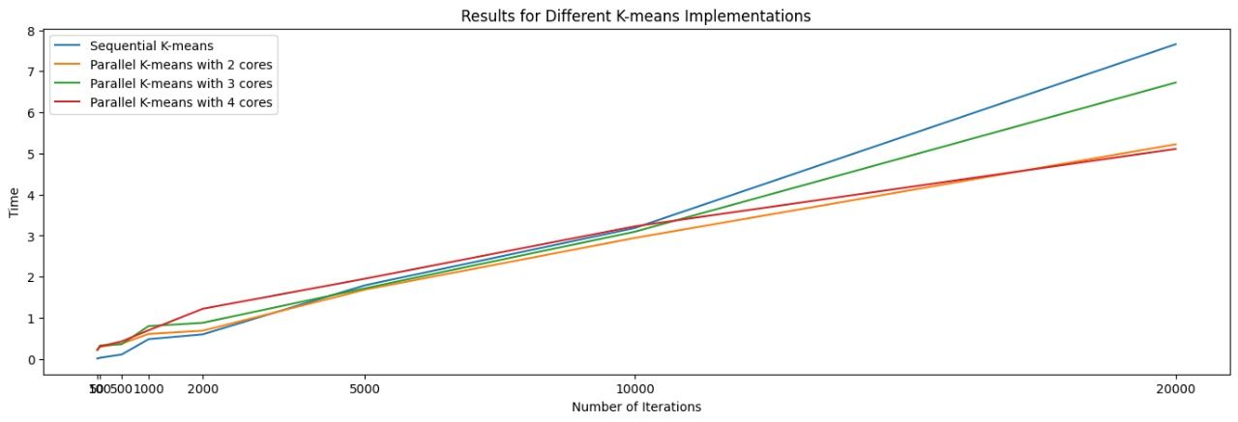

Slide 15
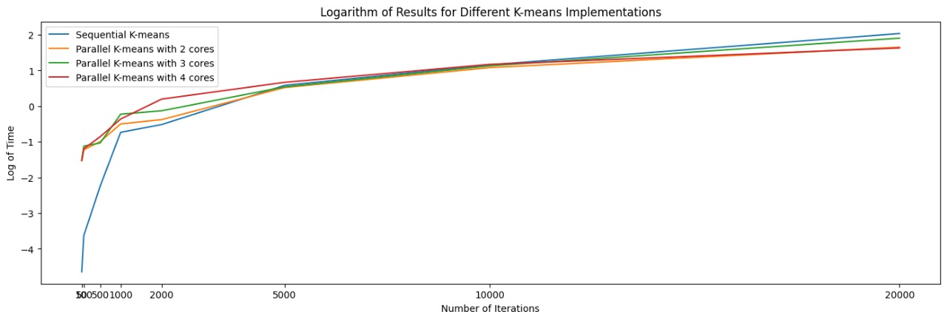

Slide 16
References
1. Wang, Bowen, et al. (2016). "Parallelizing k-means-based clustering on Spark." In *International Conference on Advanced Cloud and Big Data (CBD).* IEEE. - This paper serves as the primary reference for the parallel k-medoid algorithm based on k-means and its implementation on Apache Spark.
2. Jain, A. K., & Dubes, R. C. (1988). Algorithms for clustering data. Prentice-Hall, Inc. - A foundational book on clustering algorithms, including k-medoids, which can provide background knowledge.
3. Zaharia, M., Chowdhury, M., Franklin, M. J., Shenker, S., & Stoica, I. (2010). Spark: Cluster computing with working sets. HotCloud, 10(10-10). - The paper on Apache Spark provides insights into Spark's architecture and distributed computing capabilities, relevant for implementing parallel clustering algorithms.
4. Additional research papers and articles on k-medoid clustering, customer segmentation, and clustering in Spark, as found in academic databases like IEEE Xplore, ACM Digital Library, and arXiv

