Slide 1
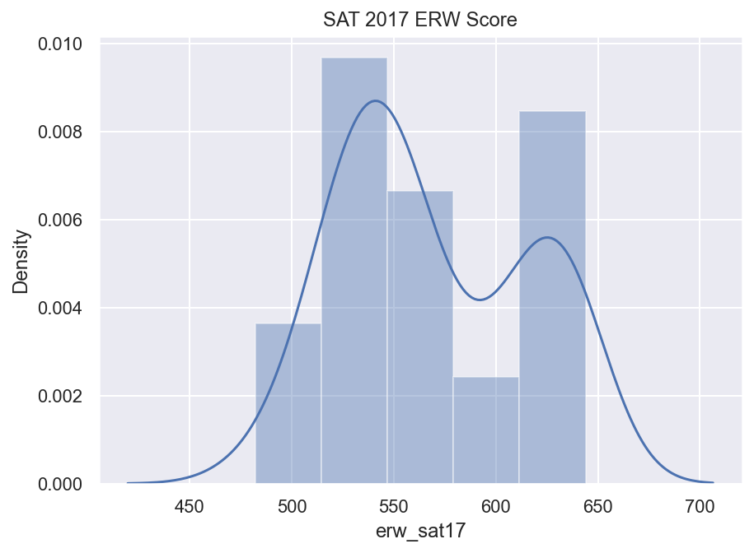
Project 1: SAT & ACT Analysis

Slide 2
Problem Statement
Analyze SAT and ACT Scores from previous years to provide Recommendations on where money can be spent to increase SAT participation rates.

Slide 3
Executive Summary
How can Data Analysis help for this problem statement?

Slide 4
What do we have, What can be done?
SAT and ACT data for 3 consecutive years 2017 to 2019.
SAT – Section Scores, Total Scores, Participation %
ACT – Section Scores, Composite Scores, Participation %

Slide 5
Target
Analyze Trends among Total Scores and Participation Rates
Get performance insights
Identify important correlated features that might help analyze the trend
Conclude our findings
Recommendations for the College Board
What else can be done?

Slide 6
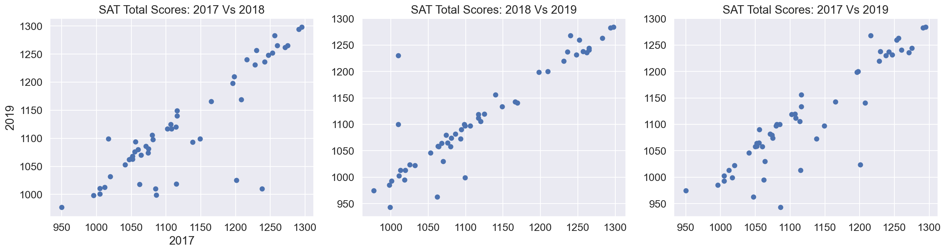
What’s Trending! - 1
2019
2018
2017
2019
SAT Average
Total Scores
2017
(/ 1600)
2018

Slide 7
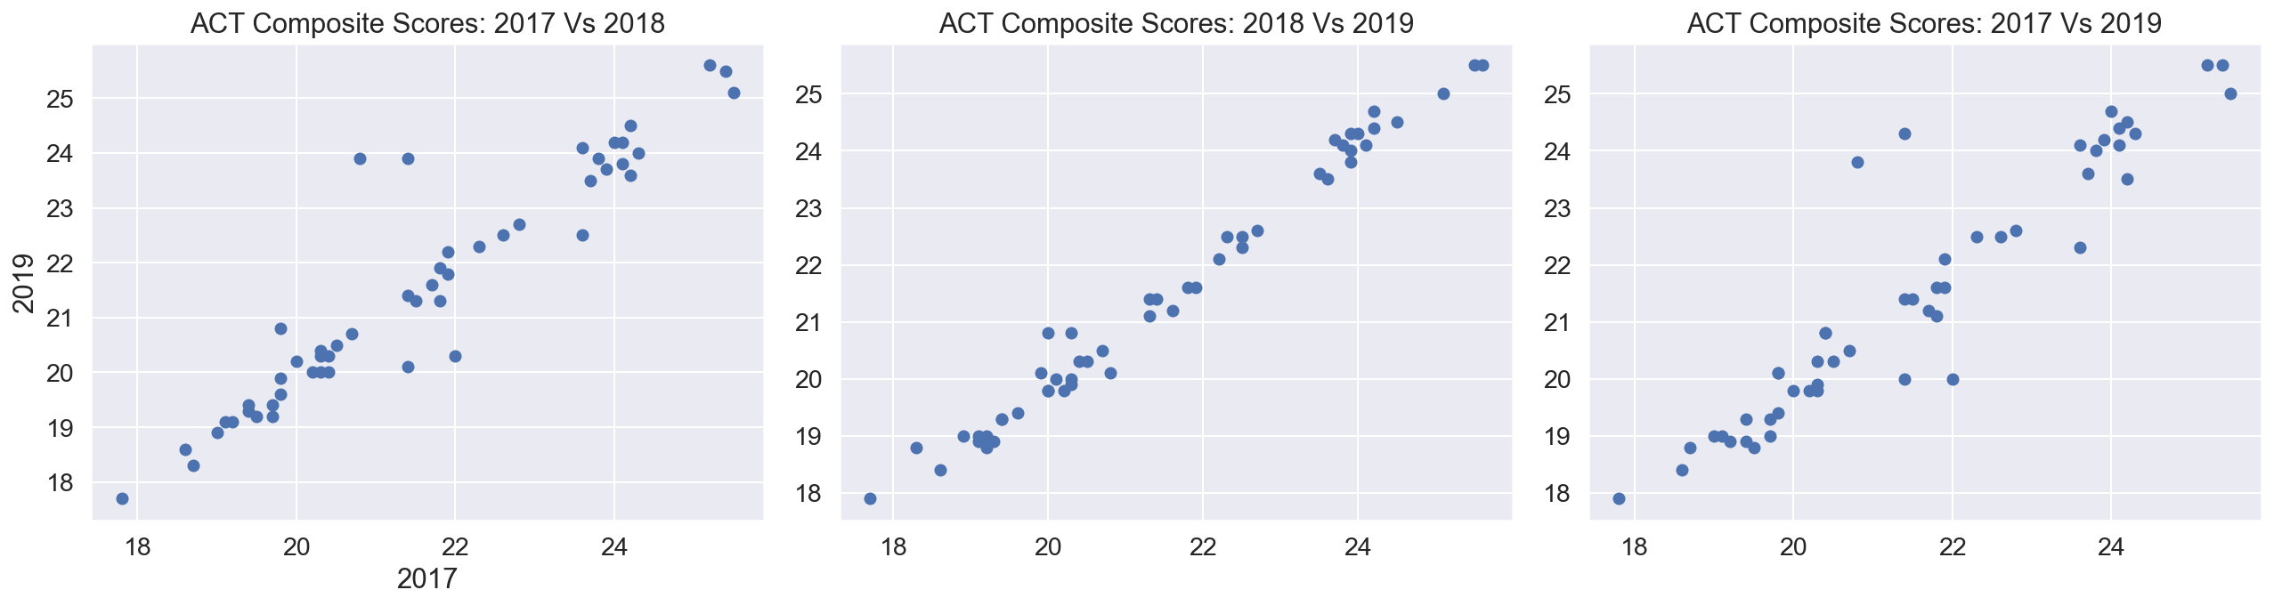
What’s Trending! - 2
2019
2018
2017
2019
ACT Average
Total Scores
2017
(/ 36)
2018

Slide 8
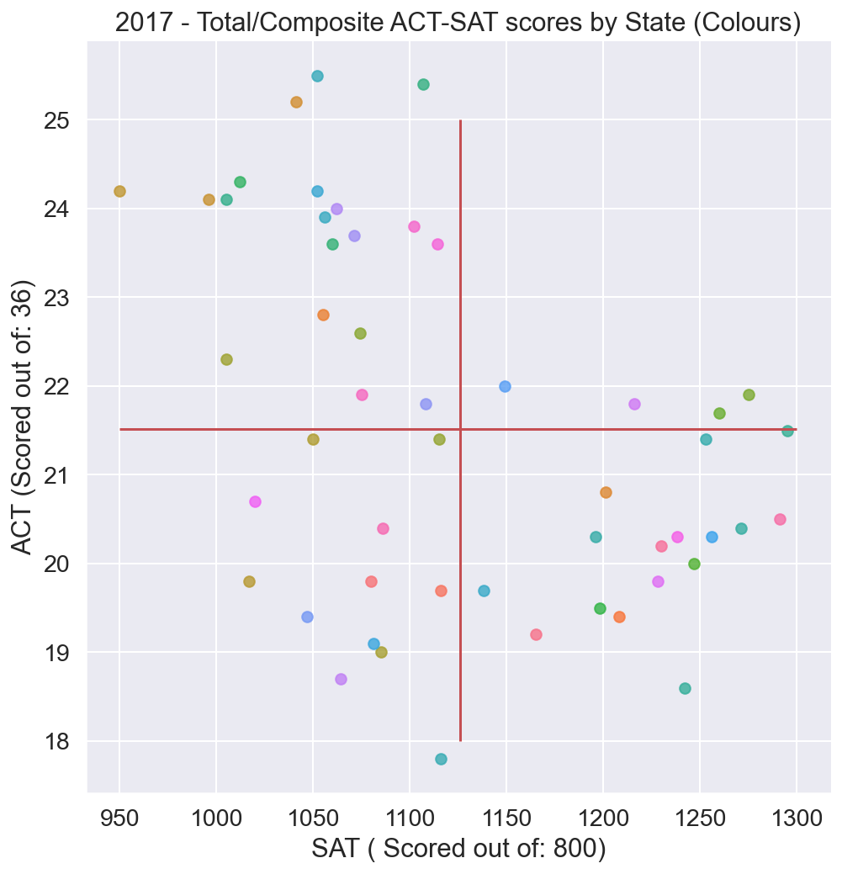
What’s Trending! contd.
SAT Vs ACT TOTAL SCORE
---------------------
3 CLUSTERS OF DATA (CL.)
---------------------
By State

Slide 9
A glance at Data Distributions

Slide 10
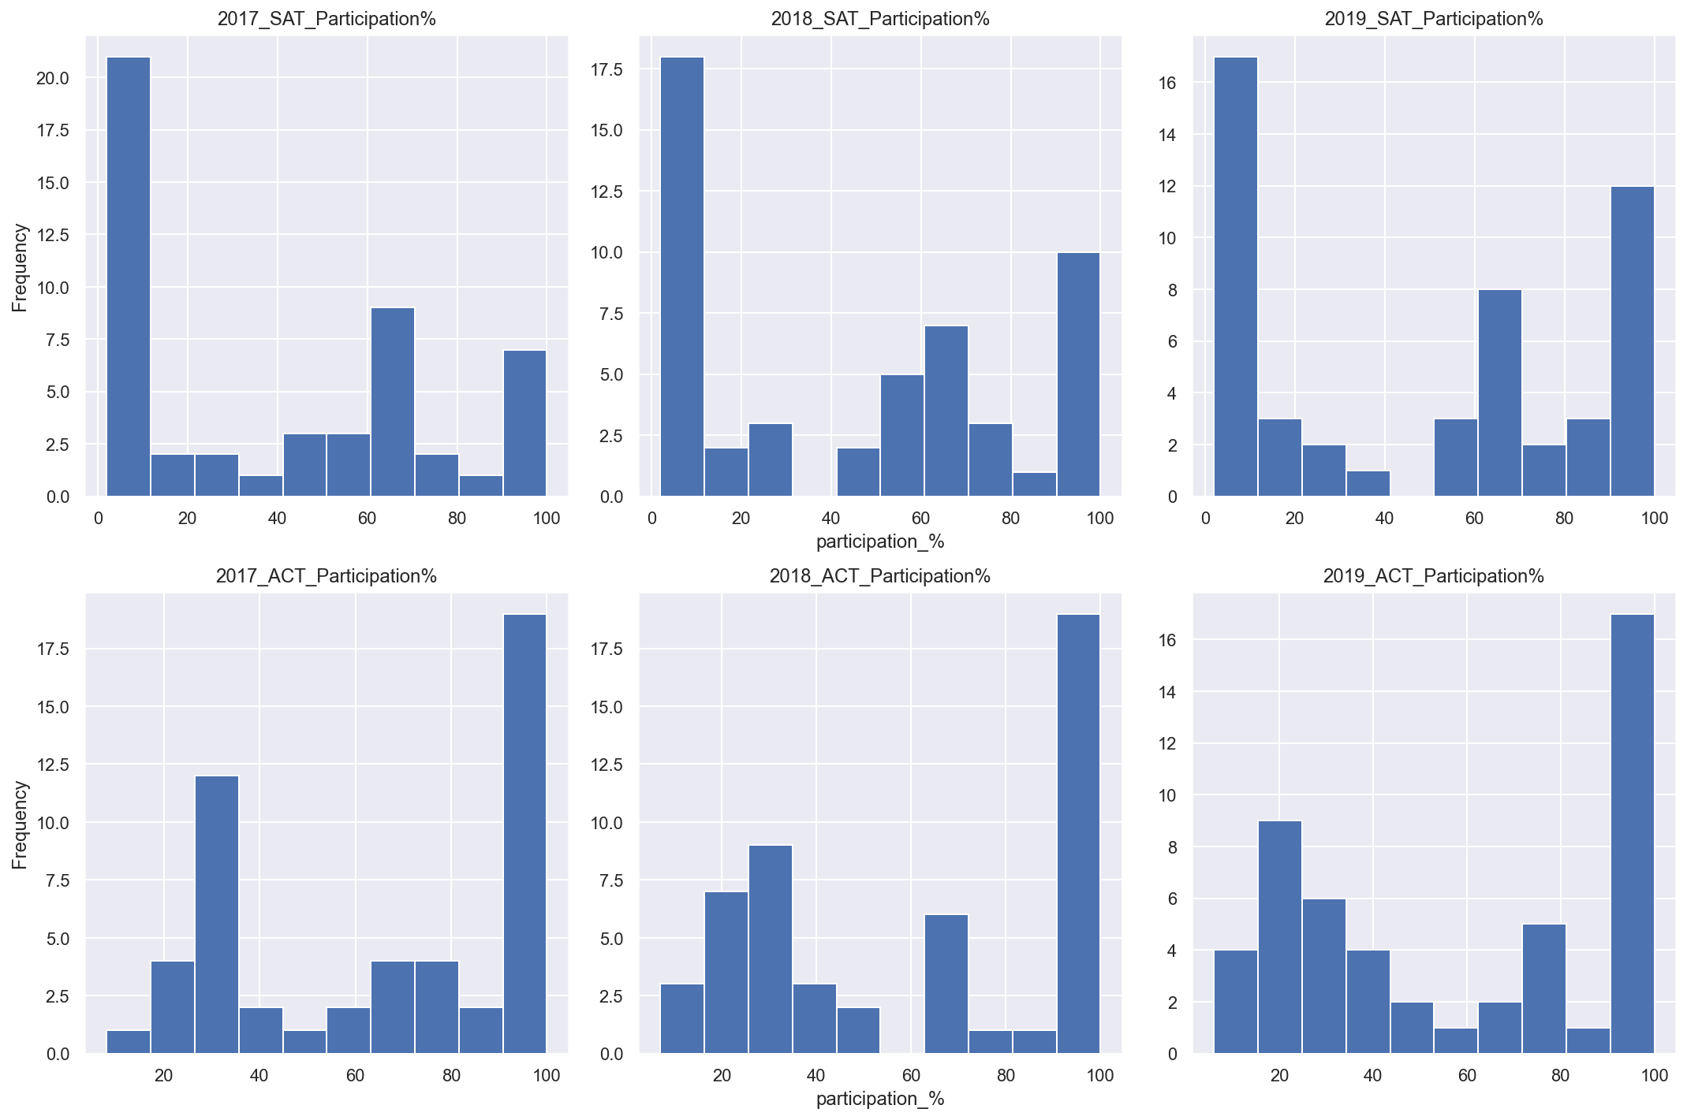
SAT Vs ACT
Participation %
---------------------
Bimodal Data
---------------------
Are we
Able to
SPOT THE
CLUSTERS?

Slide 11
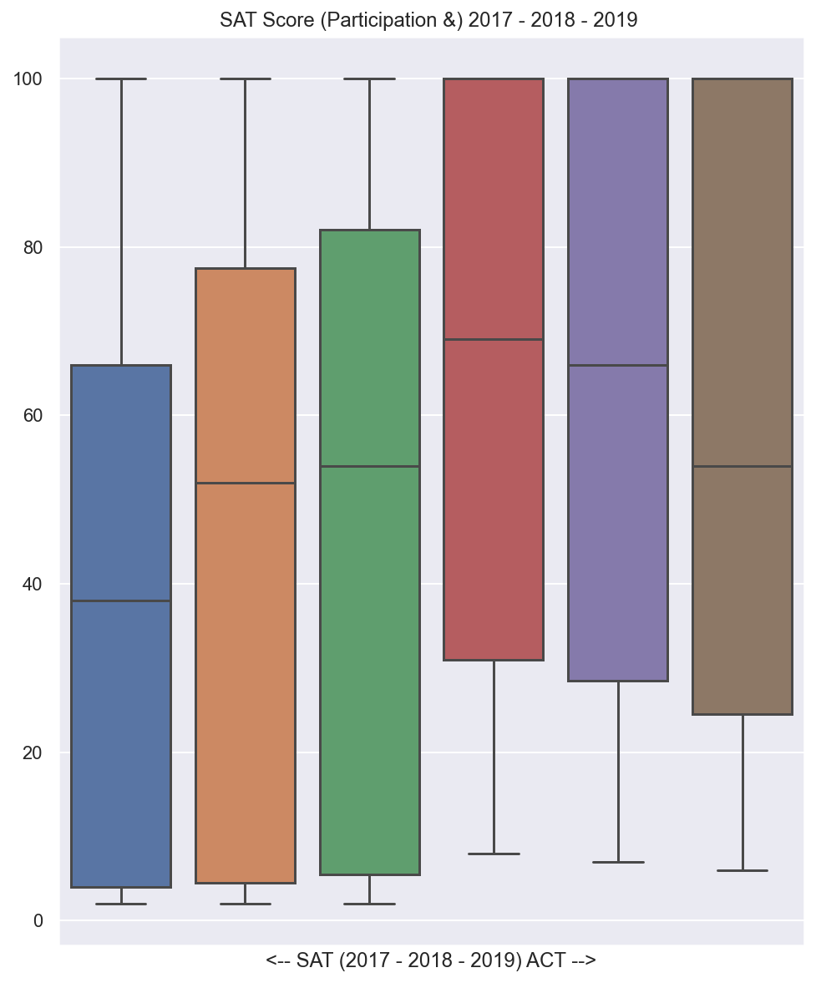
Everyone likes a BOX PLOT!
Participation %
for 2017-2018-2019
on left, SAT %
on right, ACT %

Slide 12
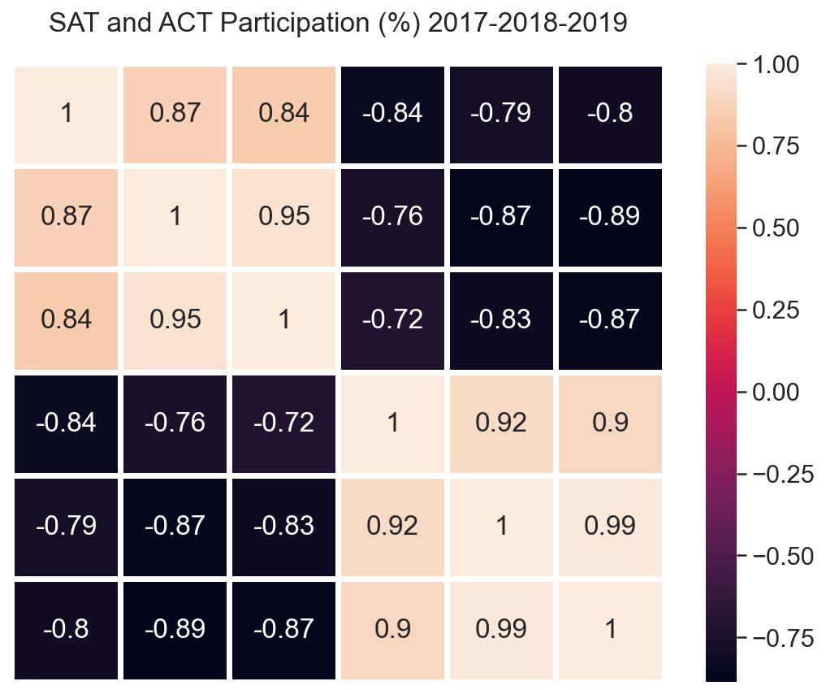
What about Collinearity?
SAT 2017
Participation %
for 2017-2018-2019
Very Strong
Collinearity within all
SAT/ACT years
Very Strong
Non-Collinearity among
each other.
SAT 2018
SAT 2019
ACT 2017
ACT 2018
ACT 2019
SAT 2017
SAT 2018
SAT 2019
ACT 2017
ACT 2018
ACT 2018

Slide 13
To sum up,
From the box plot above it's clear that on Avg. atleast 60% of States participate in ACT while less than 50% of the States participate in SAT.
Most of the Distributions, specially various Participation Rates and the Total Scores are Bimodal in nature i.e. not distributed normally.
Factors like mandatory SAT/ACT tests classifies candidates into High Scoring and Low Scoring Candidates. Some ae fully prepared due to facilities and awareness about the test, while the others just have to.
The strong non-collinearity between Total Score and Participation Percentages is a matter of concern too.
SAT - Math and ERW scores possess strong collinearity.

Slide 14
Recommendations for the College Boards
1. Investigate what strategies / implementations went right for States with increasing participation rates, like New York, Maryland, New Jersey, Maine, West Virginia, Colorado, Florida, Idaho, Illinois and Rhode Island.

Slide 15
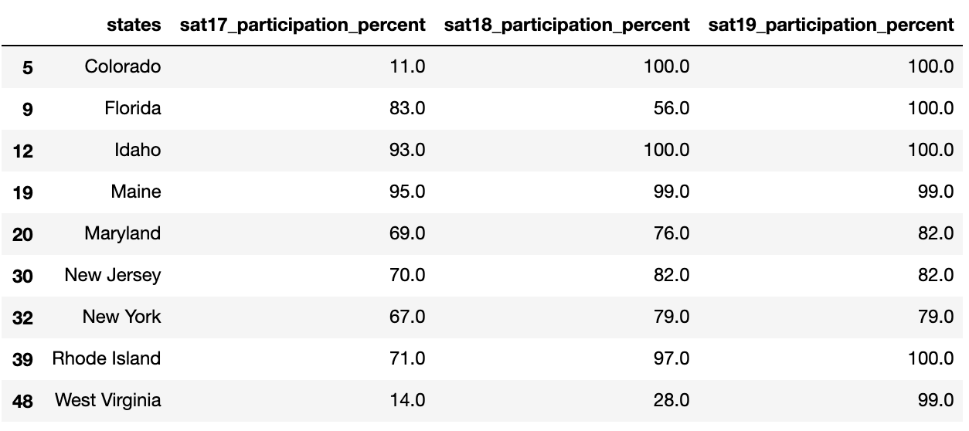
SAT Participation %

Slide 16
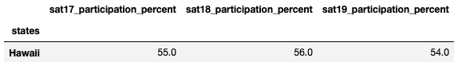

Recommendations for the College Boards contd.
2. Focusing more on States like Hawaii might help.
Hawaii displayed almost same Participation % for 3 years (55% -> 56% -> 54%) for SAT, while the ACT participation rates have dropped from 90% in 2017 to 80% in 2019, unlike other states where the participation rates usually transfer from ACT to SAT and vice-versa.

Slide 17
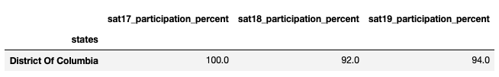
Recommendations for the College Boards contd.
3. District of Columbia, is another example of a state where SAT participation rates dropped from 100% in 2017 to 94% in 2019. We should definitely get some insights on what went wrong.

Slide 18
Opinion.
3. District of Columbia, is another example of a state where SAT participation rates dropped from 100% in 2017 to 94% in 2019. We should definitely get some insights on what went wrong.

Slide 19
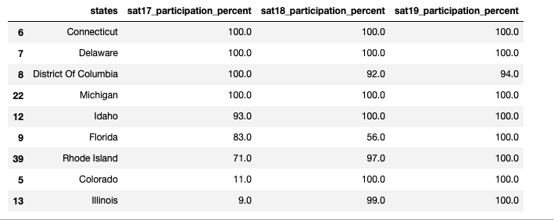
Opinion.
Previous changes like Dropping Essay Requirement, changing Exam Duration to 3hrs and engage into contracts with states and schools to make SAT's affordable are all in right direction.
We should expand these ideas to other states with low SAT scores too.

Slide 20
Before we end, my top 3 states
Illinois - Tremendous Growth in SAT participation
Colorado - Tremendous Drop in ACT participation
Hawaii - Best all rounder, based on balance between SAT and ACT participation
(Hawaii is a very good example of a State that we should focus on, ACT participation rates are constantly dropping, while SAT participation rates are almost the same, for 2017, 2018 and 2019.)
Rhode Island - Tremendous Growth in SAT participation
District of Colorado – One of the very few States that showed decline in SAT participation percentage.

Slide 21



my top 3 states contd.

Slide 22
Thank you.

