Slide 1


Capstone Project:
Forex Prediction Application
by: Samay Shah

Slide 2
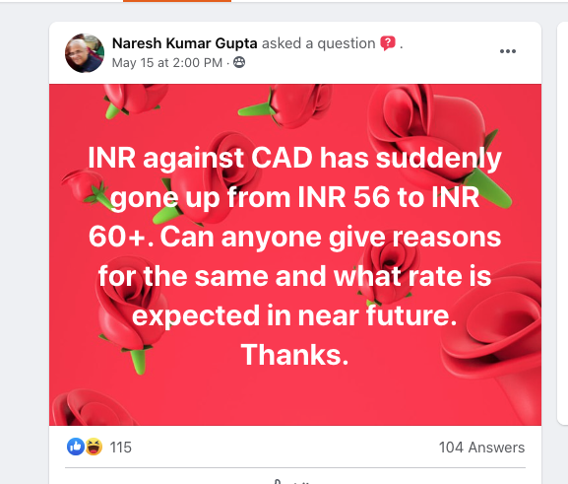
Problem Statement
Canada being a land of immigrants has thousands of new international students and workers landing every year. Most of these people, especially students end up taking loans from banks or lend money from parents to safeguard themselves. Hence paying paying back all those expenses, plus sending money to support their families abroad becomes one of their prime responsibilities. As a result they are always looking for best exchange rates in order to gain maximum advantage. With this project my intention is to understand the forex market, and develop an application where people are able to find the best time to transfer money back home.

Slide 3
What can you expect.
Research on the topic
Understand target audience
Data Sources and initial data exploration
My approach on Time Series Analysis
Compare Metrics / accuracy of prediction.
Web App Demo and insights
Future possibilities
Conclusions
Notes:
reference the research paper by Manav Kaushik and AK Giri, https://arxiv.org/pdf/2002.10247.pdf (difference of inflation and gdp)

Slide 4
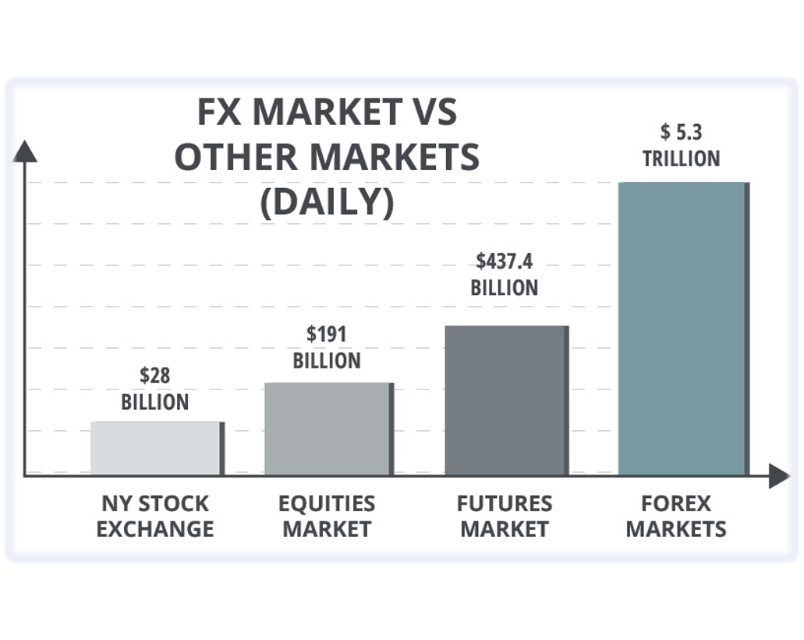
Research
Understand Forex (FX or currency Market)
Interesting Facts
Some principles to consider while trading,
  Triangular Arbitrage
  Day-of-the-week effect
Explain CAD/USD versus USD/CAD
What is Volatility?
FX Market – Dec 2020 (Ref: Daily FX)
Notes:
reference the research paper by Manav Kaushik and AK Giri, https://arxiv.org/pdf/2002.10247.pdf (difference of inflation and gdp)
- Forex, FX, Foreign exchange or currency market is a global decentralized OTC market for trading currencies. In most cases banks are main dealers ultimately., hence also called interbank market.
In terms of trading volume, it is by far the largest market in the world, followed by the credit market.
As traded in pairs FX usually works with relative values.

Slide 5
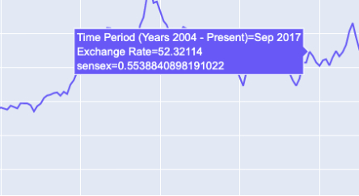
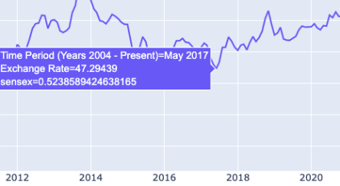
Target Audience
Students – seek for best time to bring money in to pay their tuition fees, or send money back home to pay for the loans or debts.
  Ex. CAD/INR, send $2,000 CAD to India in May 2017 would be Rs. 94,580 while same amount in Sept would get you Rs. 104,640 i.e. almost 10 percent, amount equivalent to buying a good android smart phone.
Foreign workers – send money back home to support their family.
Immigrants or traveler's – people looking for best time to book tickets for whole family to travel back home or in some other foreign country and looking for best time to pay for their holiday package.
Example: CAD/INR conversion based on my initial EDA for this project
Notes:
reference the research paper by Manav Kaushik and AK Giri, https://arxiv.org/pdf/2002.10247.pdf (difference of inflation and gdp)
- Forex, FX, Foreign exchange or currency market is a global decentralized OTC market for trading currencies. In most cases banks are main dealers ultimately., hence also called interbank market.
In terms of trading volume, it is by far the largest market in the world, followed by the credit market.
As traded in pairs FX usually works with relative values.

Slide 6
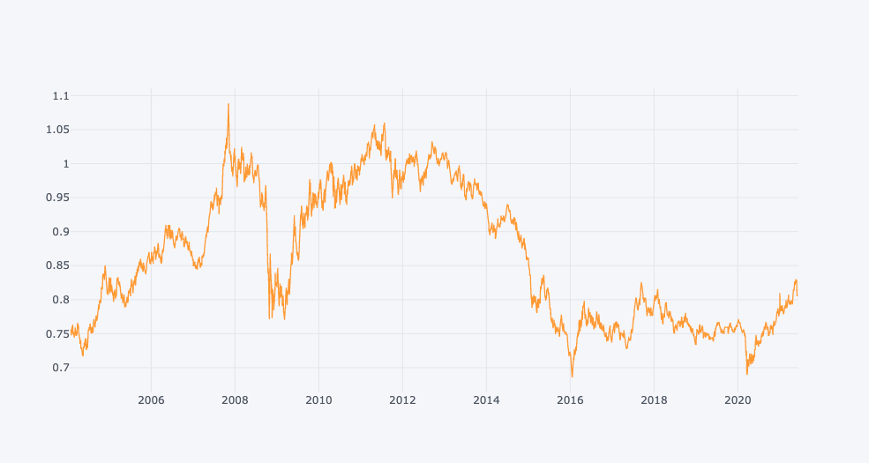
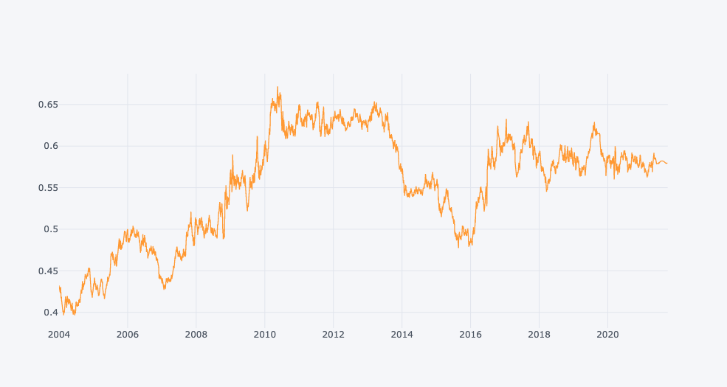
Data Sources
Time Period, I decided to include historic datasets from the year 2004 to present day in order to understand the economic shocks that occurred between the year 2006 and 2015.
Main focus was to identify open use yet reliable sources of data.
Historic Forex and stock data was obtained from the yahoo finance website, inflation and some GDP data was obtained from fred.stlouisfed.org website, Indian stock market ‘SENSEX’ data was obtained from bseindia.com/markets website and lastly the Canadian GDP information was made available by the www150.statcan.gc.ca website.
Example: USD Exchange Rate Flow from 2004 to present day (plot from my initial EDA)
Example: UK Exchange Rate Flow from 2004 to present day (plot from my initial EDA)
Notes:
reference the research paper by Manav Kaushik and AK Giri, https://arxiv.org/pdf/2002.10247.pdf (difference of inflation and gdp)
- Forex, FX, Foreign exchange or currency market is a global decentralized OTC market for trading currencies. In most cases banks are main dealers ultimately., hence also called interbank market.
In terms of trading volume, it is by far the largest market in the world, followed by the credit market.
As traded in pairs FX usually works with relative values.

Slide 7
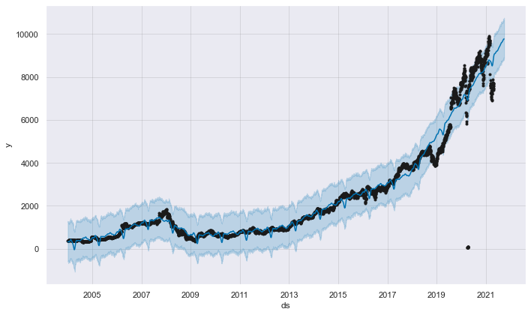
My Approach on Time Series Analysis
Gather data
Clean data, perform imputation
Exploratory Data Analysis (EDA)
Univariate Analysis to obtain a base model (using SARIMA and fbprophet)
Feature Engineering (incorporate rolling average, previous prices etc.)
Univariate Analysis to obtain exogenous variable data for multivariate modelling
Multivariate Analysis using different time series models
(including SARIMAX, VARMAX, fbprophet etc.)
Analyze results to check intuitively for any errors in prediction
Compare Results and select the best model
Build Web Application using Stream lit and deploy using Heroku platform.
Performing Univariate Analysis – Stock Prediction for London Stock Exchange - LSE
Notes:
reference the research paper by Manav Kaushik and AK Giri, https://arxiv.org/pdf/2002.10247.pdf (difference of inflation and gdp)

Slide 8
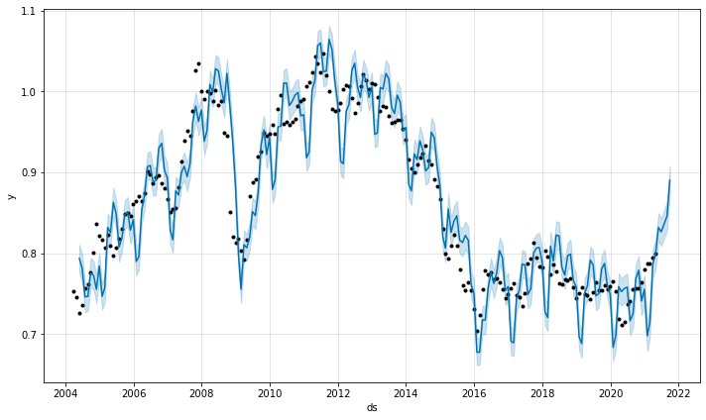
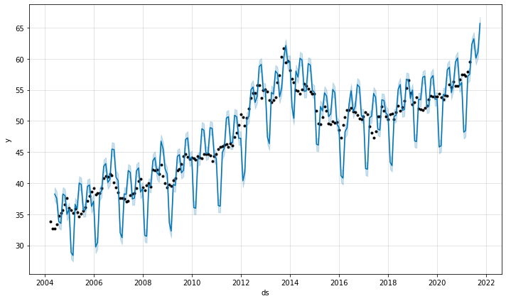
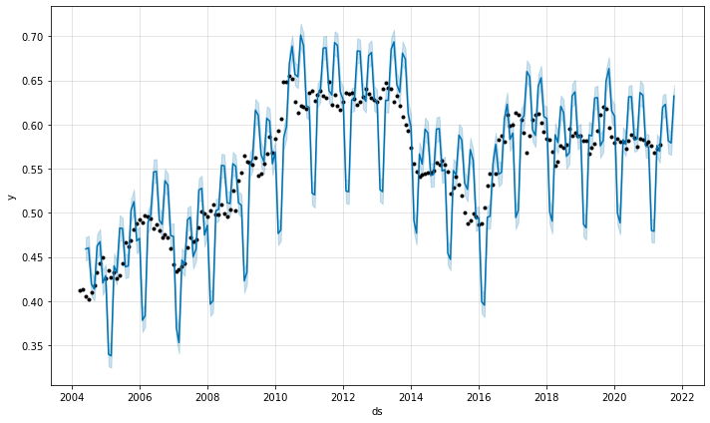
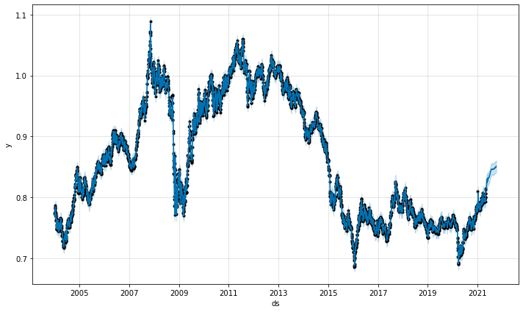
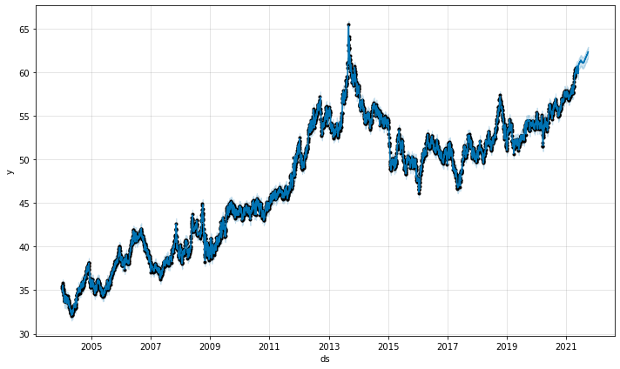
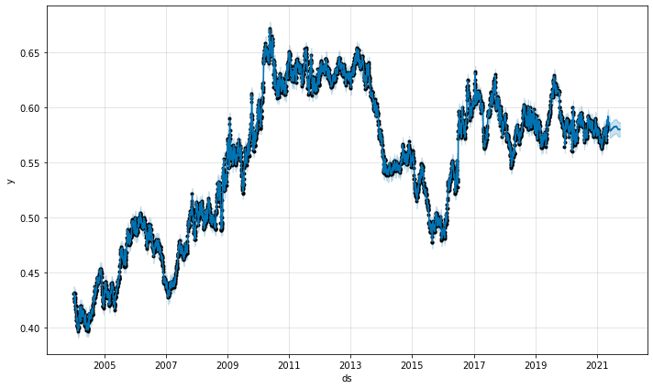
Compare Models and Explore trends - 1
Fitting fbprophet model to all 3 datasets and exogenous features to understand past trend, seasonality, sudden shocks and later plot the errors in predictions.
Monthly CAD/USD
Monthly CAD/INR
Monthly CAD/GBP
Daily CAD/USD
Daily CAD/INR
Daily CAD/GBP
Notes:
reference the research paper by Manav Kaushik and AK Giri, https://arxiv.org/pdf/2002.10247.pdf (difference of inflation and gdp)

Slide 9
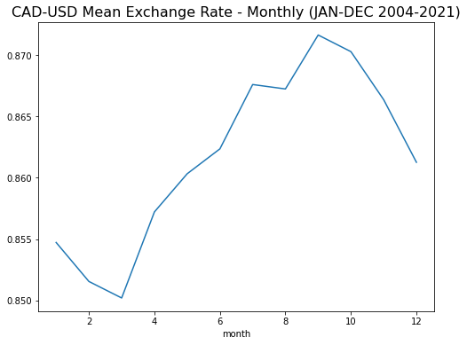
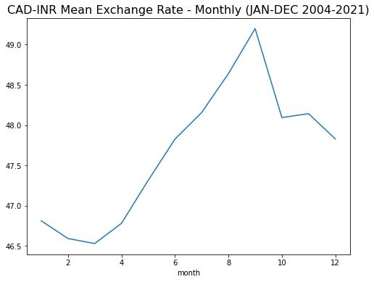
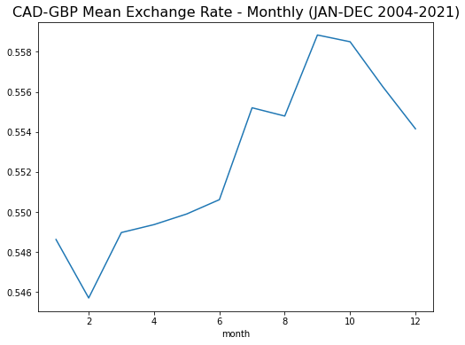
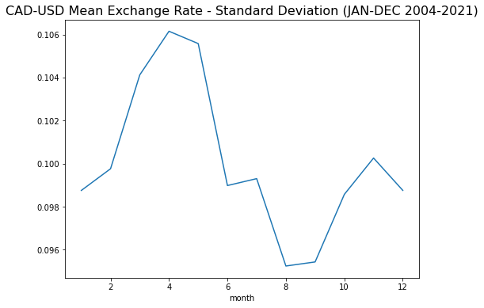
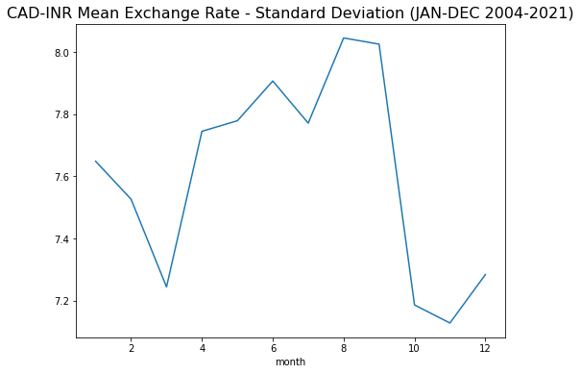
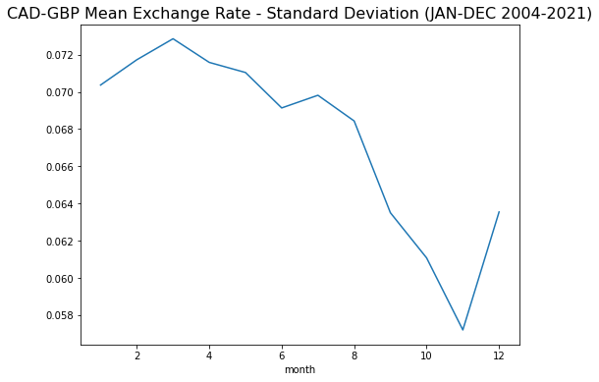
Compare Models and Explore trends - 2
Understanding Mean and Standard Deviations of errors to make decisions based on volatility of that market
Notes:
reference the research paper by Manav Kaushik and AK Giri, https://arxiv.org/pdf/2002.10247.pdf (difference of inflation and gdp)
Slide9 : Explain market stability, for CAD/USD price is high in September but its least volatile, hence ideal time of the year to send money
While for INR& GBP, the mean value is high in September, but its most volatile, so should not wait for prices getting higher. See high price send it.
USD: best time August, INR: best time November. GBP: best time November
Possible events: US Elections: November, IND Elections: May

Slide 10
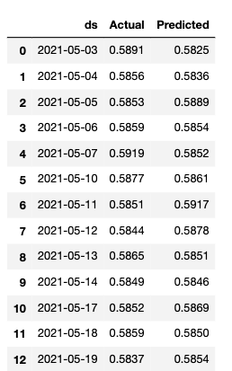


Comparing Metrics for 3 Models
The Models for daily prediction perform clearly better compared to the monthly ones, because month wise only 209 entries were collected while more than 4550 historical observations were collected for modelling the daily data.
Predictions from CAD/GBP Test Set
Notes:
reference the research paper by Manav Kaushik and AK Giri, https://arxiv.org/pdf/2002.10247.pdf (difference of inflation and gdp)
Slide9 : Explain market stability, for CAD/USD price is high in September but its least volatile, hence ideal time of the year to send money
While for INR& GBP, the mean value is high in September, but its most volatile, so should not wait for prices getting higher. See high price send it.
USD: best time August, INR: best time November. GBP: best time November
Possible events: US Elections: November, IND Elections: May

Slide 11
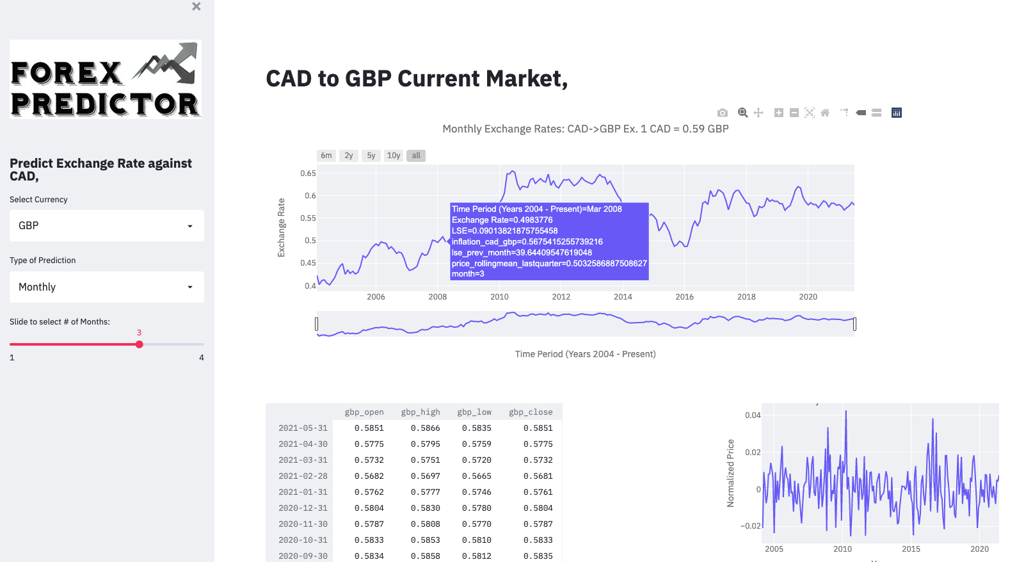
Web Application Demonstration
Demo
Notes:
reference the research paper by Manav Kaushik and AK Giri, https://arxiv.org/pdf/2002.10247.pdf (difference of inflation and gdp)
Slide9 : Explain market stability, for CAD/USD price is high in September but its least volatile, hence ideal time of the year to send money
While for INR& GBP, the mean value is high in September, but its most volatile, so should not wait for prices getting higher. See high price send it.
USD: best time August, INR: best time November. GBP: best time November
Possible events: US Elections: November, IND Elections: May

Slide 12
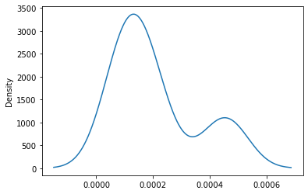
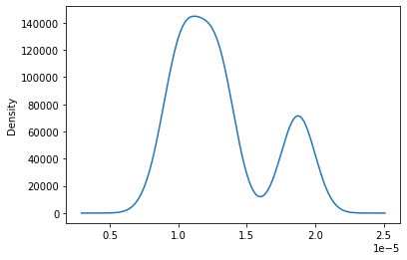
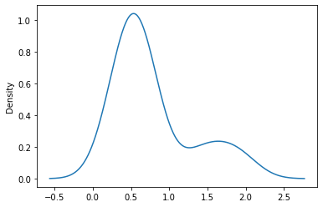
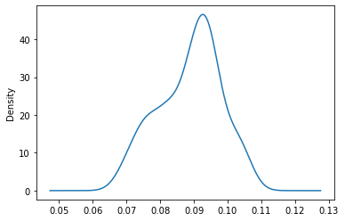
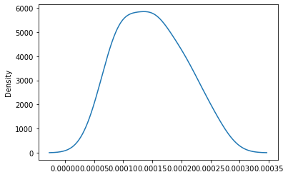
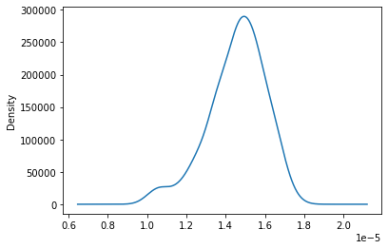
Future Possibilities
Error/ Residual Plots
Try to incorporate more exogenous variables like trade, oil/natural resources, gold and interbank rates to predict the rates.
Build models for smaller economies, unlike US and UK the exchange rates for these countries do not depend on a lot of factors and might display some linear trends.
CAD/USD Monthly
CAD/USD Daily
CAD/INR Monthly
CAD/INR Daily
CAD/GBP Monthly
CAD/GBP Daily
Notes:
reference the research paper by Manav Kaushik and AK Giri, https://arxiv.org/pdf/2002.10247.pdf (difference of inflation and gdp)
Slide9 : Explain market stability, for CAD/USD price is high in September but its least volatile, hence ideal time of the year to send money
While for INR& GBP, the mean value is high in September, but its most volatile, so should not wait for prices getting higher. See high price send it.
USD: best time August, INR: best time November. GBP: best time November
Possible events: US Elections: November, IND Elections: May

Slide 13
References
My Live Web App is available at, https://forex-predictor.herokuapp.com/
Research paper on techniques to forecast foreign exchange rates by Manav Kaushik and AK Giri , https://arxiv.org/pdf/2002.10247.pdf (difference of inflation and gdp)
Modelling with fbprophet by Andrej Baranovskij, https://towardsdatascience.com/serving-prophet-model-with-flask-predicting-future-1896986da05f
Sensex India dataset, https://www.bseindia.com/markets/equity/EQReports/StockPrcHistori.aspx?flag=1
Inflation and GDP datasets, https://fred.stlouisfed.org/series/GDP
Stockmarket and Forex datasets, https://ca.finance.yahoo.com/quote/CADINR=X/
Canada GDP datasets, www150.statcan.gc.ca
Creating Streamlit Web App by Data Professor, https://www.youtube.com/channel/UCV8e2g4IWQqK71bbzGDEI4Q
Deploying Web App, youtube videos on deploying apps using Heroku by Nachiketa Hebbar, https://www.youtube.com/c/NachiketaHebbar/featured
Notes:
reference the research paper by Manav Kaushik and AK Giri, https://arxiv.org/pdf/2002.10247.pdf (difference of inflation and gdp)
Slide9 : Explain market stability, for CAD/USD price is high in September but its least volatile, hence ideal time of the year to send money
While for INR& GBP, the mean value is high in September, but its most volatile, so should not wait for prices getting higher. See high price send it.
USD: best time August, INR: best time November. GBP: best time November
Possible events: US Elections: November, IND Elections: May

Slide 14
Thank you.
Notes:
reference the research paper by Manav Kaushik and AK Giri, https://arxiv.org/pdf/2002.10247.pdf (difference of inflation and gdp)
Slide9 : Explain market stability, for CAD/USD price is high in September but its least volatile, hence ideal time of the year to send money
While for INR& GBP, the mean value is high in September, but its most volatile, so should not wait for prices getting higher. See high price send it.
USD: best time August, INR: best time November. GBP: best time November
Possible events: US Elections: November, IND Elections: May

